Slide 2
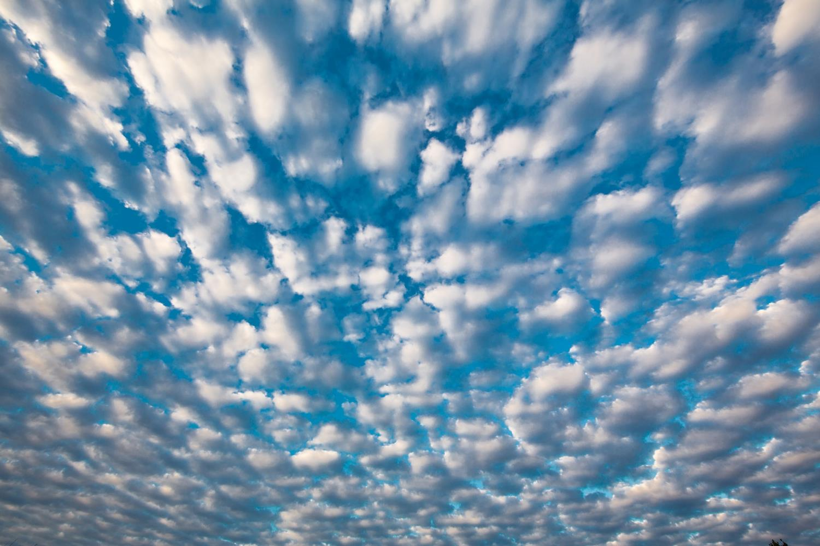
Climate and Climate Change
Notes:
Climate is one of WWF’s 6 main areas of focus.

Slide 3
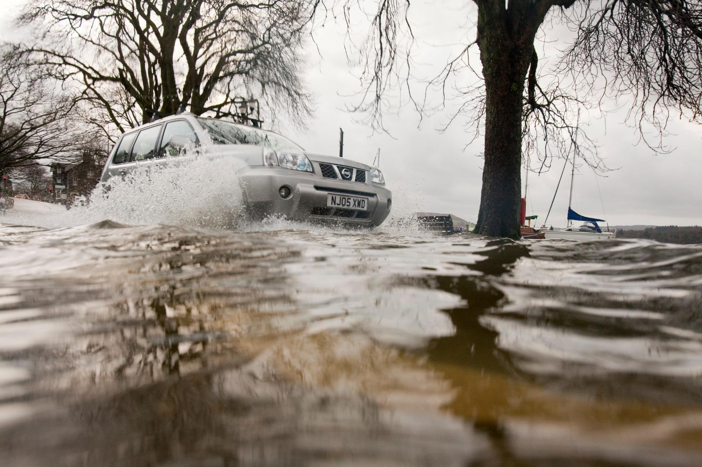
Our world is changing faster than anyone predicted.
Notes:
Our climate is changing at an unprecedented rate. Already, freshwater supplies are shrinking, agricultural yields are dropping, our forests are burning, and rising oceans are more acidic—all, in part, due to a warming climate. As our natural world changes around us, so does our way of life.
Climate change is affecting way more than just the temperature.

Slide 4
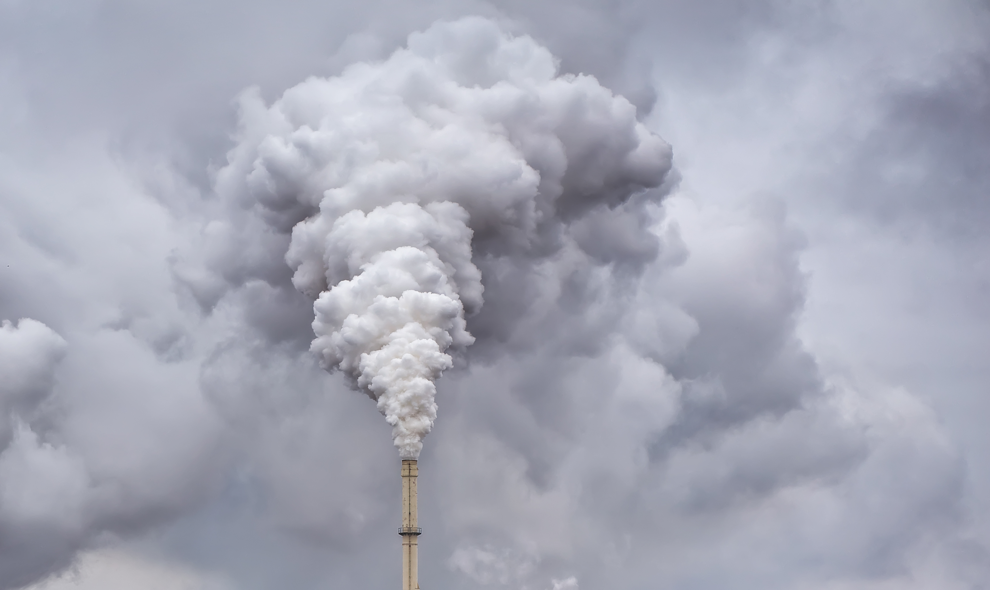
Greenhouse gases emitted by the energy, transportation, agricultural and other sectors build up in the atmosphere. They trap heat which causes the planet’s average temperature to rise.
Notes:
The biggest rise of average temperatures that we can afford is 1.5 degrees Celsius. If we overshoot that, the consequences will be much more disastrous. That’s why you often hear the phrase “the race to 1.5” in climate conversations.

Slide 5
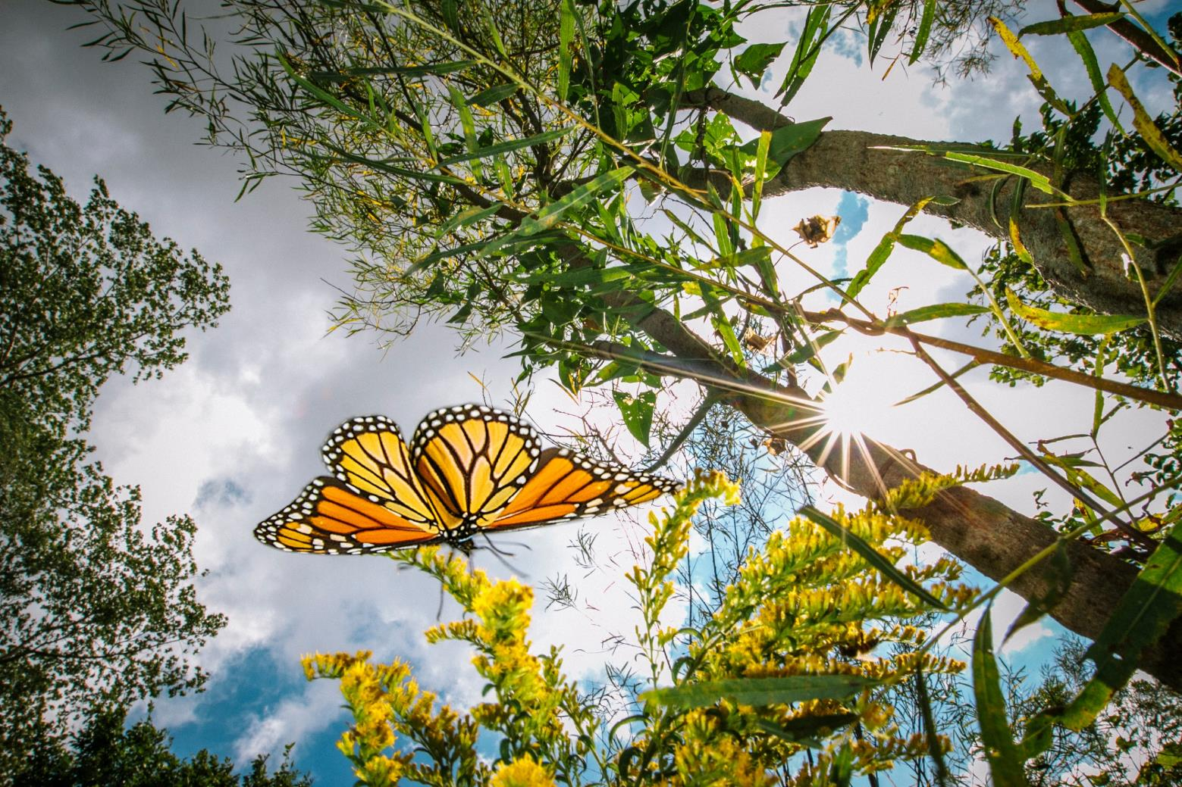
Wildlife
Animals are changing where and how they live. Those who can’t adapt may face extinction.
Notes:
Climate change is already having a significant impact on wild animals around the globe. Changes in climate are altering the timing of life cycles, causing species to shift where they live, and in some cases even leading to extinction.

Slide 6
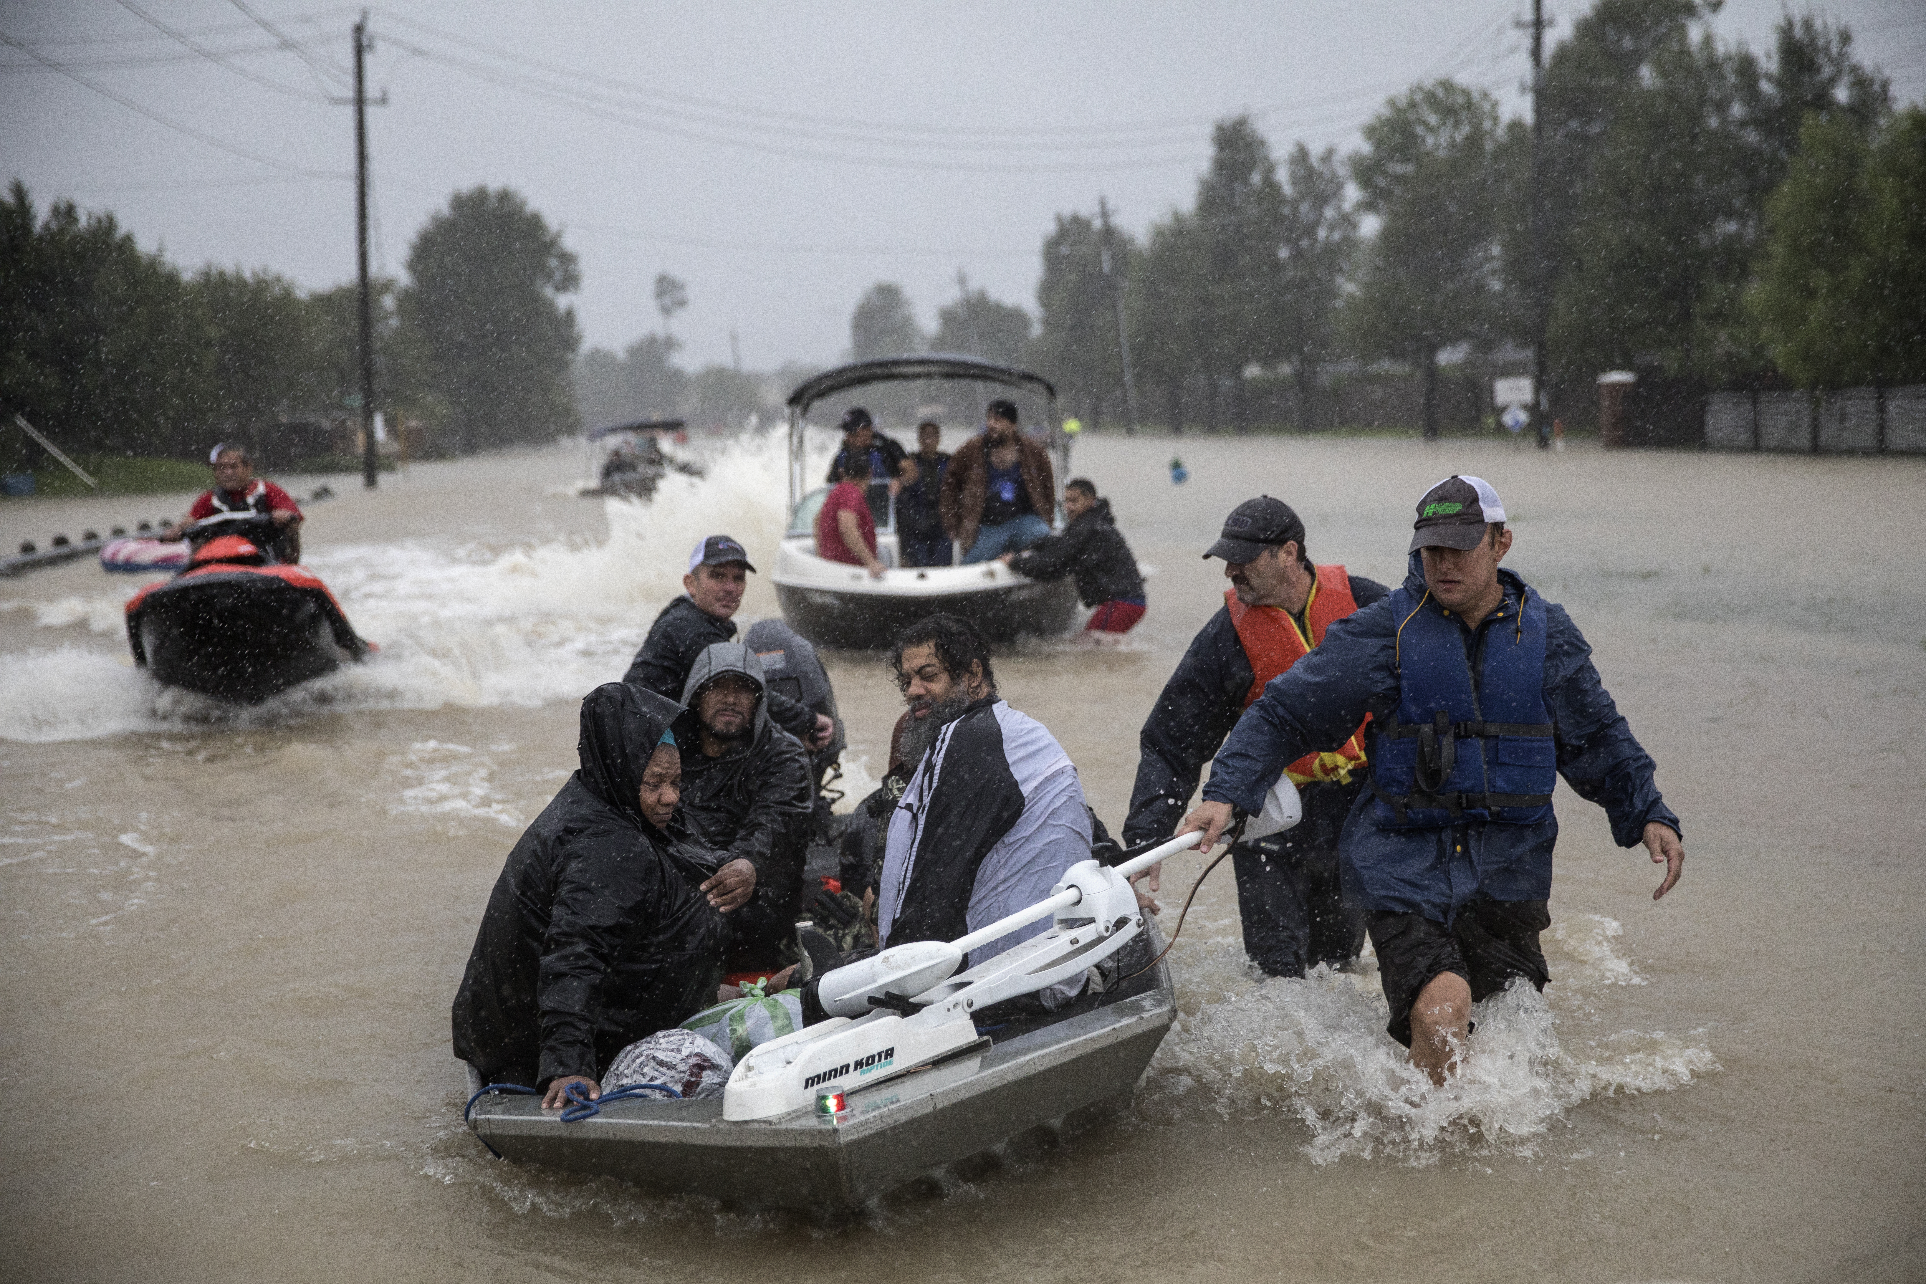
Front Line Communities
Those living nearest to floodplains, shorelines, and polluted city centers face climate change impacts as part of their daily lives.
Notes:
Climate change imposes heavy burdens on those living nearest to floodplains, shorelines, and polluted city centers. In the US and around the world, climate change is destabilizing food production, displacing people in vulnerable countries, and threatening our shorelines with sea level rise and more extreme storms. Sea level rise over the next hundred years could displace as many as 72 million people.

Slide 7
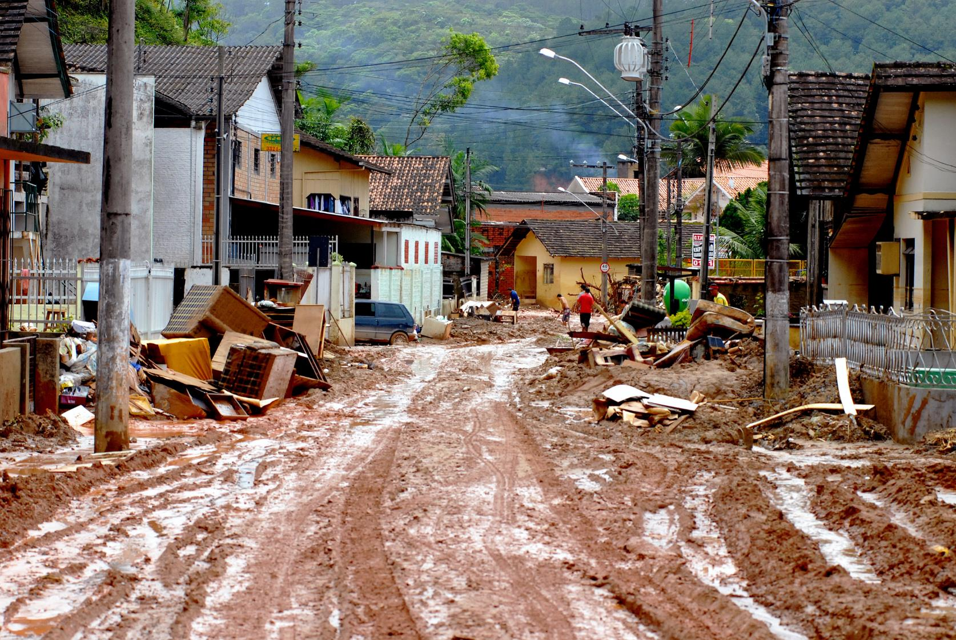
Economy
Weather disasters, crop failures, and higher insurance rates can stunt an economy.
Notes:
Taxpayers are footing the bill for weather disasters, crop failures, and higher insurance rates associated with our warming world. No economy can grow when it has to constantly rebuild.

Slide 8
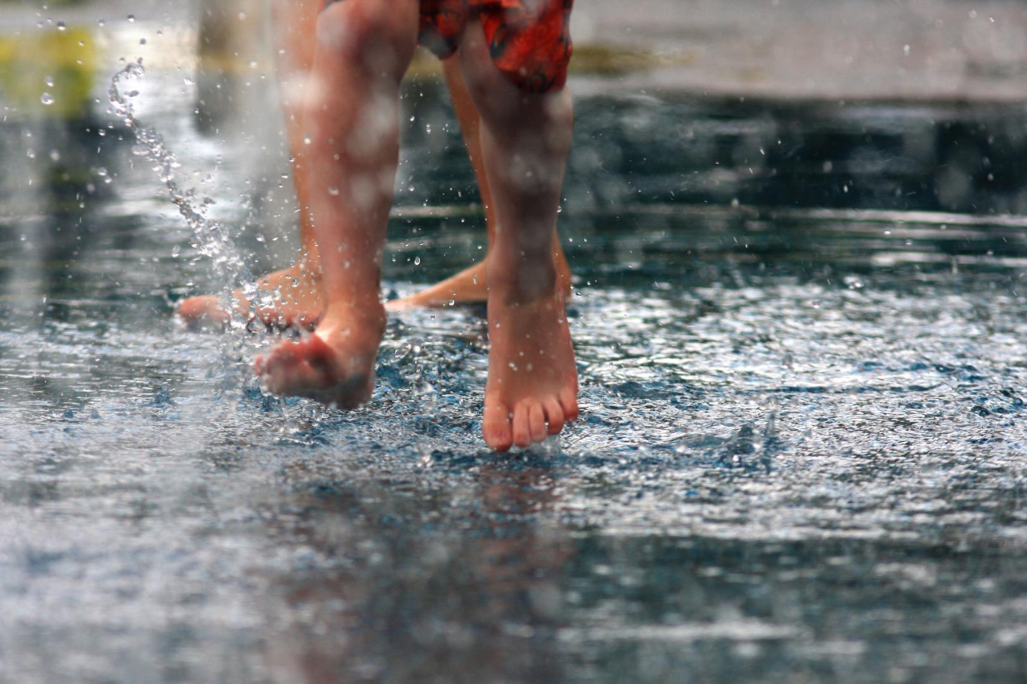
Fresh Water
Climate change is affecting the availability and quality of water around the world.
Notes:
Climate change is altering patterns of weather and water around the world, causing shortages and droughts in some areas and floods in others. These changes will combine to make less water available for agriculture, energy generation, cities and ecosystems around the world.

Slide 9
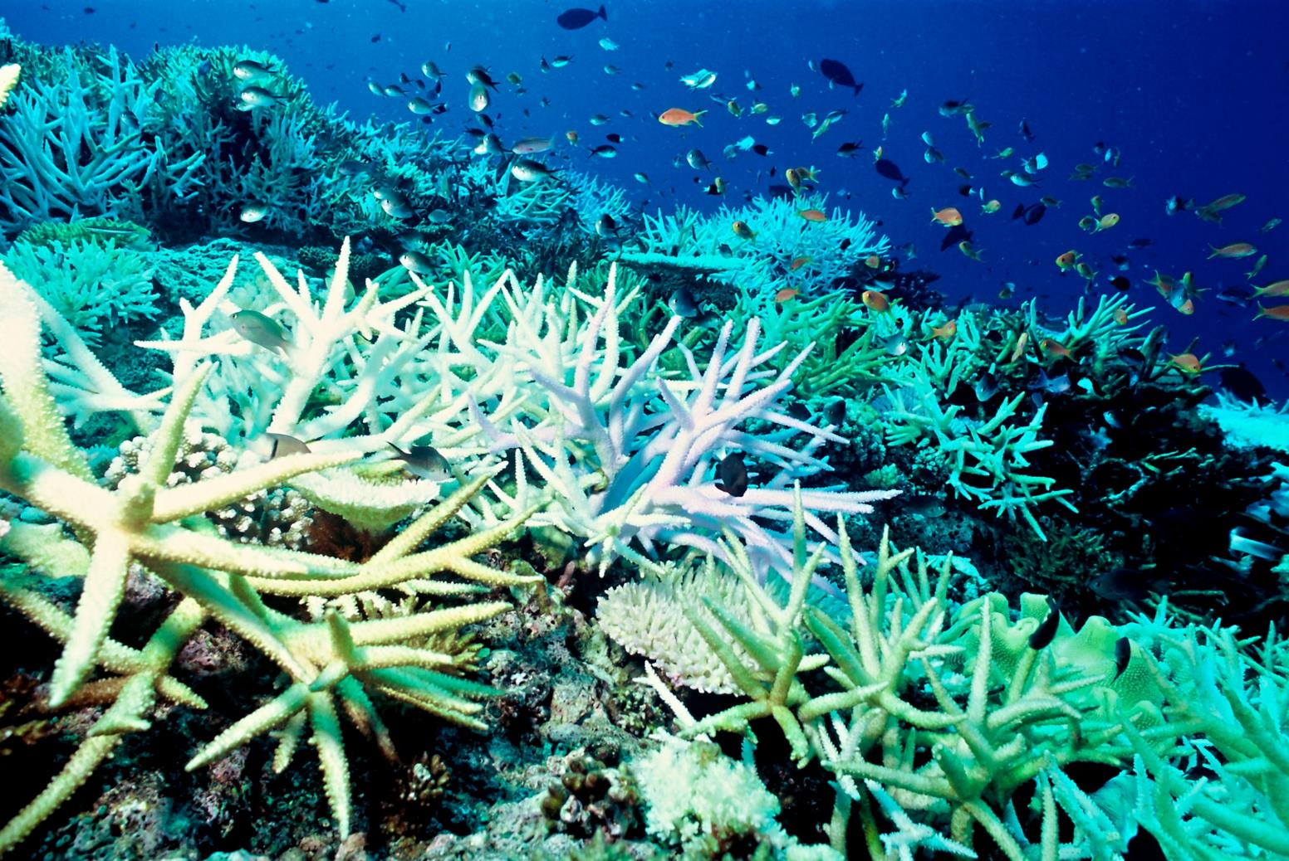
Oceans
Oceans absorb both excess heat and carbon pollution—with disastrous consequences.
Notes:
Our oceans absorb most of the warming and carbon pollution occurring today, even more than the atmosphere. Warmer oceans are driving stronger storms and bleaching coral reefs. As oceans absorb carbon dioxide, they become more acidic, threatening most shelled organisms, including small crustaceans fundamental to the marine food chain.

Slide 10
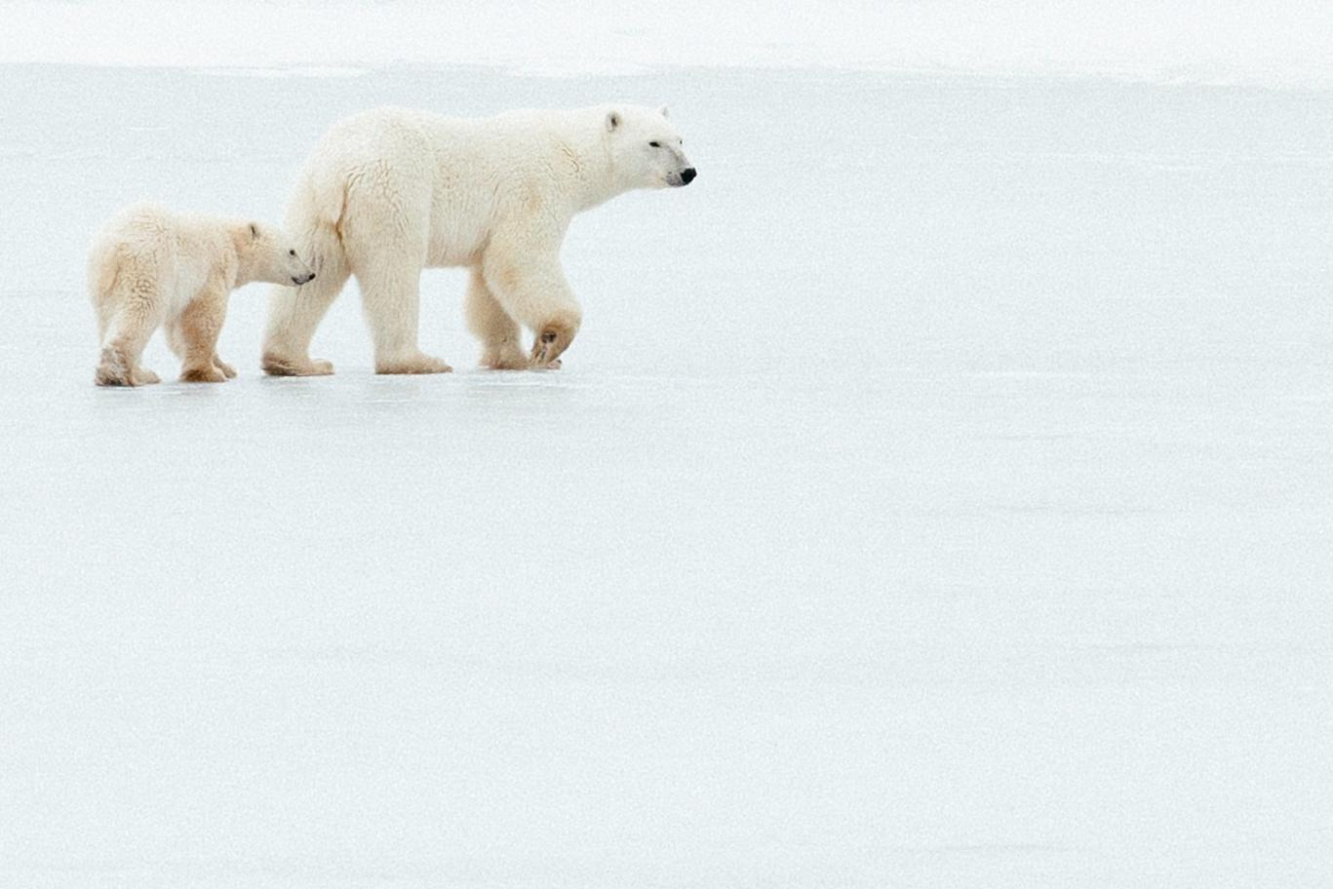
Arctic
Arctic ecosystems are in danger from rising temperatures. Melting sea ice will have consequences worldwide.
Notes:
The Arctic is warming twice as fast as the rest of the earth, affecting weather around the globe and threatening the foundation of Arctic ecosystems. Arctic summer sea ice is expected to disappear before mid-century, which will have cascading consequences worldwide.

Slide 11
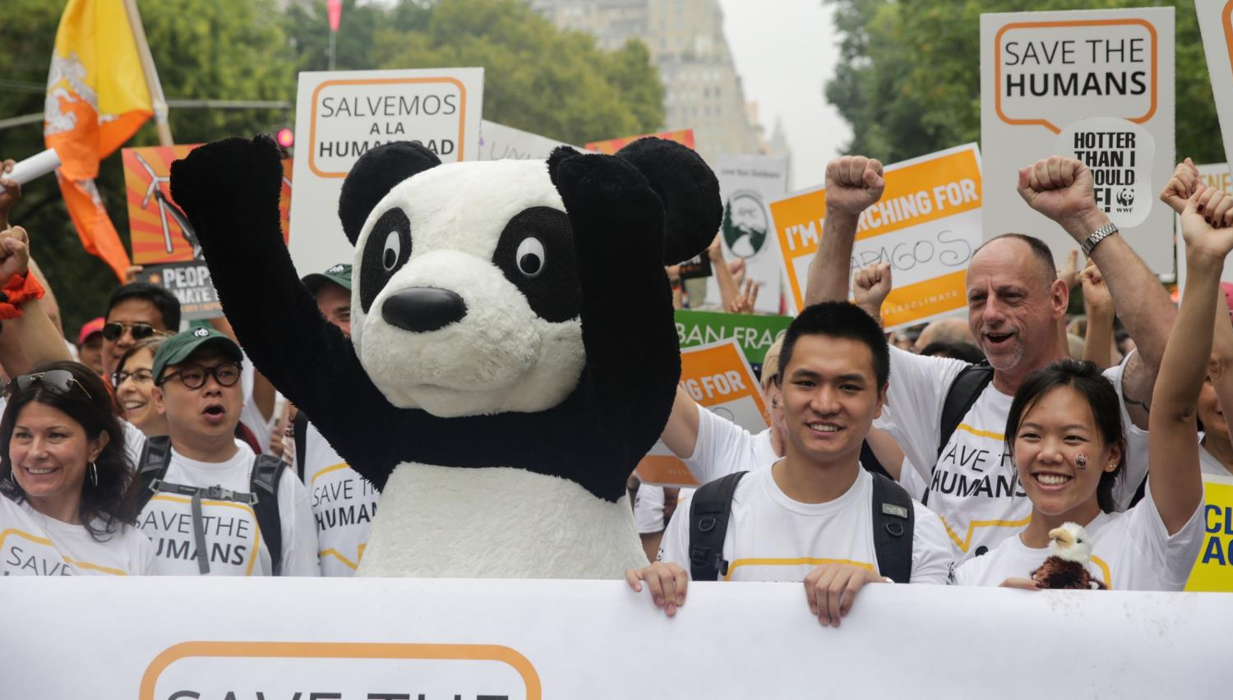
WWF is fighting for our climate
Notes:
At WWF, we believe we can fight this consequential threat and build a safer, healthier and more resilient future for people and nature. To address the climate crisis we must urgently reduce carbon pollution and prepare for the consequences of global warming—which the world is already experiencing—and raise our collective voice for action.

Slide 12
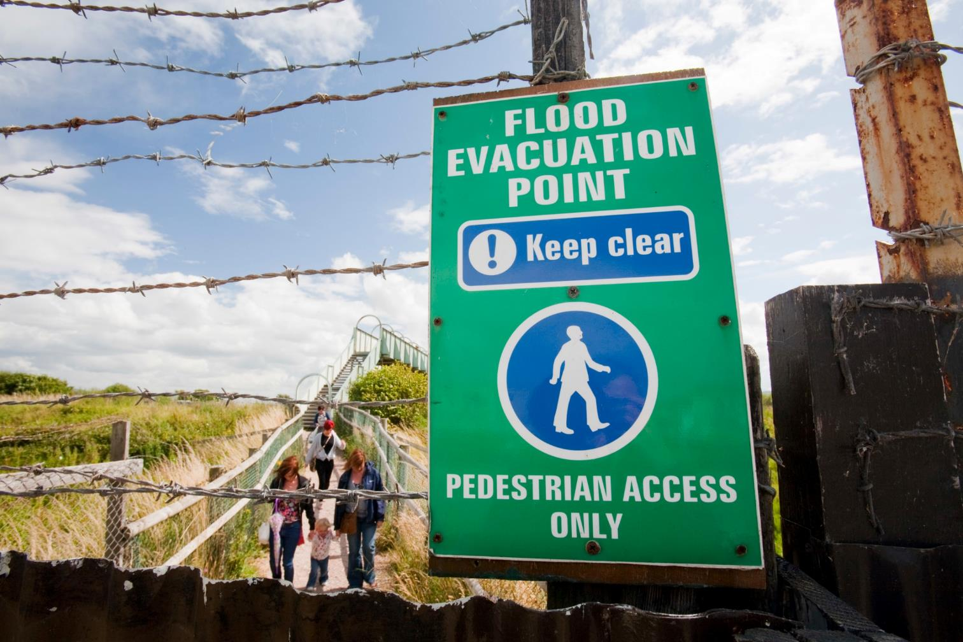
Preparing for a Changing World
Notes:
WWF works with local communities, governments and others around the world to help people and nature prepare for and adapt to the many impacts of a changing climate. We do this by:
• Working with communities and governments to understand and prepare for climate change
• Integrating environmental considerations into disaster recovery, reconstruction, and risk reduction
• Protecting, restoring, and sustainably managing ecosystems in ways that increase their resiliency and ability to address climate change
• Studying how people’s responses to climate change affect ecosystems and wildlife
• Assessing species to determine traits that make them resilient or vulnerable to changes in climate

Slide 13
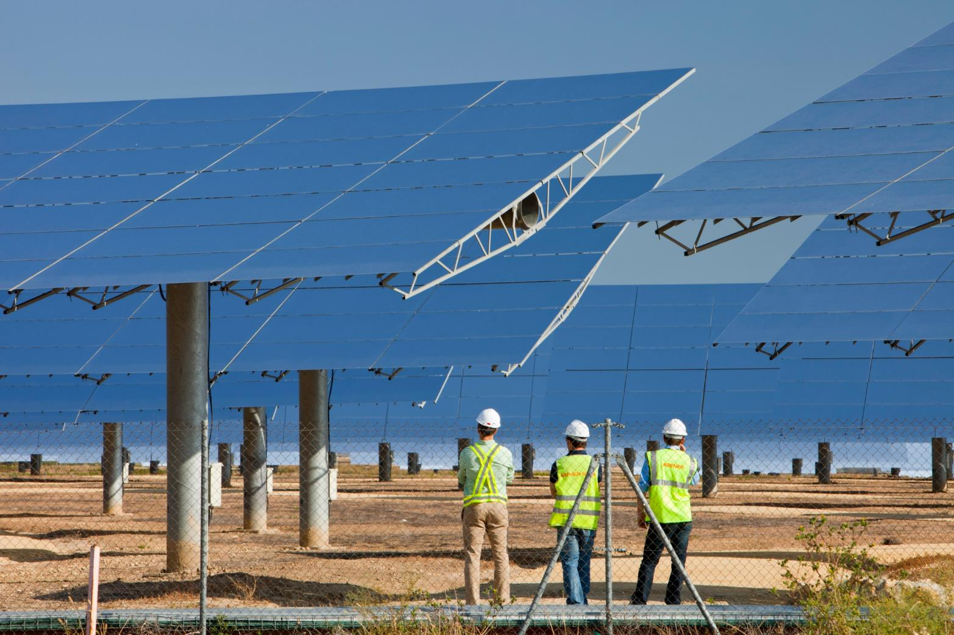
Accelerating Climate Action
Notes:
Even with the United States recommitting to the Paris Agreement, America’s cities, states, and businesses play a critical role in ensuring the promise of that agreement turns into concrete action.
WWF is helping accelerate climate action from national governments, and from cities, states and businesses to deliver on the ambitious temperature goals of the Paris Agreement by:
• Supporting the Green Climate Fund and the Global Environment Facility, programs that provide financial backing to developing countries
• Building coalitions of state and local actors in the US and around the world to realize the transformation to a clean economy
• Helping transition developing countries to clean energy sources like wind and solar
• Curbing climate pollution from international aviation
• Harnessing the power of nature to provide essential benefits and services to people, such as reducing greenhouse gas emissions or helping make geographies more resilient to the effects of the climate crisis.

Slide 14
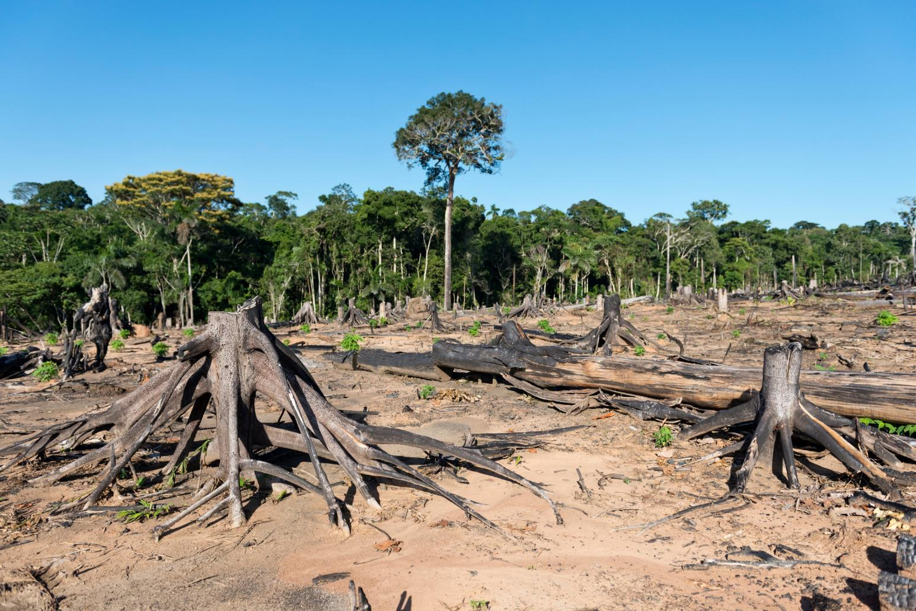
Reducing Emissions from Deforestation
Notes:
Forests combat climate change by naturally absorbing carbon dioxide. But when forests are cleared, burned, or poorly managed, they release large quantities of C02 into the atmosphere. Scientists estimate up to 13% of global carbon emissions come from deforestation. WWF is working to save forests by:
• Supporting REDD+, which offers financial incentives to developing countries that manage and use their forests responsibly.
• Creating multi-million dollar funds to properly manage forests that are designated as protected.
• Working to end illegal logging.
• Ensuring that global climate change agreements reduce forest loss and degradation.

Slide 15
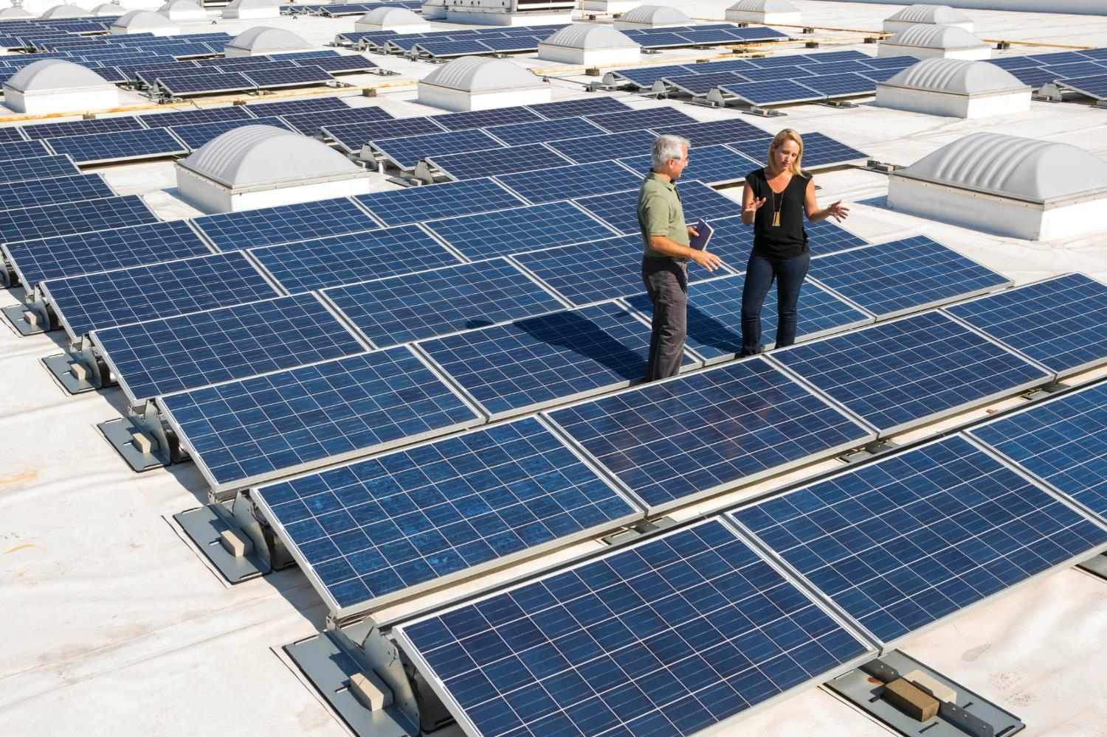
Building a Low-Carbon USA
Notes:
WWF is working with businesses, cities and national governments to set emissions reduction goals aligned what science says is needed. We’re also working to make clean, renewable energy cheaper and easier to purchase. WWF is building momentum for a low-carbon economy by:
• Helping companies set, meet, and even surpass science-based targets
• Challenging all US cities to set ambitious goals, transition toward 100% renewable energy and address local climate threats

Slide 16
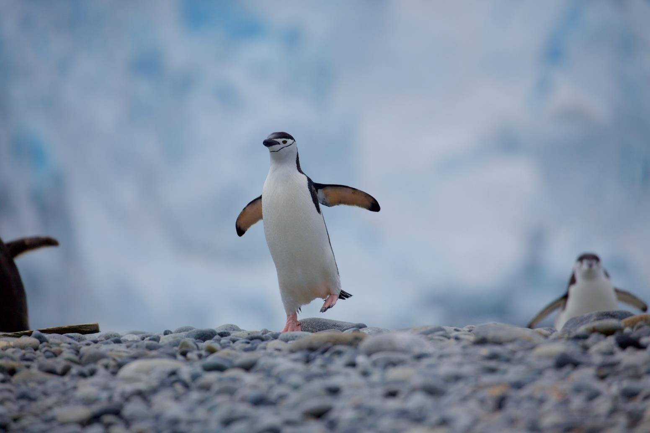
Visit worldwildlife.org/initiatives/climate
Notes:
Visit the World Wildlife website to learn more.

Slide 17
Photo Credits
Page 2: © Jason Houston / WWF-US
Page 3: © Global Warming Images / WWF
Page 4: © Shutterstock / ESOlex / WWF
Page 4: © Morgan Heim / Day's Edge Productions / WWF-US
Page 5: © Global Warming Images / WWF
Page 6: © Getty Images
Page 7: © Frank PARHIZGAR / WWF-Canada
Page 8: © Cat Holloway / WWF
Page 9: © WWF-US / Elisabeth Kruger
Page 10: © WWF Intl. / Greg Marinovich / The Stand
Page 11: © Global Warming Images / WWF
Page 12: © Global Warming Images / WWF
Page 13: © Nicolas Villaume / WWF-US
Page 14: © WWF-US / Paul Fetters
Page 15: © Adam Oswell / WWF-Myanmar
© WWF-US
© WWF-US / Darren S. Higgins
Page 16: © WWF-Aus / Chris Johnson

