Slide 1


Part 1 ‒ Pre-Audit
Notes:
YouTube video introductions if desired:
The Extraordinary Life and Times of a Strawberry (all grade levels): https://www.youtube.com/watch?v=jKQPL16WjHs
Food Wastage Footprint 1 &2 (upper-middle/high school):
https://www.youtube.com/watch?v=IoCVrkcaH6Q
https://www.youtube.com/watch?v=Md3ddmtja6s

Slide 2
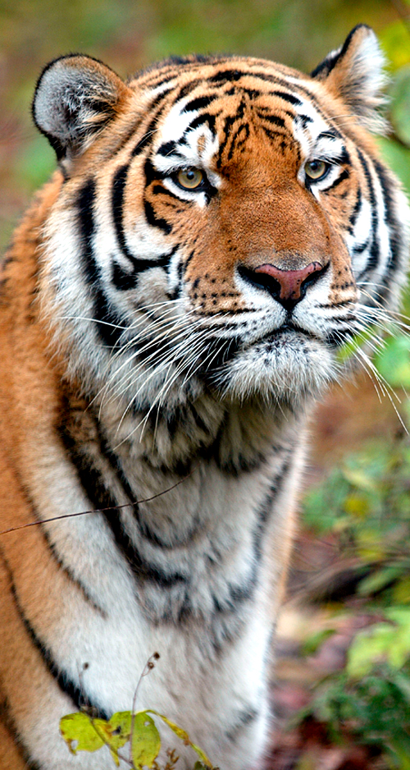
Our Mission
WWF PROTECTS THE FUTURE OF NATURE
We are a global science-based organization
We work with companies and communities
We strive to meet the needs of both people and nature
Photo: Vladimir Filonov / WWF-Canon

Slide 3
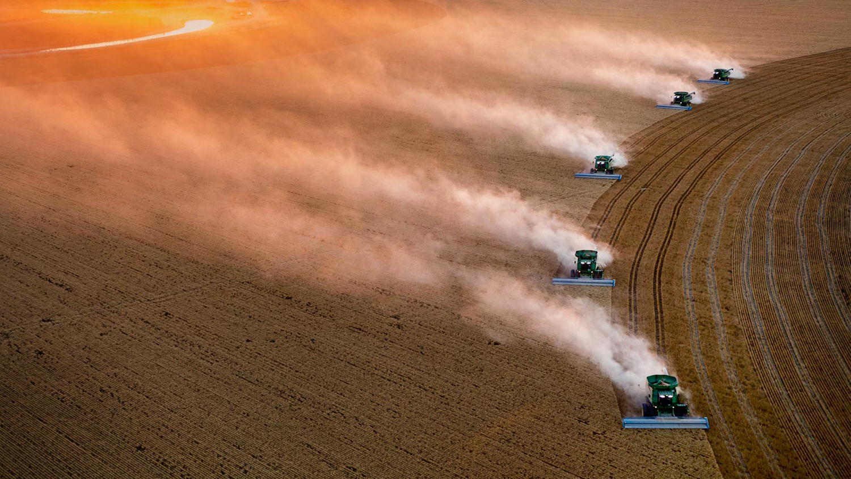

Agriculture
provides food for people everywhere, but is also one of the greatest threats to all life on Earth.
What natural resources do you think we use when we produce food?
Photo: Nat Geo / steinmetzal
Notes:
Slide Script: FOOD, how and where we produce it, is one of the greatest threats to all life on Earth. The expansion of agriculture (growing more food) is the reason why we cut down rainforests and convert grassland to farm land.
Ask students: Why do you think producing food is harmful to other life on Earth? Who is it harming—animals or humans, or both? Can you think of ways humans produce food that is harmful to our environment? Can you think of ways we produce food without harming our environment?
Answers in following slides.
NOTE TO INSTRUCTOR: The “Talking Panda” pops up to indicate when to pause for class discussion questions.

Slide 4
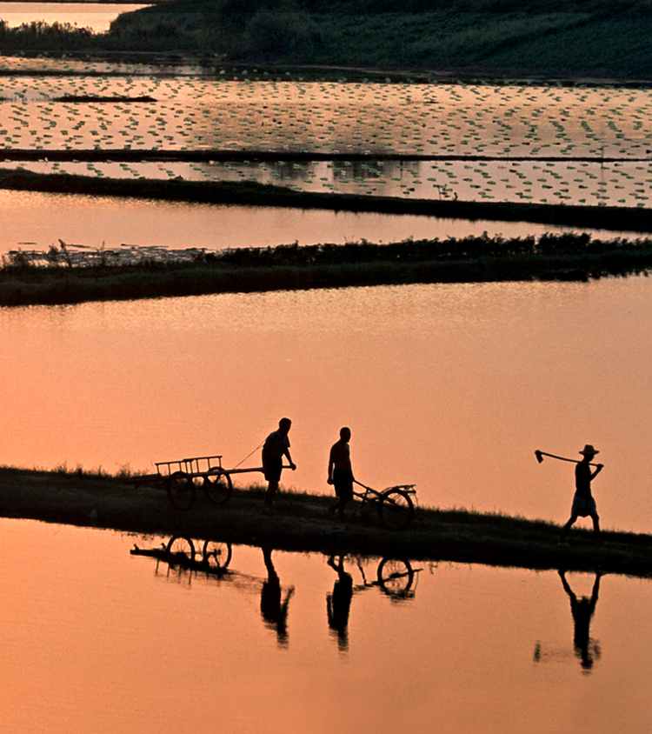
Food production takes
of all fresh water
used by people.
70%
Photo: © Michel Gunther / WWF Regional
Source: http://wwf.panda.org/what_we_do/footprint/agriculture/impacts/water_use/
Notes:
Slide Script: Agriculture claims 70% or more of all the fresh water used by people globally. How does agriculture and growing food use water? Answers – the crops we grow need LOTS of water! Some more than others. What happens when those crops go to feed animals? Does that require more or less water? If you have a plate of steak and a plate of veggies, which took more water to produce? Answer: depending on the region, a plate of beef requires about 12,000 gallons of water, while a plate of veggies requires about 200 gallons!
Source: http://wwf.panda.org/what_we_do/footprint/agriculture/impacts/water_use/

Slide 5
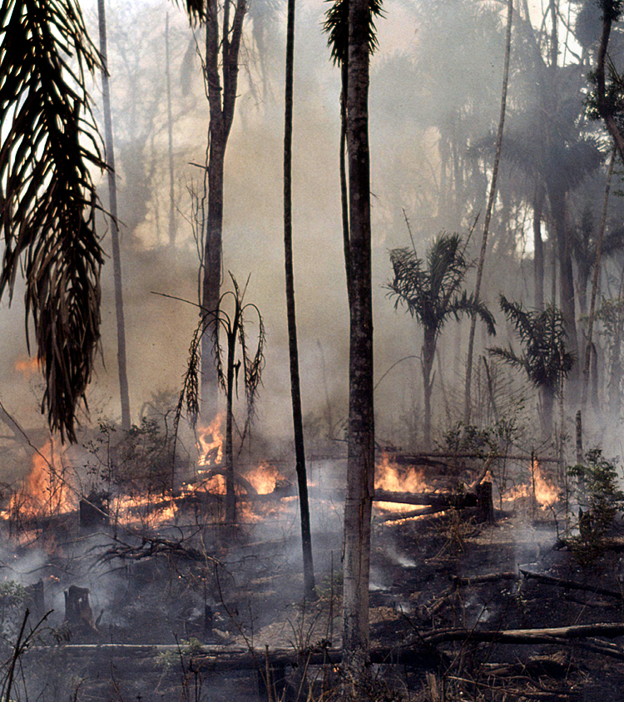
Agriculture is the world’s
2nd largest
emitter of
greenhouse gases.
Photo: © Mauri Rautkari / WWF-Canon
Source: Word Resources Institute
Notes:
Slide Script: What are greenhouse gases? How do they affect our climate and atmosphere? Why are they good? Why are they potentially bad? Why do you think agriculture is the cause of so much?
Answers: GHGs keep our planet warm and habitable, but too much in our atmosphere can quickly change the climate, cause extreme weather events, make sea levels rise, and make some areas of the planet uninhabitable.
Optional: explain how sending food to landfill produces lots of greenhouse gases, while composting food creates less greenhouse gases. The composting process uses oxygen to break down natural waste, while a landfill does not; therefore, landfills release large amounts of methane, a GHG with 25-30 times more warming potential than CO2.

Slide 6
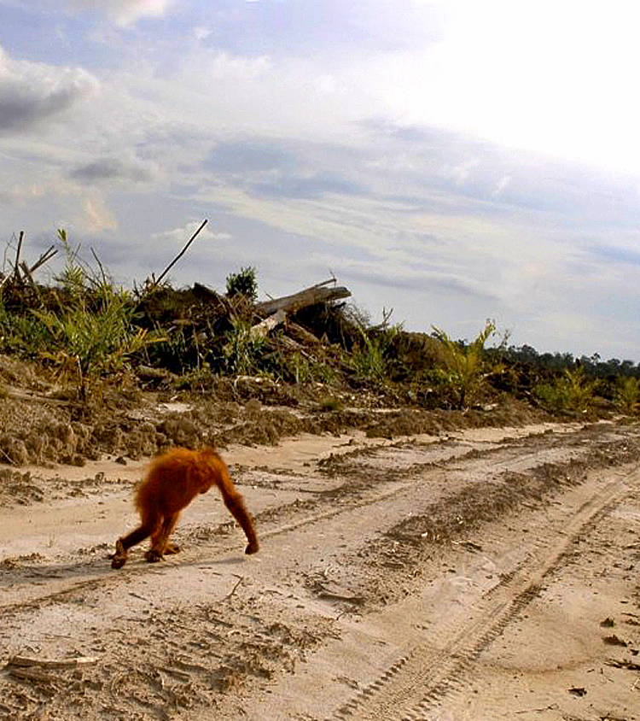
50%
of the world’s livable land
has already been
converted to farming.
70%
of biodiversity loss is due
to food production.
Photo: earthnewsmedia.com
Source: Convention on Biological Diversity, CBD Technical Series No 79, 2014
Notes:
Slide script: When we examine biodiversity loss on the planet, the vast majority is a result of farming and food production expansion.
Source: Convention on Biological Diversity, CBD Technical Series No 79, 2014

Slide 7
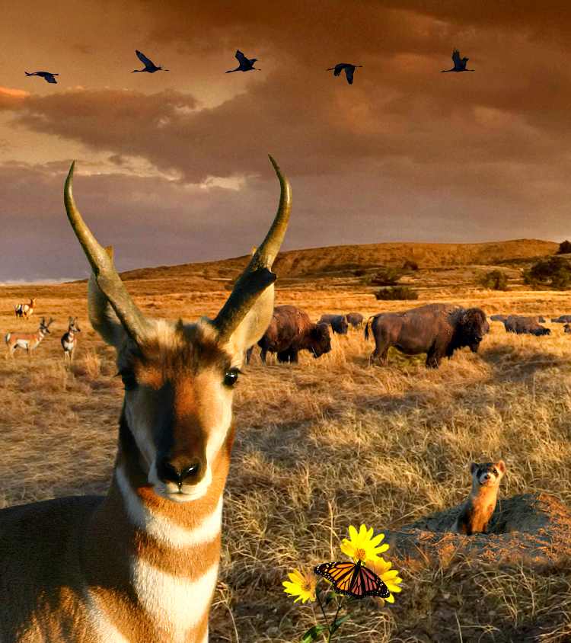
What
is biodiversity?
Why
is biodiversity so important?
How
does producing food affect biodiversity?
Notes:
Slide Script: Biodiversity is BEAUTIFUL! Biodiversity is the variety of ALL life on Earth, all the species of plants, animals, and microorganisms, the enormous diversity of genes in these species, the different ecosystems on the planet, such as deserts, rainforests and coral reefs are all part of a biologically diverse Earth.
Additional questions: What is an ecosystem? Why is it important to have biodiversity in an ecosystem?

Slide 8
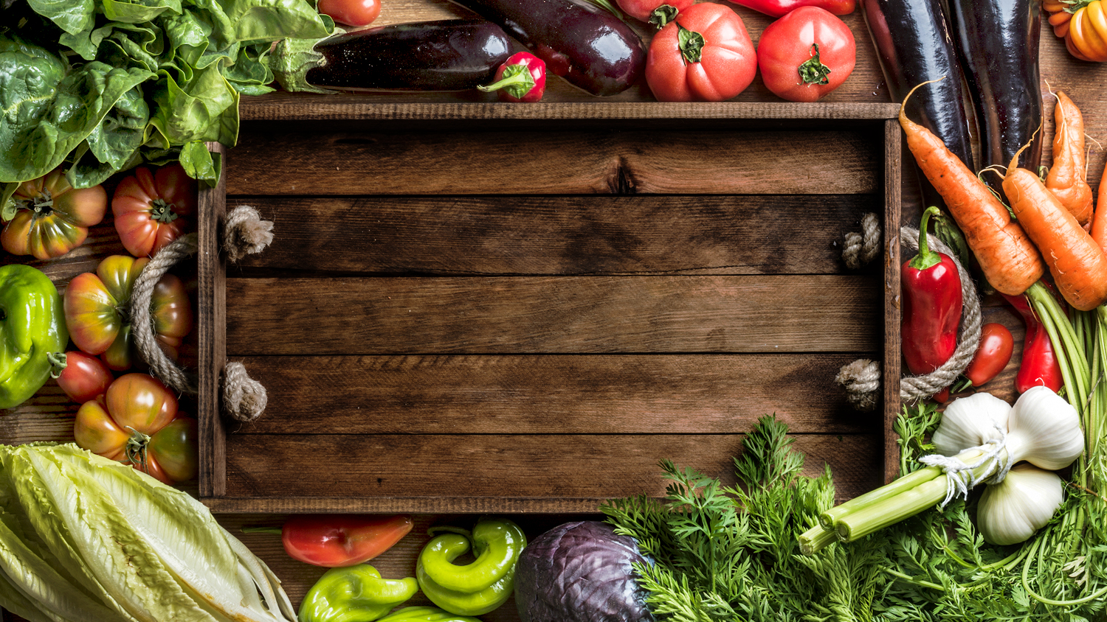
30-40%
of food produced in
the U.S. is wasted.
That’s 63 million tons
of food!
Source: 2016 ReFED Report
Notes:
Questions: What is food waste? Why do you think people waste food?
How much is 63 million tons? Can you think of anything that big?

Slide 9

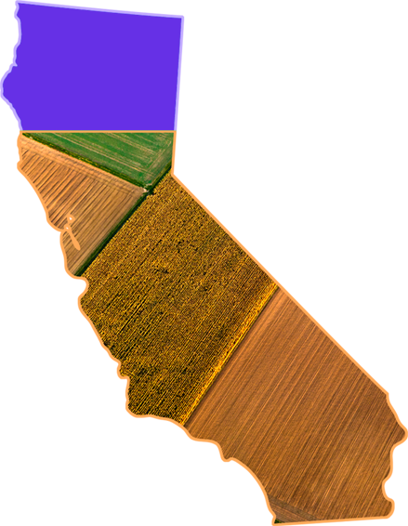

Grown on a farm
¾ the size of
California
…or the same weight as
500 million pandas!
40
tons
EVERY
20
seconds
Source: 2016 ReFED Report
Notes:
How much is 63 million tons? If you took the 63 million tons of US food waste generated each year, it would be grown on a farm three-quarters the size of California, it would harvest enough food to fill a 40-ton tractor every 20 seconds, and weigh as much as almost 500 million pandas!
Source: 2016 ReFED Report

Slide 10
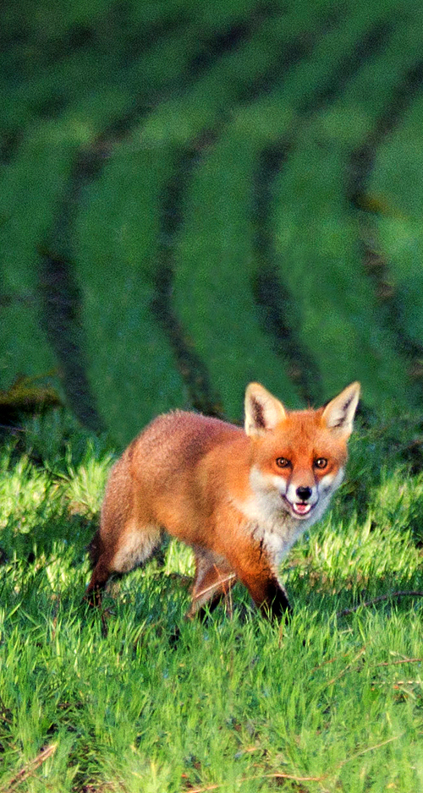
Critical thinking questions
What resources are used to produce
food and do animals also use those resources?
What happens to those resources when food is thrown away?
How does wasting food affect people and wildlife?
How can we figure out how much food we waste just in this school?

Slide 11
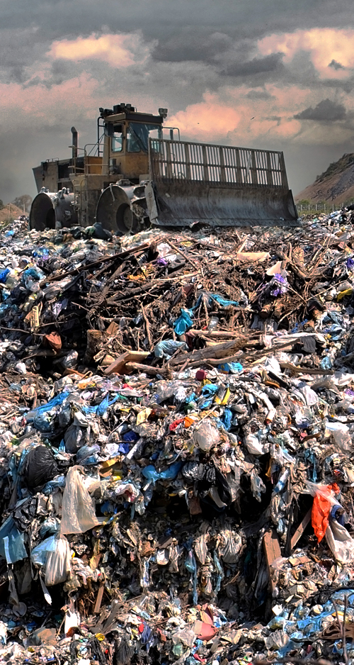
Most food waste in the U.S. is sent to landfills, where it emits an estimated
124 million tons
of greenhouse gases per year that contribute to climate change.
Source: WRI, FAO 2015
Notes:
Slide script: When food waste is put in landfill, it emits greenhouse gas emissions such as CO2 and methane. 18 million tons of GHG emissions is enough energy to power 2 million homes for one year!
(Optional explanation): Methane is 25-30 times more potent than CO2, meaning that it is much better at trapping heat in our atmosphere; it is mostly methane released from landfilled food waste. When food waste is composted, it is broken down by components in the soil and thus does not release as much methane; in fact, soil can actually store carbon within it (carbon sequestration).
SHOW STUDENTS Food Waste calculator. Difference between composting and landfill.
Note to Teachers: The calculator shows CO2e, or CO2 Equivalent, which means it calculates the potency of methane and converts it to its CO2 equivalent. The majority of gas emitted from landfilled food waste is methane.
Optional: https://www.epa.gov/energy/greenhouse-gas-equivalencies-calculator

Slide 12
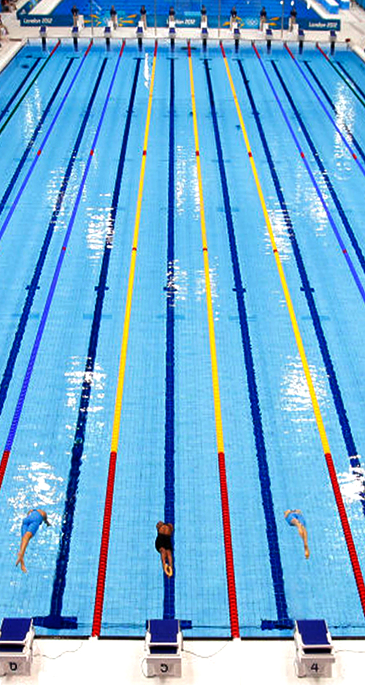
In the U.S., an estimated 25%
of all fresh water goes toward
producing food that is lost or wasted.
That’s enough water to fill almost
2.5 million
Olympic-sized swimming pools!
Source: WRI, FAO 2015
Notes:
Slide script: In the U.S., an estimated 25% of all fresh water goes toward producing food that is lost or wasted. If we reduced our country’s annual food waste by 50%, it’s possible we could save 1.6 trillion gallons of water. That’s enough water to meet the entire PLANET’s water needs!
Remind students: Fresh water is a precious resource; only 2.5% of all the water on earth is fresh water, and only some of that is usable (the rest is trapped in ice)

Slide 13
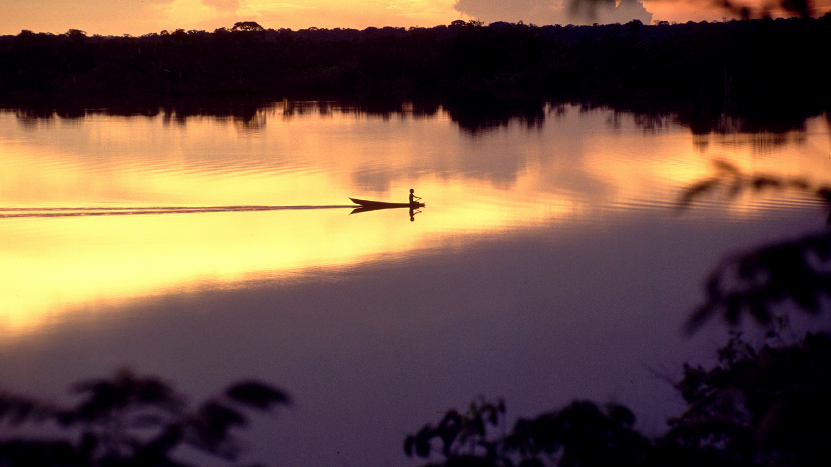
How can we
reduce our food waste and save natural resources?
Photo: © Juan Pratginestos / WWF
Notes:
Slide Script: Can you think of any ideas? (let students offer ideas for reducing food waste) Methane, CO2, which is worse?

Slide 14
Let’s become
Food Waste Warriors!
Notes:
Introduce the idea of an audit and explain what the students will be doing during lunchtime.

Slide 15
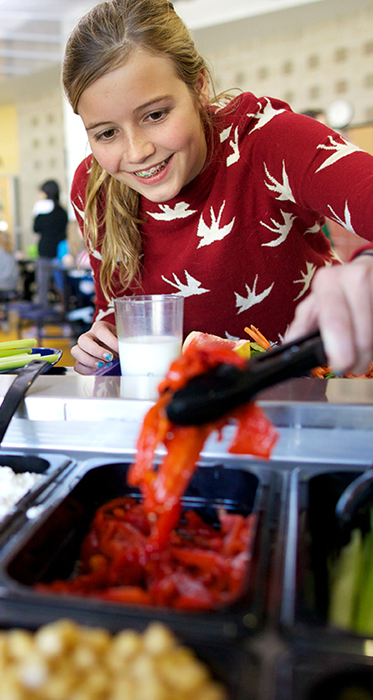
What do we need?
AUDIT
USDA Guide to Conducting Student Food Waste Audits
Two tables per audit station
Two large trash cans on wheels
Trash bags to line the buckets (optional)
Gloves for handling food/trash
Printed out audit weight log and interview sheets
Signage to direct students
Printed labels for buckets
Clothes and/or paper towels for spills and cleanup
Buckets (for sorting lunchroom food waste)
Scale for weighing food waste
Pencil, paper, clipboard
Photo: Let’s Move Salad Bars to Schools

Slide 16
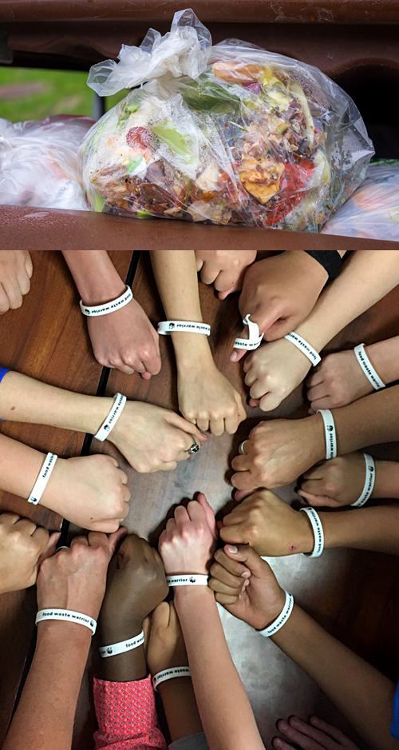
What will we do?
AUDIT
Learn about how food waste impacts our environment
Prepare for a lunchroom food waste audit by getting materials ready
Begin thinking about creating share tables or donating food that is packaged, unopened, and uneaten
Choose categories of food waste we want to sort
Pick team leaders and create a game plan
Get ready to have fun!
Notes:
Slide script: We know now that 63 million tons of food is wasted in the U.S. each year, and how that effects the environment. What benefits could come from recovering 10% of the food wasted in the US? How about 30%?
Do you usually eat all of your lunch? If not, why not?
When you buy lunch at school, do you think you have to take certain items? Why?

Slide 17

End waste, save wildlife

Slide 18
Part 2 ‒ Post-Audit
Notes:
YouTube video introductions if desired:
The Extraordinary Life and Times of a Strawberry (all grade levels): https://www.youtube.com/watch?v=jKQPL16WjHs
Food Wastage Footprint 1 &2 (upper-middle/high school):
https://www.youtube.com/watch?v=IoCVrkcaH6Q
https://www.youtube.com/watch?v=Md3ddmtja6s
NOTE TO INSTRUCTOR: The “Talking Panda” pops up to indicate when to pause for class discussion questions.

Slide 19
Audit results
Total food waste: _______ lbs
Water in wasted food: ________ gallons
Greenhouse gas emissions in wasted food: ________lbs of CO2e
Greenhouse gas emissions in compost: __________lbs of CO2e
Why are these scores different?
Why does composting produce fewer greenhouse gases than landfill?
How can we use this information to help protect our environment and wildlife?
What are some things our school or city can do to keep so much food from going into landfills?
Notes:
After your class has completed the audit, discuss the results with students after using the BEACN calculator to calculate water and greenhouse gas emissions in wasted food. Also have students calculate GHGs from landfill vs compost using the equations provided in the lesson plan.
You may also wish to explain that composting emits fewer greenhouse gases because of the different process by which both break down food. The composting process uses oxygen to break down natural waste, while a landfill does not; therefore, landfills release large amounts of methane, a GHG with 25-30 times more warming potential than CO2 .

Slide 20
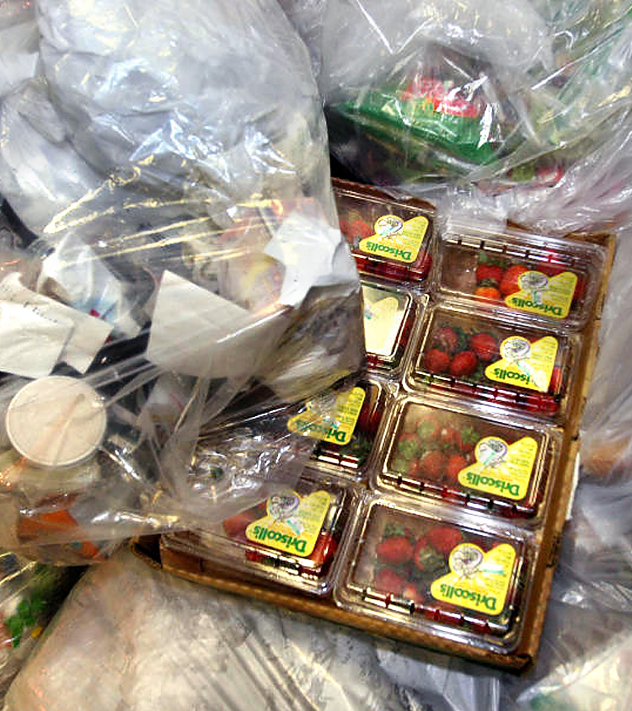
What can we do to reduce food waste?
Photo: Don Emmert_AFP_Getty Images

Slide 21
Food recovery hierarchy
Measure and reduce food waste
Start a share table and donate edible, uneaten food
Avoid sending food to landfill
Notes:
Slide Script: While diversion of your food waste is a great thing, the best thing to do for the environment, school or family is to not create food waste in the first place. We don’t grow food to compost it! By measuring food waste, we now know which foods are wasted most often and can recommend reduction strategies to cafeteria managers so they can better plan and manage meals. When there is extra food, we can use it to create share tables, donate it, or create a compost pile at our school.
But PREVENTING food waste is always the best thing, best for wildlife, the planet, and for people!

Slide 22
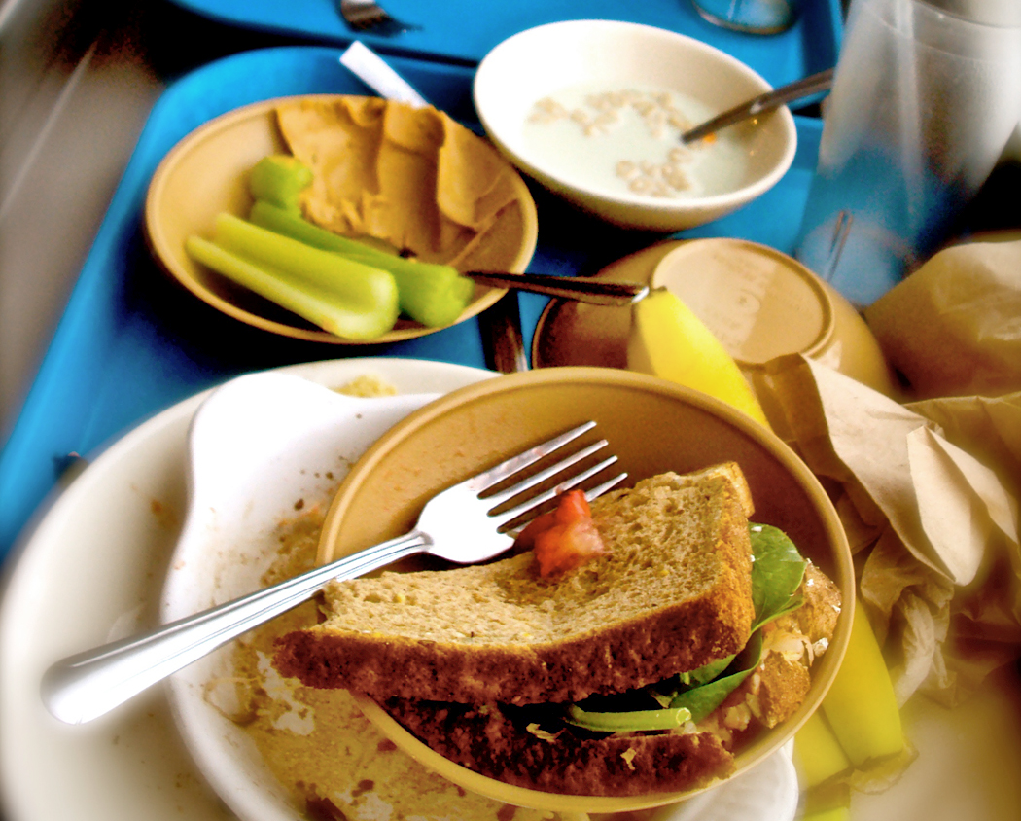
Action:
Measure and reduce wasted food at your school.
What are
some ideas for preventing food waste from happening?
Notes:
Slide Script: How can we prevent food waste? Here are some ideas:
Measure waste. By doing food waste audits regularly, we can see which food is wasted most often and why, and show the results to cafeteria managers so they can make smarter decisions about which food to serve.
Make food fun. In one study by the Smarter Lunchrooms Movement, schools that called their carrots “X-Ray Vision Carrots” doubled their consumption. Slicing apples also resulted in a 73% increase in the number of students who ate more than half of their apple.
Implement offer vs serve. OVS is a concept that applies to menu planning and meal service, and allows students to decline some of the food offered in a reimbursable lunch or breakfast.
Schedule recess before lunch. In one study by the Smarter Lunchrooms Movement, schools that scheduled recess before lunch reduced food waste by 40%.
Extend lunch periods. In one study by the Harvard School of Public Health, schools that gave students more time to eat had 13% less entré waste, 12% less vegetable waste, and 10% less milk waste.

Slide 23



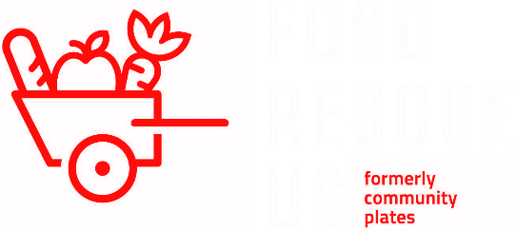
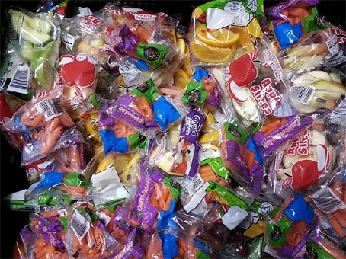
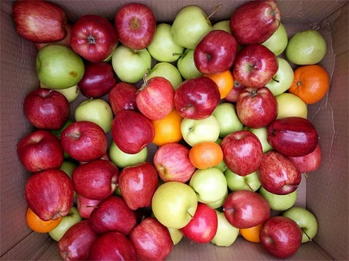
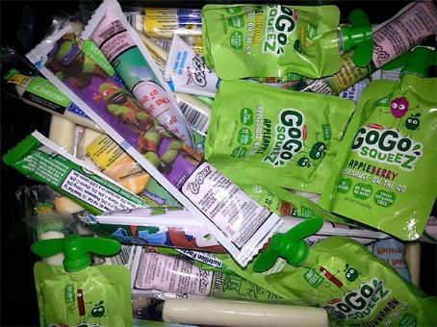
Action:
Start a
food rescue program.
FOOD RESCUE EXAMPLES
What can
we do with the
rescued food?
Notes:
Slide script: We learned that 30-40% of food is wasted in the US. This is happening while 1 in 6 Americans are food insecure, including 13.1 million children, meaning that they do not have reliable access to enough affordable, nutritious food. What can our school do to help?
Answers:
Create share tables. Allow students to leave unopened, packaged, uneaten food or fruits with non-edible skin (such as bananas and oranges) on a share table so that any student may take this food for free.
Donate leftover food from share tables or the cafeteria. Check out http://www.foodrescue.net/ for additional resources.
Refer to WWF resource guide on donation and share tables and contact us with questions specific to your school.

Slide 24
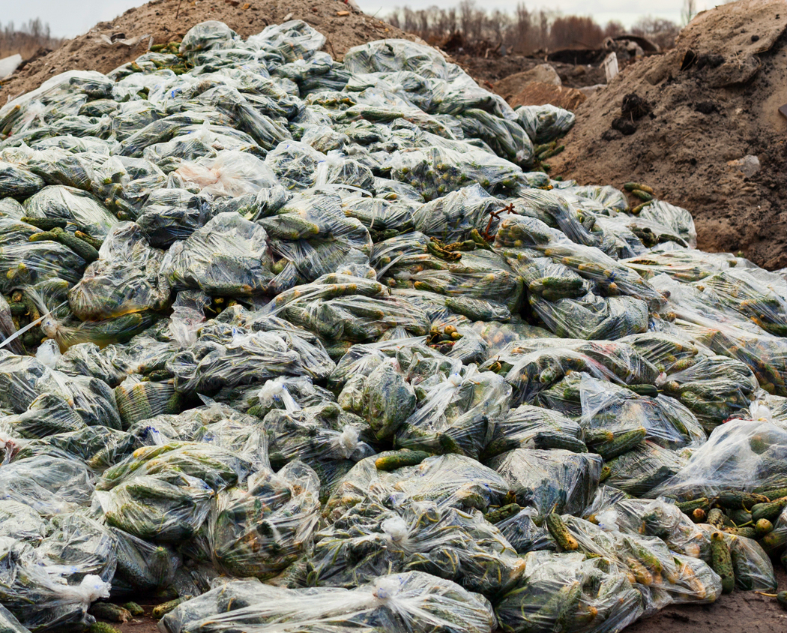
Action:
Avoid sending food waste to landfills.
What can
we do to avoid sending food to landfills?
Notes:
Slide script: It is important to avoid sending food waste to landfill. Why? Because as we learned, in landfill food waste creates harmful greenhouse gases. What can we do to avoid sending food waste to landfill?
Answers:
Start a compost pile at your school. Many cities have resources for starting gardens on your campus, and a compost pile is a perfect way to start.
Partner with local farmers to have your food waste picked up and used as animal feed or farm compost. Check out the Farm2School network.
Refer to the WWF “additional resources” page for more information on food waste diversion from landfill.

Slide 25
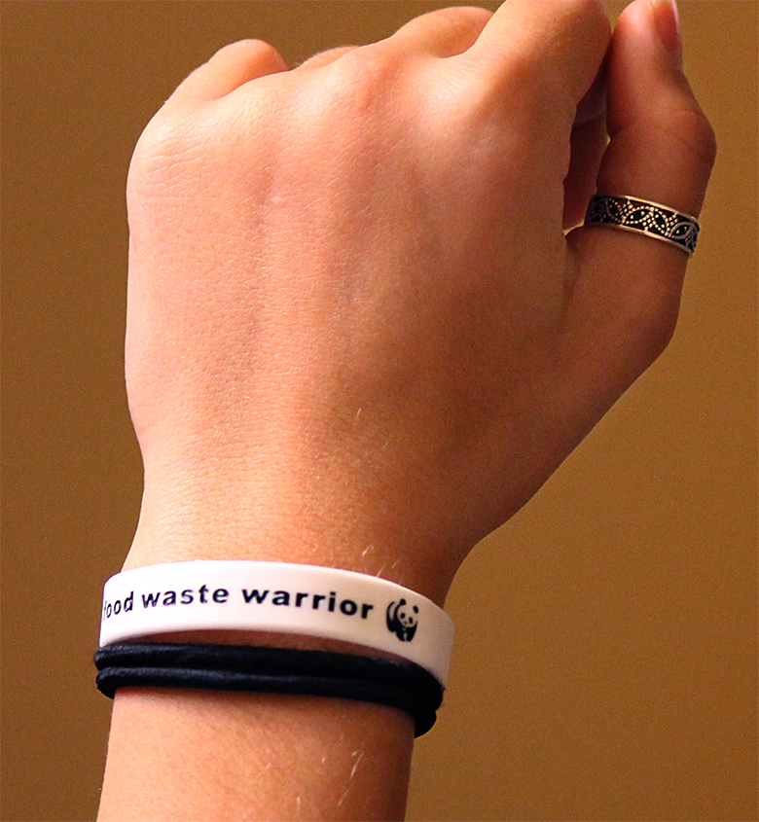
Become a
Food Waste Warrior!
Celebrate and appreciate food
Reduce waste
Take and eat only what your body needs. ☺
Notes:
Slide script: While food production is currently a major threat to global biodiversity, growing food in harmony with nature also represents our biggest opportunity for increasing global biodiversity. Supporting sustainable agriculture practices that limit environmental impact and creating zero waste food systems can change the world. Change food and we change the world!

Slide 26
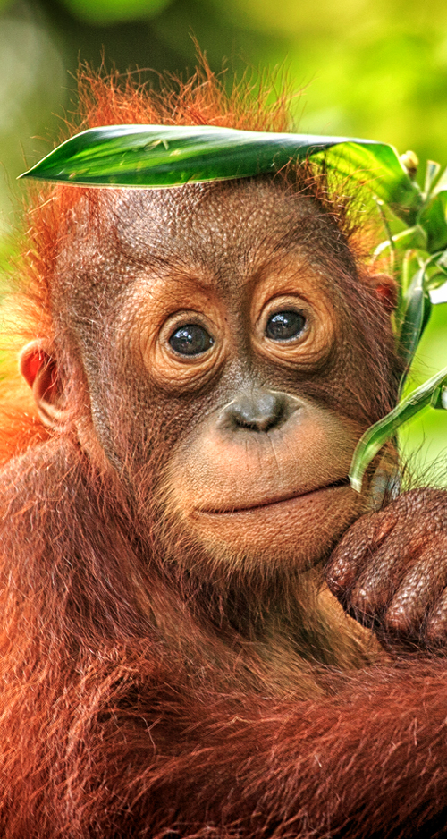
Conclusion questions
At the end of the audit guide and lesson, what
have we learned over the course of the activity?
What information do we now have about which foods are wasted more often? Why do you think these are wasted more than others?
What can each of us do to reduce food waste on our plates? What strategies have we talked about or used that seem effective?
Why is reducing food waste so important to environmental and wildlife conservation?
How does an orangutan in Indonesia relate to a candy bar that is thrown in the trash? What sort of affects do our choices have on wildlife?

Slide 27
End waste, save wildlife

