Slide 1
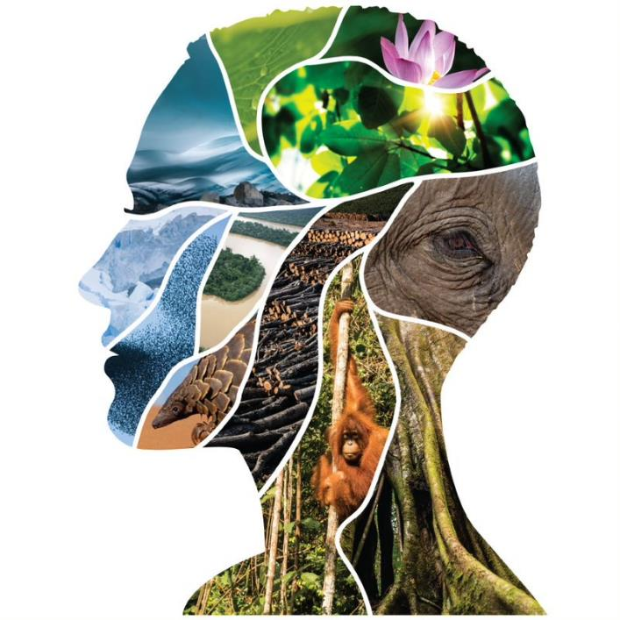
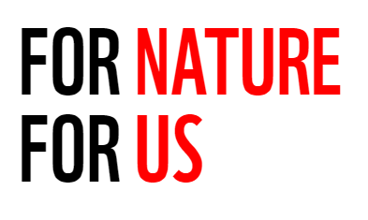
Science Brief
Beyond Boundaries
Emerging zoonotic diseases, nature, well-being
A Call to Stop the Next Pandemic
© naturepl.com / Andy Rouse / WWF
Notes:
COVID-19 is the latest zoonotic disease to become a global pandemic. But how do zoonotic diseases emerge and what can we do to prevent them? The answers lie in fixing our broken relationship with nature. We have created environments that put all of us at risk. But by taking steps to protect the planet, we can protect people from a future pandemic. Over the next half hour we will discuss what gives rise to emerging infectious diseases; how conservation interventions reduce the likelihood or severity of a zoonotic event. And direct action you can take to help.
Silouette copyright: Starting at the eye (ice cave) and going clockwise: Nicolas Villaume / WWF-US, Luis Barreto / WWF-UK, Chris J Ratcliffe / WWF-UK, Greg Armfield / WWF-UK, Ola Jennersten / WWF-Sweden, Luis Barreto / WWF-UK, Neil Ever Osborne / WWF-US, Shutterstock, Photoshot License Ltd / Alamy Stock Photo, Brent Stirton / Getty Images, Global Warming Images / WWF, Chris Johnson / WWF-Aus

Slide 2
What is a zoonotic disease?
Notes:
A zoonotic disease is a disease that jumps from animals—wild or domestic—to humans. These jumps, known as spillovers, are on an unprecedented rise. In the case of COVID-19, the disease existed in bats then moved to another host animal before spilling over to the human population.
A pathogen can be a virus, bacteria, fungus, or parasite.
Here we can watch a short explainer video, then dive in for a deeper look.

Slide 3
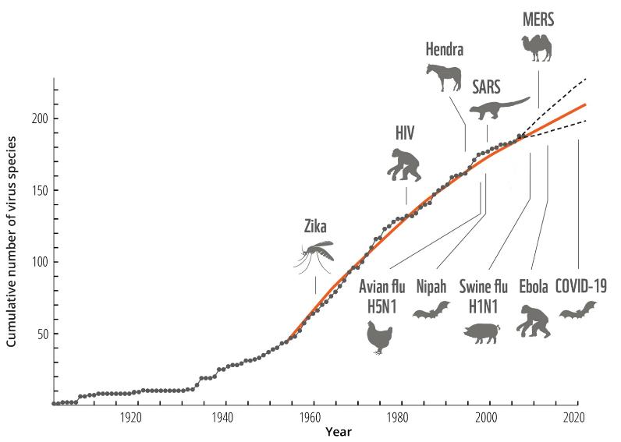
Rise of new emerging infectious diseases (EIDs)
WWF Global Science. (2020). Beyond Boundaries: Insights into emerging zoonotic diseases, nature, and human well-being. Internal science brief. Unpublished.
Notes:
This graph shows the cumulative number of virus species identified each year and the rise in zoonotic emerging infectious diseases, or EIDs, and the significant spillover events in the last 60 years.
Roughly two new infectious diseases are discovered each year (Dobson 2020 pers. Comm adapted from Woolhouse 2008).
The number of spillover events is increasing.
Many are recommending simple fixes - such as the closure of all wet markets - to be credible in the connection between the health of people and the health of nature, we need the evidence to support a bold strategy that delivers the health of both.
Let’s dig into what the science says …

Slide 4
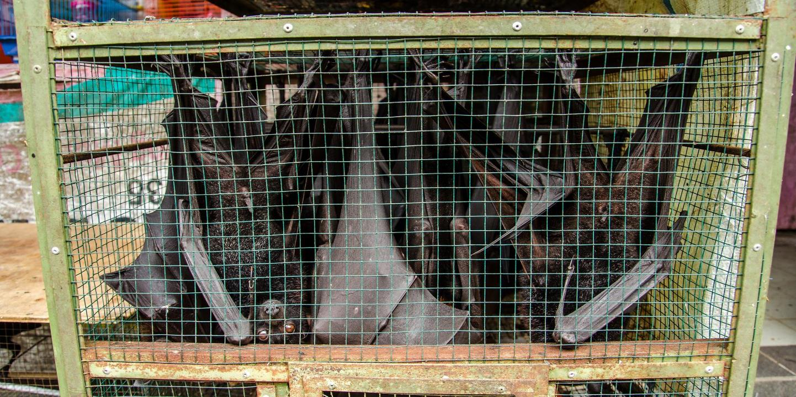
Past Zoonotic Diseases
© Shutterstock
Notes:
If you look back at the last 60 years, you’ll find
The majority of emerging diseases are zoonotic (~75%)
Not all the zoonotic diseases come from Asia.
The majority of the zoonotic diseases had a domestic livestock animal as an intermediate host that passed the pathogen on to humans, causing the ‘spillover’, and
For most diseases, bats are confirmed or suspected as the origin of the pathogen.
Bats have a special immune system that allows them to carry the virus without contracting the disease. In this way, they are ‘reservoirs’ for pathogens.
To identify the role for conservation in pandemics, we need to understand the drivers of disease emergence and how conservation interventions could make a difference. But to do this, it’s important to remember that not all diseases are the same.
The drivers of the disease vary depending on the dynamics of the particular disease – including the species that host the pathogen and how the pathogen transmits.

Slide 5
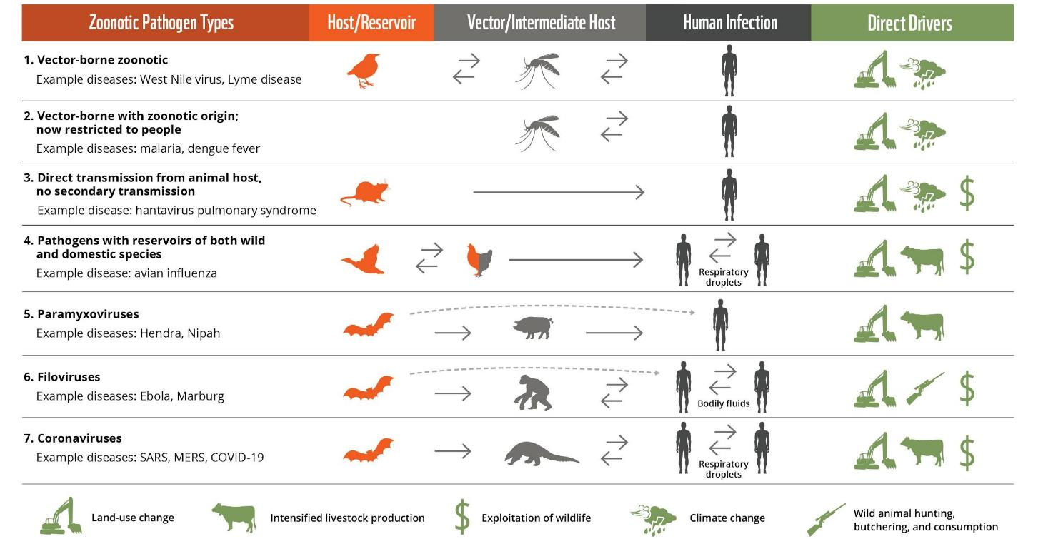
Human-human pathogen transmission
Beyond Boundaries: Emerging zoonotic diseases, nature, and human well-being
Notes:
In this graphic, the WWF science brief maps out various types of pathogens, their transmission to humans and the drivers of the transmission.
Organizing the information this way ultimately allows conservation organizations and partners to identify opportunities for how conservation can prevent spillover events. You’ll note that what happens after disease emergence is largely in the realm of public health and medical science..
In the graphic, we start with seven different zoonotic pathogen types on the left (numbers 1-7)
Each pathogen type has its an original animal hosts (in orange)
Each pathogen type has a different ways of transmission to people (in gray)
Some directly from the host, as in #3 with Hanta virus
Some transmit through a vector, such as a mosquito as in #1 West Nile virus
And some through an intermediate host, such as agoilla in #6 for Ebola
Note, that only some of them result in human-to-human transmission (the double arrows between people, #4, 6, and 7);
These are the diseases that can become pandemic.
And finally, on the right, you see the direct drivers in green.
One thing you’ll notice right away is that land-use change is a direct driver in all seven pathogen types.
You’ll also notice that the first three pathogen types have climate change as a direct driver. This is because climate change affects the geographic range of the host and/or vector such as in West Nile virus.
Bats are a host or reservoir for three of the pathways and while direct transmission from bats is possible, generally there are intermediate hosts – either domestic or wild animals – that transmit the disease to humans.
This includes the 7th pathway, coronaviruses in there have been three outbreaks in the last twenty years SARS, MERS and COVID-19
So let’s zoom in on the diseases of the study.

Slide 6
Human-to-human pathogen transmission
Beyond Boundaries: Emerging zoonotic diseases, nature, and human well-being
Notes:
...or those diseases that can become pandemic.
<CLICK>
Please note that land-use change, expansion and intensification of livestock production and exploitation of wildlife are main drivers of coronavirus spillover events.
In the science brief, WWF looked at the risk of disease emergence associated with these drivers. Understanding the relationship between drivers and disease emergence allows us to better understand conservations role in reducing the risk of disease emergence in the future. You’ll note that these direct drivers - land-use change, animal ag intensification, exploitation of wildlife and wildlife hunting have significant overlap with the drivers of biodiversity loss.

Slide 7
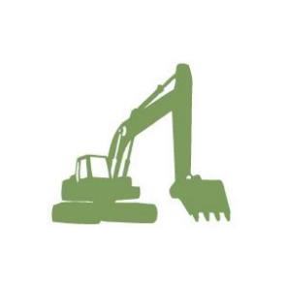
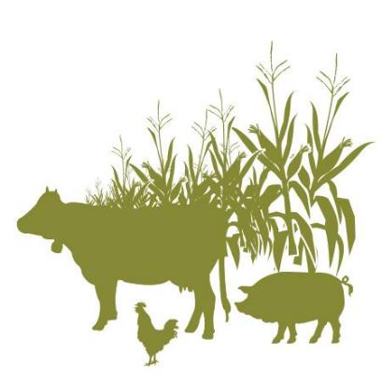
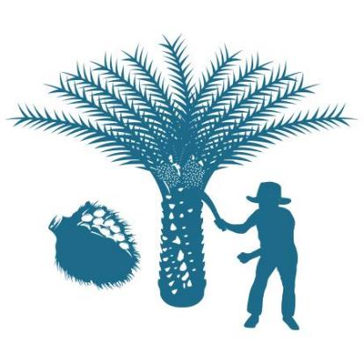
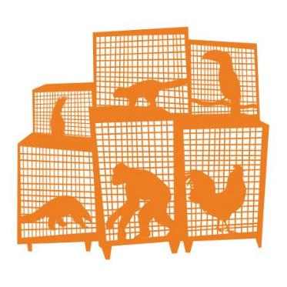
What drives novel emerging infectious diseases
Behavior
change
Deforestation and other land use changes
Wildlife
exploitation
Expansion and intensification of livestock production
Land-use change
WWF Global Science. (2020). Beyond Boundaries: Insights into emerging zoonotic diseases, nature, and human well-being. Internal science brief. Unpublished.
Notes:
While it is very hard to know precisely the origin of zoonotic diseases, the science brief shows that we do know with more scientific certainty that the rapid rise in zoonotic events over the past 30 years has been driven by:
How we are using live wild animals – We are now farming, trafficking, trading, and selling live wild animals for pets, for food, medicine, and status at levels we’ve never done before.
This has brought humans and wildlife into ever increasing contact with each other, dramatically increasing the risk of disease transmission and spillover.
How we are producing food – This is mainly how and where we are farming, transporting and selling domestic animals. Over the past 30 years, we have dramatically increased the number and the number of species we are producing on farms and those farms are closer to wildlands.
When we put these domestic livestock farms next to wild animals or wild habitats without appropriate biosecurity measures, we are increasing the risk of a spillover.
How we are using land – We are using destroying more and more natural habitat, particularly tropical forests, and converting it to agriculture.
This is bringing humans, domestic animals, and wildlife into contact in ways that we have never seen before and, yet again, increasing the risk of spillover.
Each of these direct drivers increases the proximity and intensity of interaction between live wild animals, live domestic animals, and humans. And since pathogens, particularly viruses, are constantly mutating in the arms race to survive, the increased frequency of the human-animal interactions make it more likely a human will be present when a mutation occurs that would allow a pathogen to spread and thrive in humans.

Slide 8
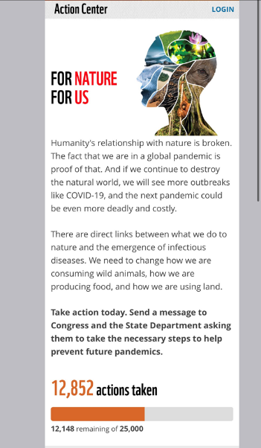
Visit worldwildlife.org/pandemics NOW to take action!
Notes:
Restoration and protection of nature are an essential component of the global COVID-19 response. They are also necessary to ensure human health and prosperous societies, to prevent future global health crises, and to build resilience to the impacts of climate change, including vector-borne zoonoses.
You may ask “what can I do to help?” In the US, WWF is calling on our government to develop plans to address future pandemics and prioritize efforts that tackle the root causes and can help reduce the chances of future animal-related outbreaks. Specifically, action is needed in five areas:
1. Ensure the US government is taking a whole-of-government and "One Health" approach to preventing future pandemics, working in collaboration with other nations and international institutions;
2. Support high-level diplomatic engagement and increased funding for international programs to shut down high-risk wildlife markets globally and reduce consumer demand for high-risk wildlife products;
3. Support increased funding for US government programs internationally that address the other root causes of zoonotic disease spillover, particularly those to end deforestation and the destruction of forest habitats and ensure rural and indigenous communities have safe and diversified sources of food and protein;
4. Take steps to prevent high-risk wildlife and harmful zoonotic pathogens from entering the United States, including through legislation, Administrative action, and increased support to relevant US government agencies; and
5. Work with other countries to improve their food security and livestock management practices and systems in order to prevent zoonotic disease transmission.
Please visit worldwildlife.org/pandemic NOW to
Our objective is to build more sustainable Post-COVID Societies.

Slide 9
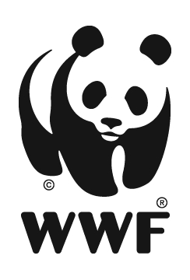
Questions?

