Slide 2
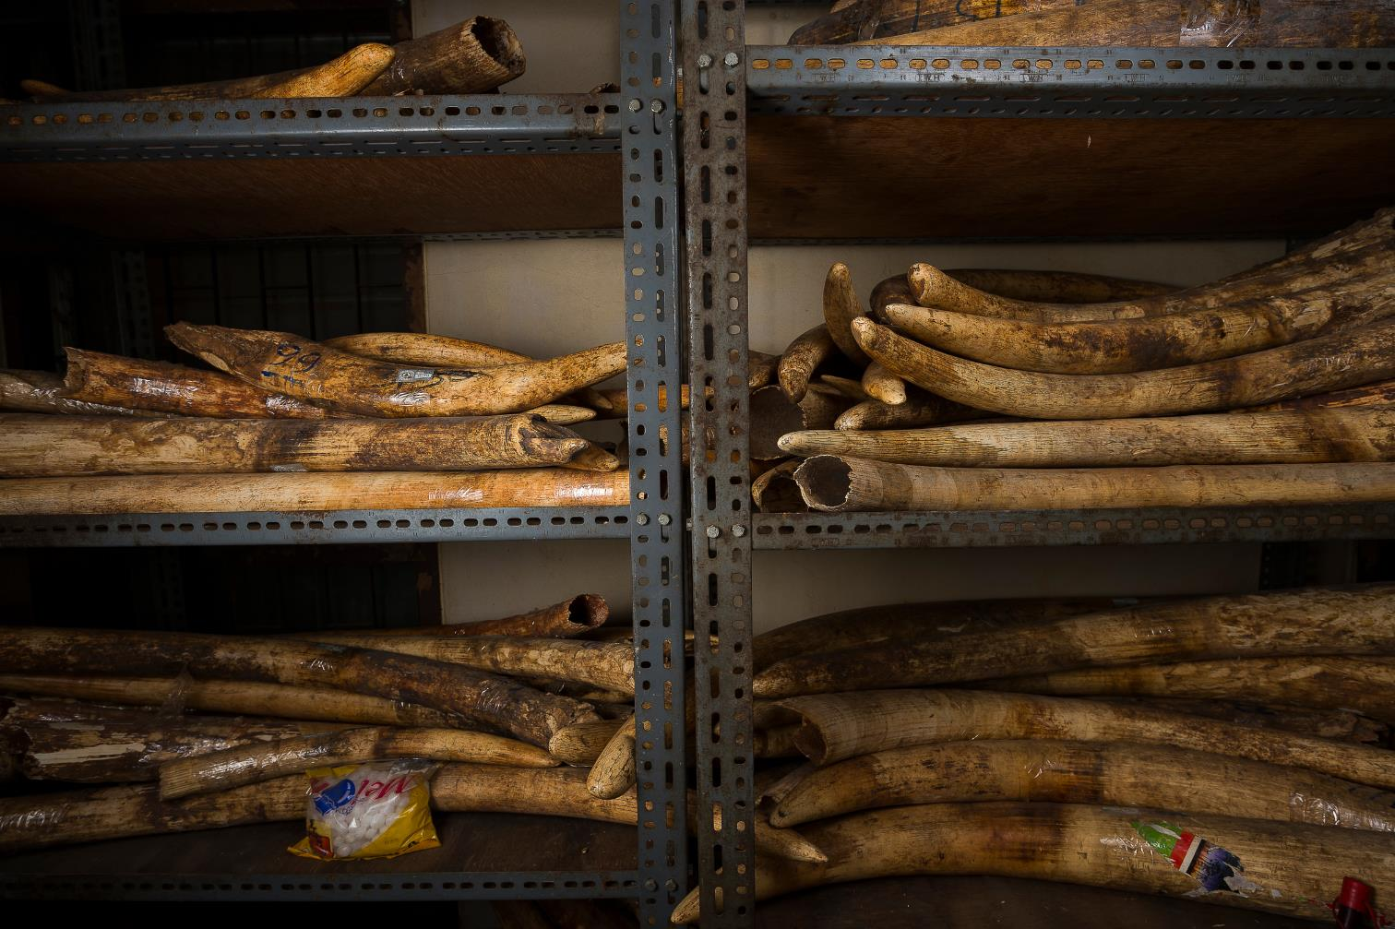
Wildlife Crime
Notes:
The world is dealing with an unprecedented spike in wildlife crime, threatening to overturn decades of conservation gains.

Slide 3
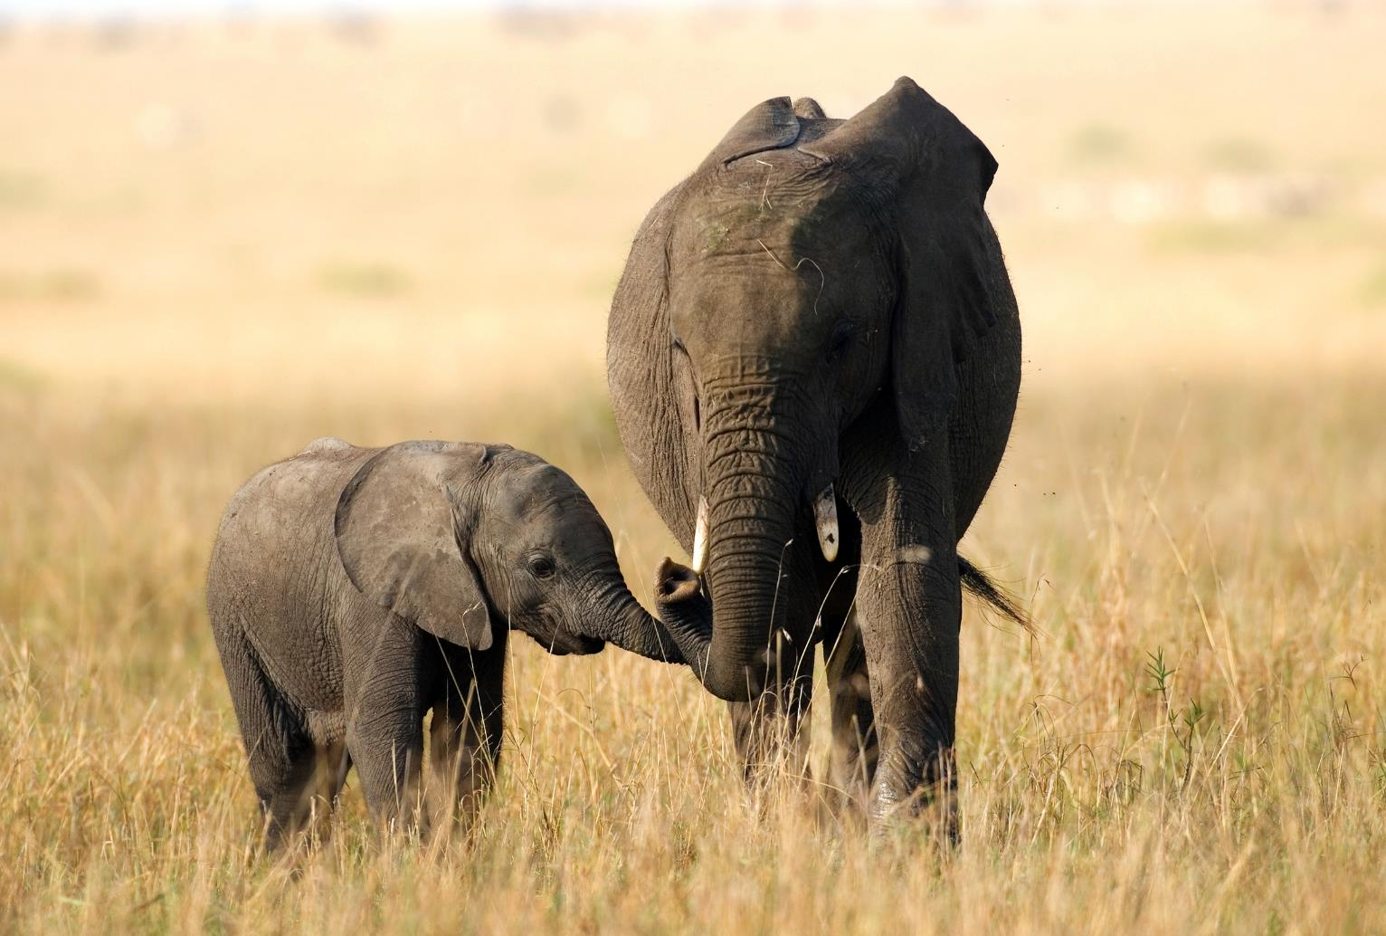
Wildlife crime is now the most urgent threat to some of the world’s best-loved species.
Notes:
Wildlife crime is now the most urgent threat to three of the world's best-loved species—elephants, rhinos and tigers.

Slide 4
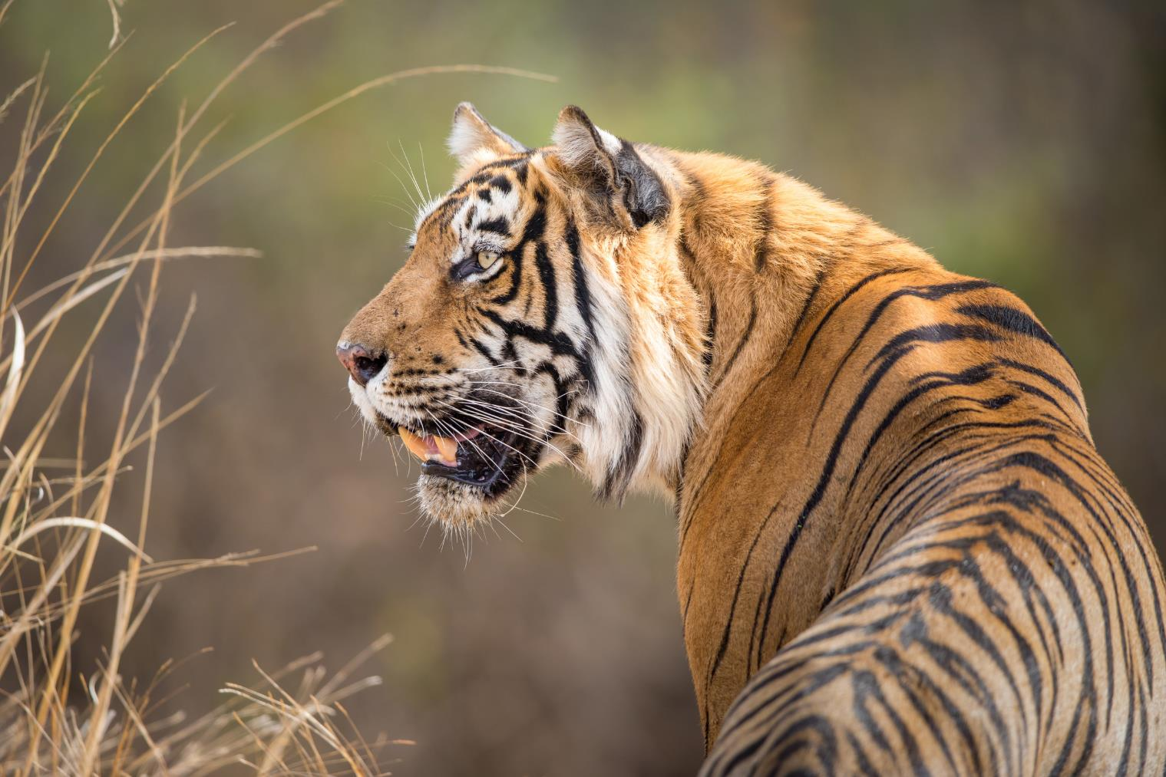
Every part of the tiger is traded in illegal wildlife markets.
Notes:
Every part of the tiger—from whisker to tail—is traded in illegal wildlife markets. Poaching is the most immediate threat to wild tigers. In relentless demand, their parts are used for traditional medicine, folk remedies, and increasingly as a status symbol in some Asian cultures.

Slide 5
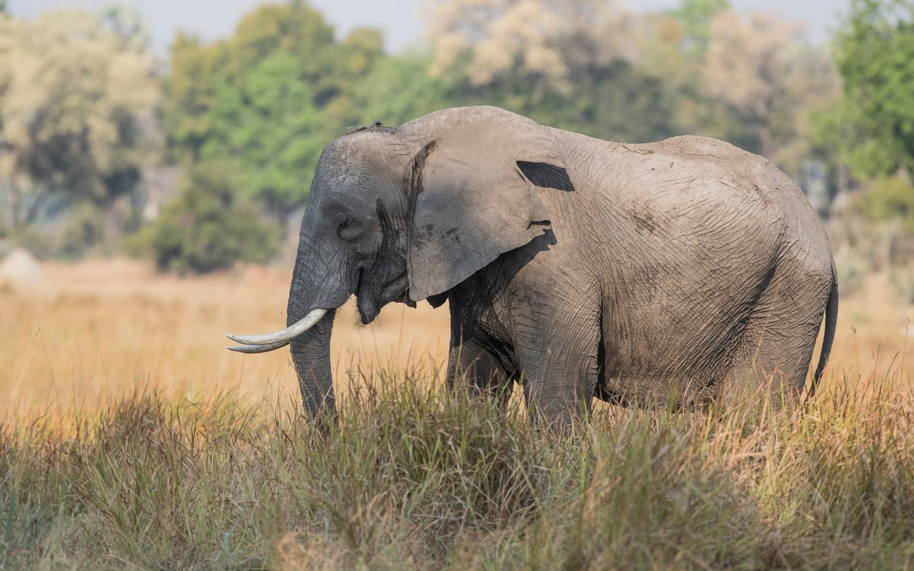
Tens of thousands of elephants are killed each year for their tusks.
Notes:
Tens of thousands of elephants are killed every year for their ivory tusks. In 1989, the Convention on International Trade in Endangered Species of Wild Fauna and Flora (CITES) banned the international trade in ivory. However, there are still some thriving unregulated domestic ivory markets in a number of countries, which fuel an illegal international trade.

Slide 6
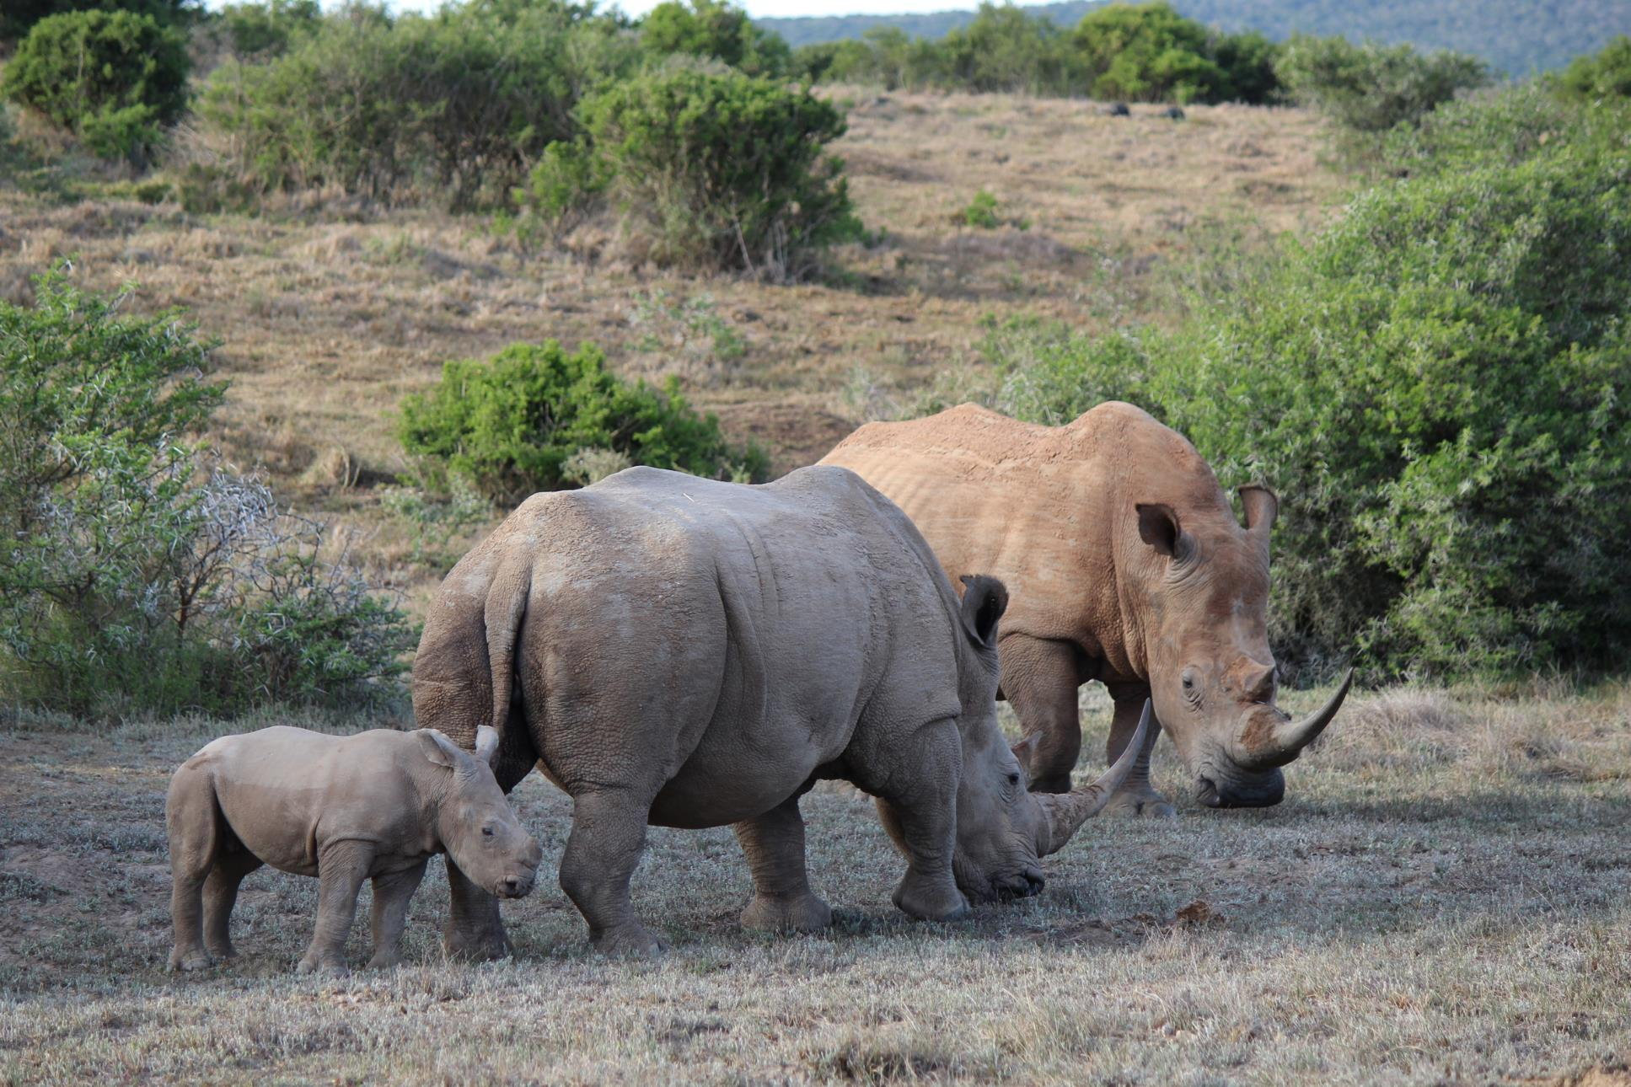
Rhinos are killed for their horns—under the mistaken belief that rhino horn cures diseases.
Notes:
At least two rhinos are killed every day due to the mistaken belief that rhino horn can cure diseases. The main market is now in Vietnam where there is a newly emerged belief that rhino horn cures cancer. Rhino horn is also used in other traditional Asian medicine to treat a variety of ailments including fever and various blood disorders and even as a treatment for hangovers.

Slide 7
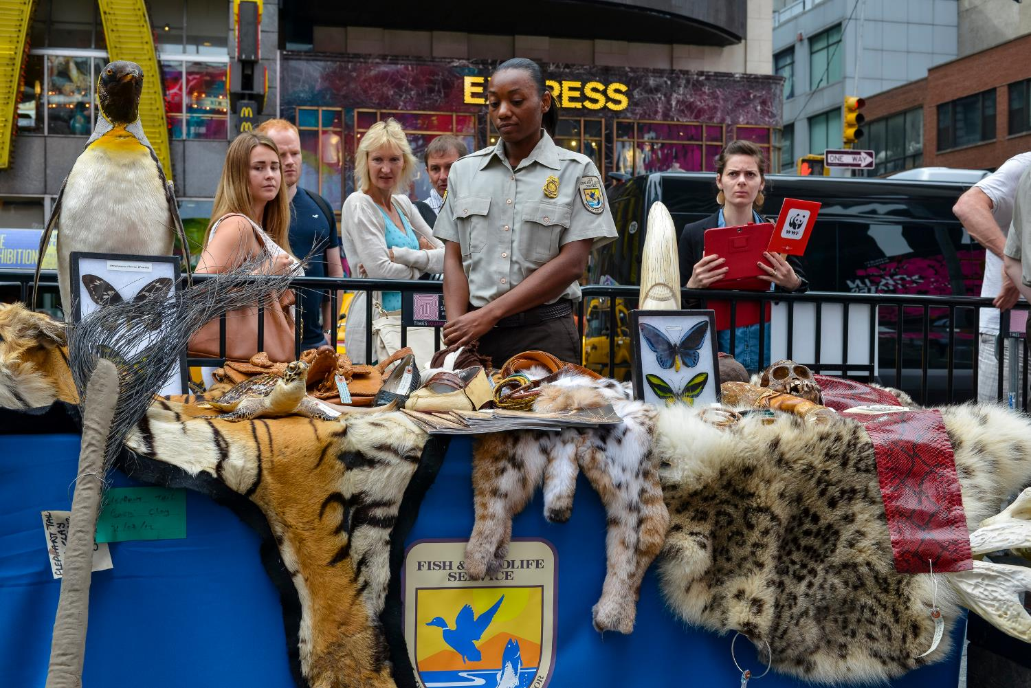
Other species are similarly trafficked for their parts.
Notes:
Countless other species are also countless other species are similarly trafficked for their parts. These animals become food, pets, leather, tourist ornaments and medicine. Even legal wildlife trade can escalate into a crisis when an increasing proportion is unregulated and unsustainable—directly threatening the survival of many species in the wild.

Slide 8
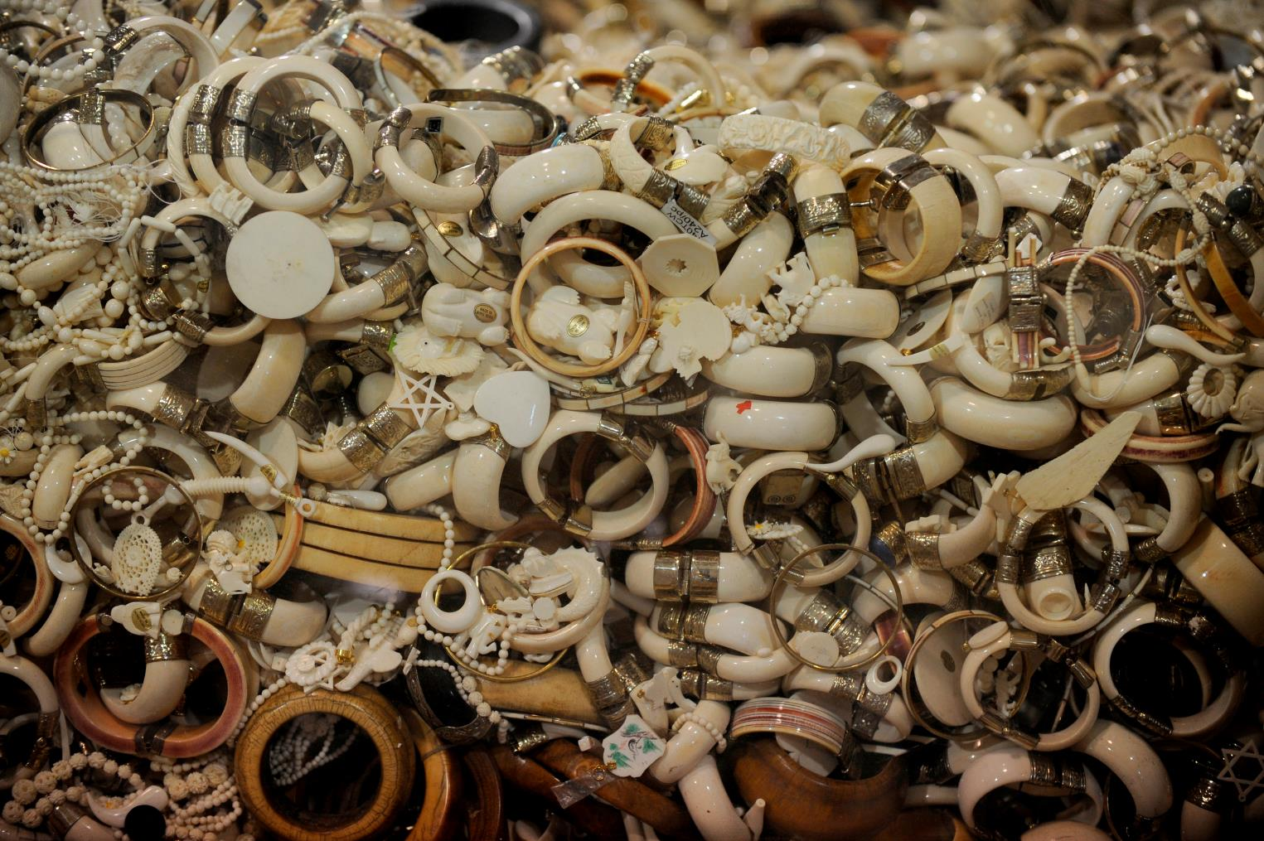
Wildlife crime is a $10 billion/year business controlled by international crime syndicates.
Notes:
Controlled by dangerous crime syndicates, wildlife is trafficked much like drugs or weapons. Today, it is the fifth most profitable illicit trade in the world, estimated at up to $10 billion annually.

Slide 9
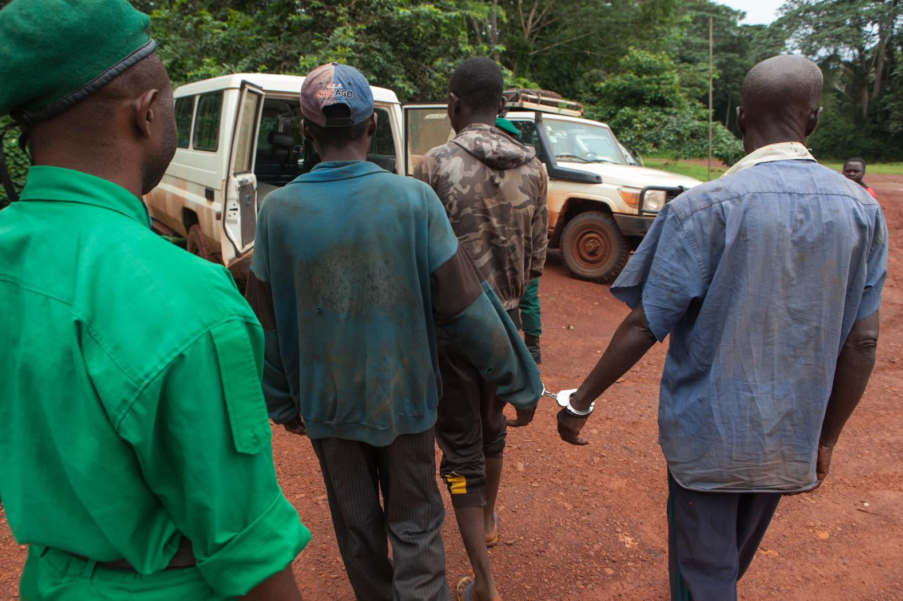
Risk is assumed by those at the bottom of the organization—making illegal wildlife trade is a low-risk, high-return business for those in charge.
Notes:
Corruption, toothless laws, weak judicial systems and light sentences allow criminal networks to keep plundering wildlife with little regard to consequences. These factors make illegal wildlife trade a low risk business with high returns. The poachers—often poor locals at the very bottom of the organization—are the usually the only ones caught, leaving the real masterminds and their network safe and operational with the ability to strike again.

Slide 10
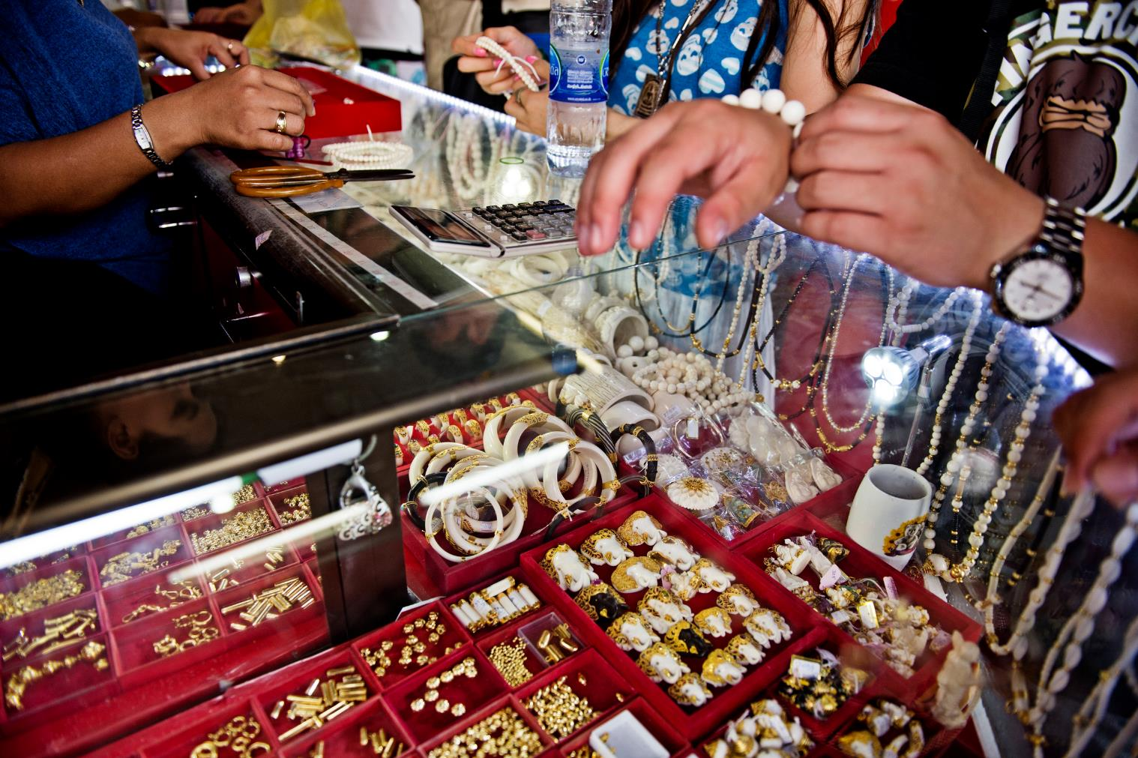
Wildlife crime is driven by high profit margins, especially for rare species.
Notes:
Illegal wildlife trade is driven by high profit margins and, in many cases, the high prices paid for rare species. Vulnerable wild animals are pushed further to the edge of extinction when nature can’t replenish their stocks to keep up with the rate of human consumption.

Slide 11
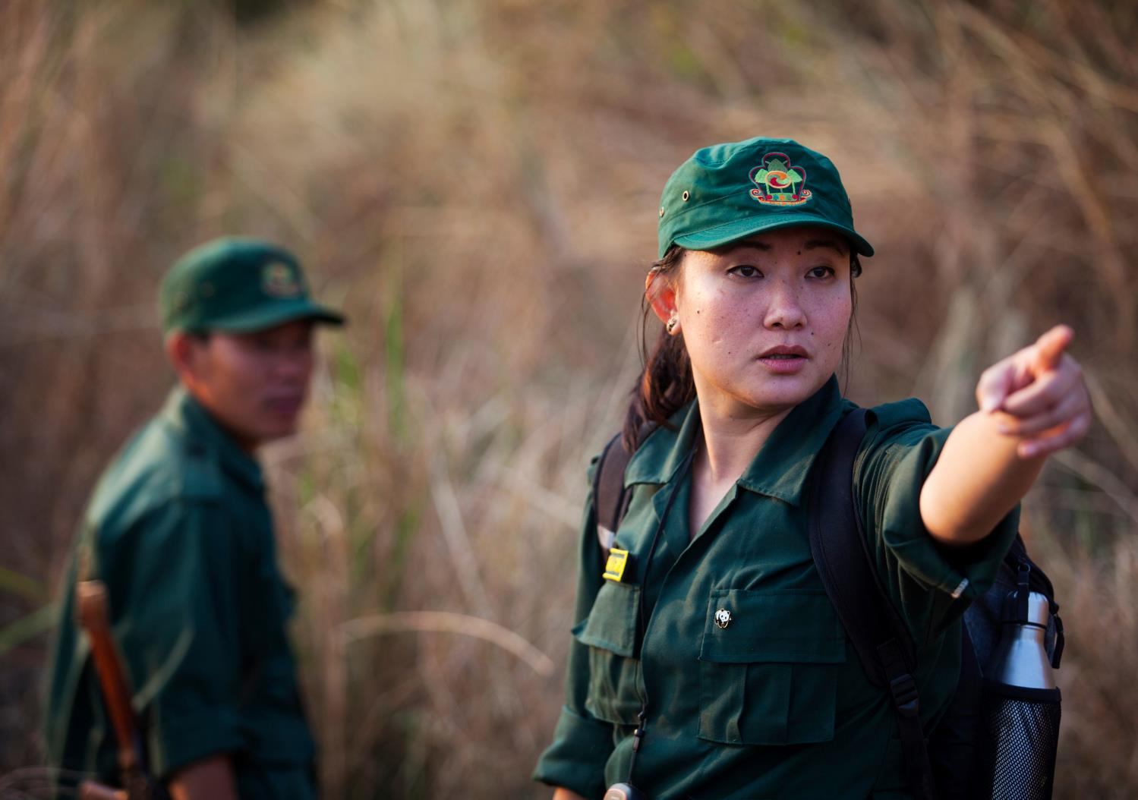
WWF is working to end wildlife crime
Notes:
WWF is leading a global campaign to stop wildlife crime. We are applying the strength of our worldwide network, our influence with partners and governments, and the passion of our supporters to end this crisis.

Slide 12
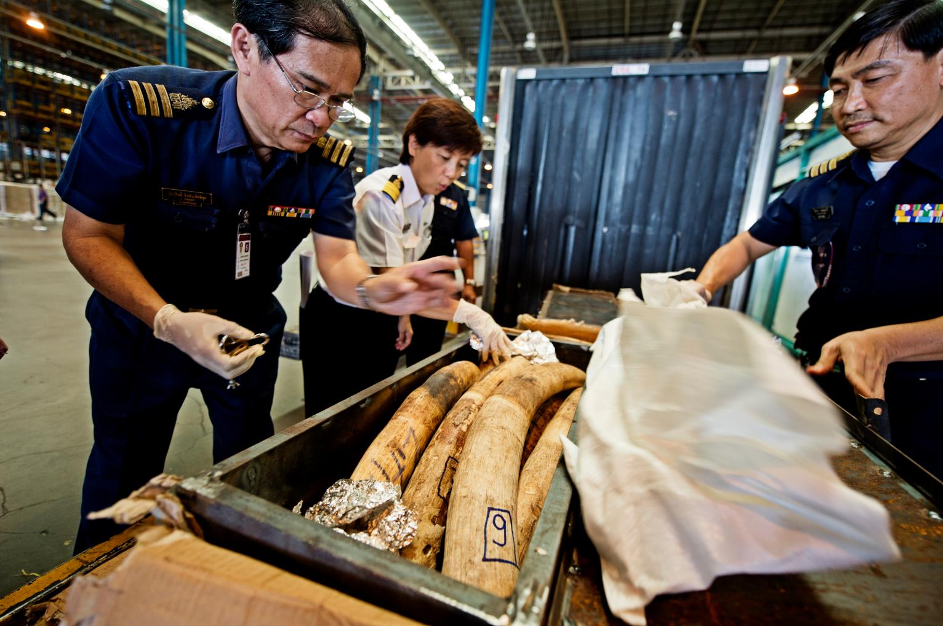
Increasing law enforcement, imposing deterrents, reducing demand, and honoring international agreements.
Notes:
WWF and our supporters push governments to protect threatened animal populations by increasing law enforcement, imposing strict deterrents, reducing demand for endangered species products and honoring international commitments made under CITES.

Slide 13
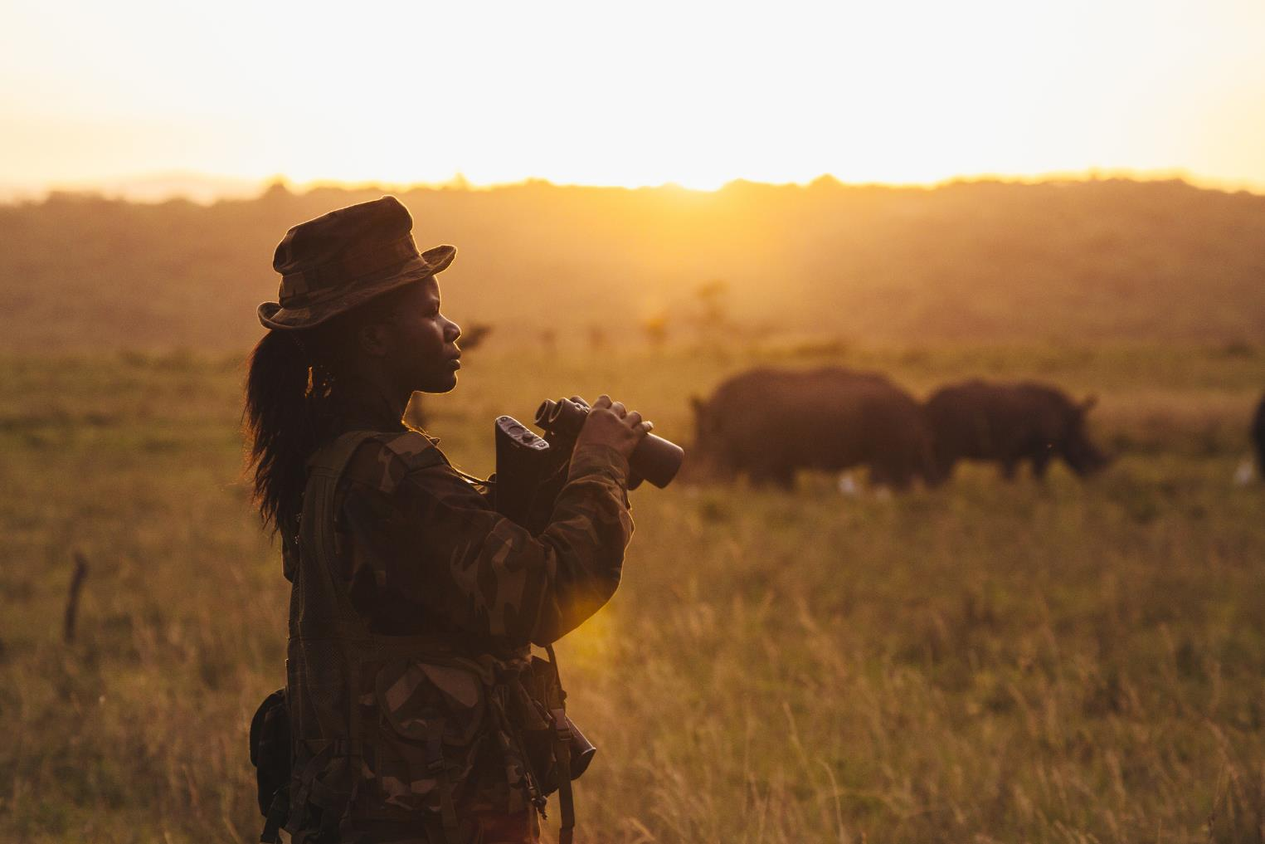
Supporting rangers and guards on the frontlines against armed poachers.
Notes:
We speak up on behalf of those on the frontlines being threatened by armed poachers so they are properly equipped, trained and compensated.

Slide 14
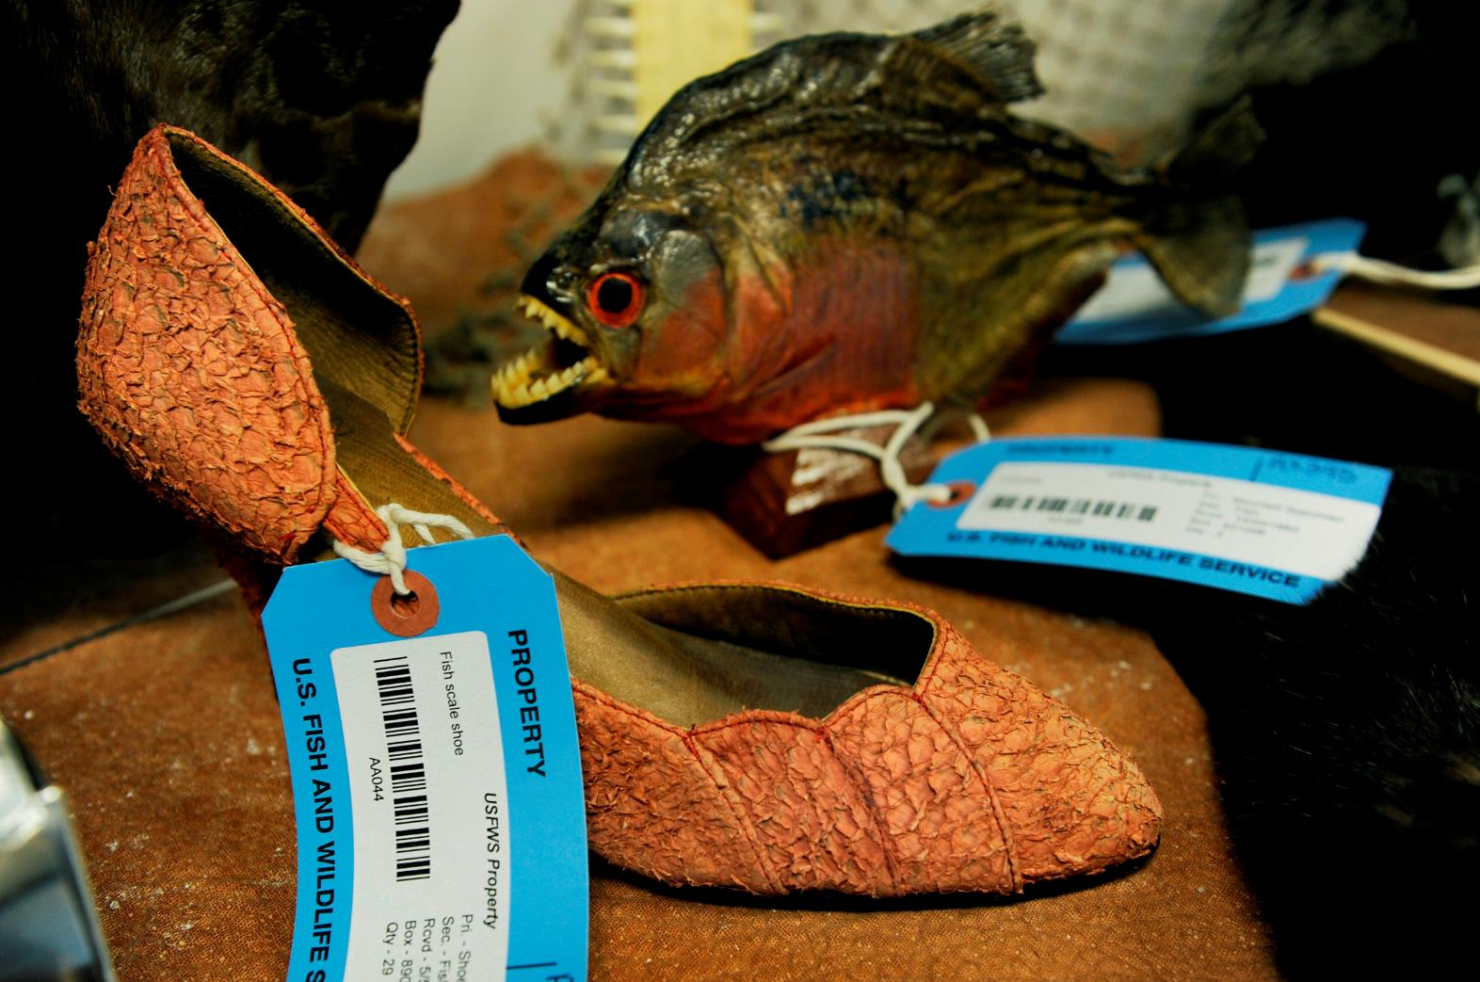
Reducing demand for wildlife parts and products.
Notes:
WWF reduces demand for illegal wildlife parts and products by encouraging others to ask questions and get the facts before buying any wildlife or plant product.

Slide 15
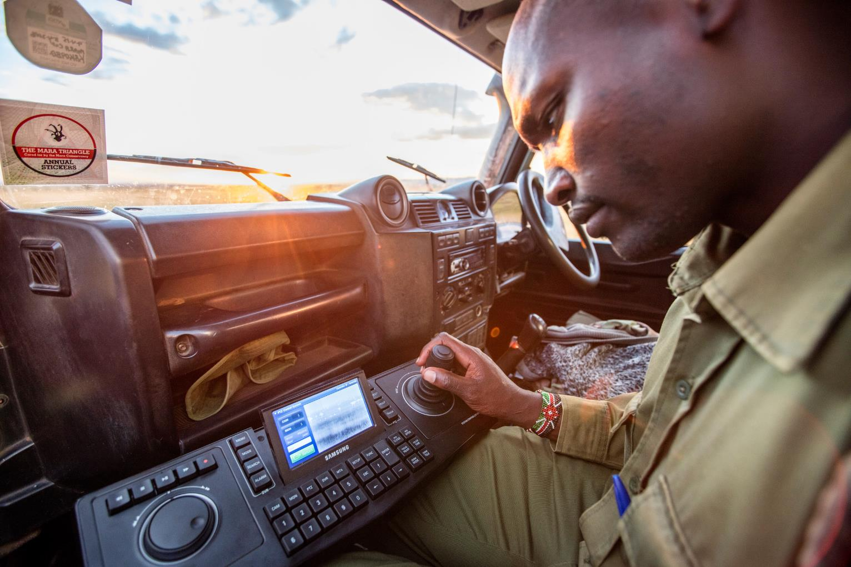
Using the latest technology to stop poaching.
Notes:
WWF is also working on a number of specific projects to stop wildlife crime, including the Wildlife Crime Technology Project. This Google.org-funded project allows us to innovate and test a number of new technologies, many of which have the potential to change the course of the global fight against wildlife crime.

Slide 16
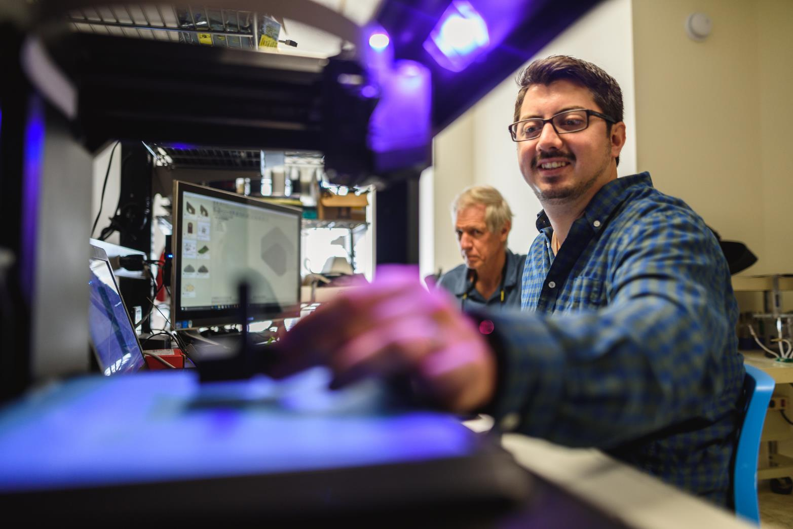
Connecting engineers, conservationists, and scientists to share information, tools, and resources.
Notes:
With support from Google.org and ARM, we’ve also created WILDLABS.net, a conservation technology network to bring together conservationists, technologists, engineers, data scientists, entrepreneurs and change makers in a central, open space to share information, ideas, tools and resources.

Slide 17
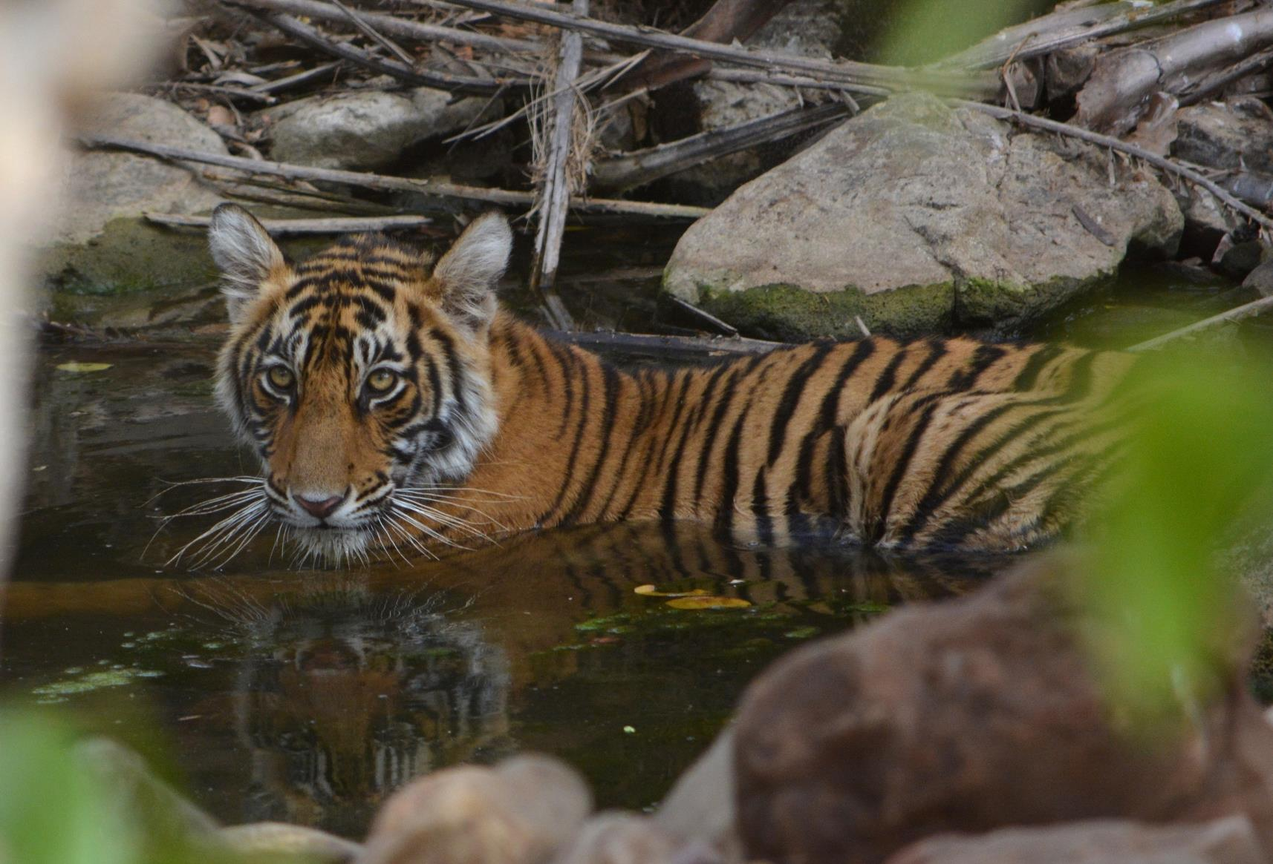
worldwildlife.org/pages/stop-wildlife-crime
Notes:
Visit the World Wildlife website for more information.

Slide 18
Photo Credits
Page 2: © Ola Jennersten / WWF-Sweden
Page 3: © Shutterstock / Albie Venter / WWF-Sweden
Page 4: © Jeff Goldberg
Page 5: © James Suter / Black Bean Productions / WWF-US
Page 6: © Teresa McLaughlin
Page 7: © Albin Lohr-jones / WWF-US
Page 8: © Jamie Cotten / IFAW / WWF-US
Page 9: © WWF / Mike Goldwater
Page 10: © WWF / James Morgan
Page 11: © Simon Rawles / WWF-UK
Page 12: © WWF / James Morgan
Page 13: © Jonathan Caramanus / Green Renaissance / WWF-UK
Page 14: © Jamie Cotten / IFAW / WWF-US
Page 15: © WWF-US / James Morgan
Page 16: © WWF-US/Nathan Mitchell
Page 17: © Tommy Mitchell

