Slide 2
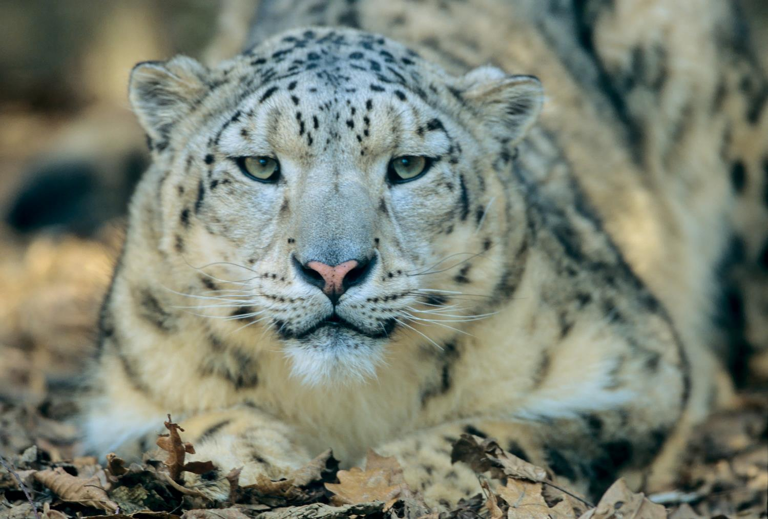
Wildlife
Notes:
Wildlife is one of WWF’s six main areas of focus

Slide 3
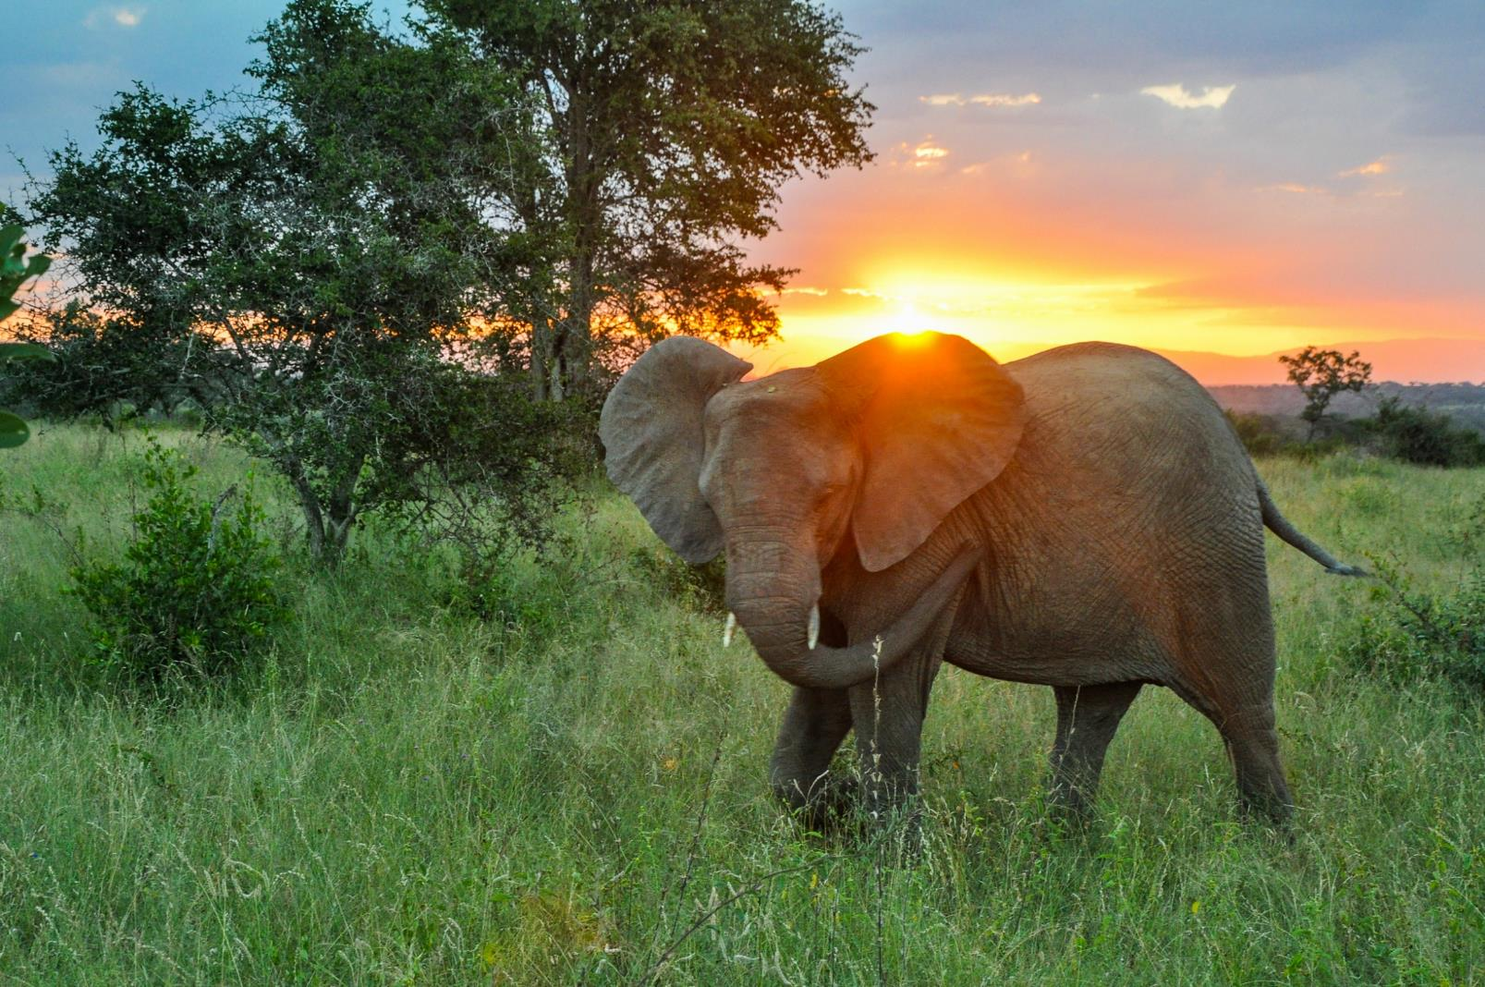
WWF has been working to protect nature and wildlife for more than 50 years.
Notes:
Saving nature is at the very heart of what we do as WWF. For more than 50 years, we have made it our mission to find solutions that save the marvelous array of life on our planet by applying the best science available and working closely with local communities.

Slide 4
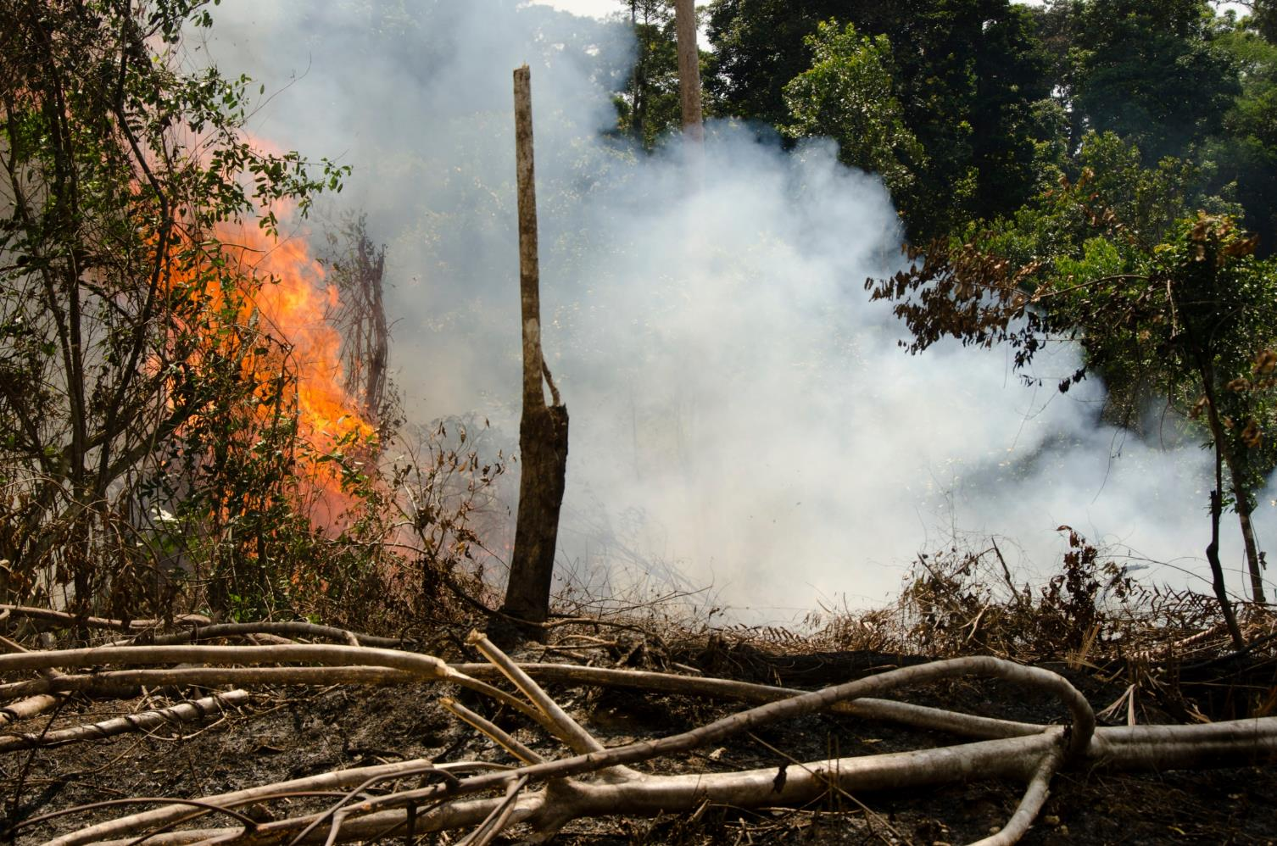
Today we’re facing unprecedented threats.
Notes:
But our work is far from done. Humans are behind the current rate of species extinction, which is at least 100–1,000 times higher than nature intended. WWF’s 2016 Living Planet Report found global populations of fish, birds, mammals, amphibians and reptiles declined by 58% between 1970 and 2012.

Slide 5
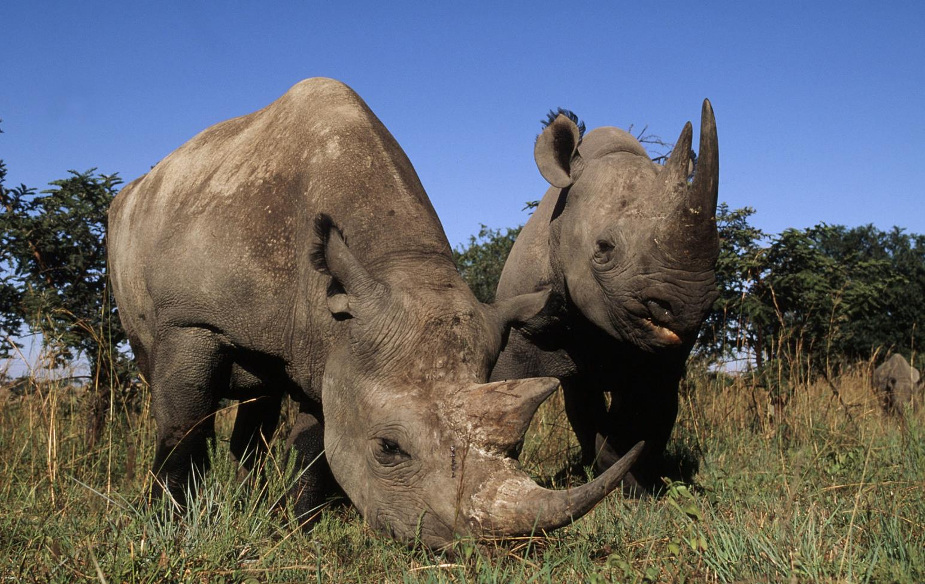
WWF has a proven track record of success—even when the odds are against us.
Notes:
The good news is we know what works. WWF has been part of successful wildlife recovery stories ranging from southern Africa’s black rhino to black bucks in the Himalayas. And this in turn is helping protect rich and varied ecosystems while ensuring people continue to benefit from nature.
This much is clear: we cannot afford to fail in our mission to save a living planet.

Slide 6
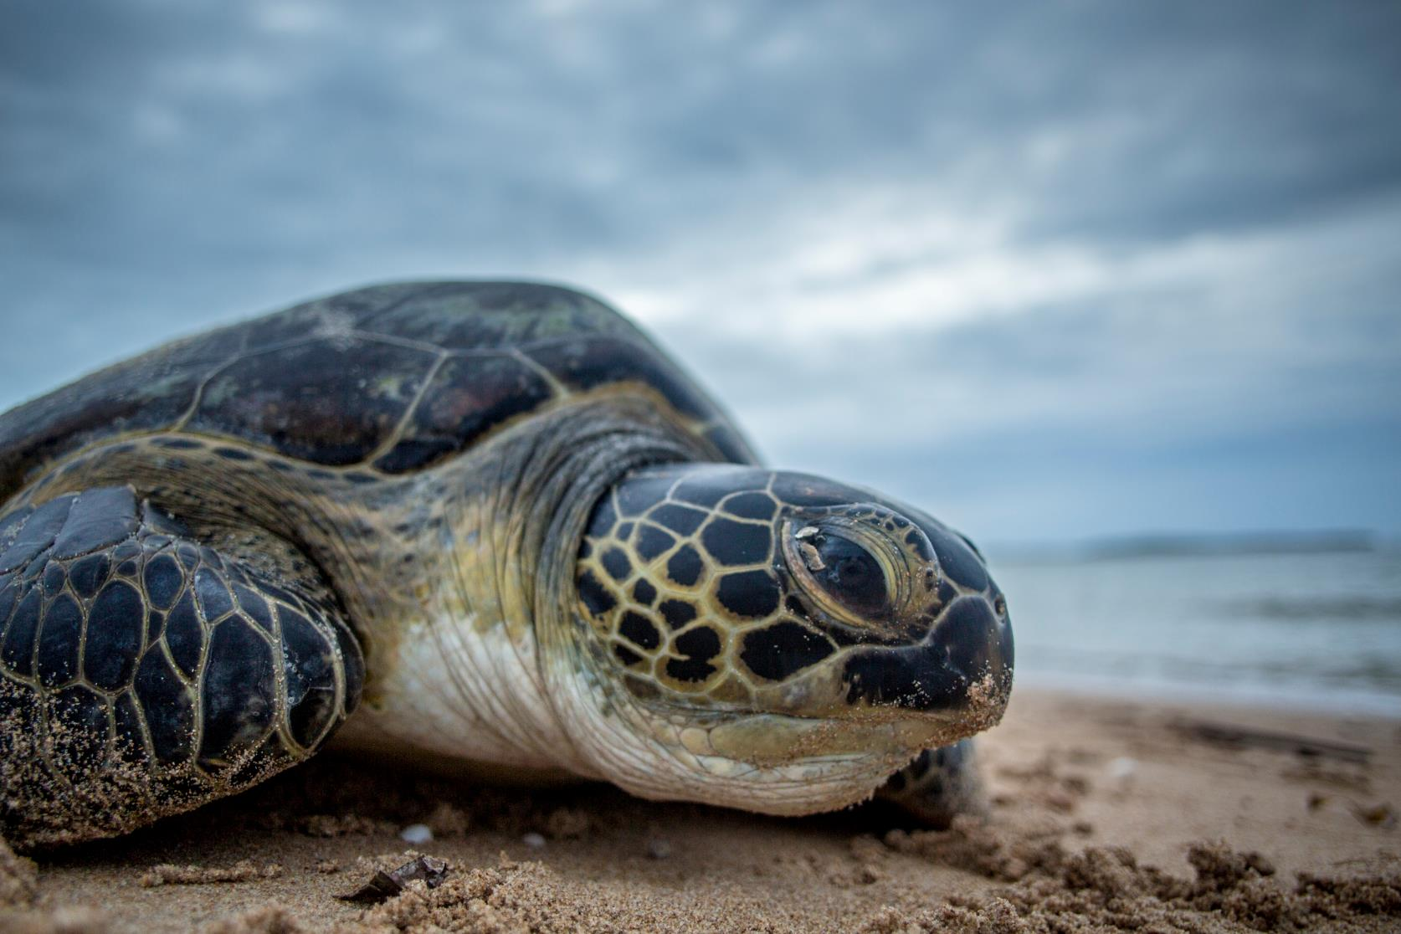
We protect wildlife to preserve the balance of nature – and to save our planet.
Notes:
We protect wildlife for many reasons. It is a source of inspiration. It nurtures a sense of wonder. It is integral to the balance of nature. In our work, WWF focuses on saving populations of the most ecologically, economically and culturally important species in the wild. Ultimately, by protecting species, we save this beautiful, vulnerable and utterly irreplaceable planet we call home.

Slide 7
We’re also improving human lives.
Notes:
By protecting species, we also protect the essential goods and services that make our lives possible and contribute enormously to human health and well-being — breathable air, clean water, food, fibers, building materials, medicines, energy, fertile soils, climate regulation, transport, and recreational and spiritual values.

Slide 8
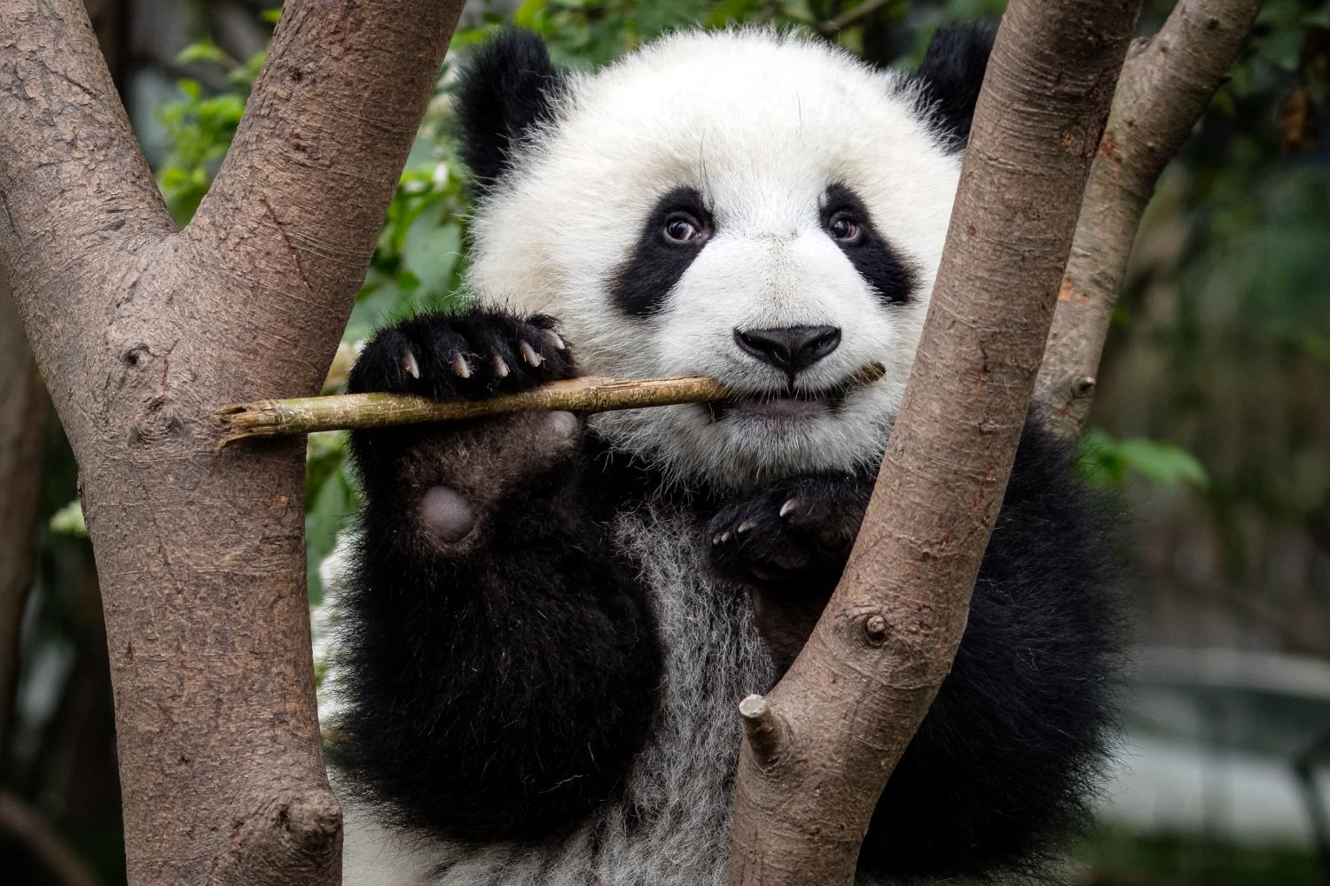
The recovery of the giant panda is an example of what we can accomplish when we work together.
Notes:
The giant panda is a conservation icon and not only because it is WWF’s widely recognized logo. The entire world has come together to protect the 1,600 or so pandas that live in the wild. WWF has played an important role in their recovery for over 30 years, ever since we became the first private conservation group to receive an official invitation from the Chinese government in 1978.

Slide 9
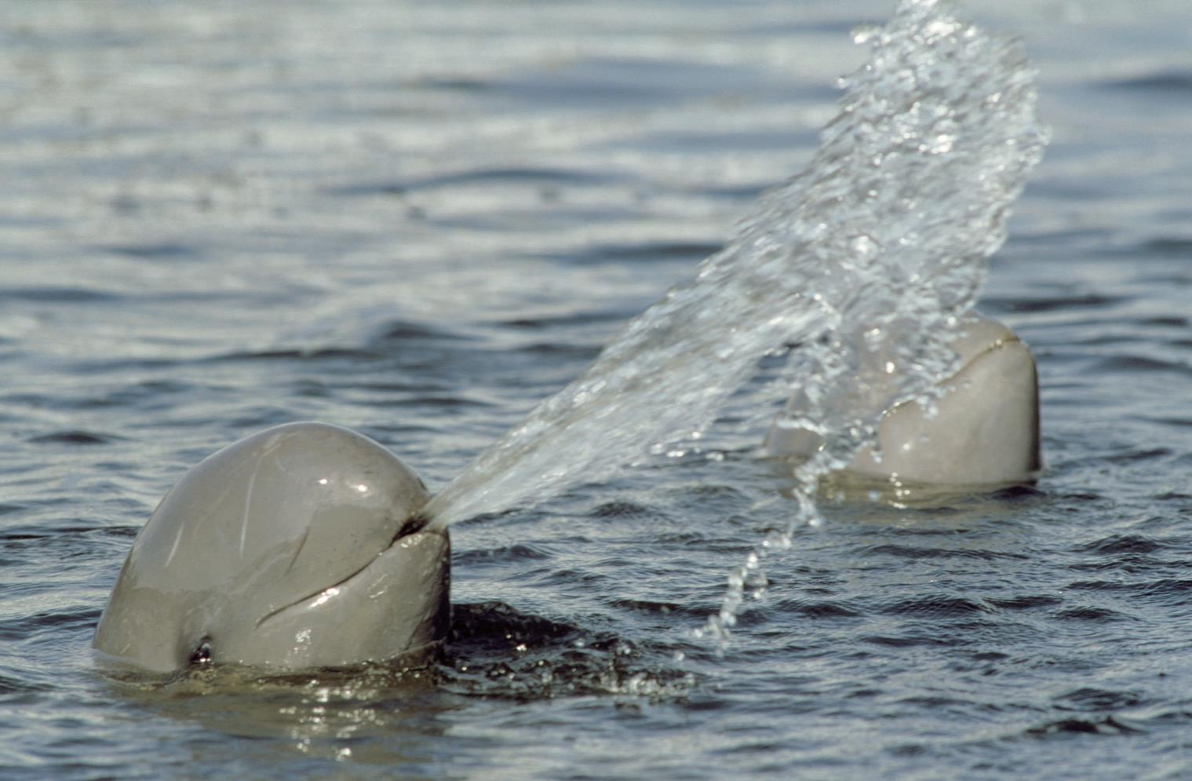
Wildlife inspires us to act on behalf of nature.
Notes:
A critically endangered population of the Mekong River’s Irrawaddy dolphins became the face of a global campaign to stop a major dam that would also impact local communities and livelihoods. The connection to the “smiling face of the Mekong” influenced more than a quarter of a million people around the world to join WWF in saying no to the Don Sahong dam. This species continues to inspire people to reduce pollution of freshwater sources, improve fishing practices and encourage only sustainable hydropower development.

Slide 10
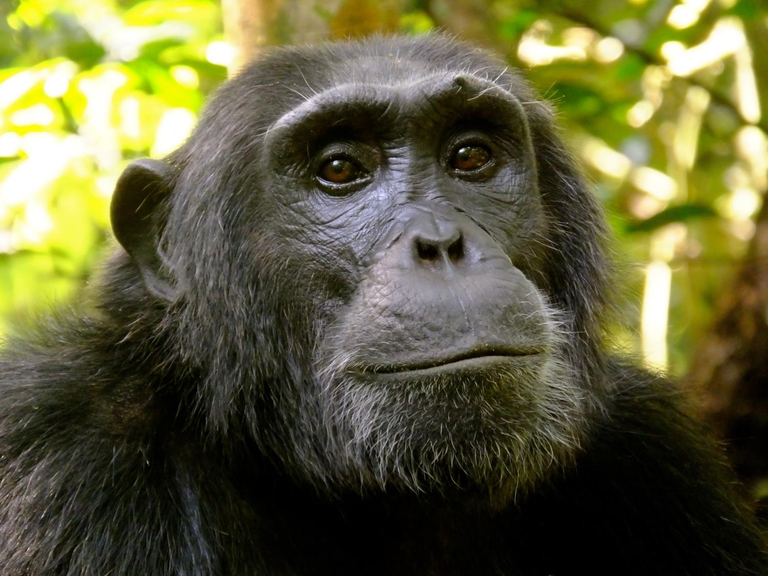
How WWF Works for Wildlife
Notes:
We focus on protecting populations of some of the world’s most ecologically, economically, and culturally important species—the survival of which are threatened by poaching, illegal trade and habitat loss.
We use the best science available to link on-the-ground work with high-level policy action to create lasting solutions that benefit wild animals as well as the people that live alongside them.

Slide 11
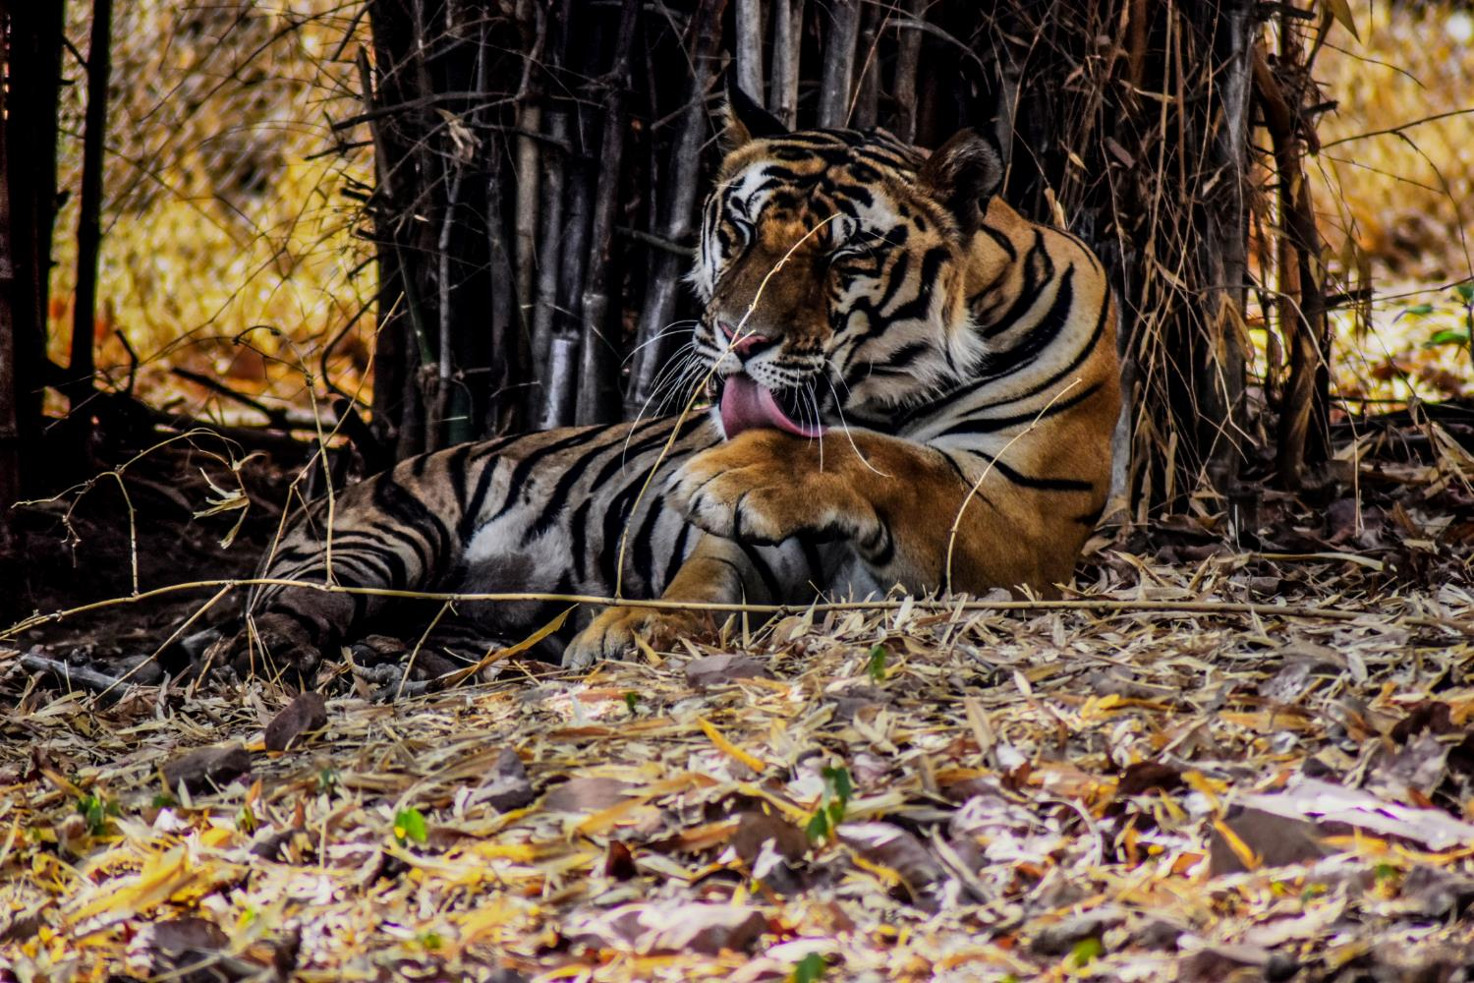
Working to double the number of tigers.
Notes:
WWF aims to double the world’s wild tiger population by 2022. We’re working with world leaders to take action, focusing conservation efforts in key sites, raising funds to permanently protect landscapes, and supporting community-based conservation.
Saving tigers is about more than restoring a single species. As a large predator, tigers play an important role in maintaining a healthy ecosystem. Every time we protect a tiger, we also protect around 25,000 acres of forest.

Slide 12
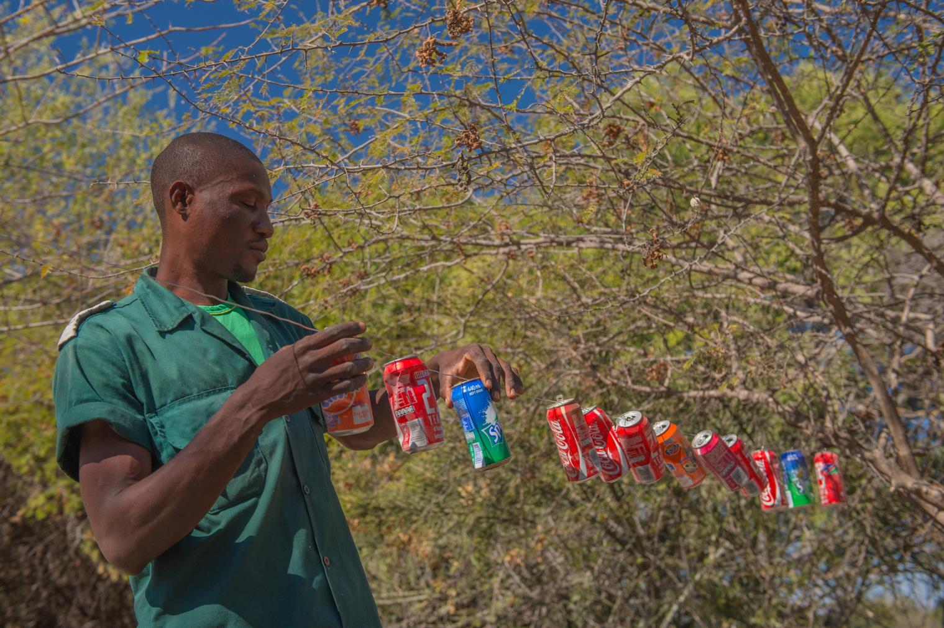
Empowering people to protect their local wildlife.
Notes:
Community involvement is critical to wildlife conservation success. Local communities must see the value in actively stewarding the natural resources around them to improve economic and social well-being. WWF works across a variety of communities, taking into consideration each region’s particular set of conservation assets and challenges.
(In this photo, a community wildlife guard is setting up a simple tin can fence to repel local elephants that might otherwise come into the village and destroy food and property)

Slide 13
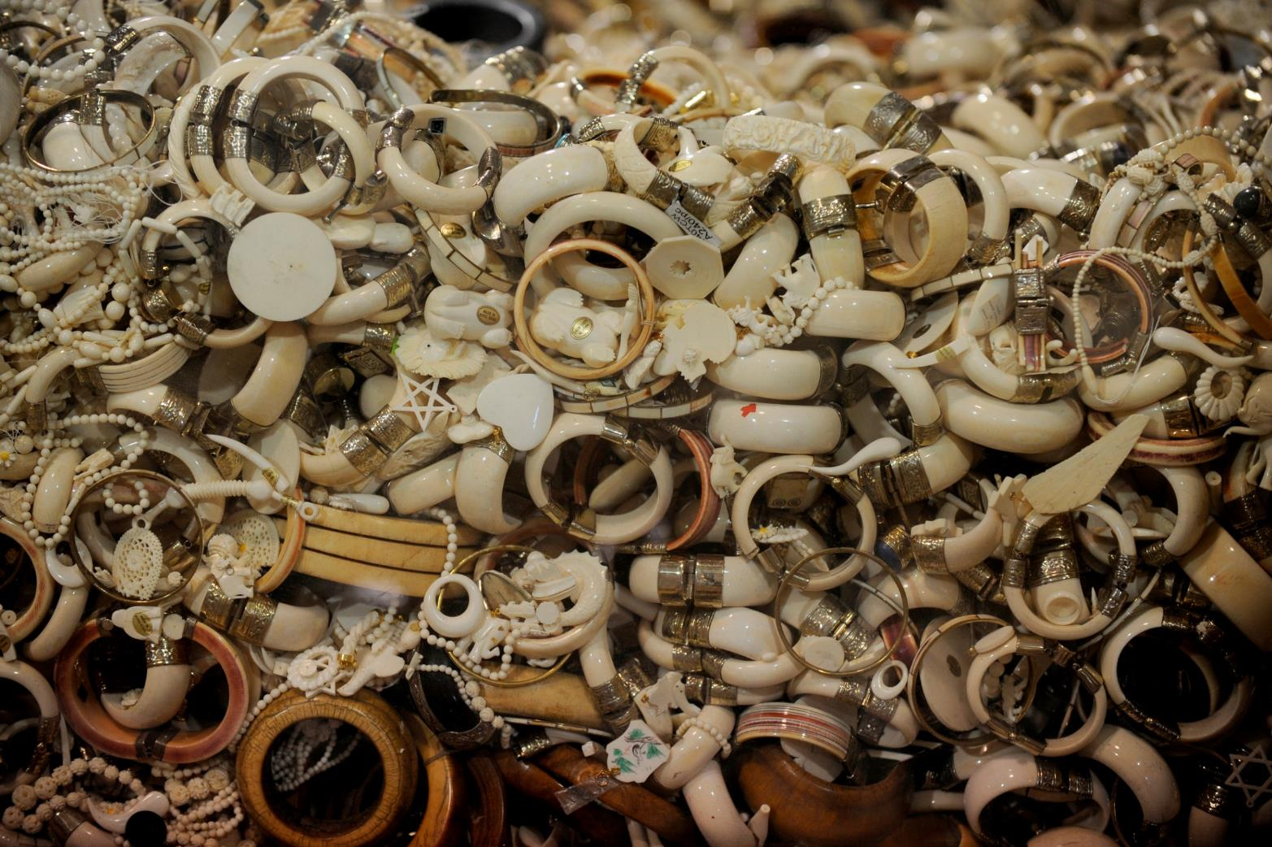
Shutting down Asia’s ivory markets.
Notes:
Each year poachers slaughter an estimated 20,000 elephants, mostly for their ivory tusks. WWF is working to shut down the ivory markets in East and Southern Asia where demand for ivory is highest. We’re actively closing illegal markets in Thailand, and we helped end the legal ivory trade in China.

Slide 14
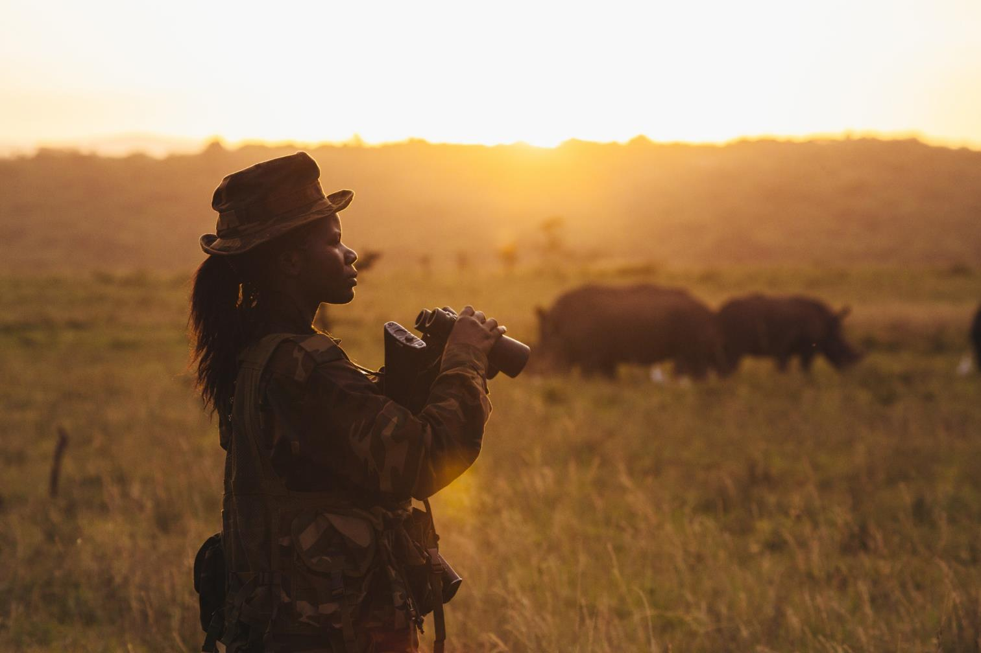
Stopping wildlife crime.
Notes:
WWF is using our expertise in policy, wildlife trade, advocacy, and communications to end wildlife crime in the US and around the world.

Slide 15
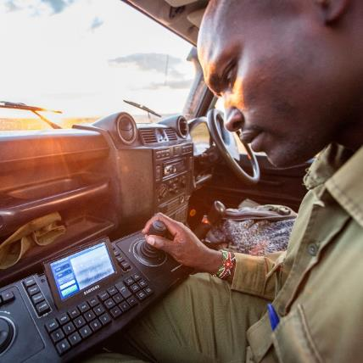
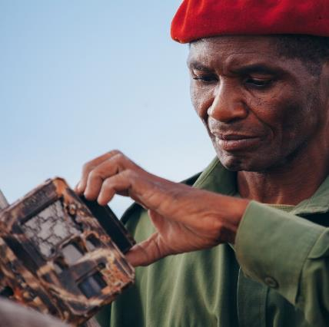
Projects
Wildlife Crime Technology Project
WILDLABS.NET
Zero Poaching in Selous
Notes:
WWF’s wildlife conservation team works on several projects around the world, including:
Wildlife Crime Technology Project – A Google grant provided WWF a platform to innovate and test a number of innovative technologies, many of which have the potential to change the course of the global fight against wildlife crime.
WILDLABS.net- This new network brings together conservationists, technologists, engineers, and others to find technology-enabled solutions to some of the biggest conservation challenges.
Zero poaching in Selous - Tanzania's Selous Game Reserve lost 80% of its elephants between 2007 and 2014. Now WWF together with other partners and stakeholders are intent on eliminating poaching in Selous entirely.

Slide 16
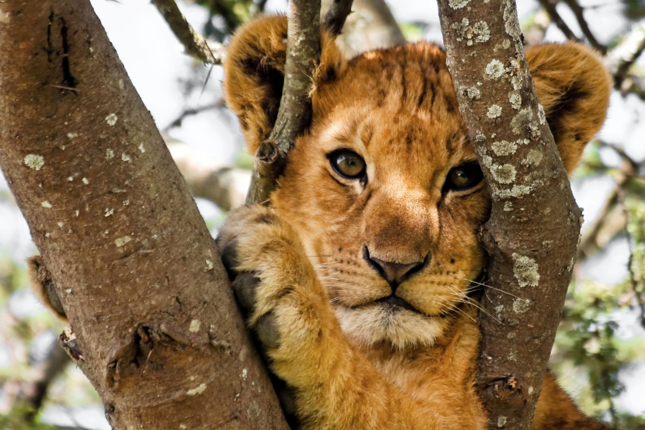
worldwildlife.org/initiatives/wildlife-conservation
Notes:
Visit the World Wildlife website to learn more.

Slide 17
Photo Credits
Page 2: © R.Isotti, A.Cambone / Homo Ambiens / WWF
Page 3: © WWF-US / Colby Loucks
Page 4: © Jaap van der Waarde / WWF Netherlands
Page 5: © Martin Harvey / WWF
Page 6: © Georgina Goodwin / Shoot The Earth / WWF-UK
Page 7: © Greg Armfield / WWF-UK
Page 8: © Sharon Fisher
Page 9: © naturepl.com / Roland Seitre / WWF
Page 10: © Kirsten Lies-Warfield
Page 11: © Sanskar Khedekar
Page 12: © Gareth Bentley / WWF-US
Page 13: © Jamie Cotten / IFAW / WWF-US
Page 14: © Jonathan Caramanus / Green Renaissance / WWF-UK
Page 15: © WWF-US / James Morgan
© WILDLABS.NET
© Greg Armfield / WWF
Page 16: © Shutterstock / Nickolay Stanev / WWF-Sweden

