Slide 2
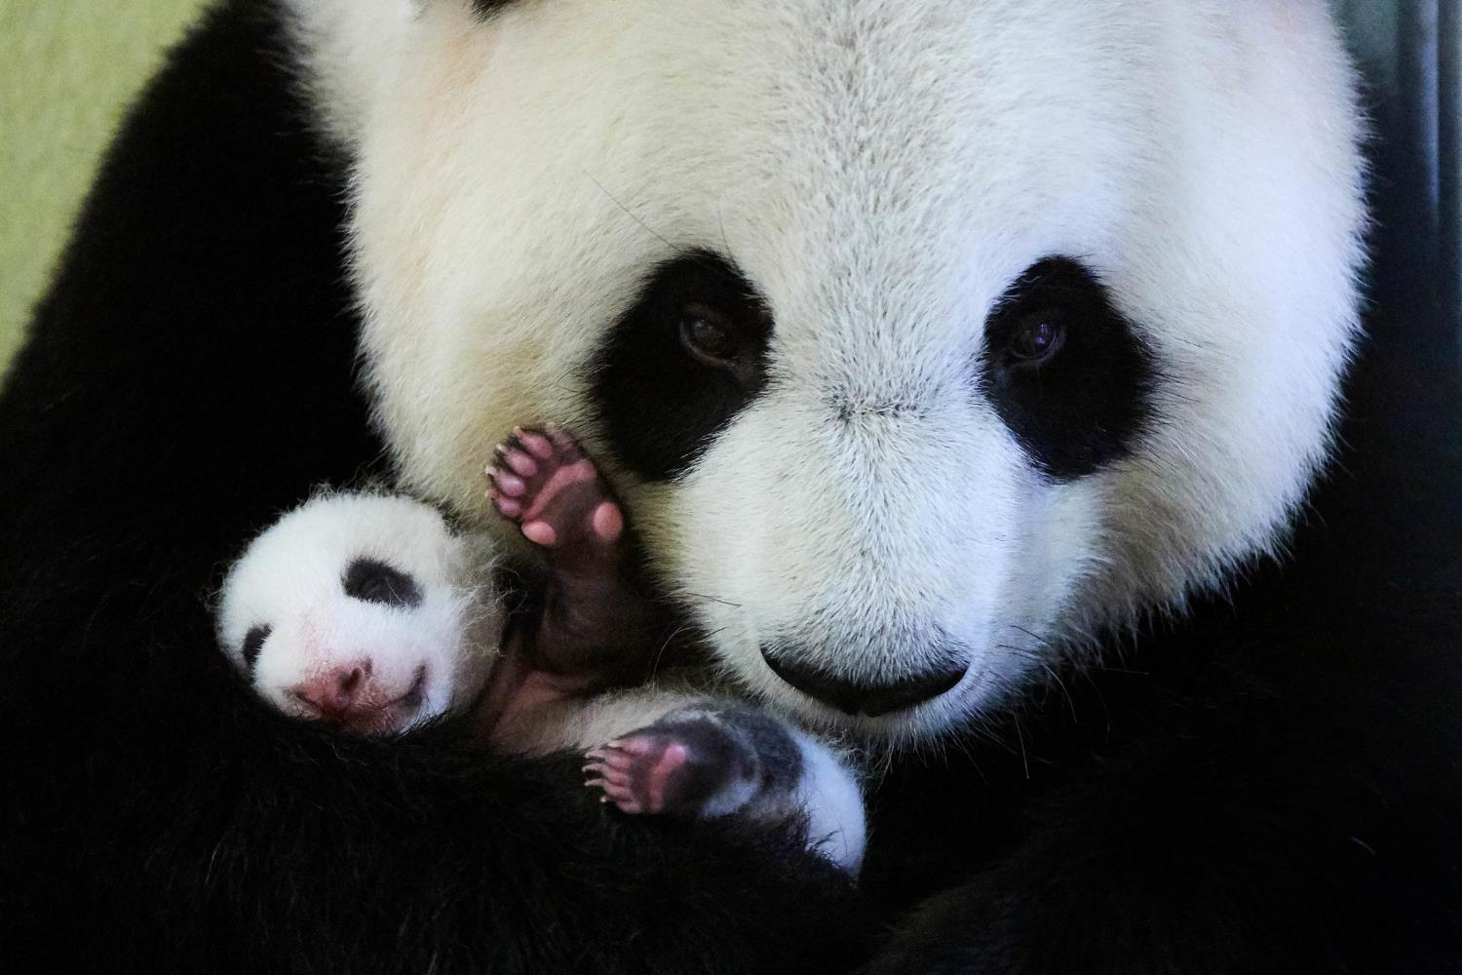
About World Wildlife Fund

Slide 3
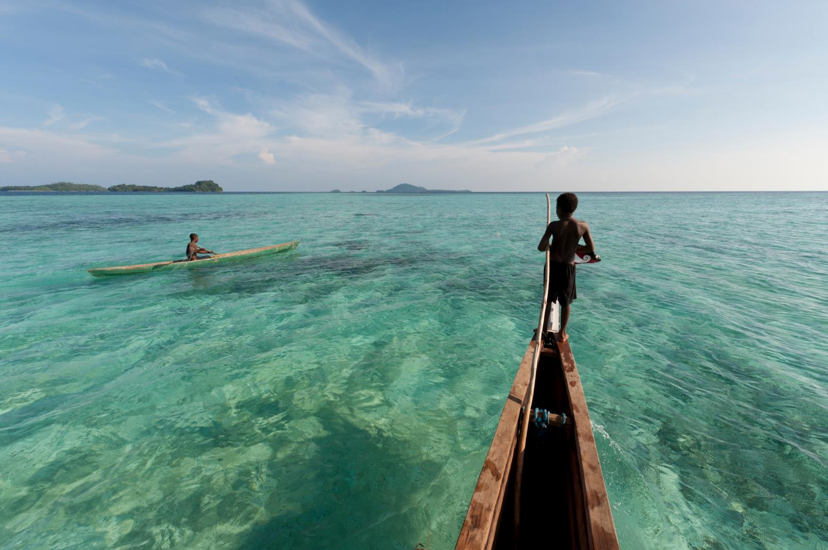
World Wildlife Fund is working to protect the future of nature.
Notes:
WWF believes in a future where nature and people can thrive together; for more than 50 years we’ve been working to make that future a reality.

Slide 4
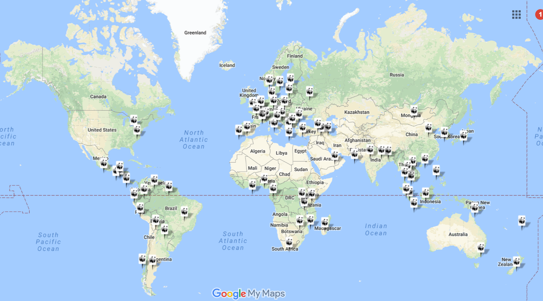
WWF Offices Worldwide
Notes:
WWF works in more than 100 countries with the support of more than 6 million members worldwide. We work on all levels and with all sectors to make an impact for wildlife, ecosystems, and the planet as a whole.

Slide 5
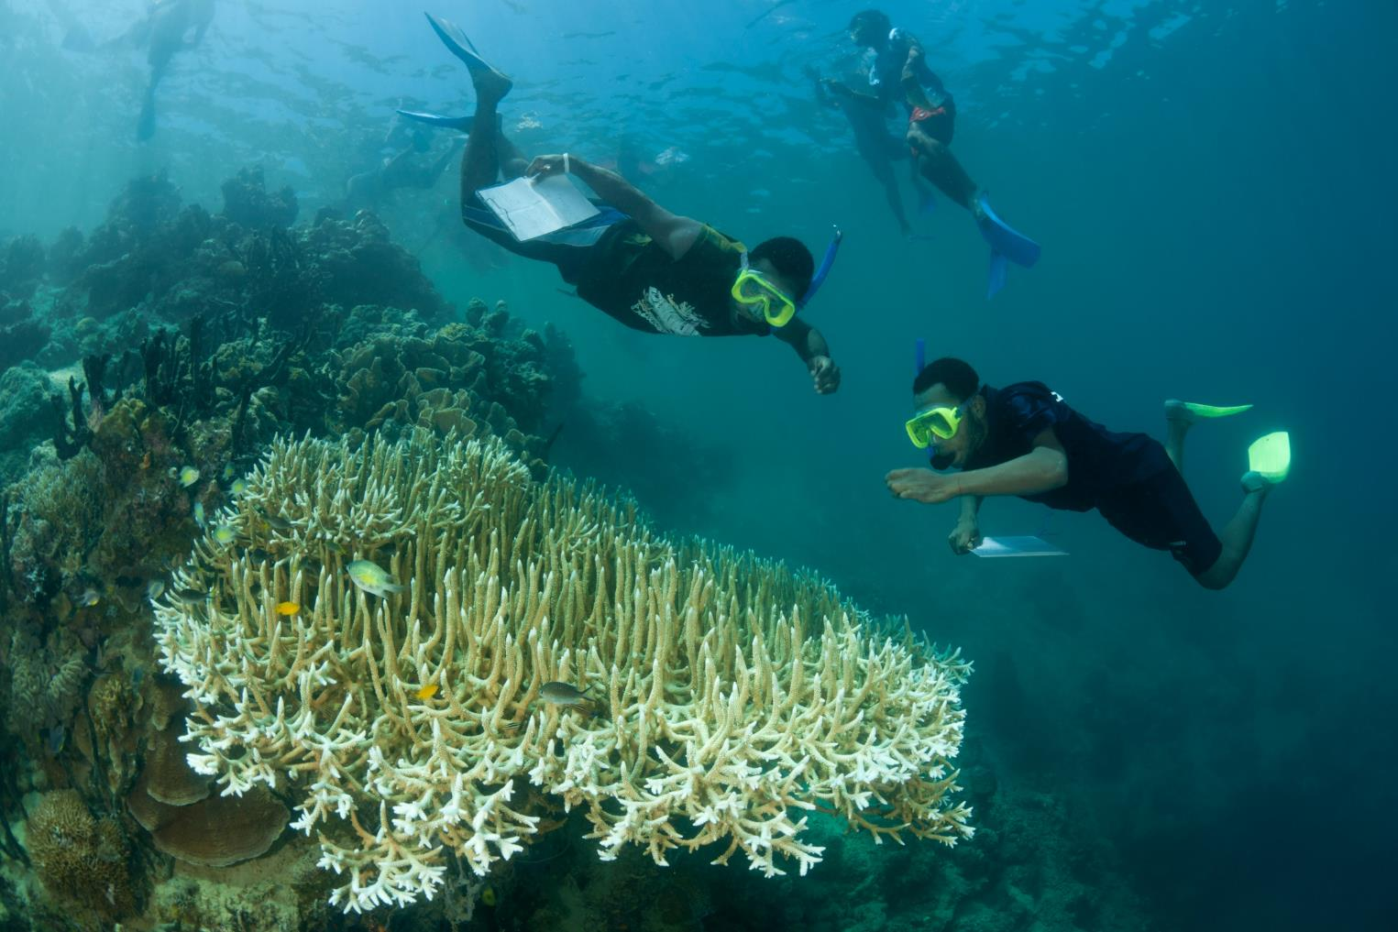
Science is the basis of everything WWF does
Notes:
Saving the planet is complicated. There are so many threats, direct and indirect; so many people involved with competing priorities; and so many factors to consider in every decision. That’s why we employ a scientific approach for everything we do – analyzing all sides of a problem to come up with lasting, sustainable solutions.

Slide 6
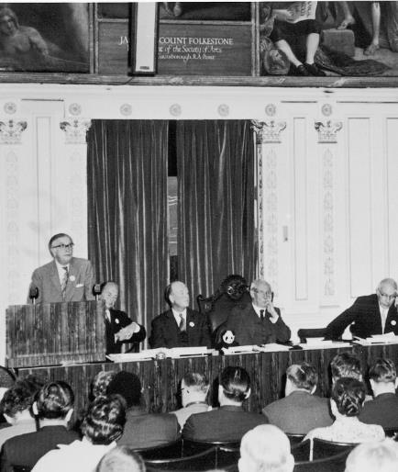
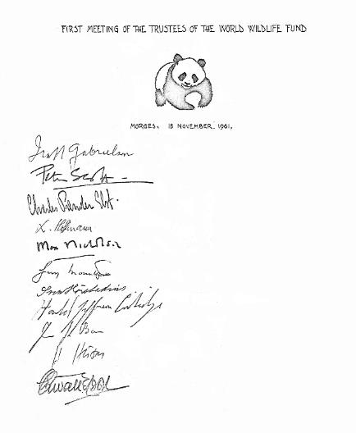
WWF was established in 1961, initially as a fund for conservation of vulnerable species.
Notes:
WWF began in 1961 with the goal of protecting wildlife species, but we quickly realized that there’s a lot more to it than saving individual animals. For lasting impact, we had to understand all the reasons why wildlife populations were in decline and address each threat head-on.

Slide 7
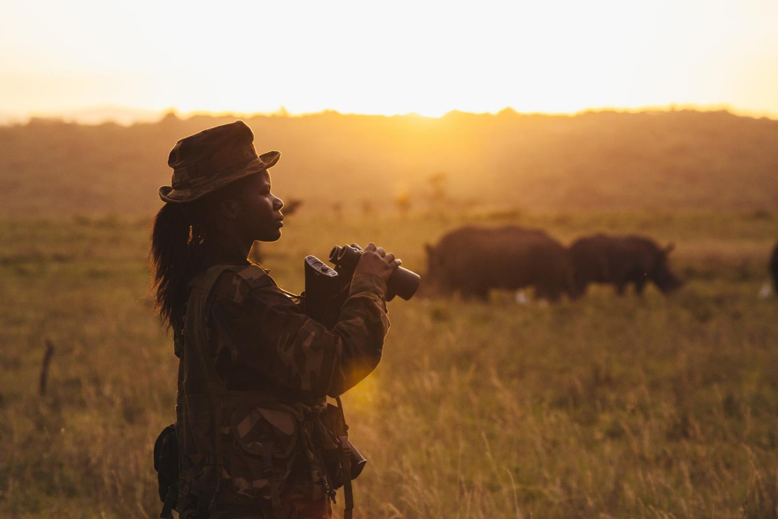
Today we focus our work across six goal areas.
Notes:
WWF’s mission has since evolved to protecting the future of nature. We do that by focusing on six goal areas.

Slide 8
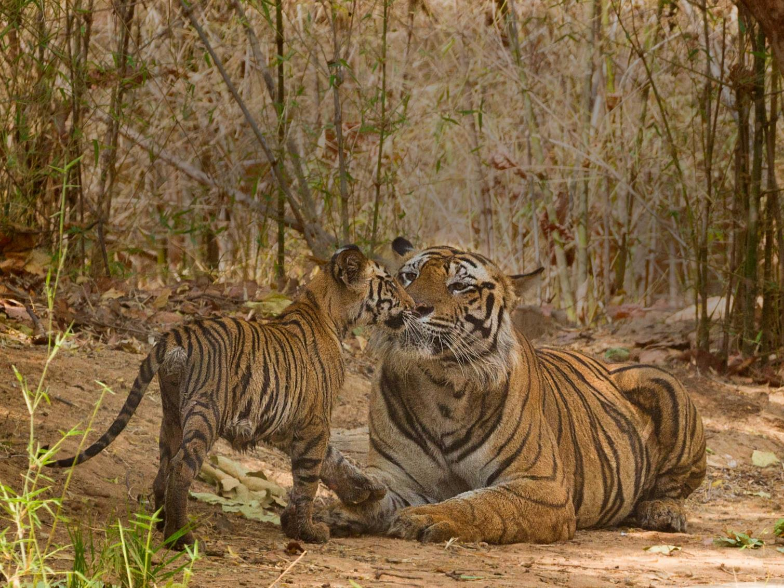
Wildlife
Protect the world’s most important species
Notes:
Wildlife - We’re working to make sure the world’s most iconic species, including tigers, rhinos, and elephants, are safe and thriving in the wild.

Slide 9
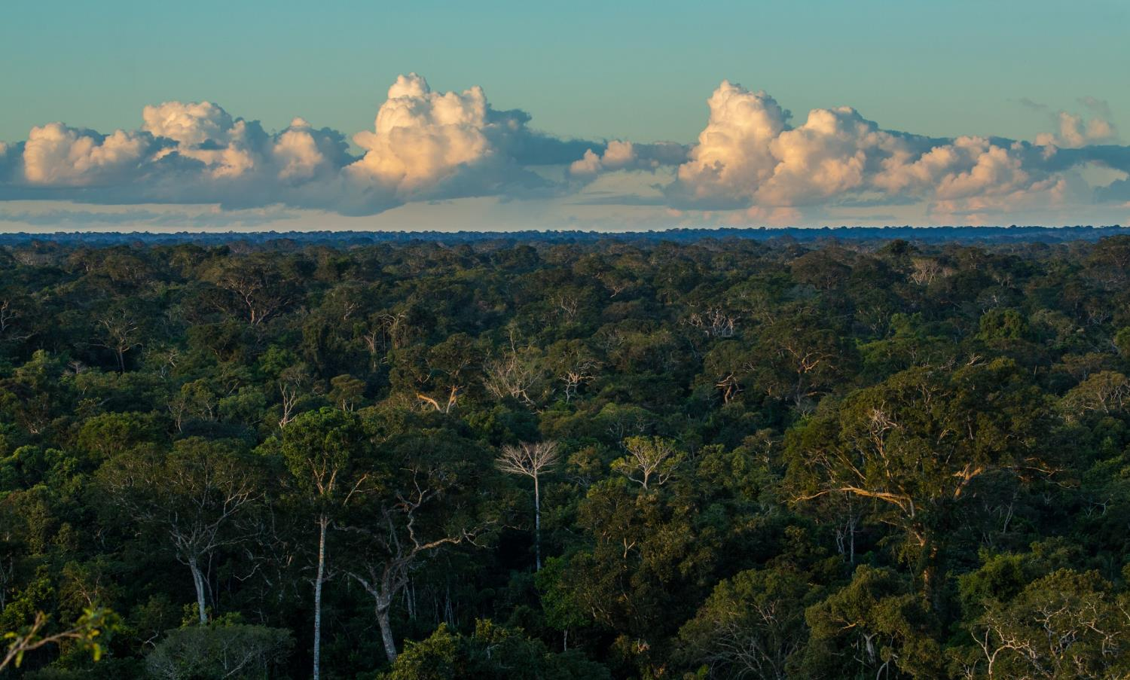
Forests
Conserve the world’s most important forests
Notes:
Forests – safeguarding the world's most important forests to protect plant and animal diversity.

Slide 10
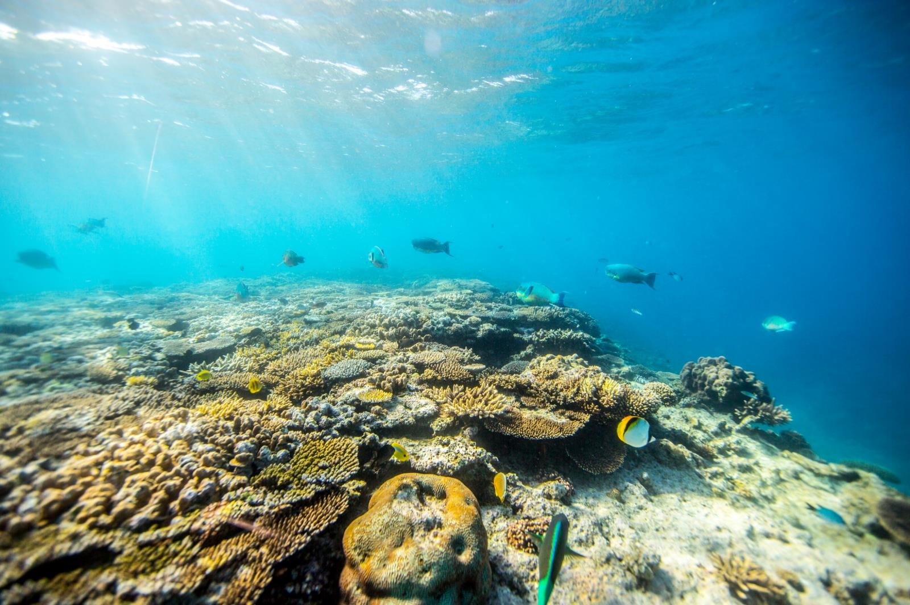
Oceans
Safeguard healthy oceans and marine livelihoods
Notes:
Oceans – building more resilient oceans through sustainable fishing practices and by protecting important regions.

Slide 11
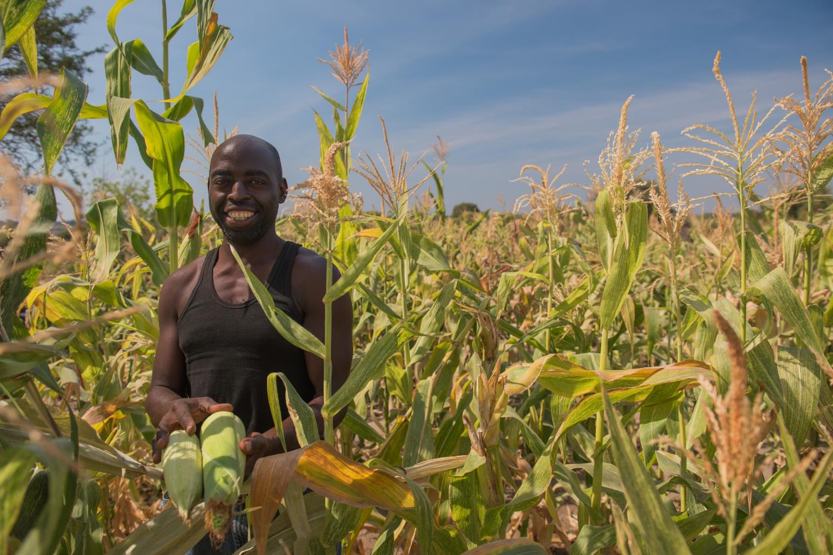
Food
Feed the world without sacrificing nature
Notes:
Food – innovating strategies to produce the world’s food without sacrificing nature.

Slide 12
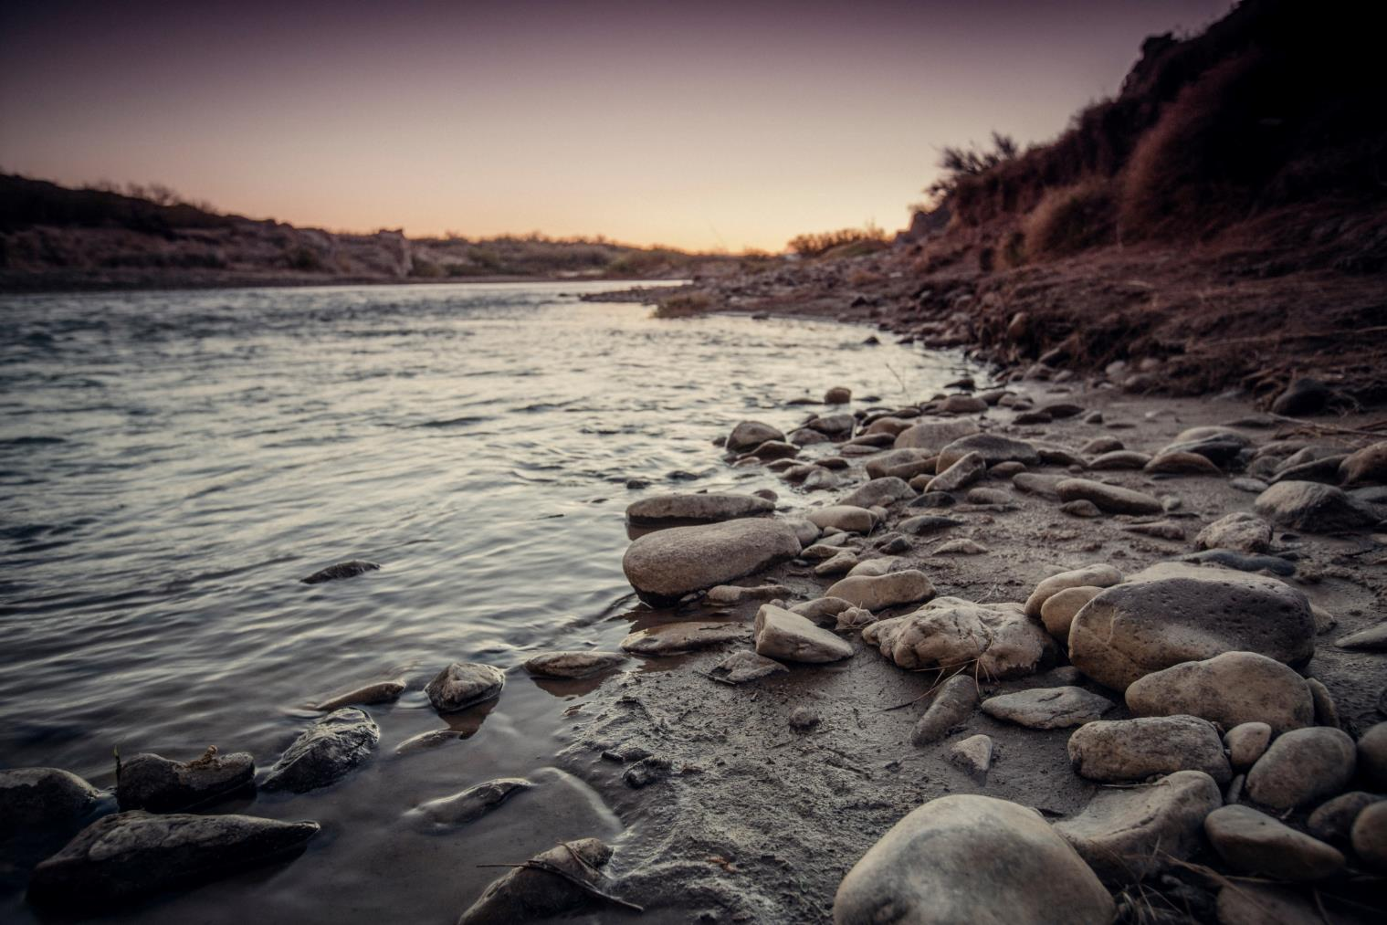
Fresh water
Secure water for people and nature.
Notes:
Fresh water – maintaining or improving the health of major fresh water basins around the world.

Slide 13
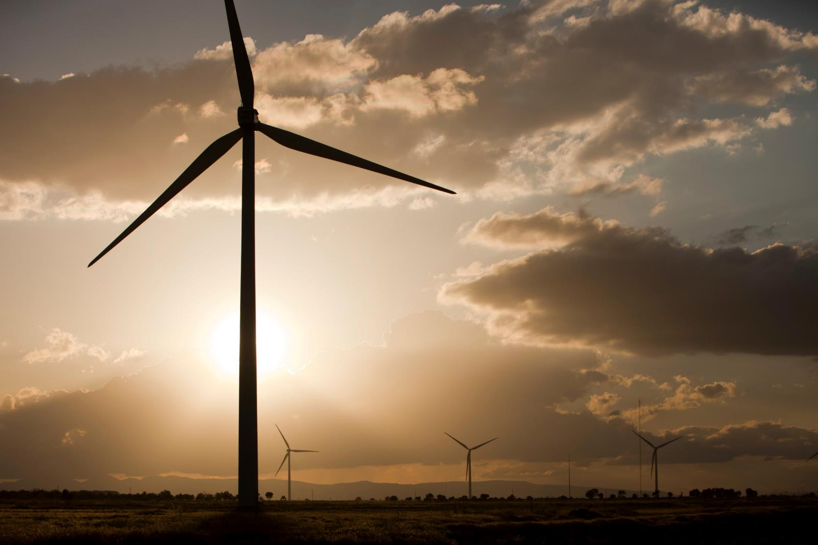
Climate
Creating a climate-resilient and zero-carbon world, powered by renewable energy
Notes:
Climate – creating a climate-resilient and zero-carbon world, powered by renewable energy.

Slide 14
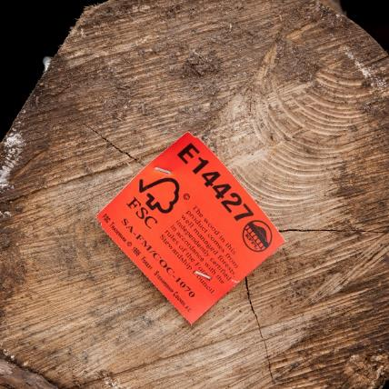
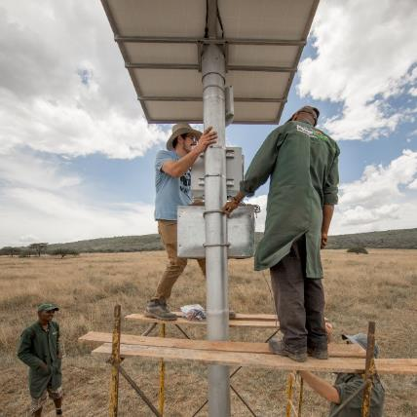
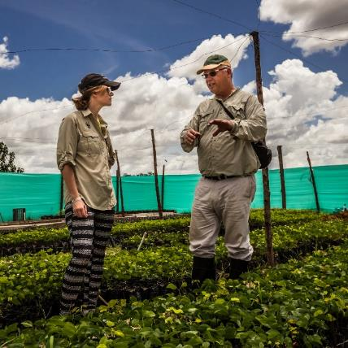
More than 1200 Projects Worldwide
Notes:
Each of the six areas has international and national priorities and ongoing projects--many of which overlap or build on the work of the others. These projects can include things like restoring the health of a river system; stopping wildlife poaching at a vulnerable reserve; or establishing certification programs for commodities like timber or fish. Each of the six areas is staffed with top scientists and experts, all in close cooperation with our WWF colleagues worldwide, all working to make sure we make the biggest possible impact.

Slide 15
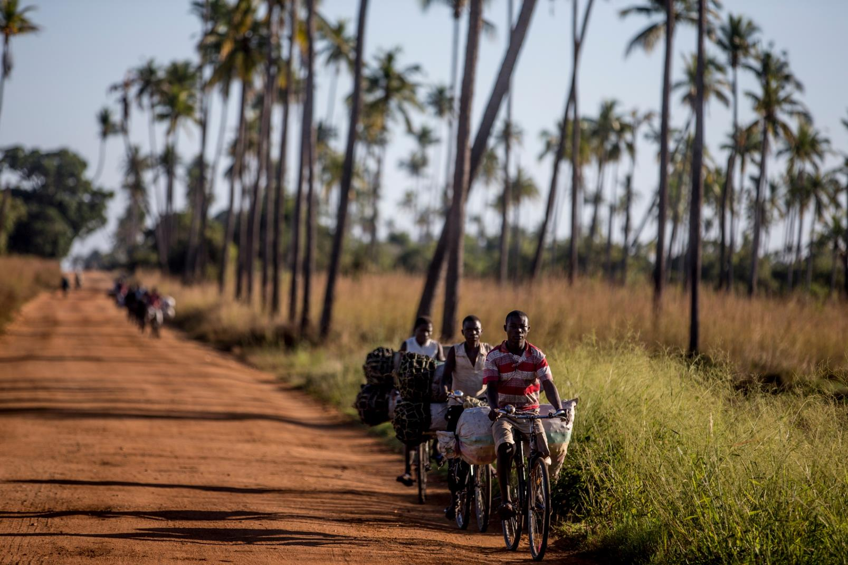
But we can’t do it alone.
WWF partners with other environmental organizations and humanitarian organizations.
Notes:
But as WWF has advanced, so have the threats facing the planet. We know we can’t tackle major issues like climate change, deforestation, and global food security alone. That’s why we’ve teamed up with so many other organizations, businesses, and people. We work very closely with other environmental organizations on a number of projects; we partner with humanitarian organizations like CARE to make sure our programs positively affect impoverished and indigenous communities.

Slide 16
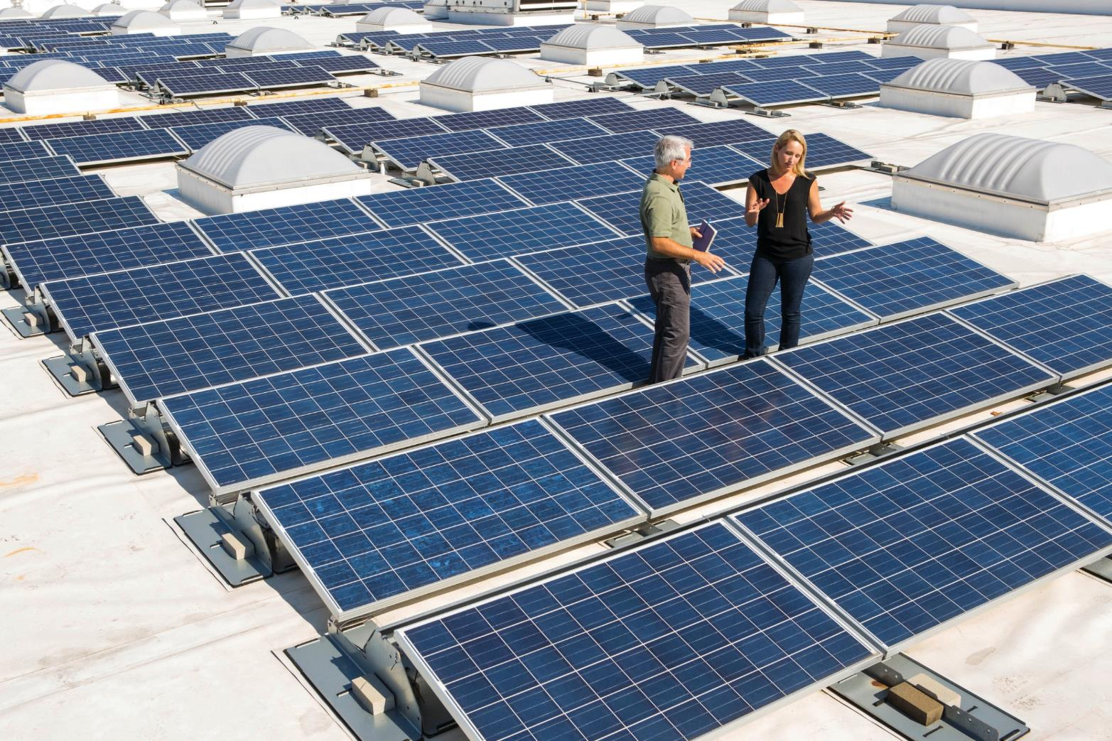
WWF works with businesses to improve their eco-footprints and move entire sectors toward sustainability
Notes:
And we work with businesses across the spectrum to improve their eco-footprints and move entire sectors toward sustainability.

Slide 17
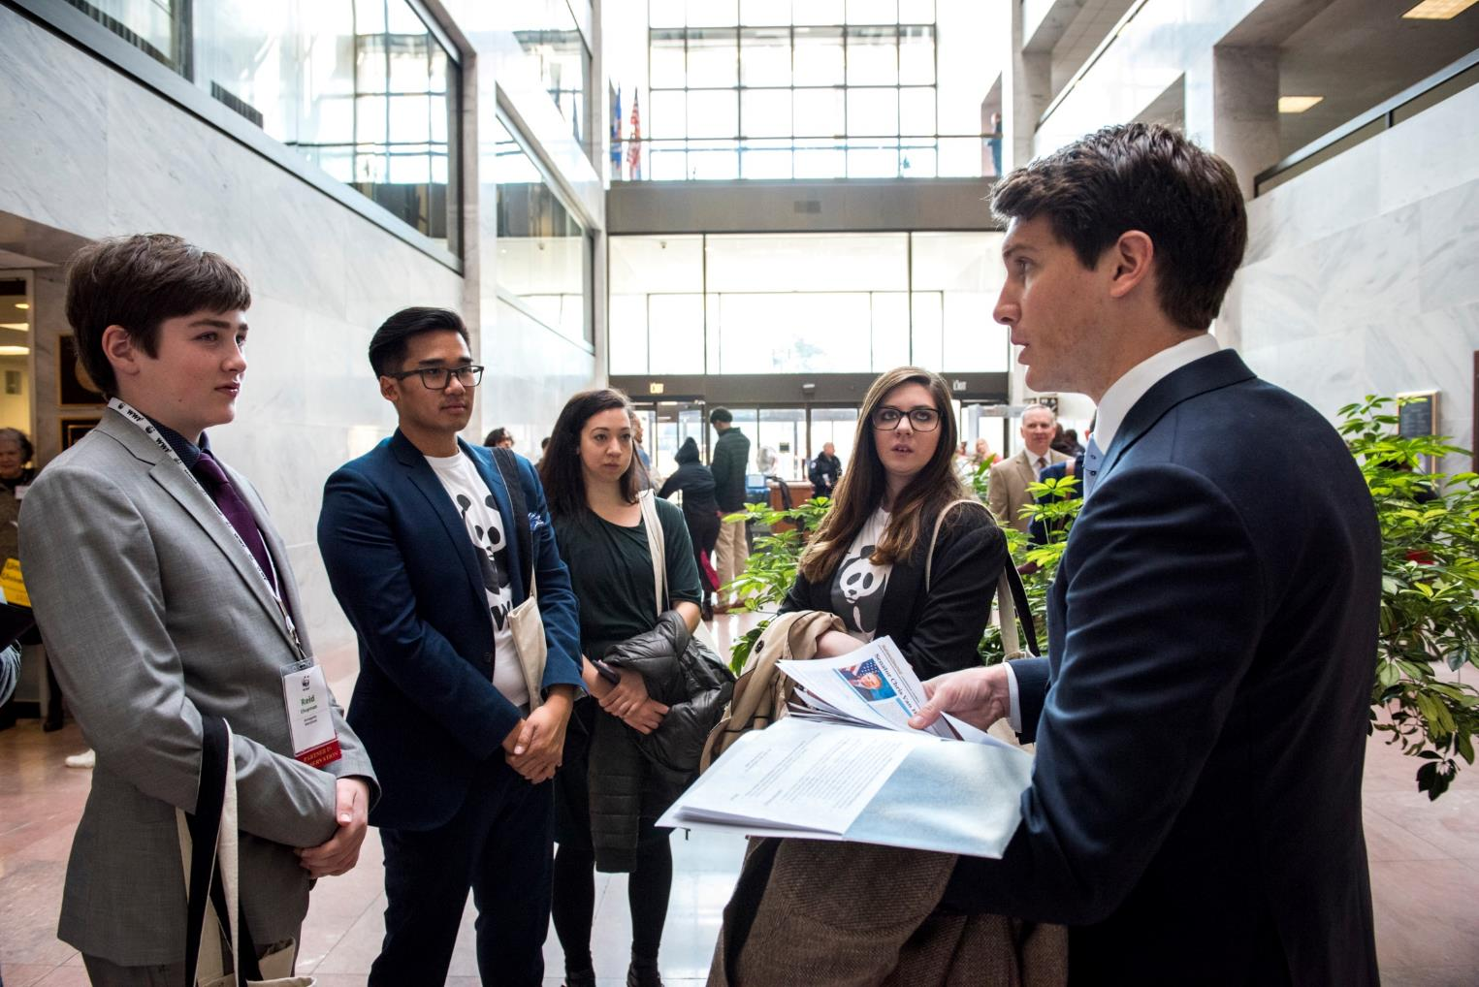
WWF also works with local, state, and national politicians.
Notes:
We also engage politicians and governments to pass environmentally-sound legislation and consider and prioritize nature in all decision making.

Slide 18
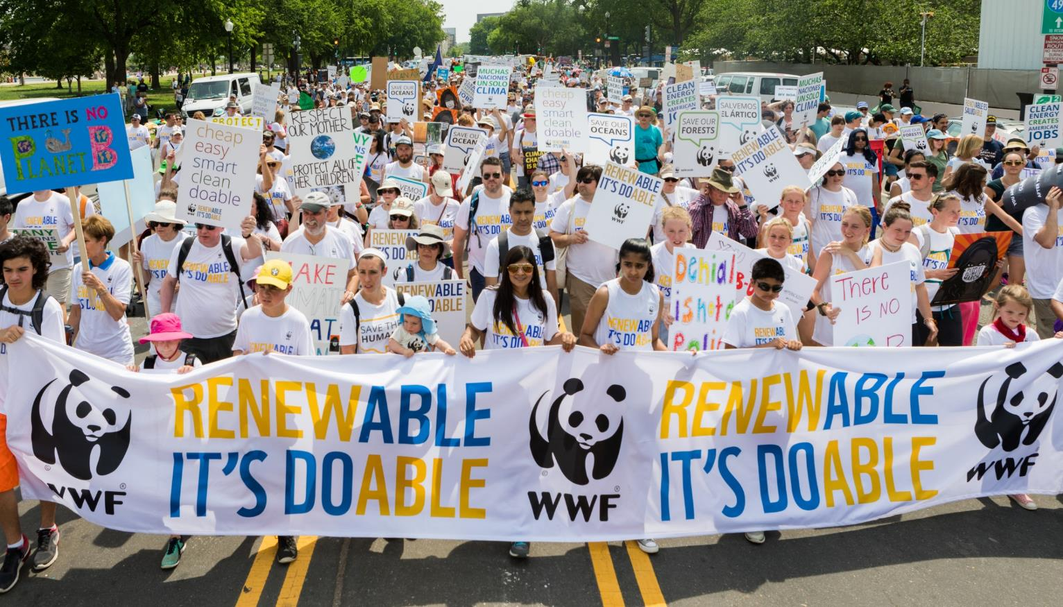
Together, we can protect life on our planet—including our own.
Notes:
We also engage influencers, celebrities, religious leaders, community organizers, and the general public. Because it’s going to take all of us to make a difference. Together we can protect all life on our planet– including our own.

Slide 19
Photo Credits
Page 2: © naturepl.com / Eric Baccega / WWF
Page 3 & 5: © Jürgen Freund / WWF
Page 6: © WWF Intl. / WWF
Page 7: © Jonathan Caramanus / Green Renaissance / WWF-UK
Page 8: © Souvik Kundu / WWF
Page 9: © © Day's Edge Productions / WWF-US
Page 10: © WWF / James Morgan
Page 11: © Gareth Bentley / WWF-US
Page 12: © Day's Edge / WWF-US
Page 13: © Global Warming Images / WWF
Page 14: © Jürgen Freund / WWF
© WWF-US / James Morgan
© Meridith Kohut/WWF-US
Page 15: © WWF-US / James Morgan
Page 16: © WWF-US / Paul Fetters
Page 17: © naturepl.com / Eric Baccega / WWF
Page 18: © WWF-US / Keith Arnold

