Slide 2
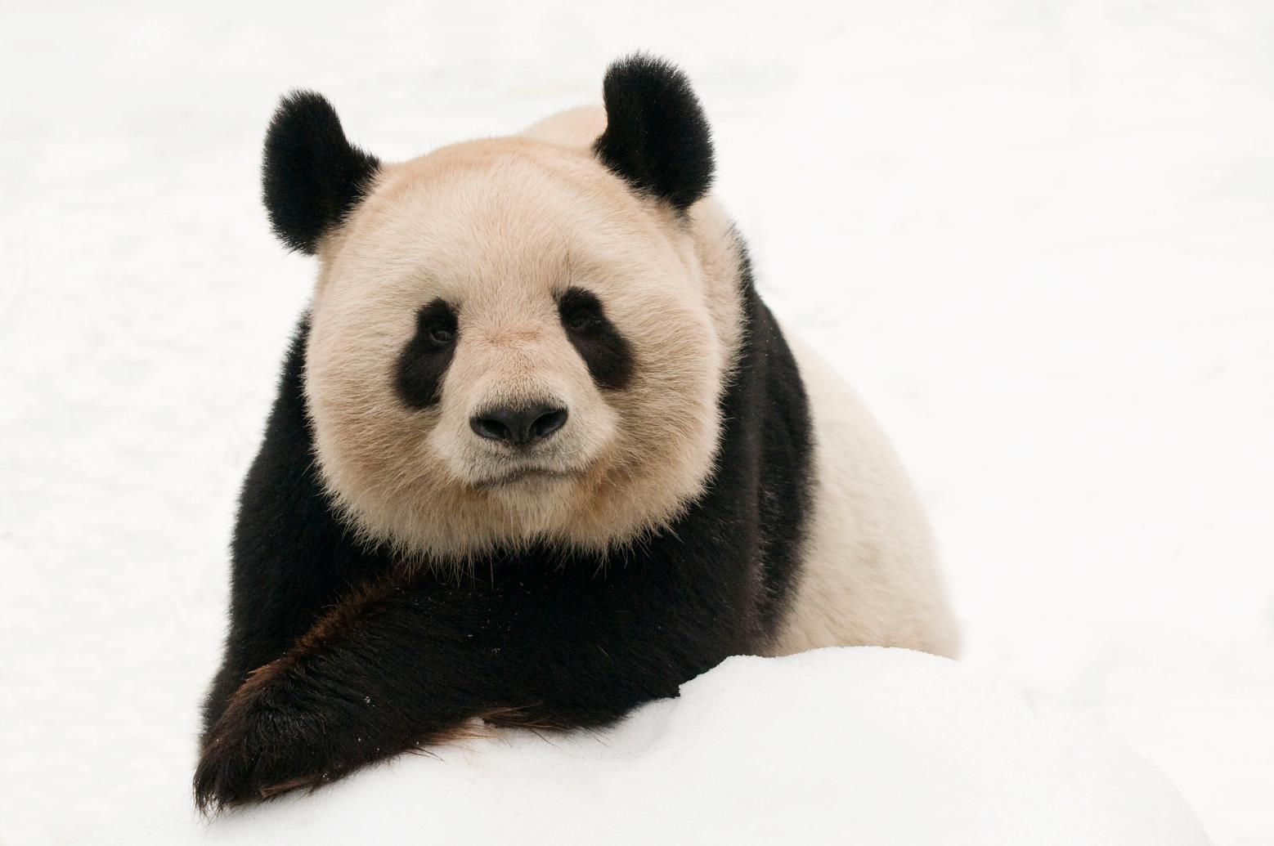
WWF Priority Species
Notes:
Conserving wildlife is at heart of WWF’s mission.

Slide 3
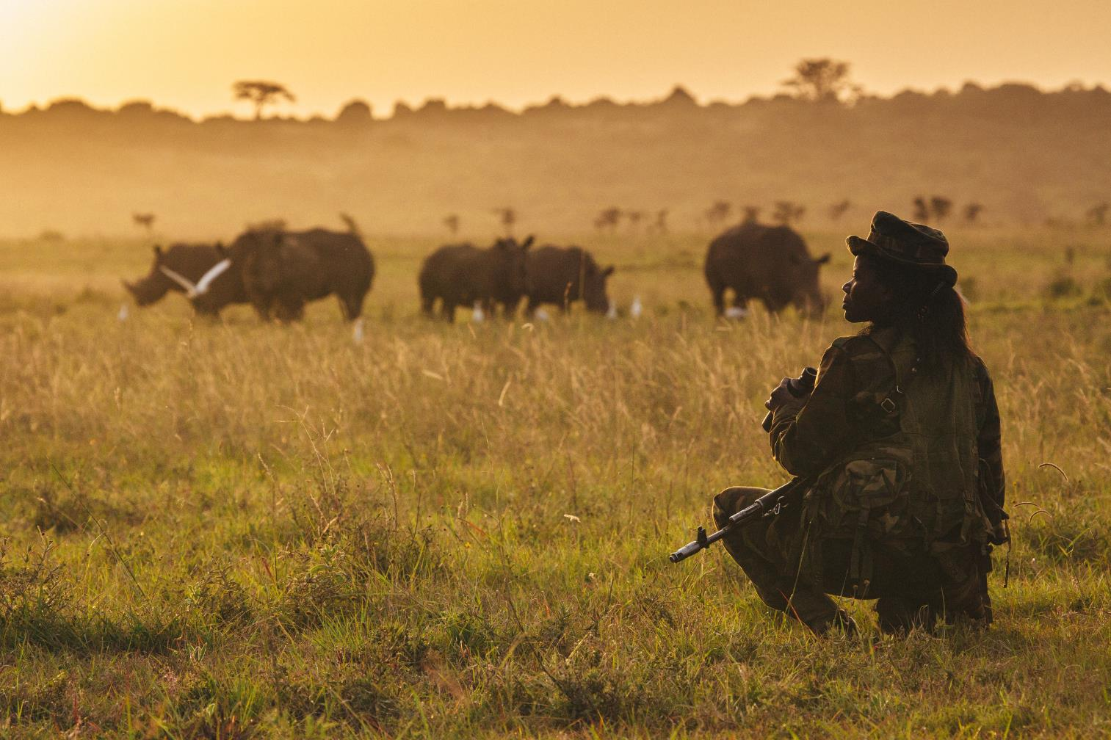
WWF protects species threatened by poaching, illegal trade, habitat loss, and climate change.
Notes:
We focus on protecting populations of some of the world’s most ecologically, economically, and culturally important species—the survival of which are threatened by poaching, illegal trade, habitat loss and climate change.
We use the best science available to link on-the-ground work with high-level policy action to create lasting solutions that benefit wild animals as well as the people that live alongside them.

Slide 4
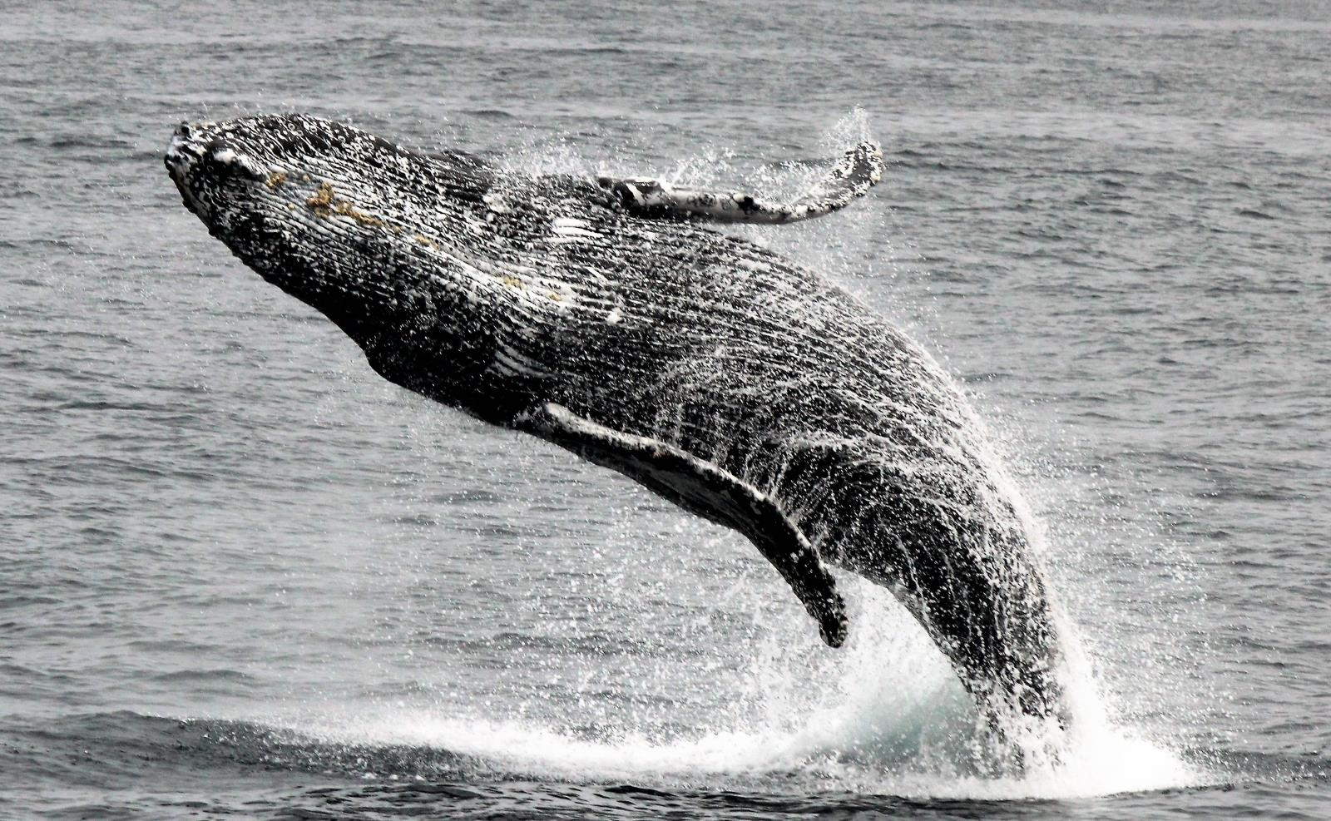
We focus on umbrella species—the protection of which supports the survival of whole landscapes and ecosystems.
Notes:
We protect wildlife because they inspire us. But we also focus our efforts on those species—like tigers, rhinos, whales and marine turtles—whose protection influences and supports the survival of other species or offers the opportunity to protect whole landscapes or marine areas.
Following are some of the most critical species WWF works to protect.

Slide 5
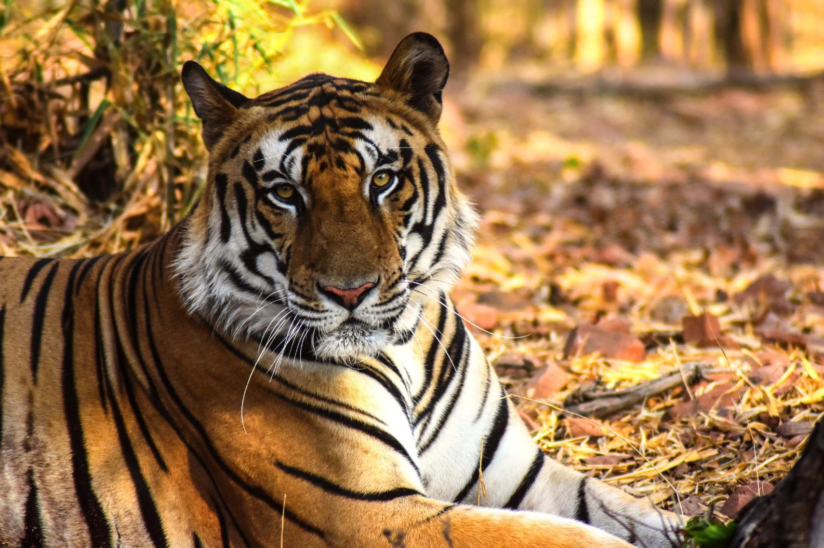
WWF is working to double the number of tigers in the wild by 2022.
Notes:
Tigers are the largest of the Asian big cats and are admired and feared around the world. There are about 3,890 in the wild.
A tiger can consume up to 88 pounds of meat at one time. On average, tigers give birth to two to four cubs every two years.
Males of the largest subspecies, the Amur (Siberian) tiger, may weigh up to 660 pounds. For males of the smallest subspecies—the Sumatran tiger—upper range is at around 310 pounds.
Tigers are mostly solitary, apart from associations between mother and offspring.
Across their range, tigers face unrelenting pressures from poaching, retaliatory killings and habitat loss. They are forced to compete for space with dense and often growing human populations.
WWF is working with others to double the number of tigers in the wild by 2022.

Slide 6
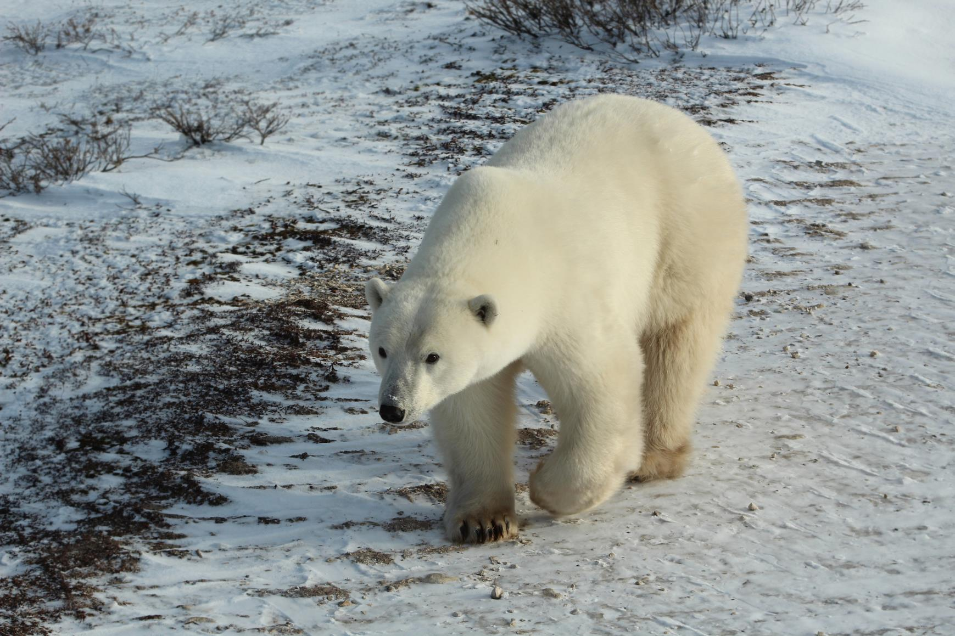
The survival and the protection of the polar bear and its habitat are urgent issues for WWF.
Notes:
Polar bears are classified as marine mammals because they spend most of their lives on the sea ice of the Arctic Ocean. They have a thick layer of body fat and a water-repellant coat that insulates them from the cold air and water. Considered talented swimmers, they can sustain a pace of six miles per hour by paddling with their front paws and holding their hind legs flat like a rudder.
Polar bears spend over 50% of their time hunting for food. Their diet mainly consists of ringed and bearded seals because they need large amounts of fat to survive.
Because of ongoing and potential loss of their sea ice habitat resulting from climate change, polar bears were listed as a threatened species in the US under the Endangered Species Act in May 2008.
The survival and the protection of the polar bear and its habitat are urgent issues for WWF.

Slide 7
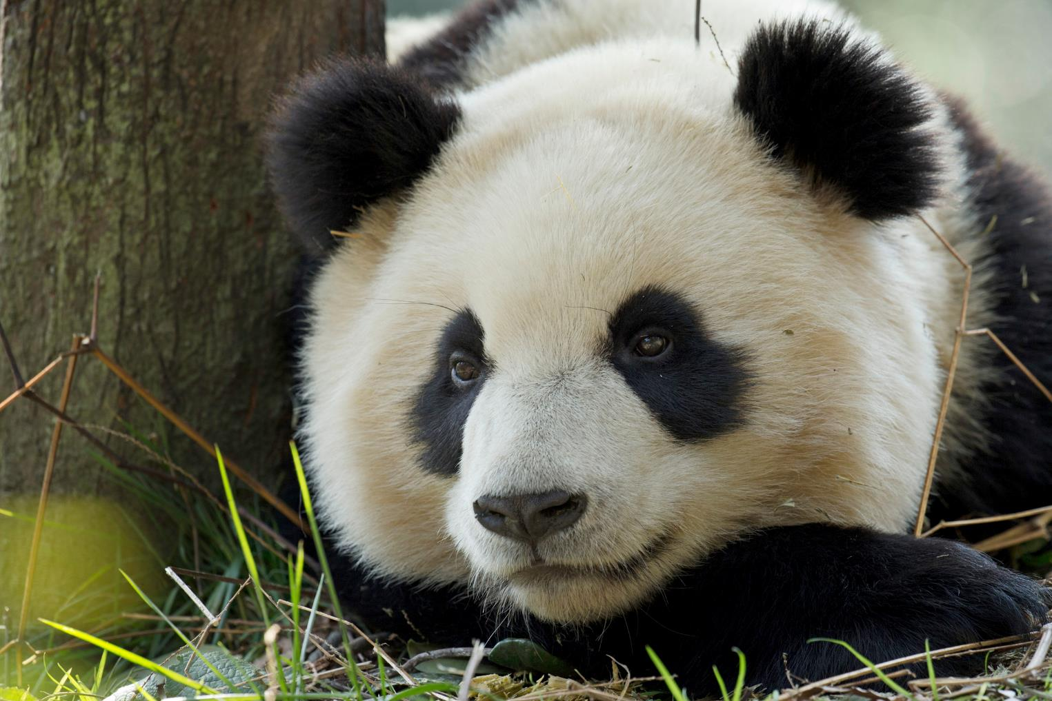
There are only about 1,800 giant pandas in the wild.
Notes:
This peaceful creature with a distinctive black and white coat is adored by the world and considered a national treasure in China. The panda also has been WWF's logo since our founding in 1961.
Pandas live mainly in bamboo forests high in the mountains of western China, where they subsist almost entirely on bamboo. They must eat from 26 to 84 pounds of it every day, a formidable task for which they use their enlarged wrist bones that function as opposable thumbs.
A newborn panda is about the size of a stick of butter—about 1/900th the size of its mother—but can grow to up to 330 pounds as an adult. These bears are excellent tree climbers despite their bulk.
Despite their exalted status and relative lack of natural predators, pandas are still at risk. Severe threats from humans have left just over 1,800 pandas in the wild.

Slide 8
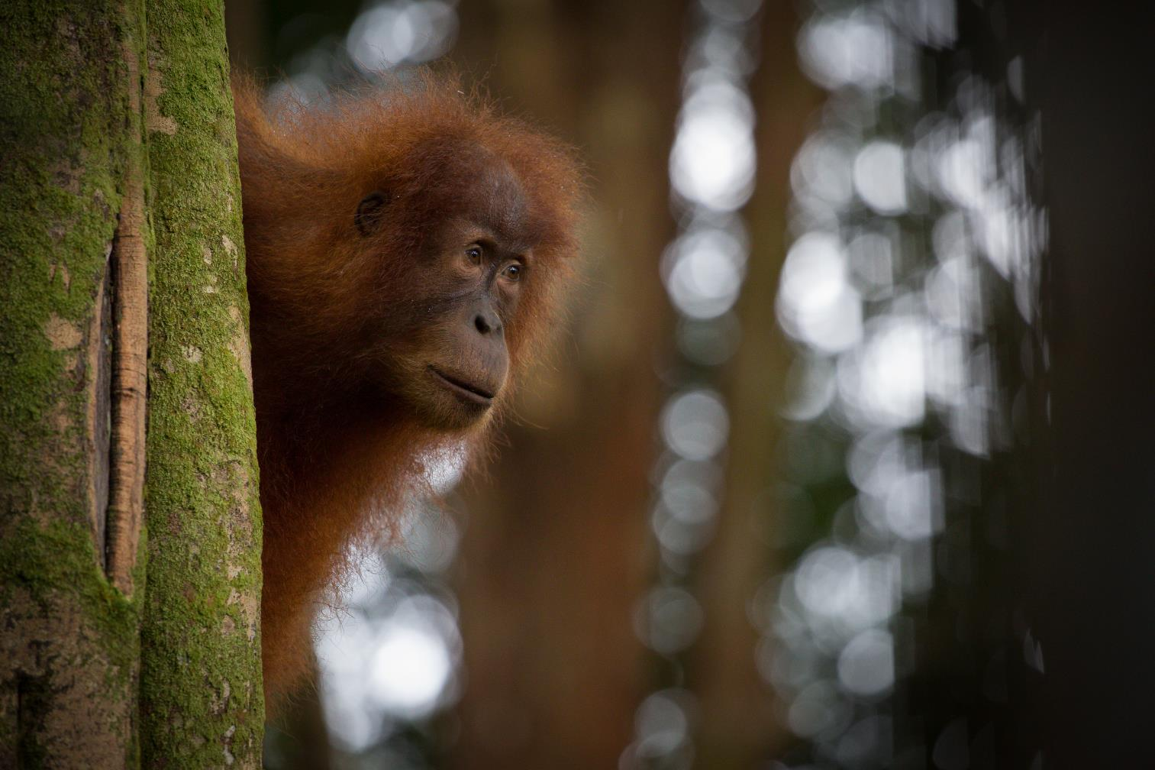
WWF has been working to conserve orangutans since the 1970s.
Notes:
Known for their distinctive red fur, orangutans are the largest arboreal mammal, spending most of their time in trees. Long, powerful arms and grasping hands and feet allow them to move through the branches. These great apes share 96.4% of our genes and are highly intelligent creatures.
In the lowland forests in which they reside, orangutans live solitary existences in trees where they make nests. They feast on wild fruits and slurp water from holes in trees. Adult male orangutans can weigh up to 200 pounds. Flanged males have prominent cheek pads called flanges and a throat sac used to make loud verbalizations called long calls.
There are three species of orangutans: Bornean, with a population of about 104,700; Sumatran, with a population of 13,846; and Tapanuli with a population of only 800.
WWF has been working on orangutan conservation since the 1970s. Our efforts include conserving orangutan habitat, antipoaching, promoting sustainable forestry and agriculture, and halting the pet trade.

Slide 9
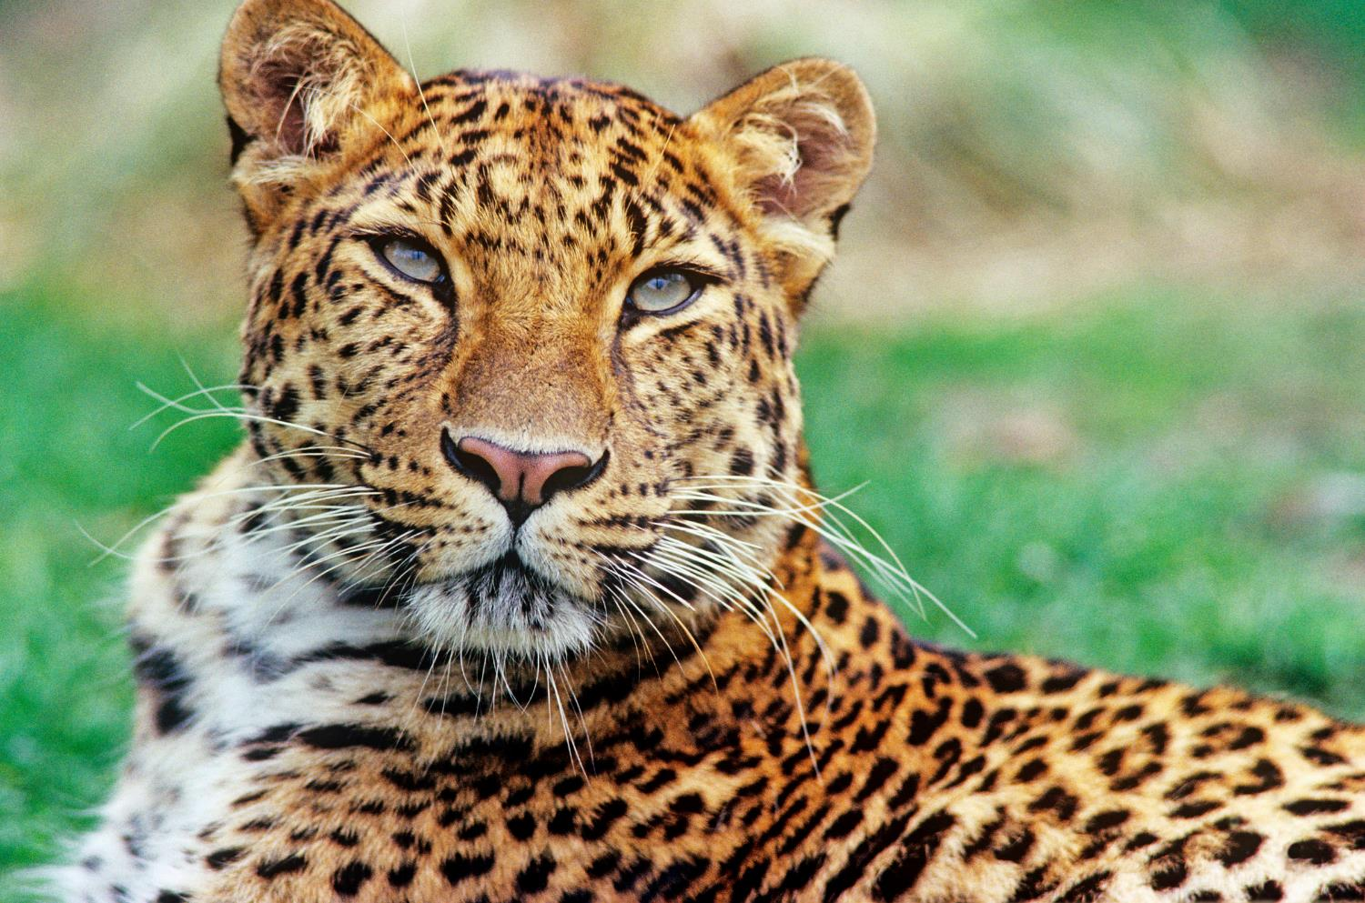
The Amur leopard is the world’s rarest big cat.
Notes:
The amur leopard is the world’s rarest big cat with only around 85 individuals. In the Russian Far East, this subspecies has adapted to life in the temperate forests that make up the northern-most part of the species’ range. Similar to other leopards, the Amur leopard can run at speeds of up to 37 miles per hour. They can leap more than 19 feet horizontally and up to 10 feet vertically.
The Amur leopard is solitary. Nimble-footed and strong, it carries and hides unfinished kills so that they are not taken by other predators. It has been reported that some males stay with females after mating, and may even help with rearing the young. They live for 10-15 years, and in captivity up to 20 years.
WWF works with local communities, regional authorities, government and other non-governmental organizations to save the Amur leopard and ensure the long-term conservation of the region.

Slide 10
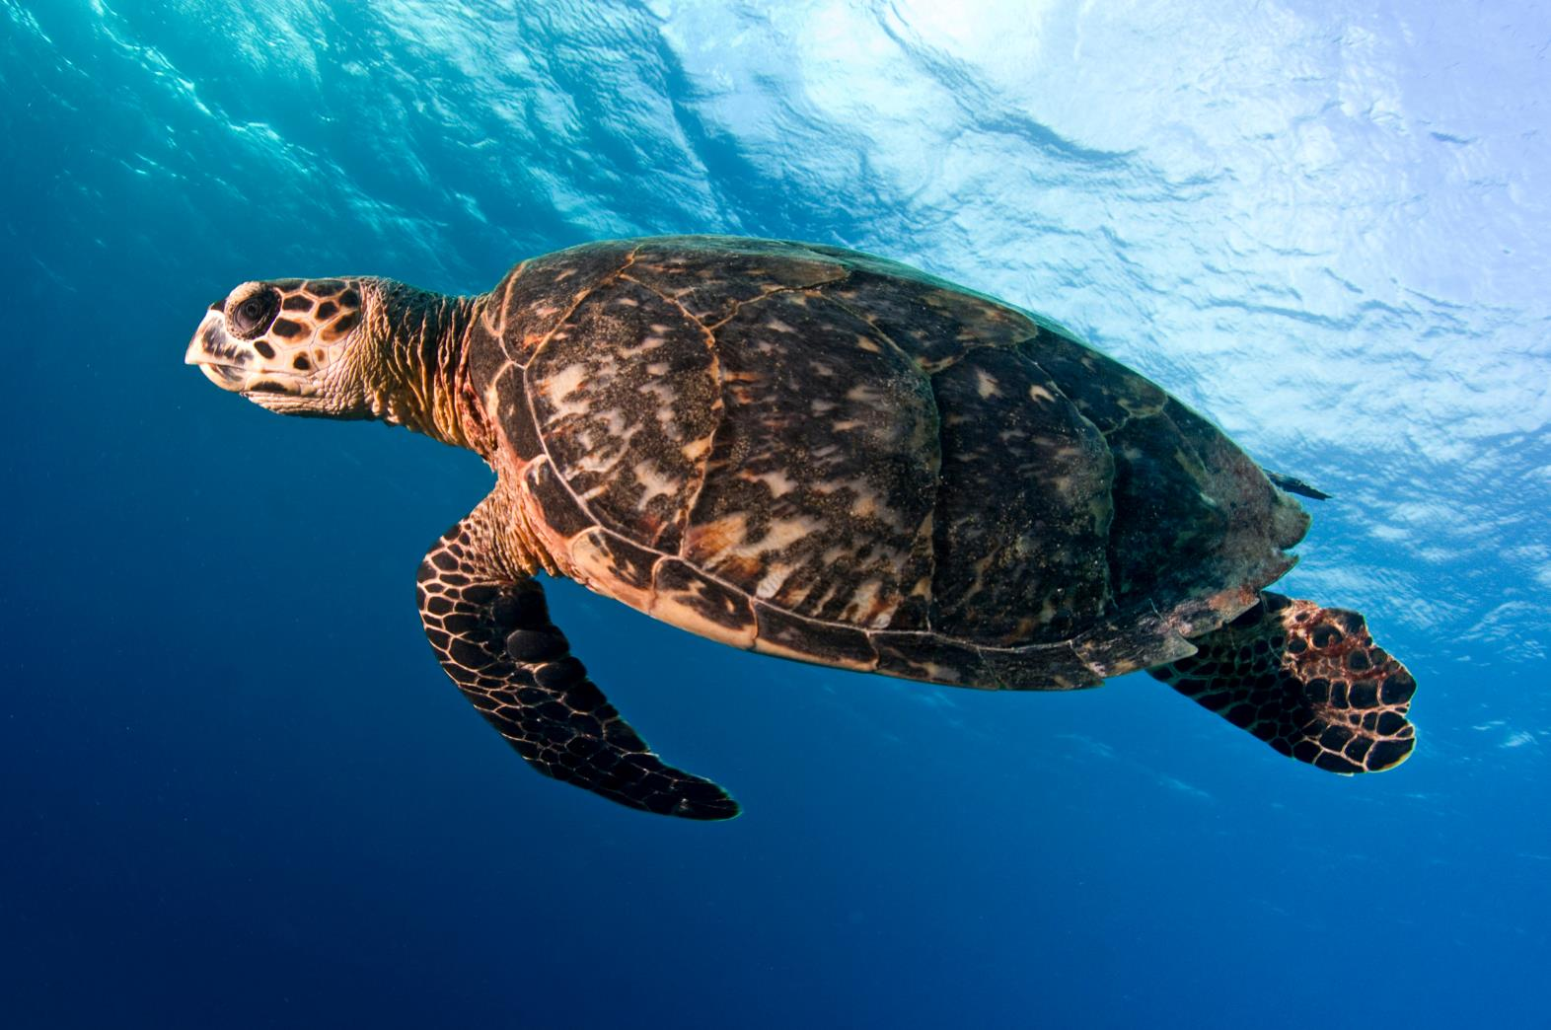
WWF is committed to stopping the decline of sea turtles and working for the recovery of the species.
Notes:
There are seven different species of sea (or marine) turtles. WWF focuses on five of those species: green, hawksbill, loggerhead, leatherback and olive ridley. Human activities have tipped the scales against the survival of these ancient mariners. Nearly all species of sea turtle are classified as Endangered. Slaughtered for their eggs, meat, skin and shells, sea turtles suffer from poaching and over-exploitation. They also face habitat destruction and accidental capture in fishing gear. Climate change has an impact on turtle nesting sites. It alters sand temperatures, which then affects the sex of hatchlings. WWF is committed to stopping the decline of sea turtles and working for the recovery of the species. We work to secure environments in which both turtles—and the people that depend upon them—can survive into the future.

Slide 11
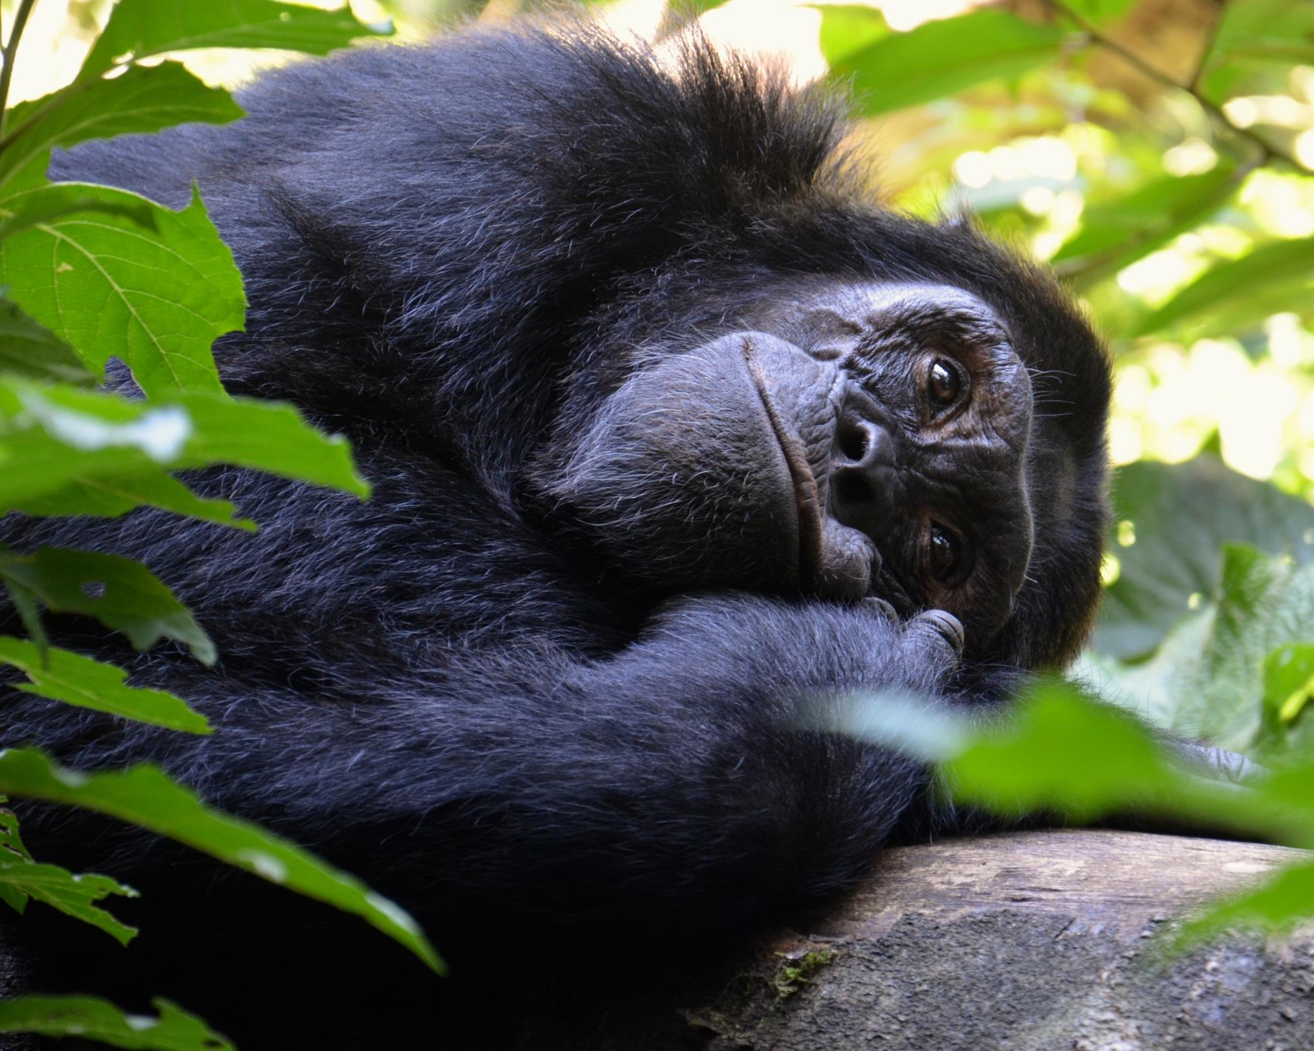
WWF protects chimpanzees by establishing, strengthening, and managing protected areas in Central and West Africa
Notes:
Like us, chimpanzees are highly social animals, care for their offspring for years and can live to be over 50. In fact, chimpanzees are our closest cousins; we share about 98 percent of our genes. In their habitat in the forests of central Africa, chimpanzees spend most of their days in the tree tops. When they do come down to earth, chimps usually travel on all fours, though they can walk on their legs like humans for as far as a mile. They use sticks to fish termites out of mounds and bunches of leaves to sop up drinking water.
Despite our shared lineage, humans are pushing chimpanzees toward extinction. Chimps have already disappeared completely from four countries and are under tremendous pressure everywhere else they live.
WWF establishes, strengthens, and manages protected areas in Central and West Africa to safeguard chimpanzees through antipoaching and effective law enforcement.

Slide 12
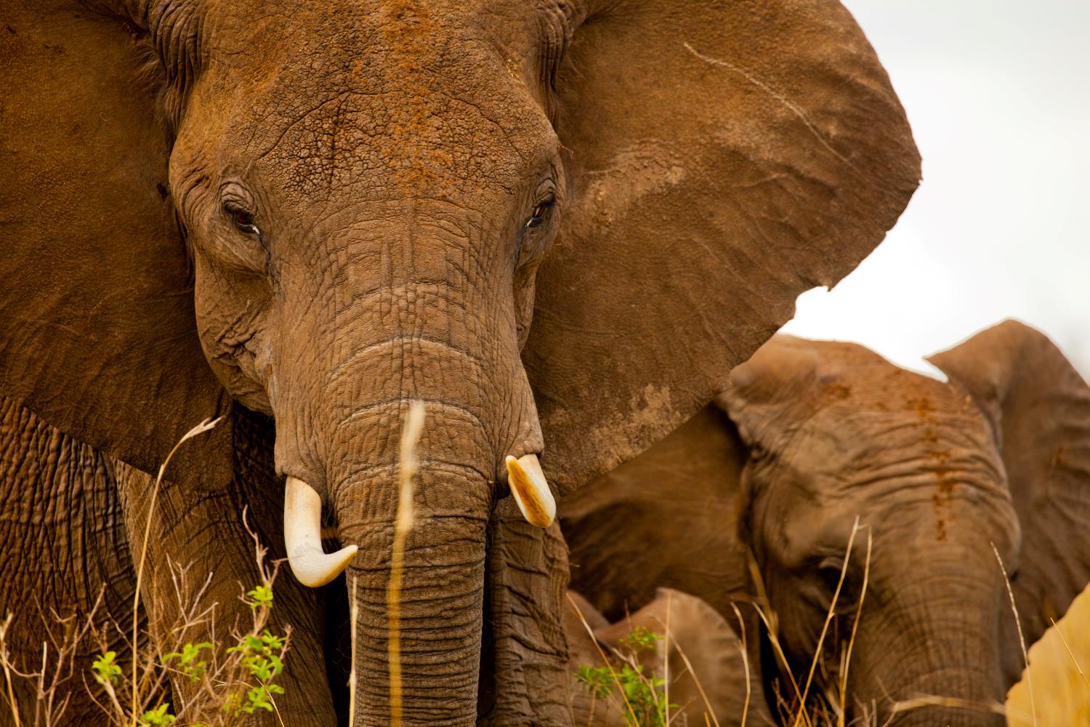
Tens of thousands of elephants are killed every year for their ivory tusks.
Notes:
Once common throughout Africa and Asia, elephant numbers were severely depleted during the 20th century, largely due to the massive ivory trade. While some populations are now stable and growing, poaching, conflict and habitat destruction continue to threaten the species.
The largest land mammal on earth, the African elephant weighs up to eight tons. The elephant is distinguished by its massive body, large ears and a long trunk, which has many uses ranging from using it as a hand to pick up objects, as a horn to trumpet warnings, an arm raised in greeting to a hose for drinking water or bathing.
Asian elephants differ in several ways from their African relatives. They are much smaller in size and only some Asian male elephants have tusks. All African elephants, including females, have tusks.
Led by a matriarch, elephants are organized into complex social structures of females and calves, while male elephants tend to live in isolation. A single calf is born to a female once every 4-5 years and after a gestation period of 22 months—the longest of any mammal. These calves stay with their mothers for years and are also cared for by other females in the group.
Elephants need extensive land to survive. Roaming in herds and consuming hundreds of pounds of plant matter in a single day, both species of elephant require extensive amounts of food, water and space. As a result, these large mammals place great demands on the environment and often come into conflict with people in competition for resources.
WWF is working to reduce conflict between humans and elephants and end wildlife crime and poaching.

Slide 13
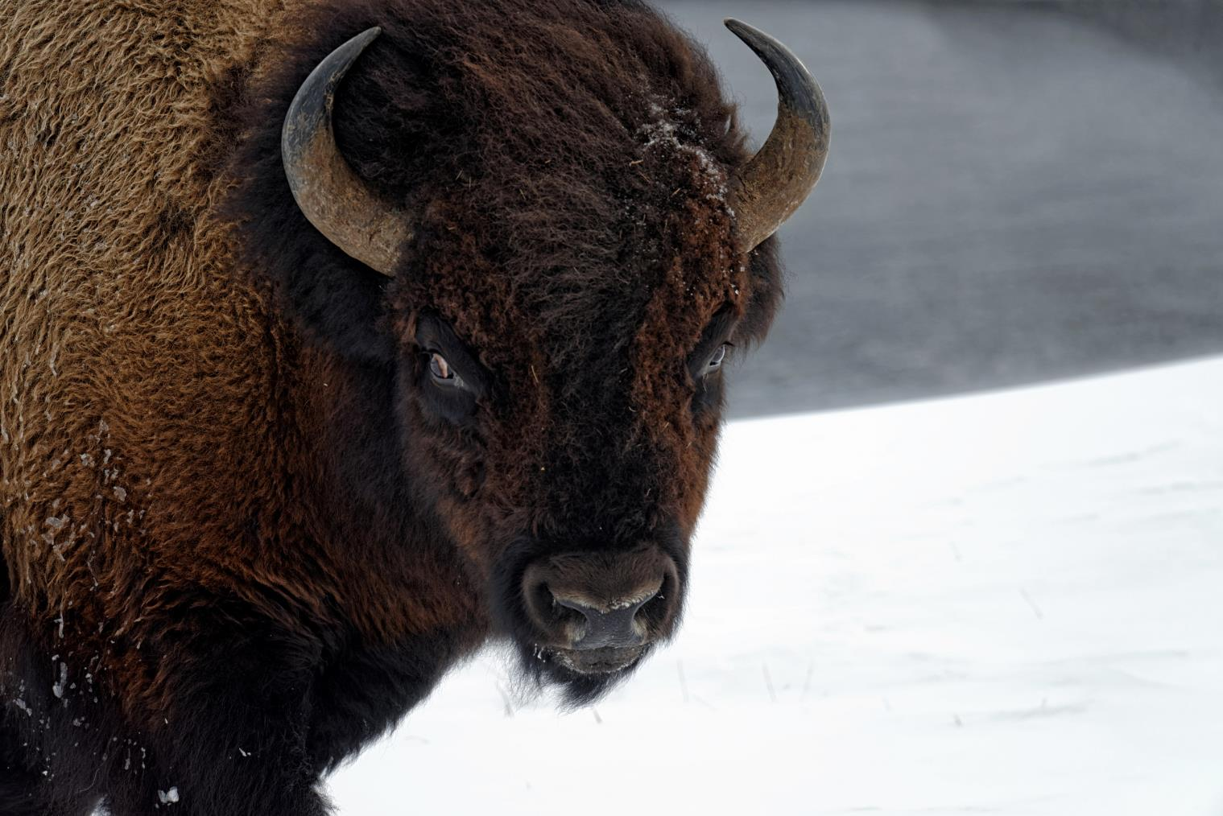
Several Native American tribes are working with WWF to restore bison numbers.
Notes:
Symbols of strength and determination, bison are Ice Age survivors. Clearing away snow and brush with their massive heads, they weigh up to 2,000 pounds and can run up to 40 miles per hour. Once numbering 30-60 million in North America, their numbers were decimated in just a few decades as European expansion pressed westward. No other species on Earth has declined so quickly.
Several Native American tribes are working with WWF to grow bison numbers once again across vast grasslands under their management.

Slide 14
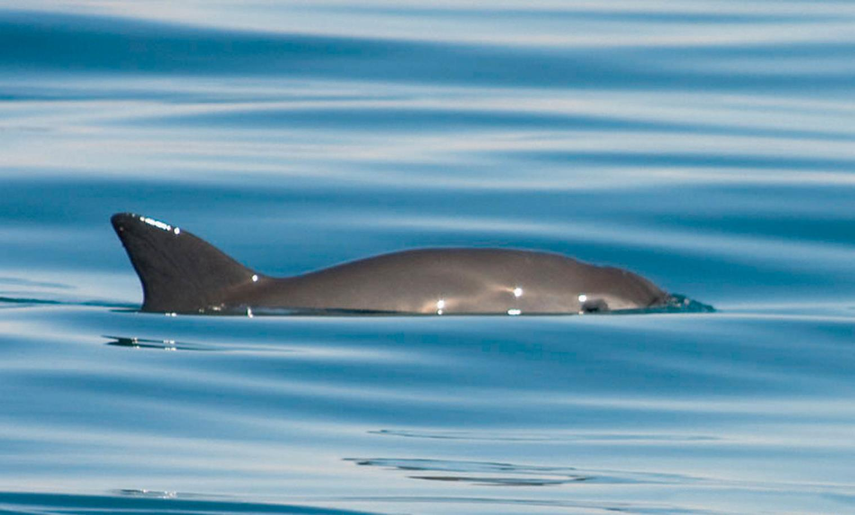
The vaquita is on the edge of extinction.
Notes:
Vaquita, the world’s most rare marine mammal, is on the edge of extinction with only about 30 individuals remaining. This little porpoise wasn't discovered until 1958 and a little over half a century later, we are on the brink of losing them forever. Vaquita are often caught and drowned in gillnets used by illegal fishing operations in marine protected areas within Mexico's Gulf of California. The population has dropped drastically in the last few years. WWF is urgently working to ensure they can live and thrive in their natural habitat.

Slide 15
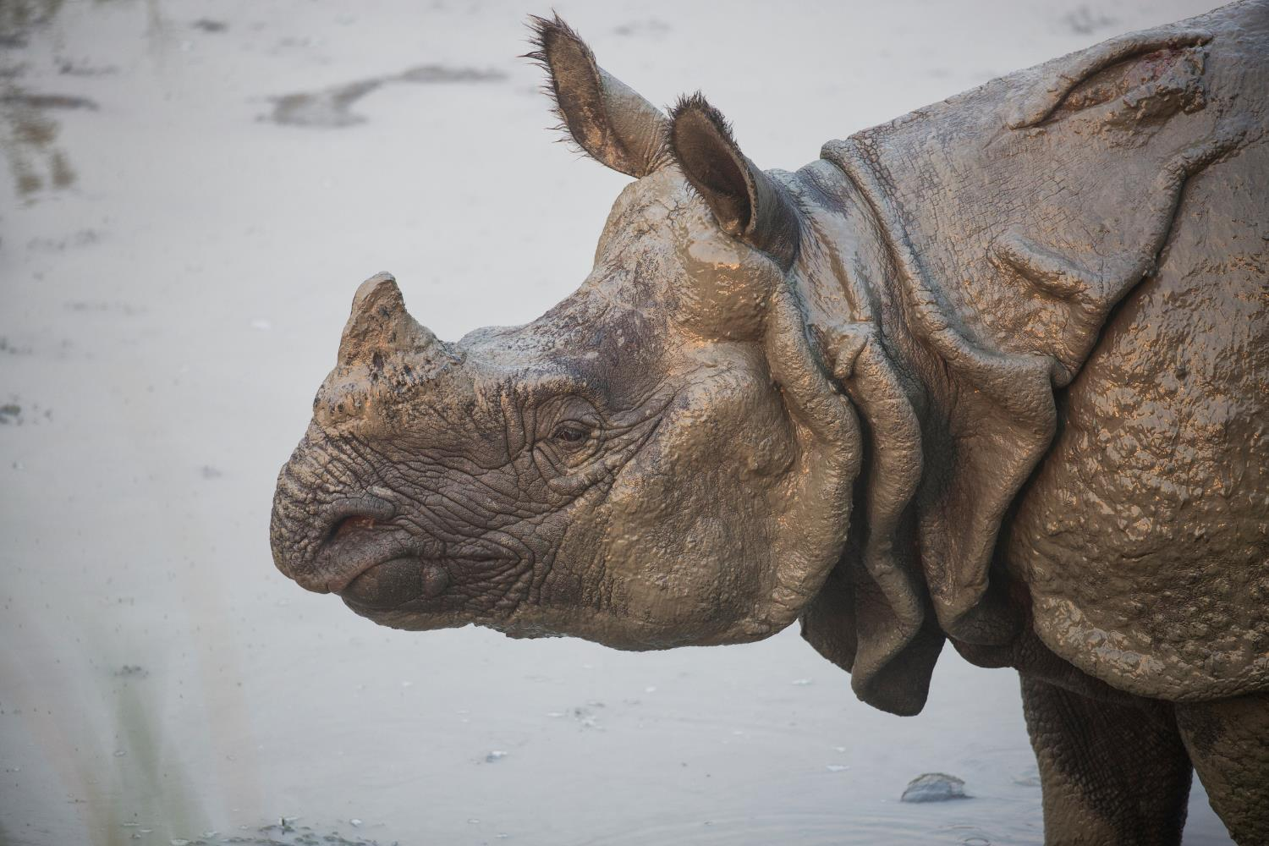
WWF plays a vital role in the fight to protect rhinos.
Notes:
Today very few rhinos survive outside national parks and reserves due to persistent poaching and habitat loss over many decades. Two species of rhino in Asia—Javan and Sumatran—are critically endangered. Successful conservation efforts have helped the third Asian species, the greater one-horned rhino, to increase in number.
In Africa, southern white rhinos, once thought to be extinct, now thrive in protected sanctuaries. But the western black rhino and northern white rhinos have recently gone extinct in the wild. The only three remaining northern white rhino are kept under 24-hour guard in Ol Pejeta Conservancy in Kenya.
Black rhinos have doubled in number over the past two decades from their low point of fewer than 2,500 individuals.
WWF plays a vital role in the fight to protect rhinos. WWF secures and protects rhino populations, and establishes new populations through translocations, and works to combat poaching. We also tackle illegal trade of—and demand for—rhino horn through advocacy and strengthening of local and international law enforcement to bring trafficking perpetrators to justice.

Slide 16
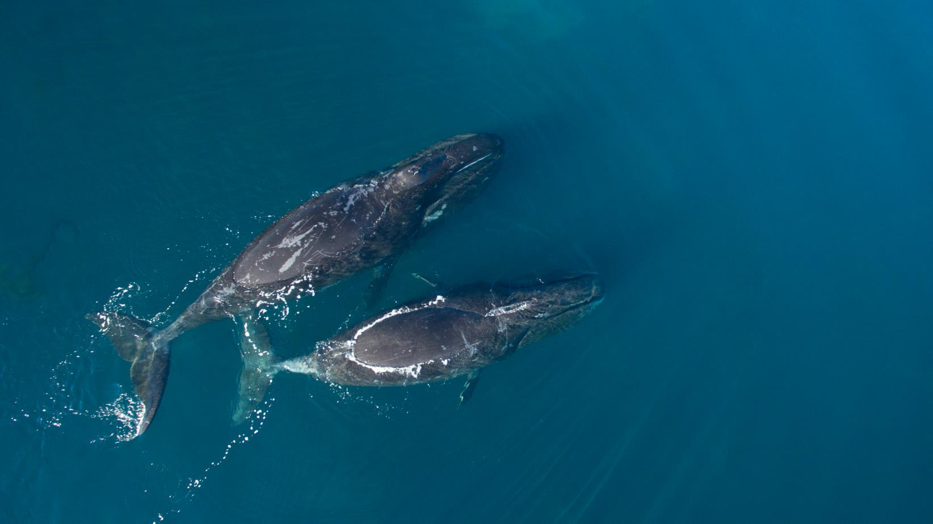
Six out of the 13 great whale species are classified as endangered.
Notes:
Whales roam throughout all the world’s oceans, communicating with complex and mysterious sounds. Their sheer size amazes us: the blue whale can reach lengths of more than 100 feet and weigh up to 200 tons—as much as 33 elephants.
Despite living in the water, whales breathe air. And like humans, they are warm-blooded mammals who nurse their young. A thick layer of fat called blubber insulates them from cold ocean waters.
Whales are at the top of the food chain and have an important role in the overall health of the marine environment. Unfortunately their large size and mythical aura does not protect them; six out of the 13 great whale species are classified as endangered, even after decades of protection.
WWFs work to establish whale sanctuaries, help shift shipping lanes and curtail seismic surveys that disrupt feeding grounds.

Slide 17
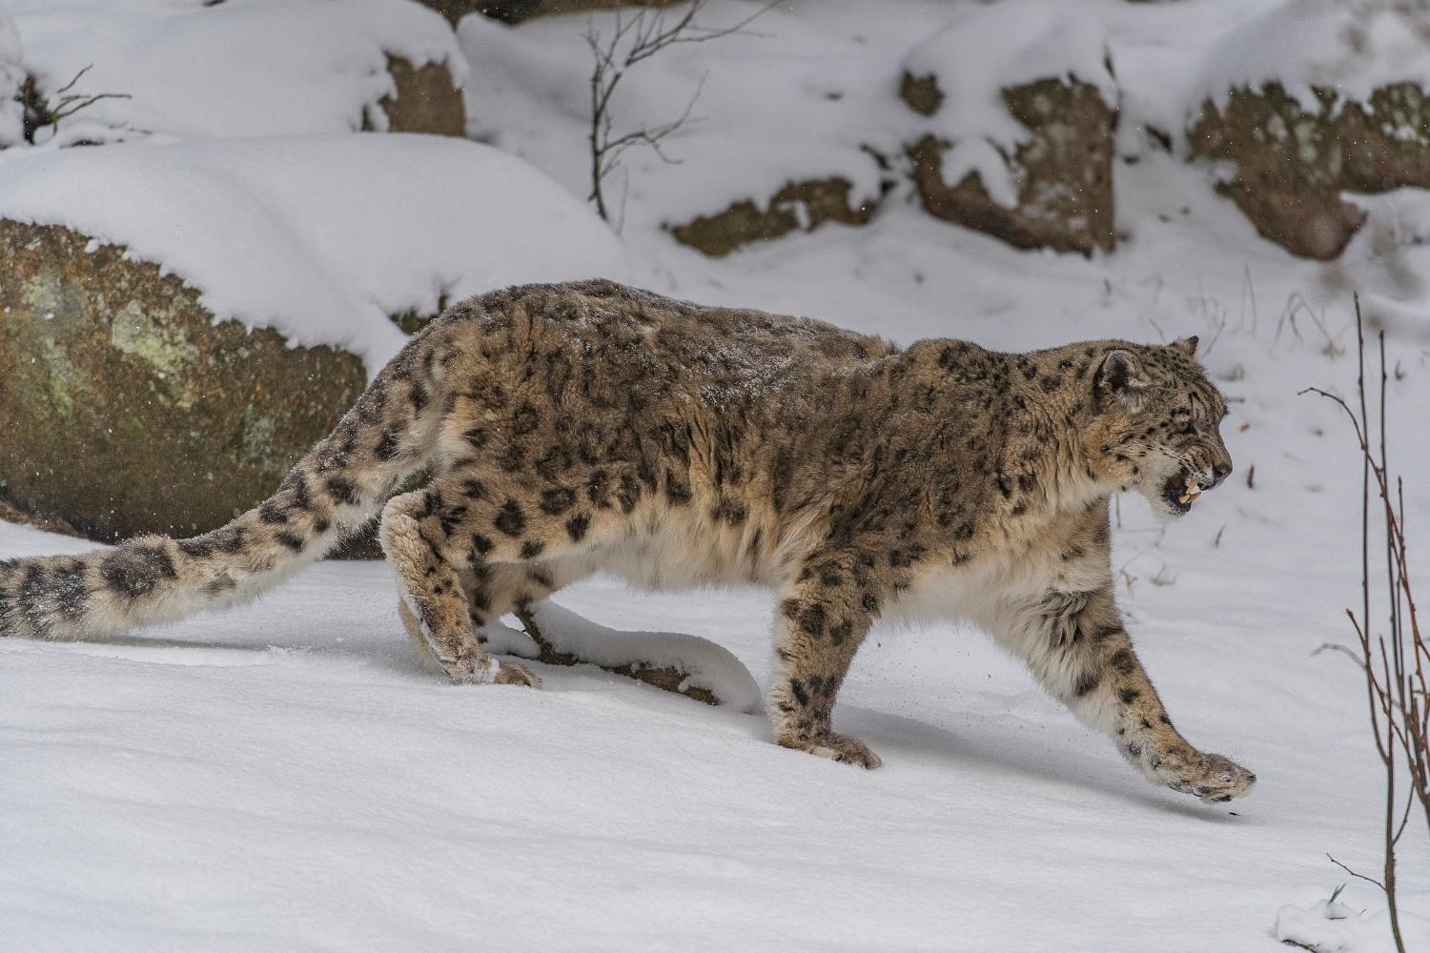
Snow leopards are threatened by hunting, habitat loss, and retaliatory killings.
Notes:
Snow leopards have evolved to live in some of the harshest conditions on Earth.
The snow leopard’s powerful build allows it to scale great steep slopes with ease. Its hind legs give the snow leopard the ability to leap six times the length of its body. A long tail provides balance and agility and also wraps around the resting snow leopard as protection from the cold.
Today there are only an estimated 4,080-6,590 individuals remaining.
Hunting, habitat loss and retaliatory killings are the main reasons this big cat is under threat.
WWF’s work focuses on reducing human-leopard conflict and rural development, education for sustainable development, stopping mining in fragile snow leopard habitat, and the control of the illegal wildlife trade.

Slide 18
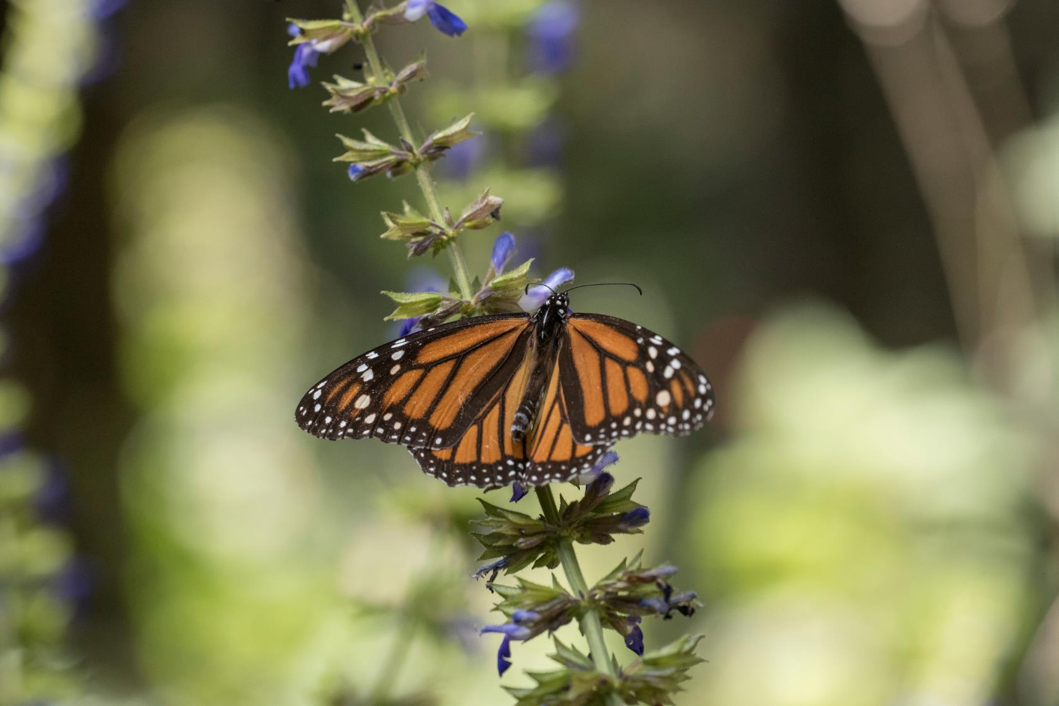
Climate change threatens to disrupt the monarch butterfly’s annual migration pattern.
Notes:
Monarch butterflies travel between 1,200 and 2,800 miles or more from the United States and Canada to central Mexican forests. There the butterflies hibernate in the mountain forests, where a less extreme climate provides them a better chance to survive. Each adult butterfly lives only about four to five weeks.
Climate change threatens to disrupt the monarch butterfly’s annual migration pattern by affecting weather conditions in both wintering grounds and summer breeding grounds. Colder, wetter winters could be lethal to these creatures and hotter, drier summers could shift suitable habitats north. WWF’s 2013 report from Mexico showed that the number of monarch butterflies wintering there was at its lowest in 20 years.

Slide 19
Ultimately, by protecting species, WWF is working to protect our planet.
Notes:
We protect wildlife for many reasons. It is a source of inspiration. It nurtures a sense of wonder. It is integral to the balance of nature. In our work, WWF focuses on saving populations of the most ecologically, economically and culturally important species in the wild. Ultimately, by protecting species, we save our vulnerable and irreplaceable planet.

Slide 20
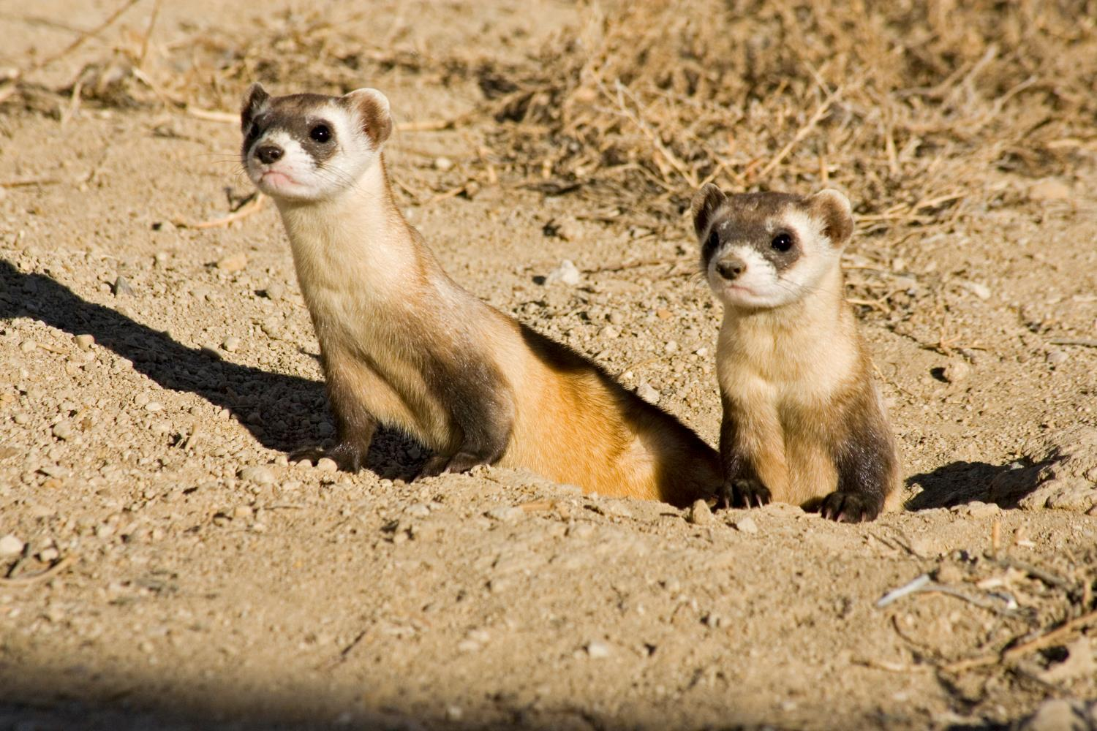
worldwildlife.org/species
Notes:
Visit the World Wildlife website to learn more about these and other priority species.

Slide 21
Photo Credits
Page 2: © naturepl.com / Edwin Giesbers / WWF
Page 3: © Jonathan Caramanus / Green Renaissance / WWF-UK
Page 4: © Renee Green
Page 5: © Sanskar Khedekar
Page 6: © WWF-US / Sharon Dreyfuss
Page 7: © naturepl.com / Andy Rouse / WWF
Page 8: © Christy Frank
Page 9: © David Lawson / WWF-UK
Page 10: © Antonio Busiello / WWF-US
Page 11: © Cliff Foltz
Page 12: © Greg Armfield / WWF-UK
Page 13: © Mac Mirabile / WWF-US
Page 14: © Thomas A. Jefferson / VIVA Vaquita
Page 15: © Karine Aigner/WWF-US
Page 16: © VDOS Global / WWF-Canada
Page 17: © Ola Jennersten / WWF-Sweden
Page 18: © WWF-US / Clay Bolt
Page 19: © Julia Thiemann / WWF-Germany
Page 20: © naturepl.com / Shattil & Rozinski / WWF

