Slide 2
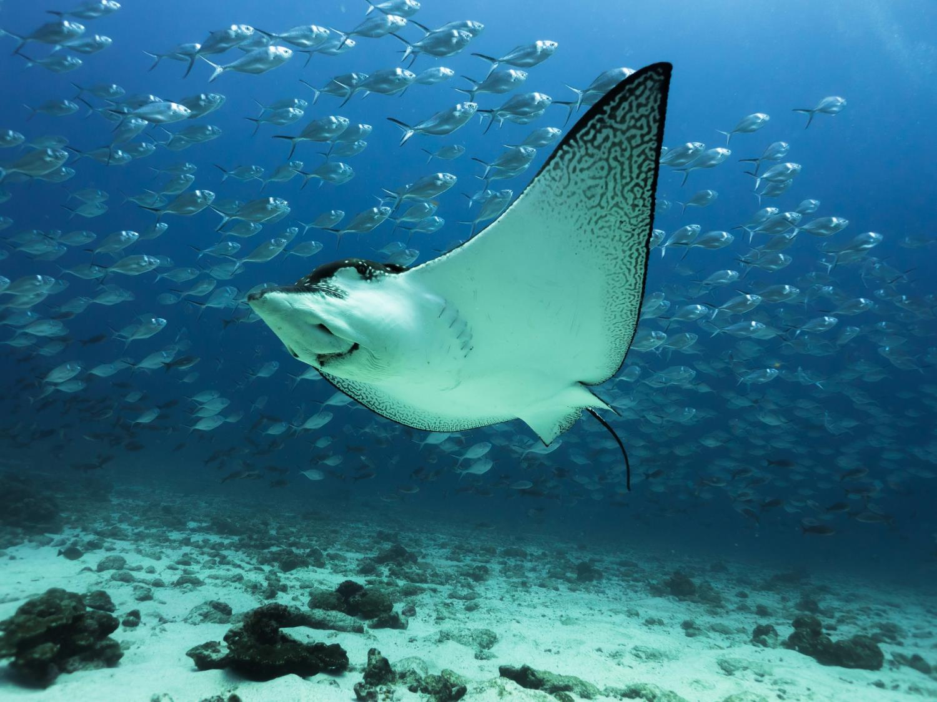
Oceans
Notes:
Oceans are one of WWF’s six main areas of focus

Slide 3
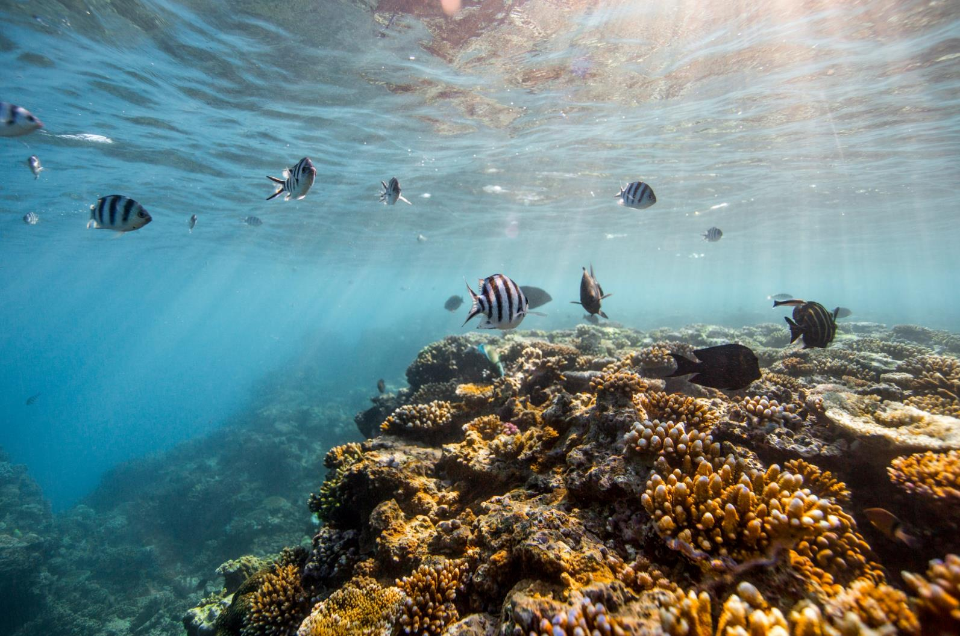
Our living planet is only as healthy as its oceans.
Notes:
These vast bodies of water cover more than two-thirds of Earth’s surface and are home to some of our most spectacular and treasured life. Oceans regulate our climate, produce half the oxygen we breathe, fuel the water cycle that produces rain and freshwater, sustain the livelihoods of millions, and provide nourishment for nearly 3 billion people.

Slide 4
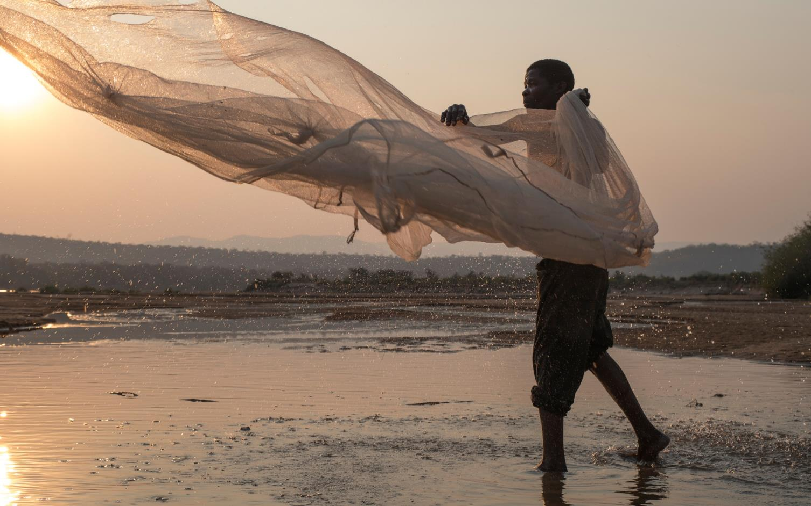
Protecting the oceans is critical for communities around the world.
Notes:
The world’s oceans are a lifeline for people around the world, generating at least $2.5 trillion worth of products and services each year. Fishing alone supports more than 260 million jobs. Only a healthy ocean can keep this economic engine running.

Slide 5
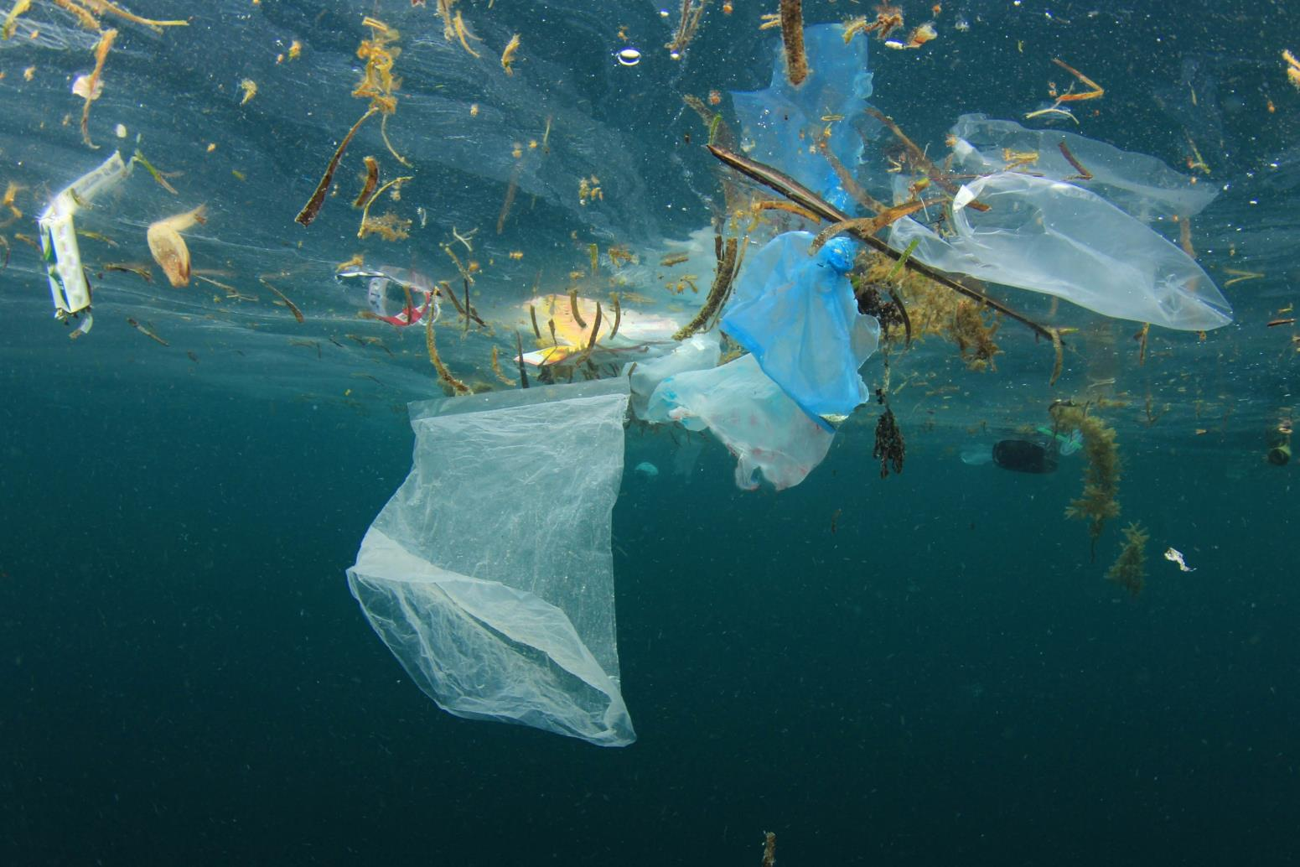
Ocean ecosystems are threatened by overfishing and unsustainable development.
Notes:
Today the ocean’s reserves are overdrawn, threatening countless communities around the world with climate, economic, and food insecurities. Unsustainable development, fueled by human population growth, has weakened ocean ecosystems. Modern technology is accelerating the rate of change.

Slide 6
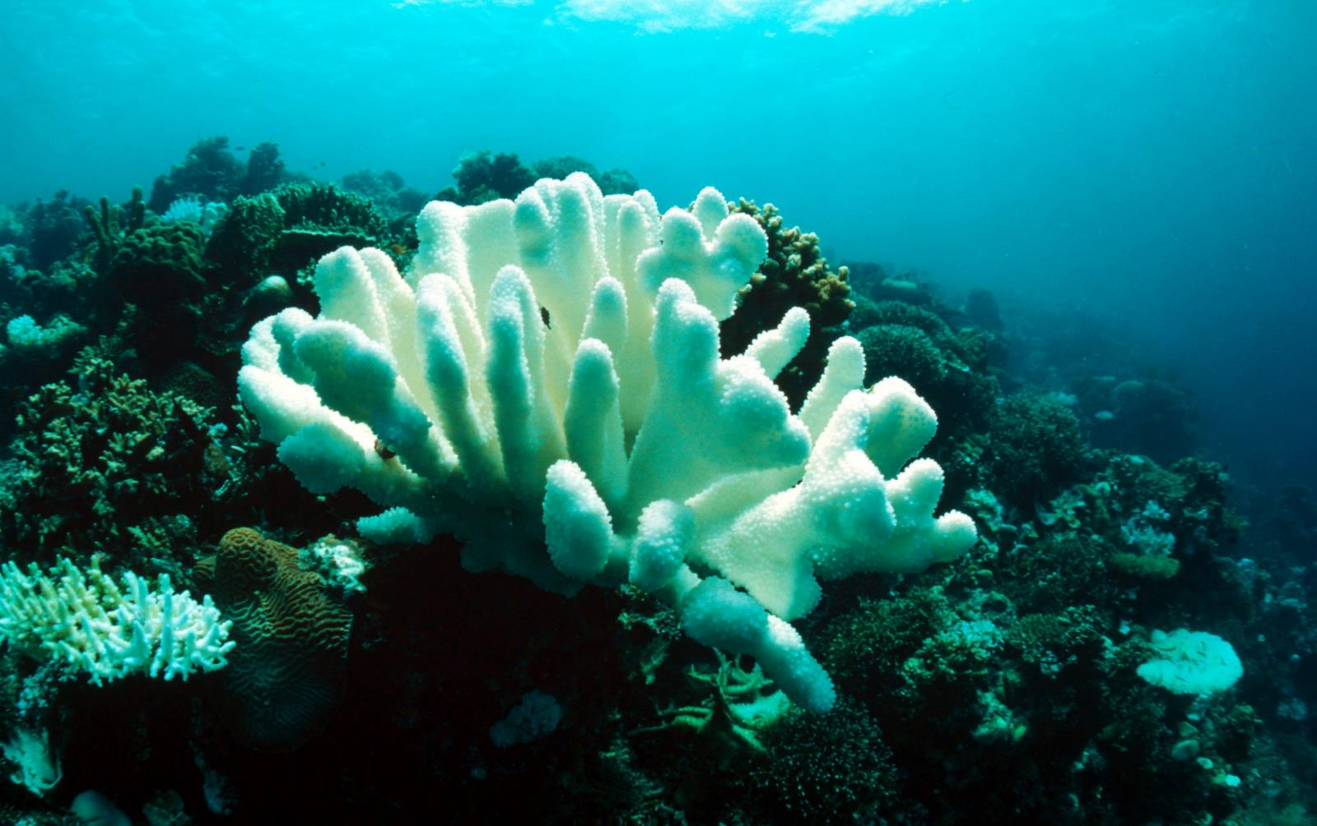
Oceans have absorbed more than 90% of the world’s warming.
Notes:
Our oceans have absorbed most of the planet’s warming—over 90%—and a significant amount of our carbon pollution. Warmer oceans are driving stronger storms and bleaching coral reefs. As oceans absorb carbon dioxide, they become more acidic, threatening most shelled organisms, including small crustaceans fundamental to the marine food chain.

Slide 7
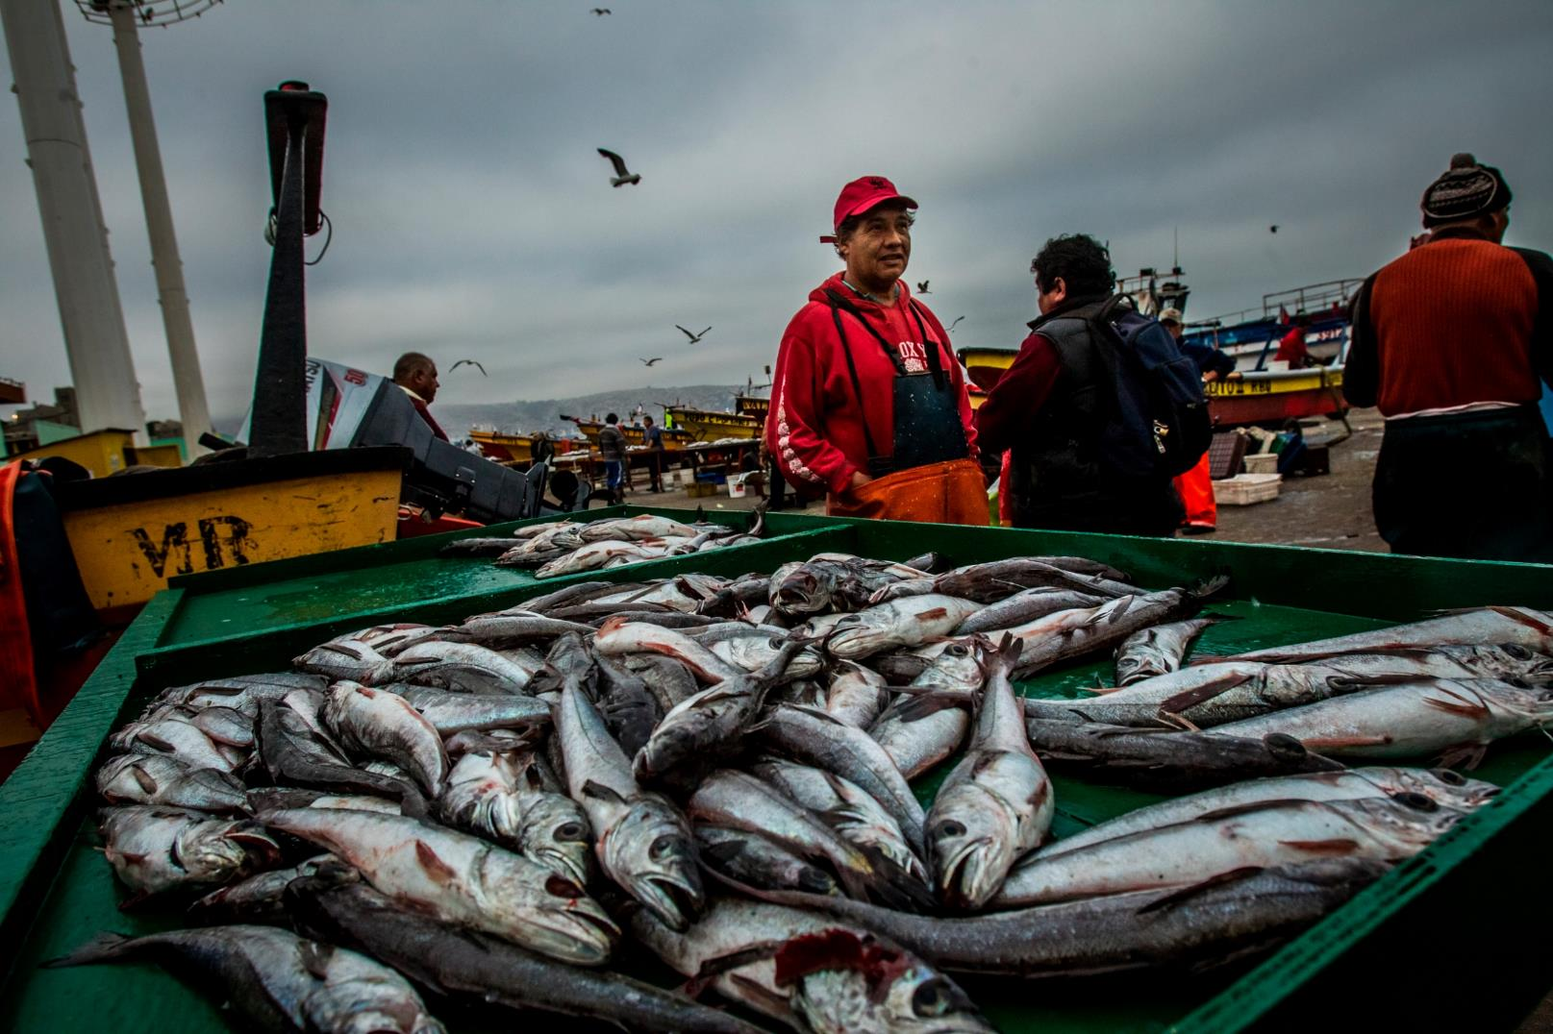
1/3 of wild fish populations have been harvested beyond their limit.
Notes:
Seafood is the major source of protein for roughly a billion people. But according to the UN Food & Agriculture Organization, one third of assessed wild fish populations have been harvested beyond their limit. Most of what’s left cannot handle the pressure that would come from adding more boats, nets, or poles. There are also regions with little enforcement of rules where the most destructive fishing practices continue to damage habitats and ecosystems, as well as the marine life that call them home.

Slide 8
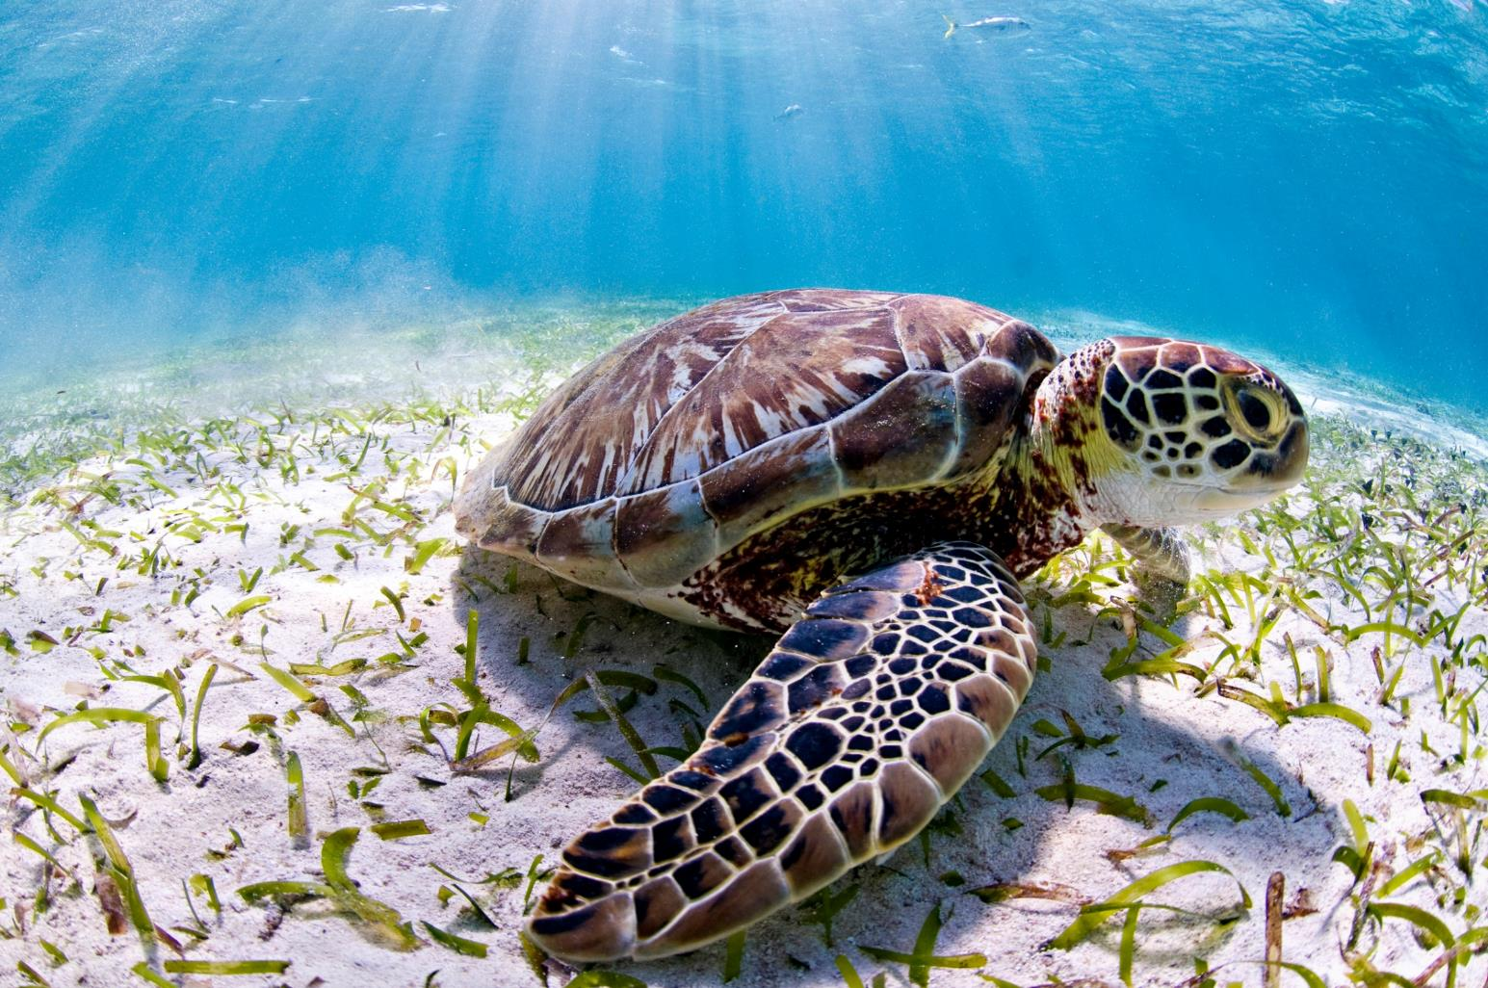
More than 2 million species live in the ocean – and we haven’t even identified most of them.
Notes:
Scientists estimate more than 2 million species live in ocean waters. And nine out of 10 haven’t been fully identified. The Marine Living Planet Index recorded a 36% overall decline in the abundance of marine life between 1970 and 2012. Unsustainable fishing is the primary direct threat to marine population, followed by habitat changes, which can also include a loss of food sources.

Slide 9
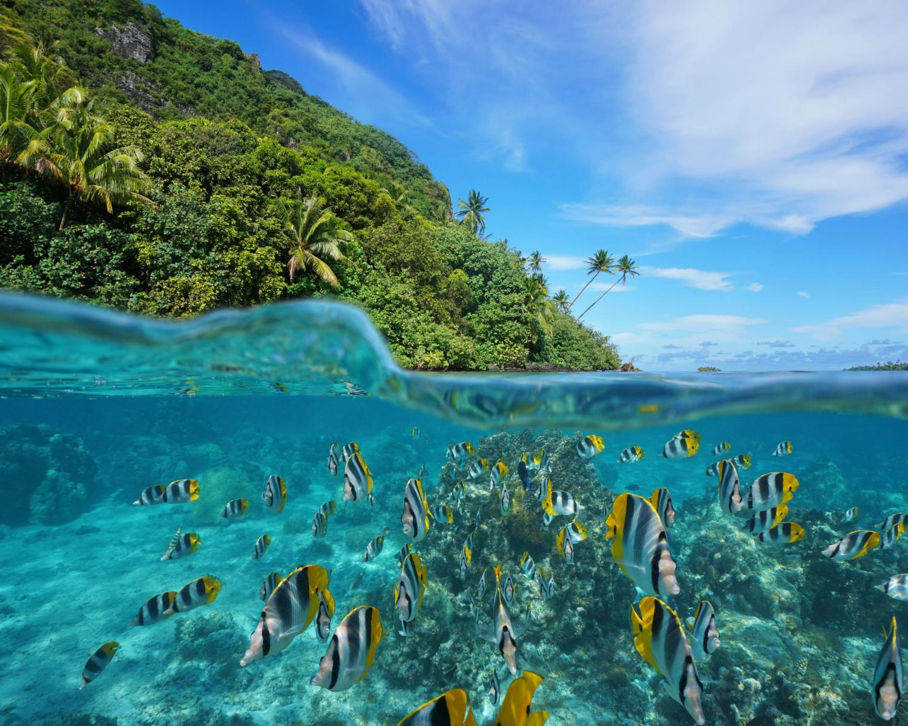
WWF is building more resilient oceans
Notes:
WWF is working collaboratively on the brightest conservation ideas that focus on building a more resilient ocean through sustainable fishing practices and protecting important regions, like the Arctic and threatened mangrove forests.
The problems we face go well beyond borders and so does our work. WWF is uniquely positioned to activate a global network of experts and activists to confront the world’s most pressing ocean conservation challenges.

Slide 10
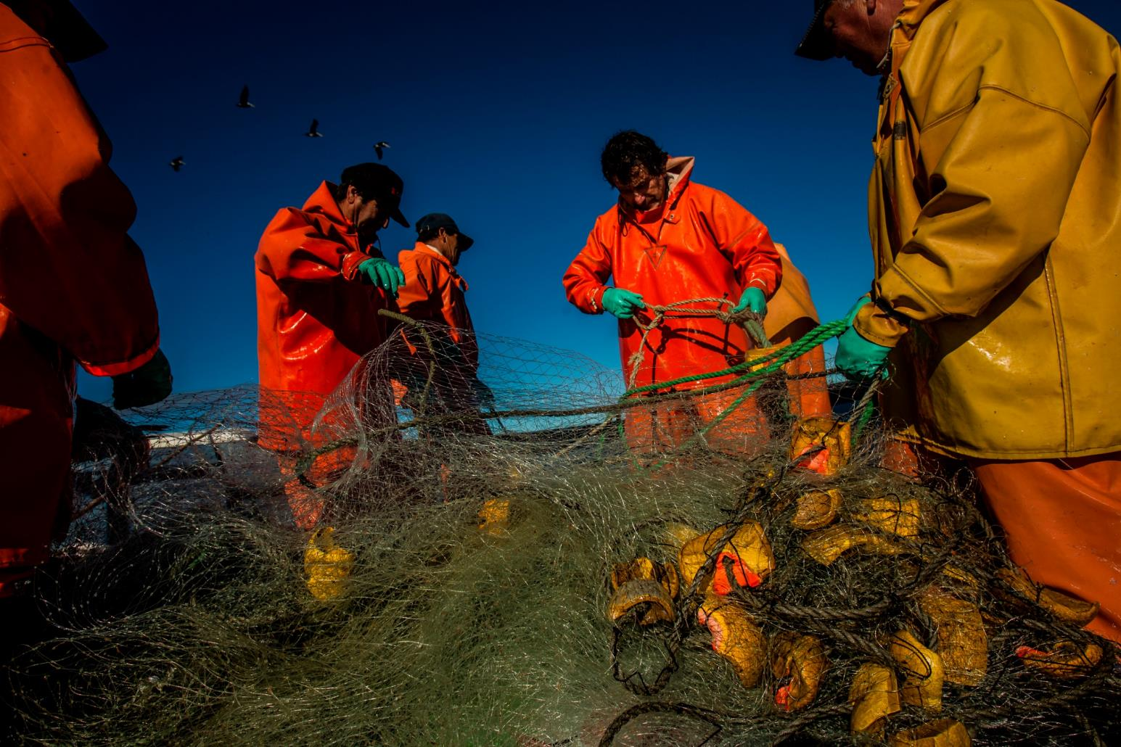
Increasing sustainable fishing
Notes:
WWF is working with fishers, fishing companies and scientists around the globe to understand and meet sustainability standards. We also leverage the power of the marketplace to incentivize sustainable fishing by connecting responsible producers with partners in preferred markets, linking fishermen directly with major seafood buyers in retail, food service, and manufacturing who want to support sustainable fishing. This creates financial incentive to invest in long-term sustainability.

Slide 11
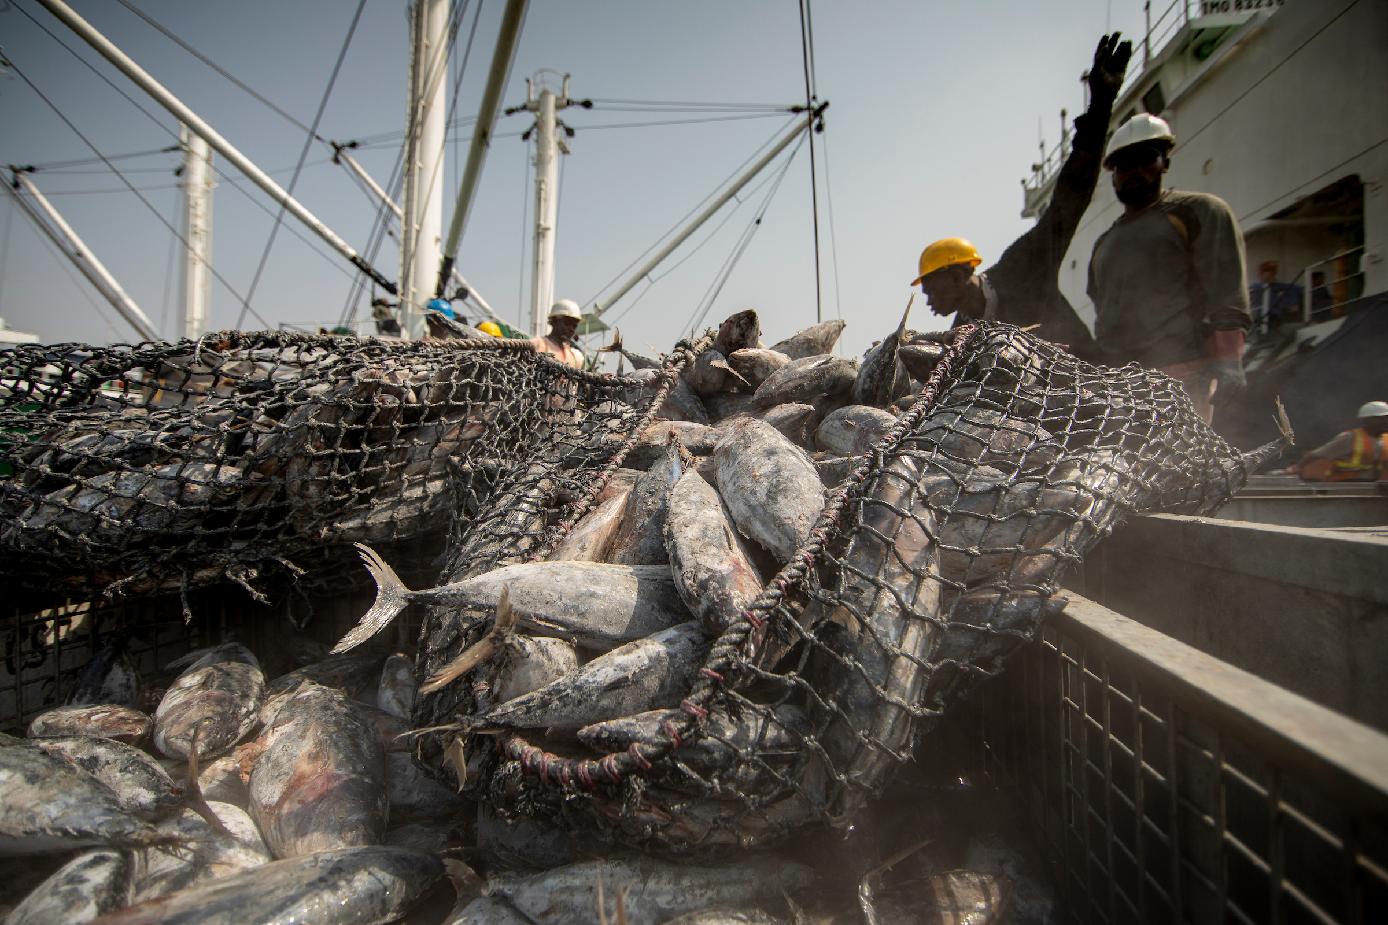
Stopping illegal, unreported, and unregulated fishing
Notes:
At the same time, we work to stop illegal, unreported, and unregulated fishing through a combination of governance, enforcement, technology, and engagement.
(Photo from the WWF Ghana EMS pilot project)

Slide 12
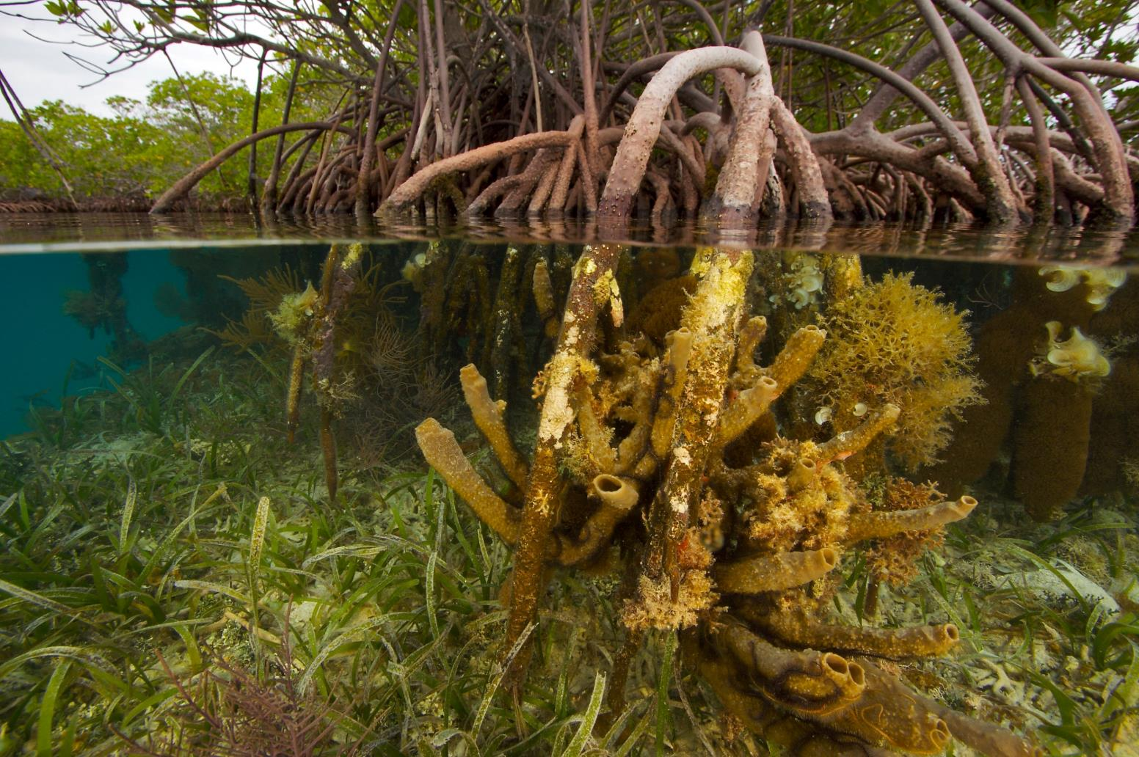
Expanding coastal ecosystem resilience
Notes:
The coastal zone makes up only 10% of the ocean environment but is home to over 90% of all marine species. Coral reefs and mangrove forests provide people and nature with numerous benefits, like protecting coastlines and communities from sea level rise and intense storms, while also housing many nurseries of the sea where fish spawn. WWF and partners aim to build the resilience of tropical coastal ecosystems and support the conservation and restoration of 6 priority seascapes through community and science-based, cross-sectoral approaches, thereby improving the lives of 10 million people.

Slide 13
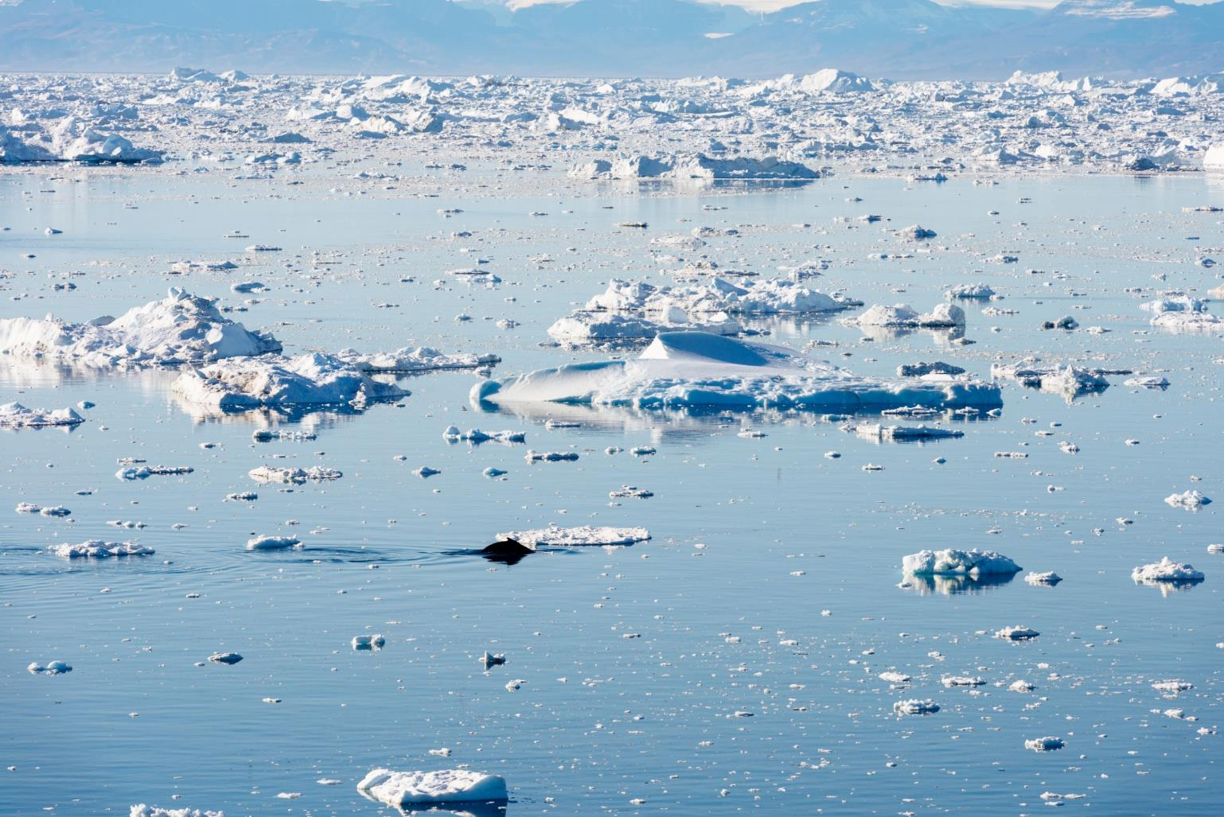
Protecting the Arctic
Notes:
WWF has been on-the-ground for 25 years in the Arctic, collaborating with local communities and experts in science, policy, and planning. We work to strengthen Arctic-wide governance, advance climate-smart, sustainable development, and secure permanent protection for ecologically critical areas.

Slide 14
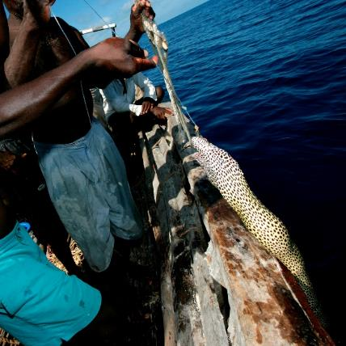
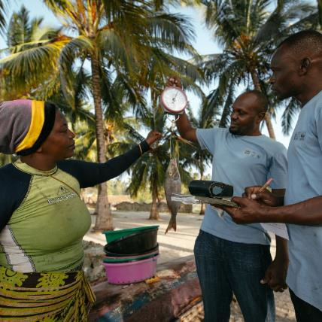
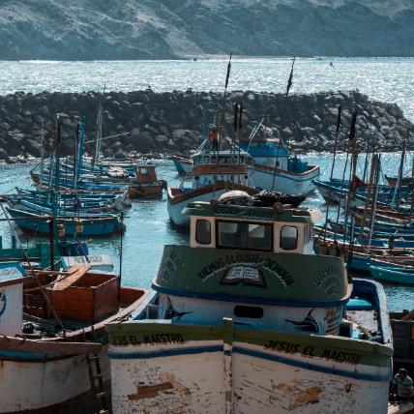
Projects
Bait to Plate
Smartphone App for Fisheries Management
Affordable Electronic Monitoring
Notes:
WWF’s oceans team is working on several projects to ensure healthy, resilient oceans. Those include:
Tracking seafood from bait to plate- WWF works with leaders in the public and private sectors track seafood along every step of the supply chain
Smartphone app for fisheries management - WWF has developed a new smartphone app that helps fisherman self-report their catch data while at sea, making it easier and cheaper for fisheries managers, businesses, and governments to collect vital information about community fishing activities.
Affordable electronic monitoring - WWF is collaborating with the US government and a company called Flywire to develop a low cost electronic monitoring system that is able to collect high quality data at less than a tenth of the cost of existing systems used by the commercial fishing fleet.

Slide 15
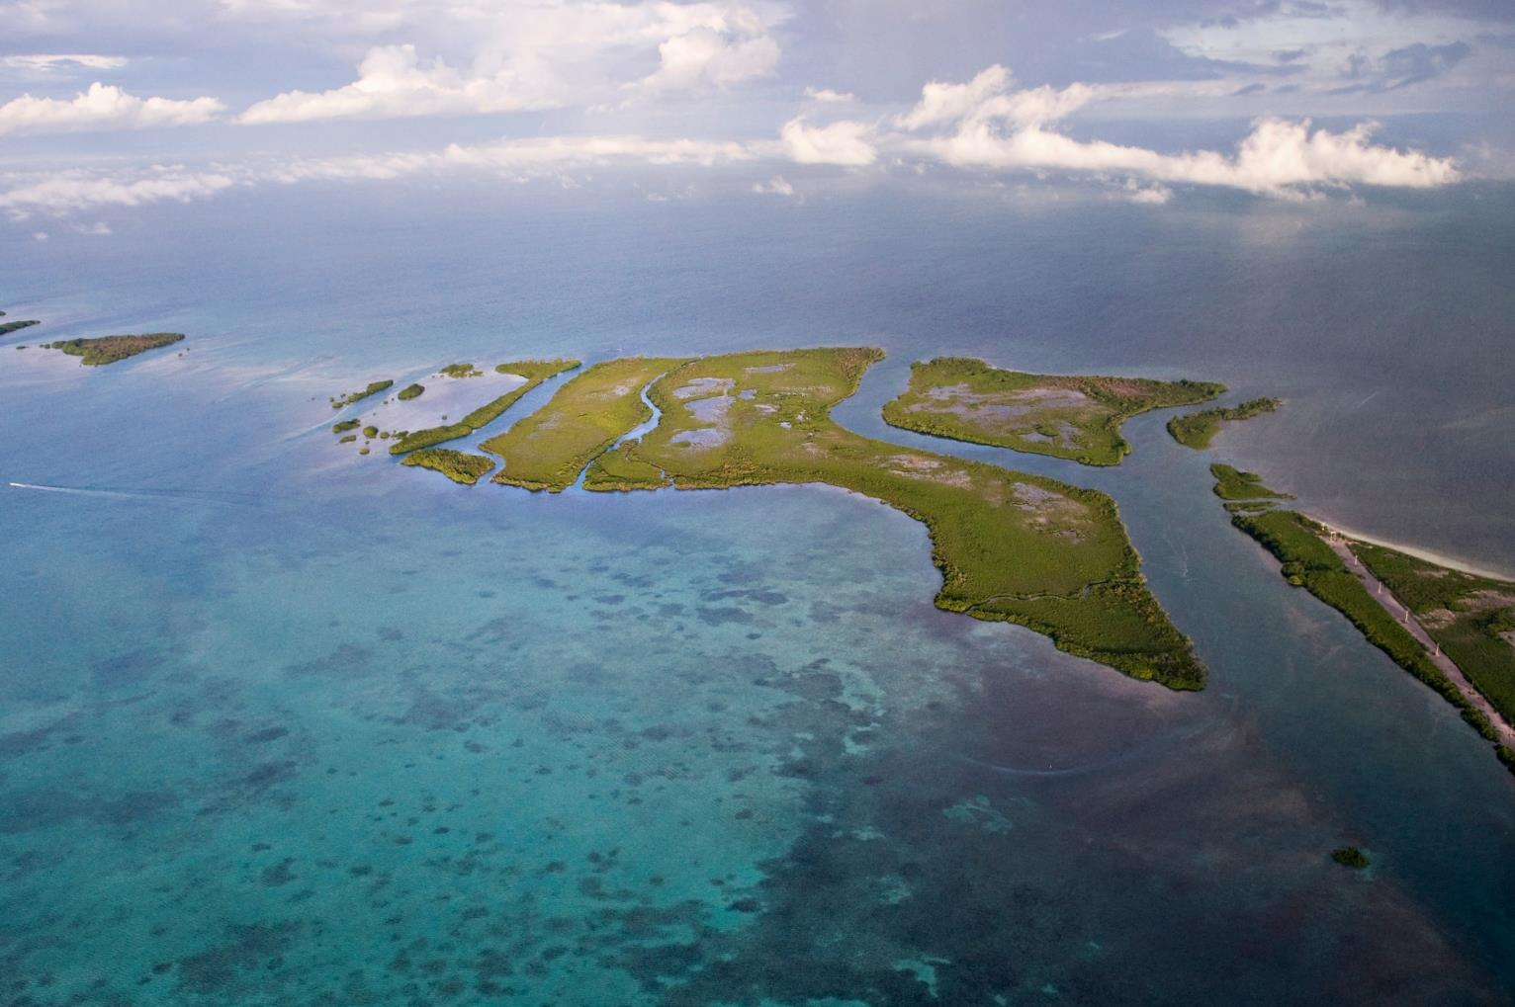
worldwildlife.org/initiatives/oceans
Notes:
Visit the World Wildlife website to learn more.

Slide 16
Photo Credits
Page 2: © Daniel Versteeg / WWF
Page 3: © WWF / James Morgan
Page 4: © James Suter / Black Bean Productions / WWF-US
Page 5: © Shutterstock / Rich Carey / WWF
Page 6: © Jürgen Freund / WWF
Page 7: © Meridith Kohut / WWF-US
Page 8: © Antonio Busiello / WWF-US
Page 9: © Shutterstock / Damsea / WWF
Page 10: © Meridith Kohut / WWF-US
Page 11: © WWF/ Kyle Laferriere
Page 12: © naturepl.com / Tim Laman / WWF
Page 13: © Elisabeth Kruger / WWF-US
Page 14: © Jürgen Freund / WWF
Page 15: © Brent Stirton / Getty Images / WWF-UK
© Green Renaissance / WWF-UK
© Yawar Motion Films / WWF-Peru
Page 16: © Antonio Busiello/WWF-US

