Slide 2
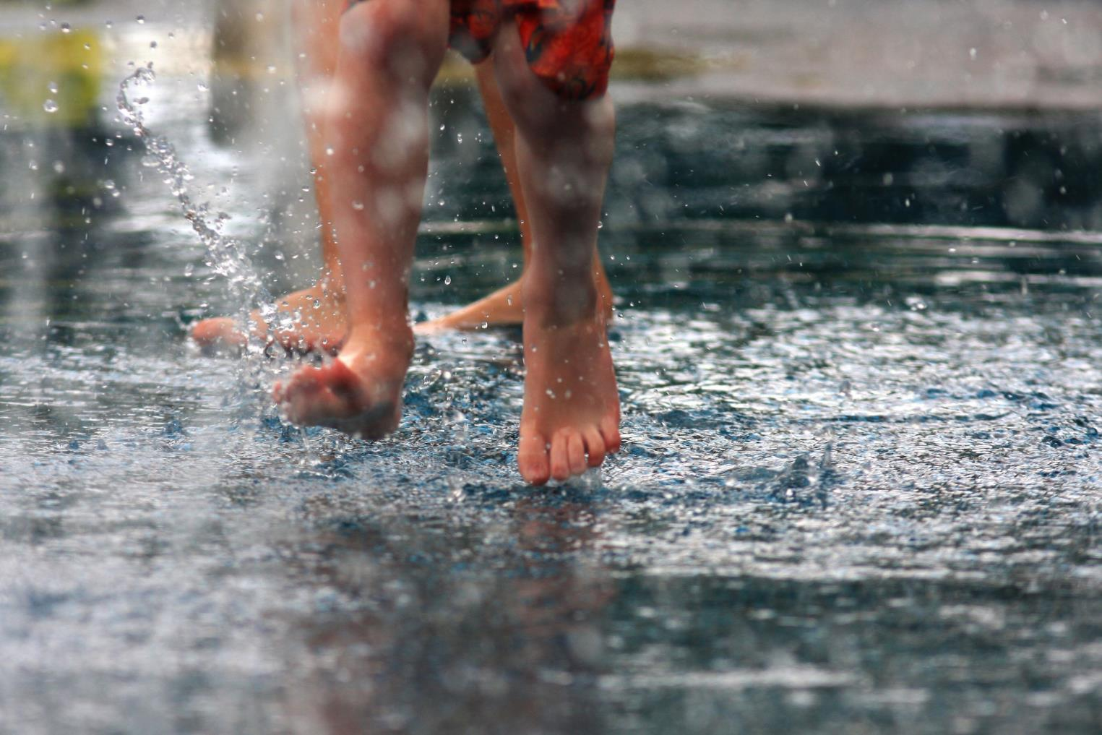
Fresh Water
Notes:
All life needs water. It is the world’s most precious resource, fueling everything from the food you eat, to the clothes you wear, to the energy you depend upon every day. Water is just as critical to nature and wildlife.

Slide 3
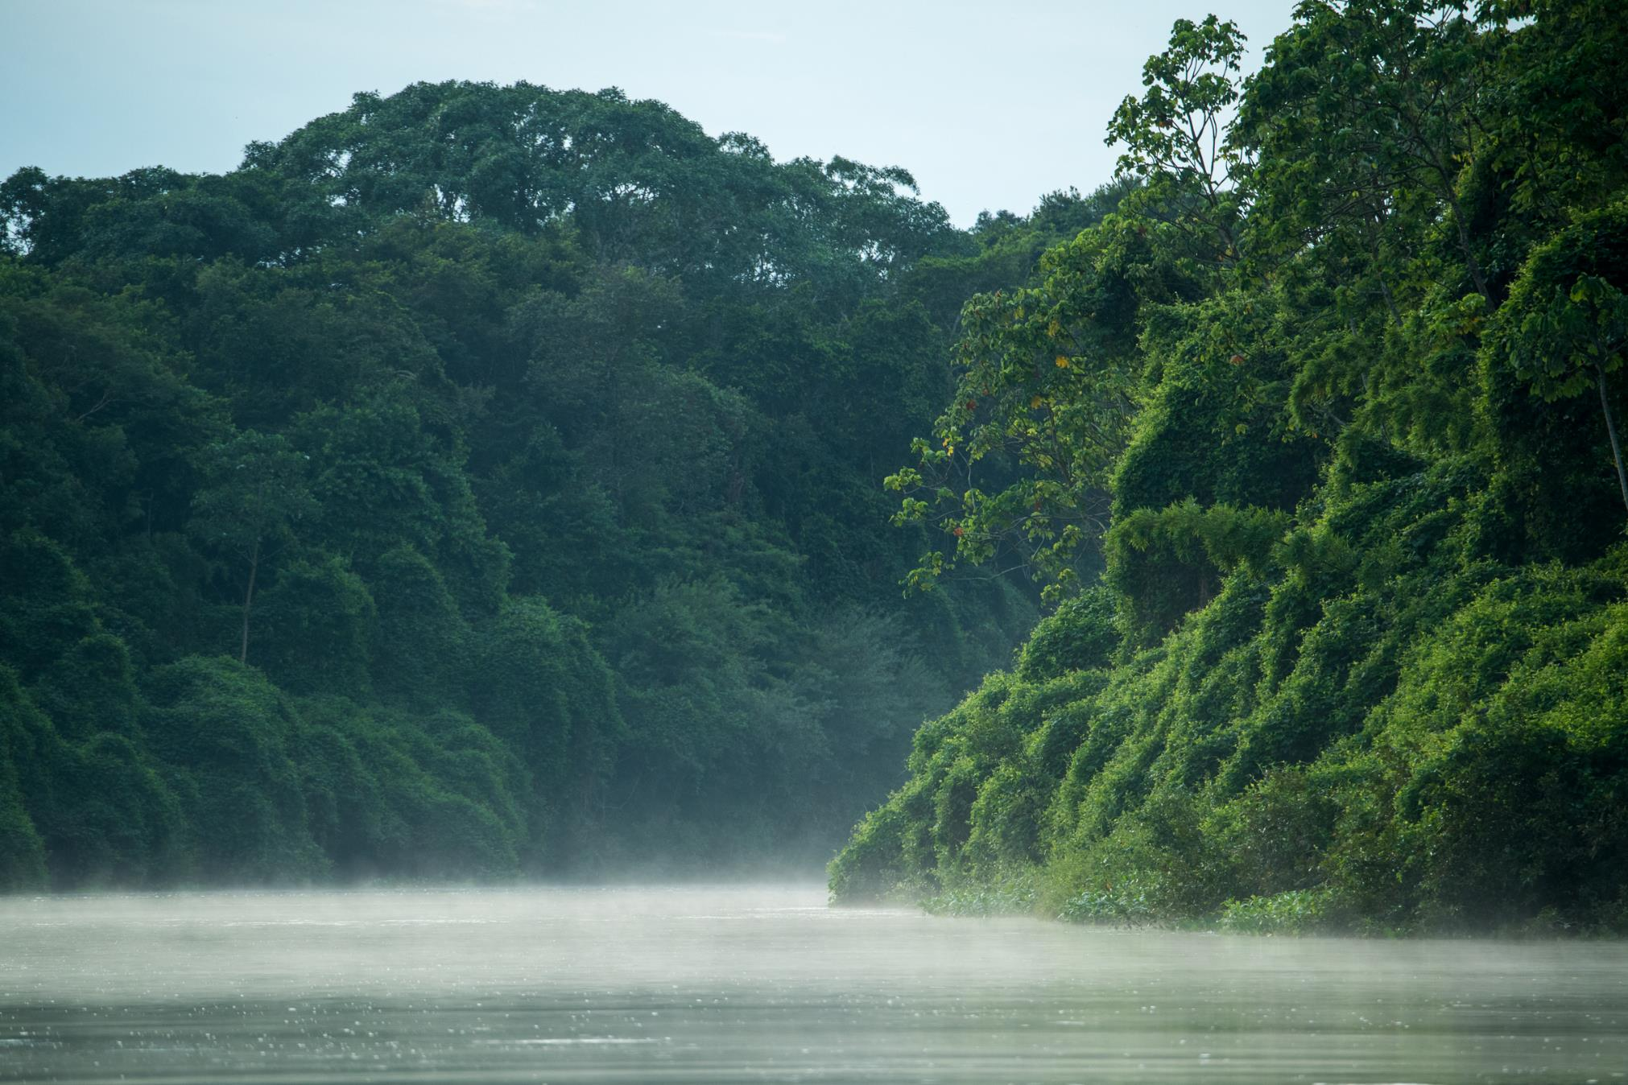
Less than 1% of the world’s water is fresh and accessible.
But fresh water is home to more than 10% of all known animals and about 50% of all known fish species.
Notes:
While nearly 70% of the world is covered in water, only about 2.5% is fresh—not saline or ocean. And most of that 2.5% is inaccessible, frozen in glaciers or snowpack.

Slide 4
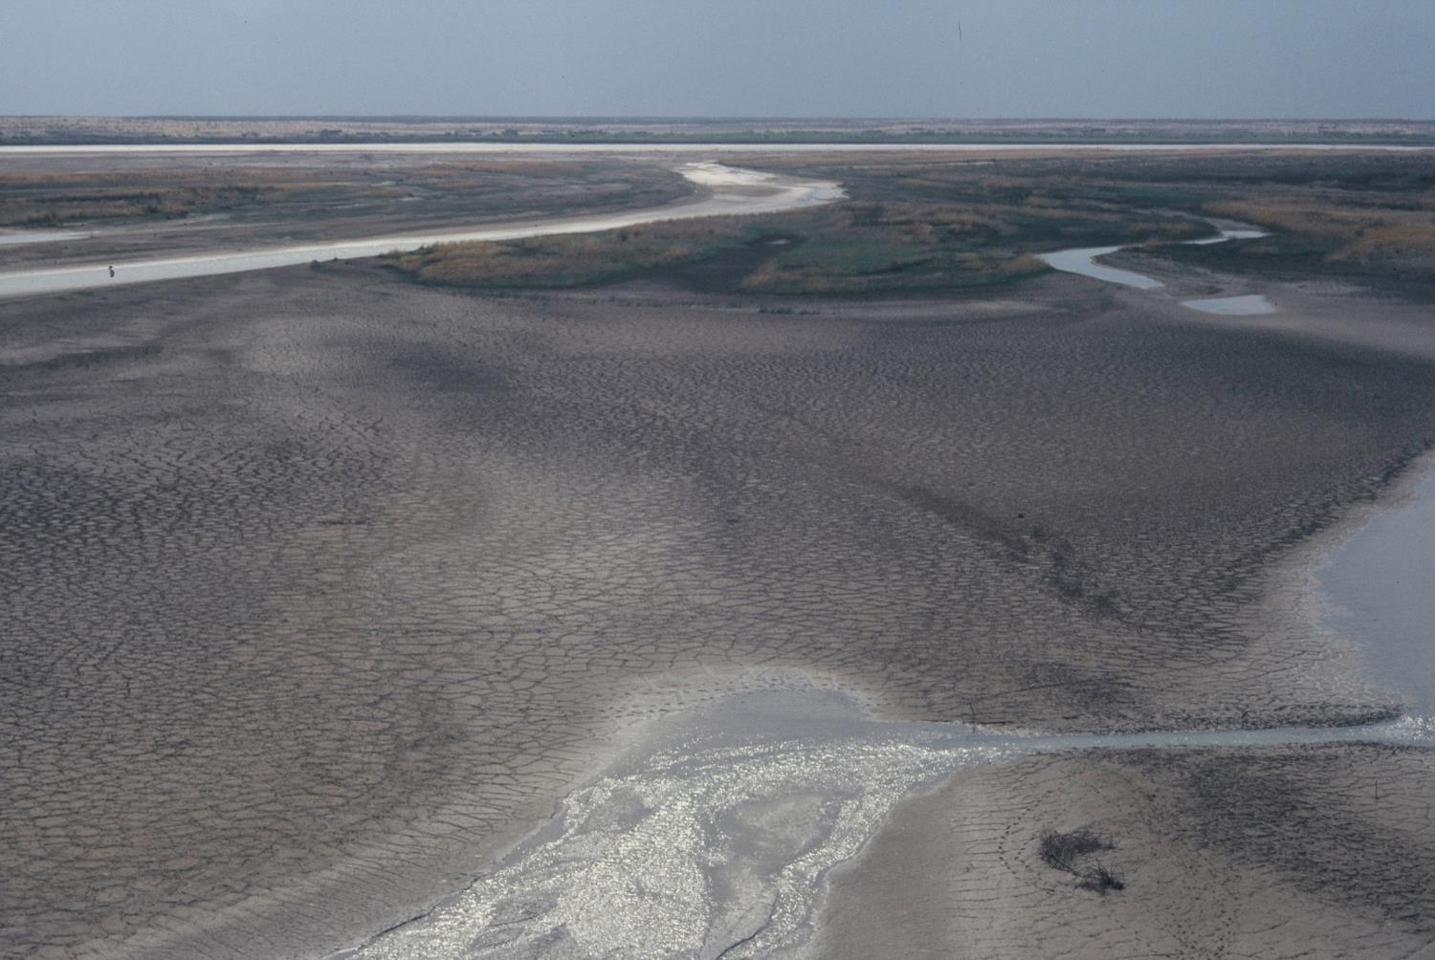
Climate change, population growth, and increasing demand threatens our freshwater systems.
Notes:
This incredibly scarce resource is also threatened. Climate change is leaving us hotter and drier, and adding instability to weather patterns that we rely upon. At the same time there are more people using more water. As we manufacture more goods and produce more energy, we’re using water faster than it can be replenished.

Slide 5
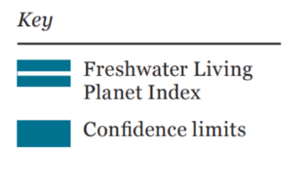
Freshwater Species Populations Have Declined by 83% Since 1970
Trend in population abundance for 3,324 populations of 881 freshwater species monitored across the
globe between 1970 and 2012 (WWF/ZSL, 2016).
Notes:
Our use of fresh water also has devastating consequences for the environment and nature. WWF’s 2016 Living Planet Report found that freshwater species populations have declined by 83% since 1970. Compare that to land-based populations, which have declined 38% in the same time period.

Slide 6
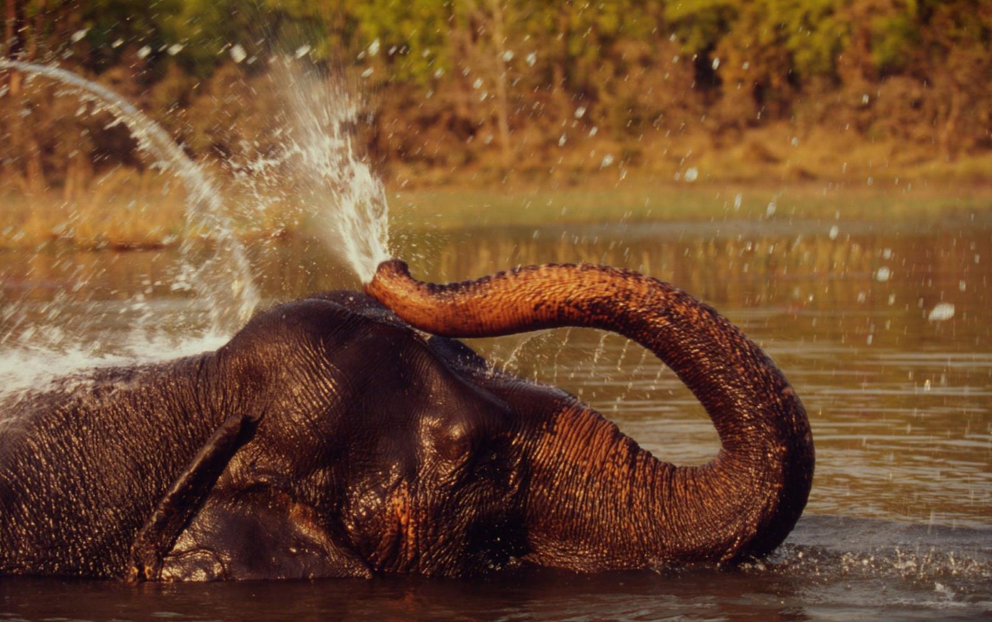
Fresh Water is Critical to All Aspects of Life
Notes:
WWF is working to maintain or improve the health of the world’s most critical basins by 2025. We do this by bringing all actors together to make sure we manage resources wisely, ensuring there’s enough fresh water for what’s most important.

Slide 7
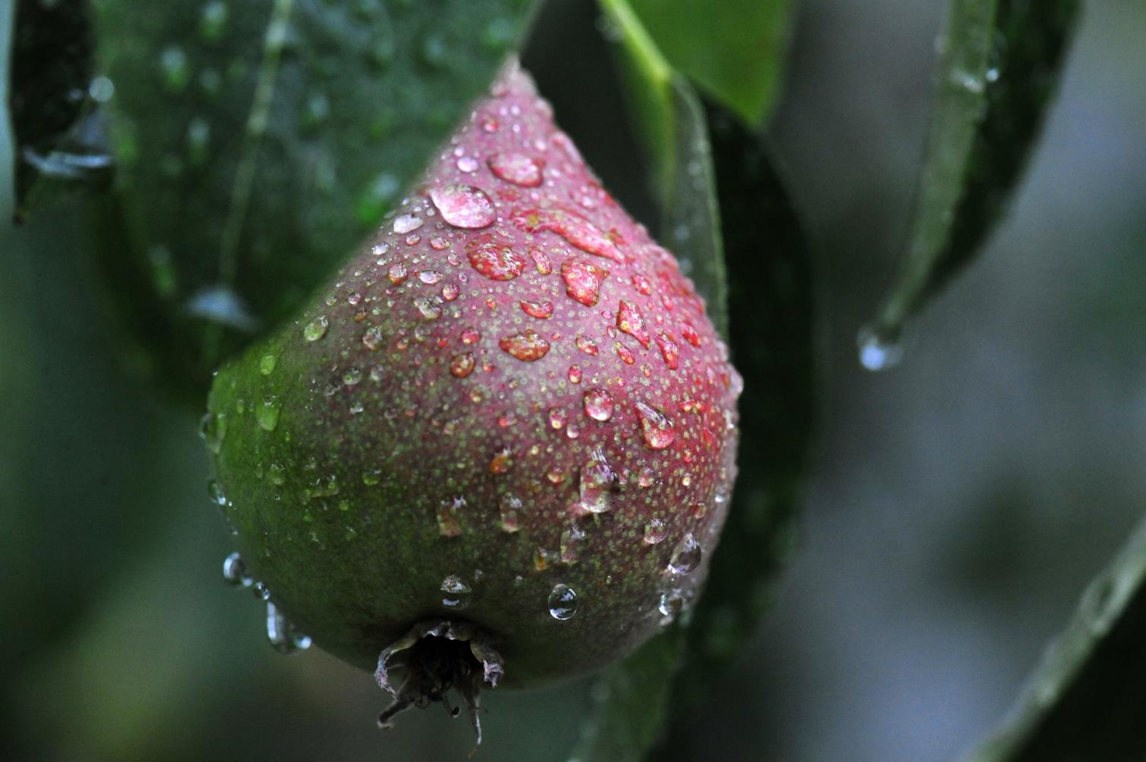
Food
70% of the world’s freshwater resources are used in agriculture.
Notes:
Globally, agriculture uses the highest percentage of freshwater, accounting for about 70% of total water withdrawals. Most of the water goes to irrigation. As the planet’s population increases and we consume more, global demand for food –and subsequently, water--will increase.

Slide 8
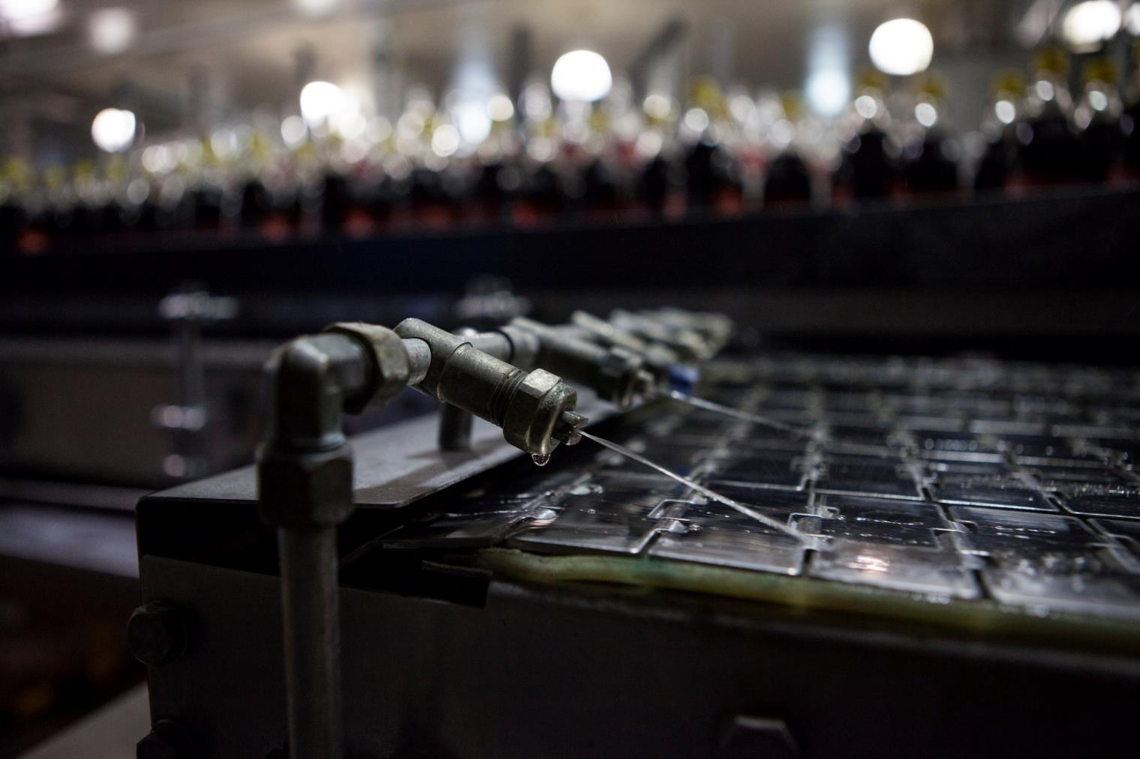
Business & Industry
Every business relies on water. Uncertainty in water availability and quality poses serious risk.
Notes:
Nearly every business is water-dependent in one way or another. Issues of water scarcity and poor water quality have significant and growing social, environmental and economic consequences. And although water risk is rising quickly on the agenda of business and investors, many businesses are just beginning to understand what fresh water means to them, their profits, and their company’s long-term viability.

Slide 9
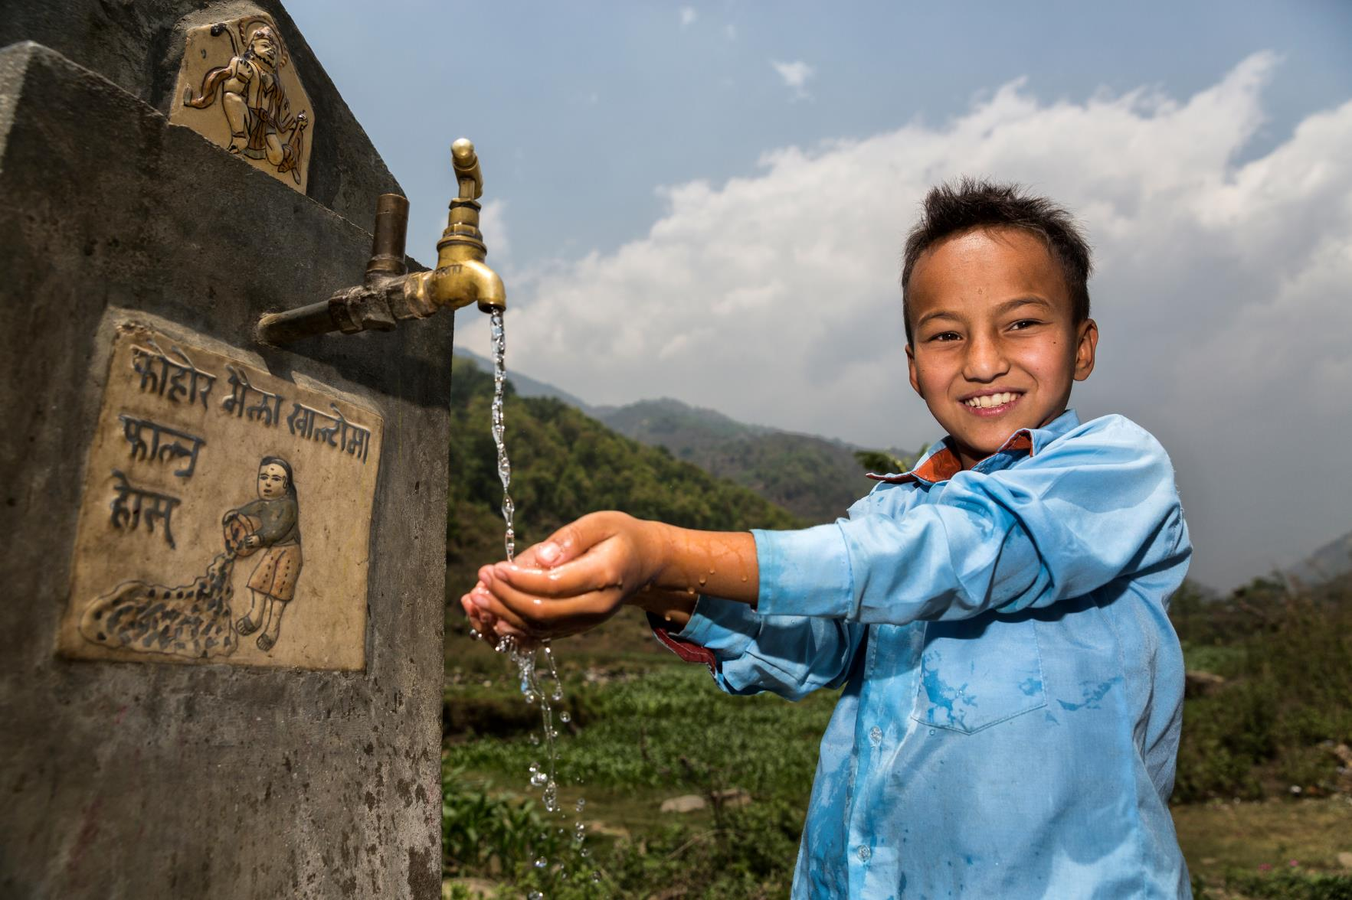
Healthy Communities
1.1 billion people lack access to water. 2.4 billion don’t have adequate sanitation.
By 2025, two-thirds of the world’s population may be facing water shortages.
Notes:
Clean, fresh water is an essential ingredient for a healthy human life, but 1.1 billion people lack access to water and 2.4 billion don’t have adequate sanitation. Diseases caused by unsafe water and inadequate sanitation kill more people every year than all forms of violence, including war.
The situation is predicted to get worse: by 2025, two-thirds of the world’s population may be facing water shortages.
Sustainable access to fresh water and sanitation leads to healthier people and economic growth.

Slide 10
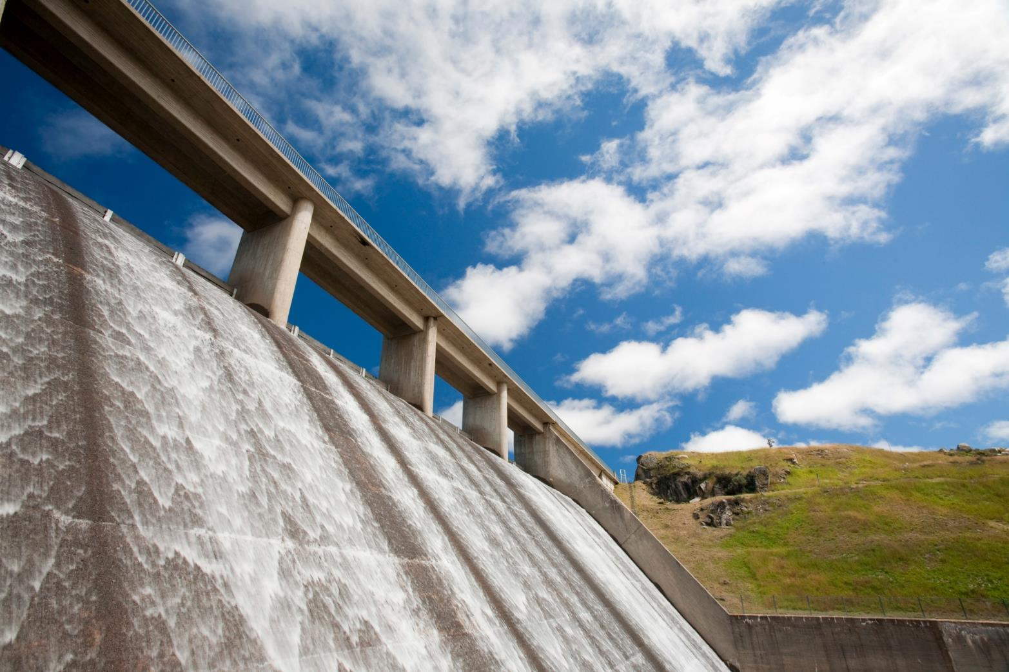
Energy
Water is essential for producing almost all forms of energy.
Notes:
Energy and water are interdependent. Energy is required for pumping, storing, transporting and treating water, and water is essential for producing almost all kinds of energy. While the role of water in hydropower is obvious, water also irrigates biofuels, plays an essential role in fracking, and cools thermoelectric power plants like coal, nuclear, natural gas, and oil.

Slide 11
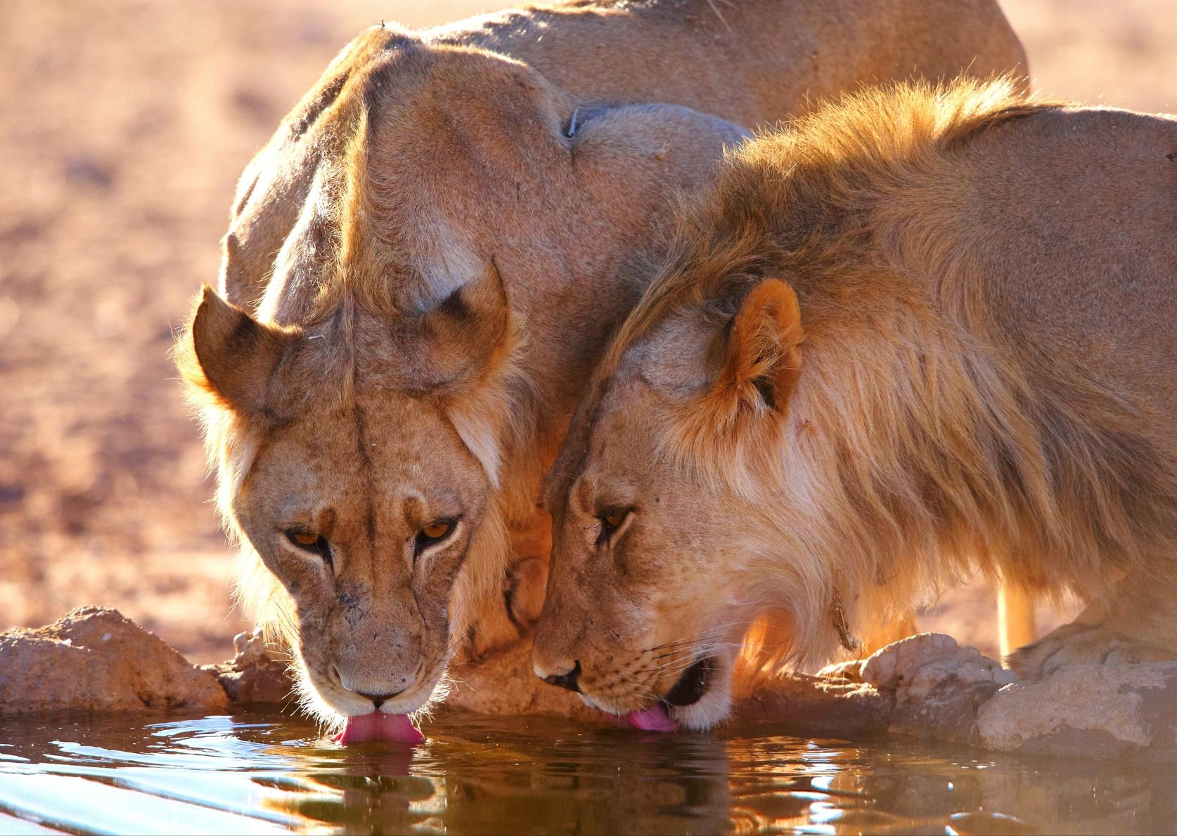
Nature
Freshwater ecosystems cover less than 0.01% of the planet’s total surface area but support more than 125,000 species, from fish to terrestrial animals.
Notes:
Freshwater ecosystems cover less than 0.01% of the planet’s total surface area but they support more than 125,000 species, from fish to terrestrial animals. These ecosystems also help to regulate the temperature of the land and sea, creating clouds and affecting the weather, transporting nutrients and minerals, and keeping nature clean and healthy by dissolving pollutants and sediment run off. However, more than half of the world’s wetlands have disappeared since 1900, and fewer than 70 of the world’s 177 longest rivers remain free of man-made obstructions.

Slide 12
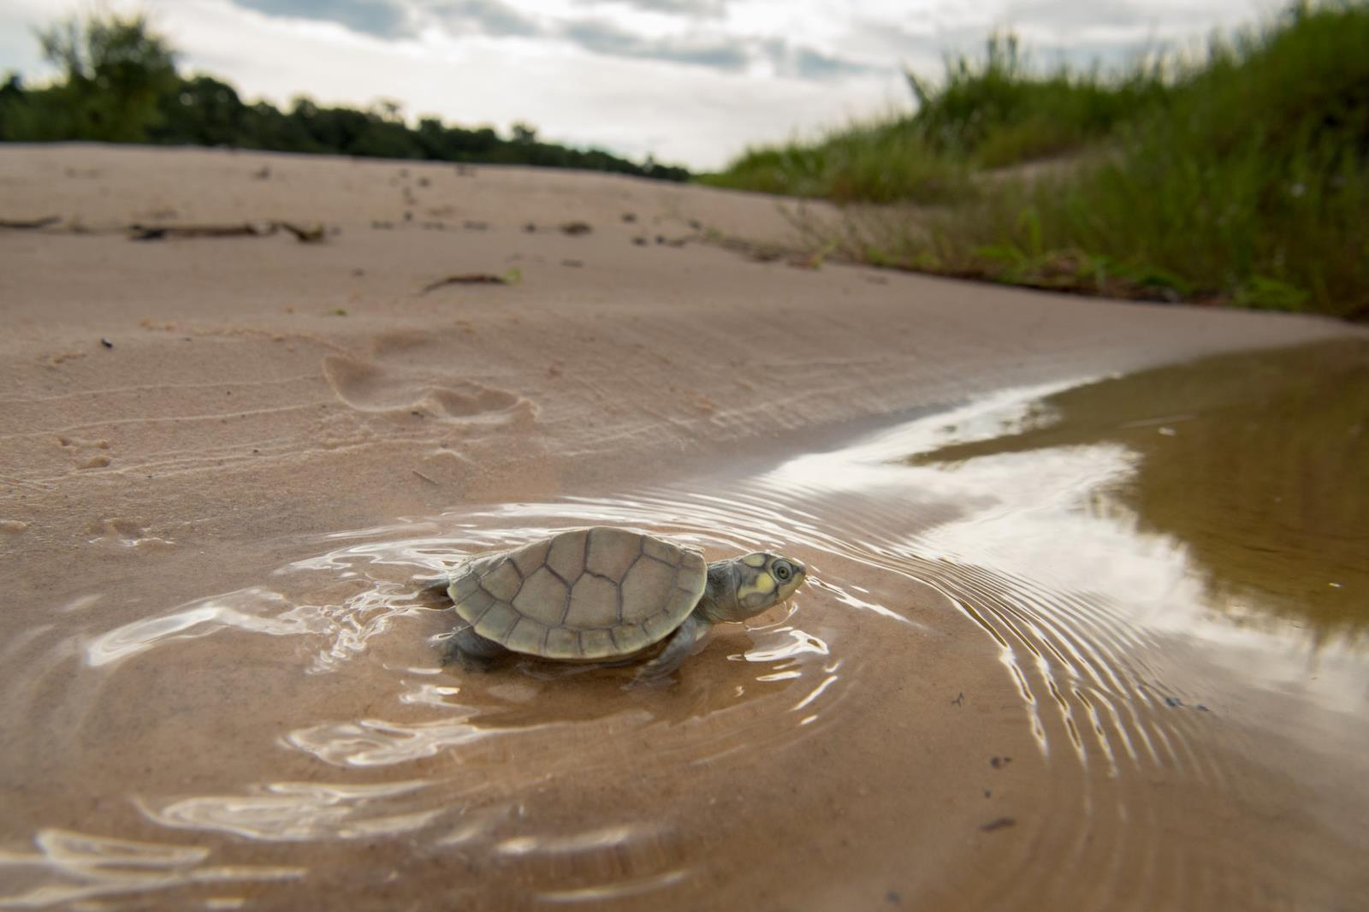
How WWF is Protecting Fresh Water

Slide 13
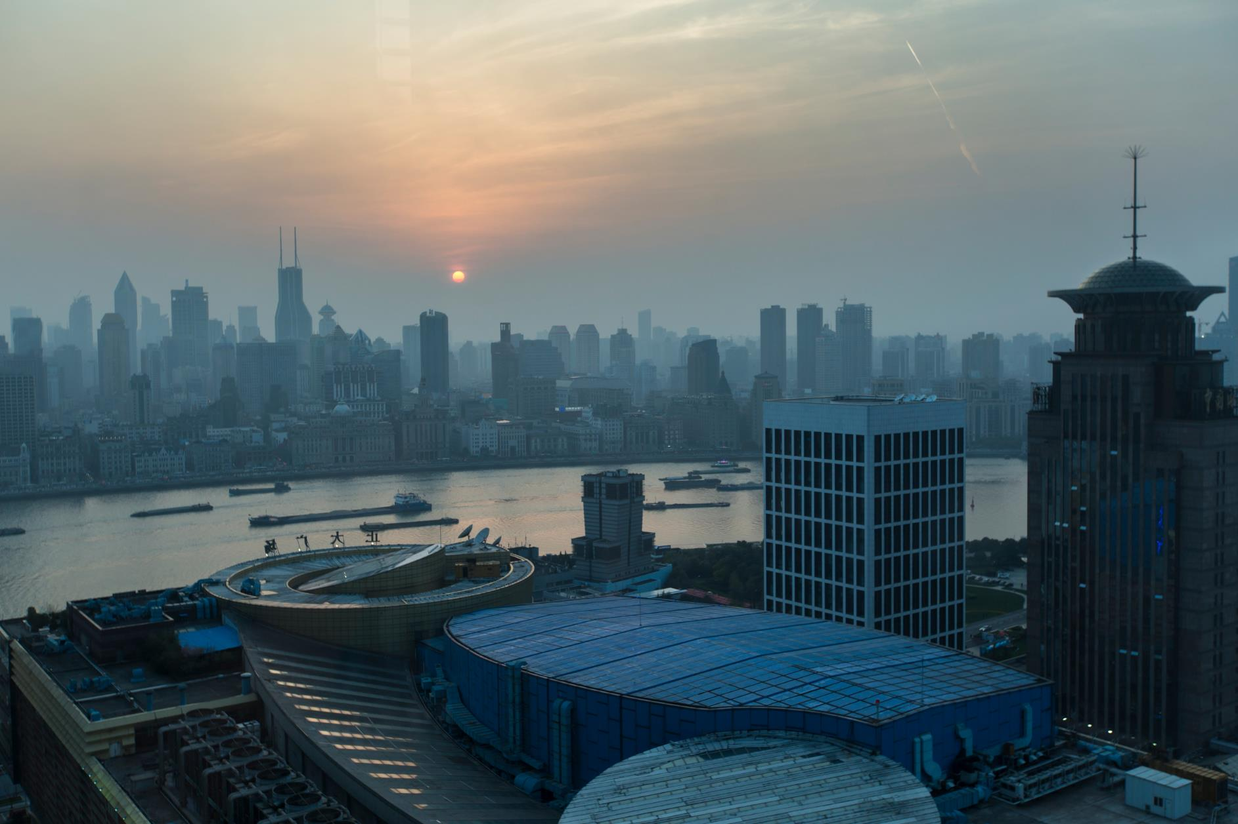
Promoting Good Water Governance
Ensuring freshwater is prioritized in decision making.
Notes:
WWF seeks to change how water is managed around the world. We encourage states relying on the same river to coordinate better and allocate resources fairly. We also push governments and others to prioritize freshwater resources, to ensure that freshwater ecosystem integrity is considered in decision making processes.

Slide 14
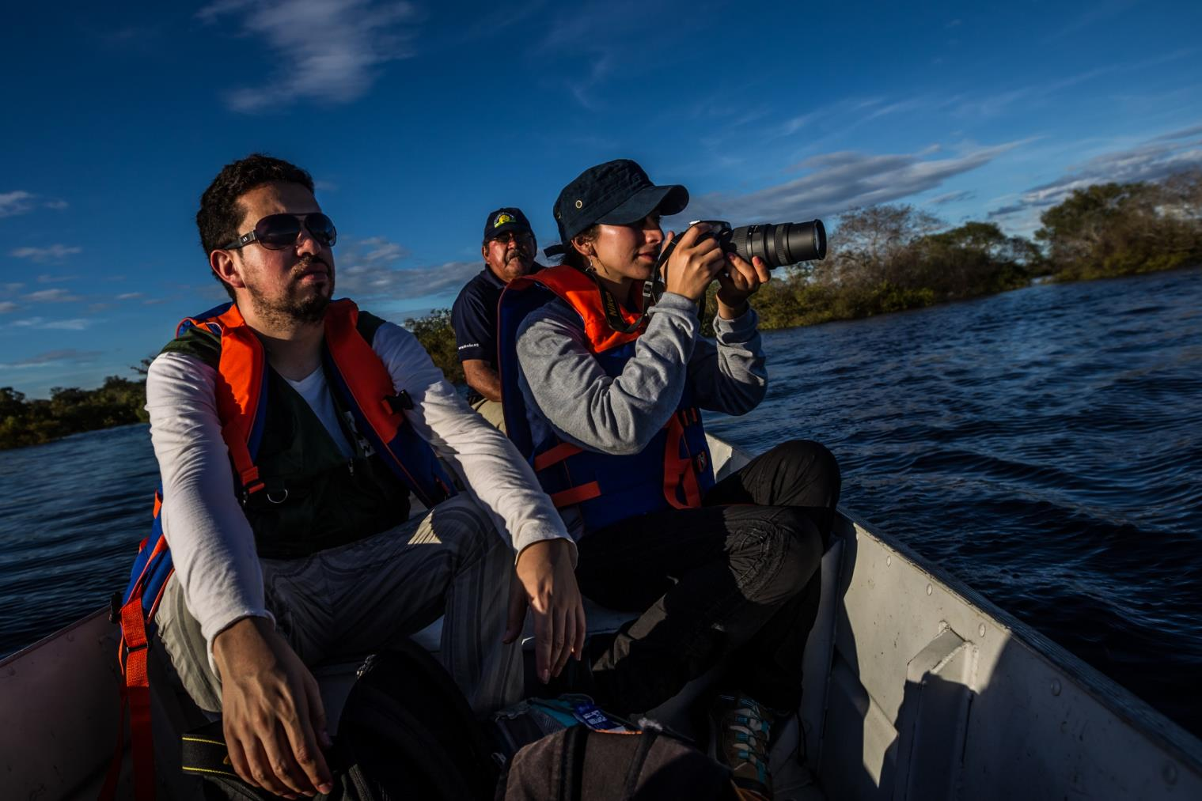
Protecting Freshwater Ecosystems
WWF works on the ground in key river basins around the world.
Notes:
WWF embraces a holistic basin-wide approach to address the variety of threats to fresh water. We work on the ground in key rivers basins around the world, supporting responsible water use and infrastructure, and testing and implementing innovative solutions. We also seek to develop and share tools, techniques and knowledge globally.

Slide 15
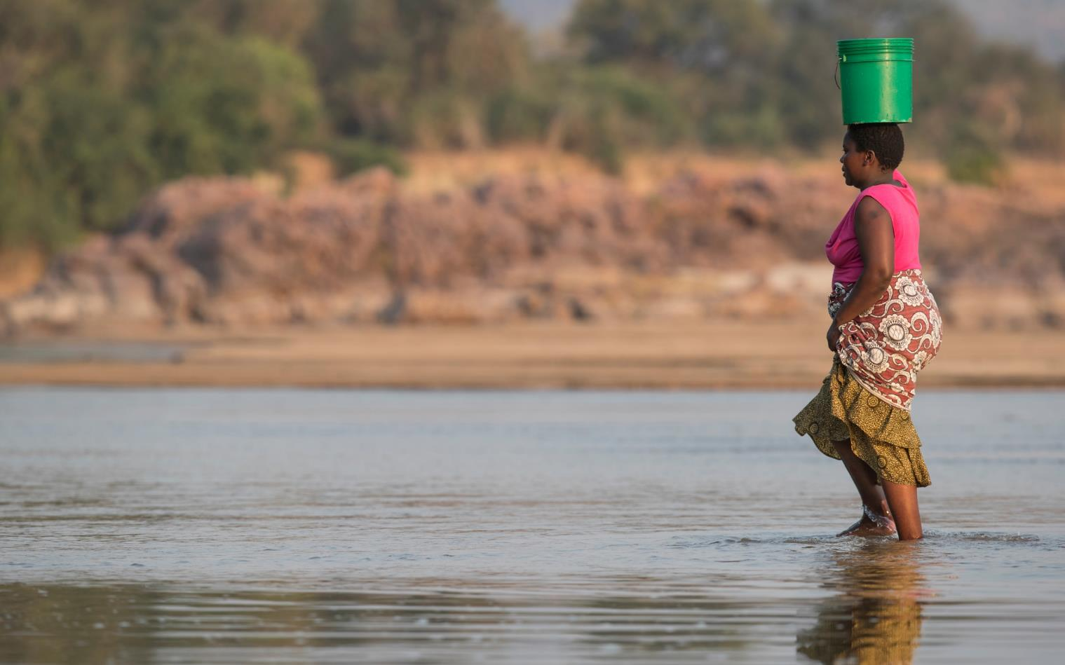
Managing Resources in a Changing Climate
Assessing climate change vulnerability and planning for both human and environmental needs.
Notes:
WWF has collaborated with local stakeholders and governments in critical river basins around the world to assess climate change vulnerability and plan interventions. WWF has also engaged institutional partners to investigate how to most effectively adapt to climate change. By both working in the field, where many impacts of climate change are already evident, we hope to safeguard a future where both human and environmental needs are met.

Slide 16
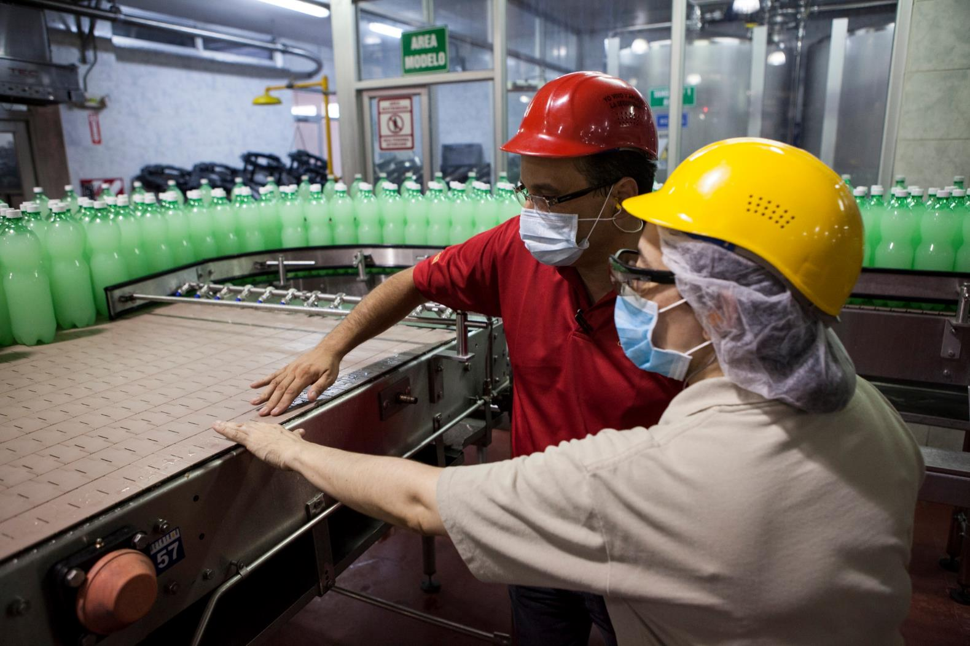
Advancing Corporate Water Stewardship
Helping businesses go beyond water efficiency to become water stewards.
Notes:
We believe businesses can help us solve the world’s water problems. WWF helps governments, companies, investors, communities and others understand their water footprints and water-related risks. More importantly, we help our partners go beyond adopting water efficiency practices to becoming better water stewards.
Water stewardship requires collaboration with all levels of government, local communities, and other industries in a basin—sometimes even competitors—to ultimately change how water is governed. We challenge businesses to think differently about water and to help us accelerate stewardship efforts because it’s good for business, it’s good for people, and it’s good for nature.

Slide 17
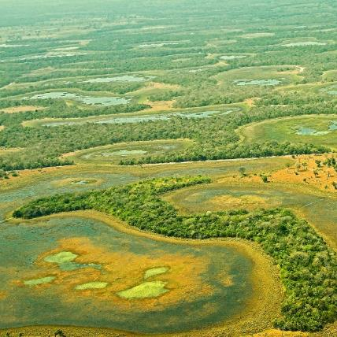
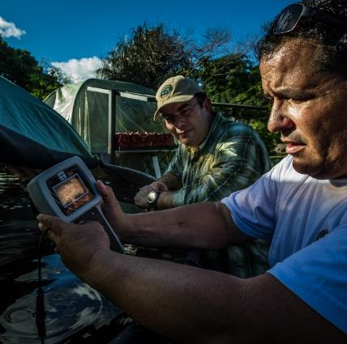
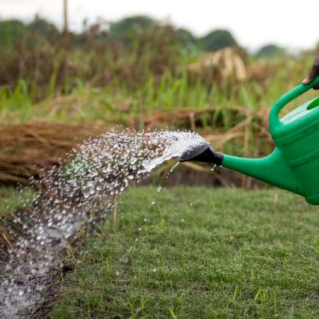
Major Fresh Water Projects
The Pantanal: Saving the world’s largest tropical wetland
Corporate Water Stewardship: River Basin Report Cards
Free-Flowing Rivers: The AgWater Challenge
Notes:
WWF is engaged in projects to protect fresh water resources around the world. The 3 top priorities are The Pantanal, Corporate Water Stewardship, and free-flowing rivers.
The Pantanal: Saving the world’s largest tropical wetland - Recognizing the global importance of the Pantanal and the scale of the challenges it faces, WWF is working with Bolivia, Brazil, in a transboundary effort to conserve and sustainably develop the world’s largest tropical wetland.
Corporate Water Stewardship: River Basin Report Cards - WWF, the University of Maryland Center for Environmental Science, and several local partners are working to create a series of report cards to assess and monitor river basin health. The first, evaluating the Orinoco river in Colombia, was released in 2016.
Free-Flowing Rivers: The AgWater Challenge - WWF and CERES created the AgWater Challenge to engage leading food and beverage companies and protect fresh water resources in agricultural supply chains.

Slide 18
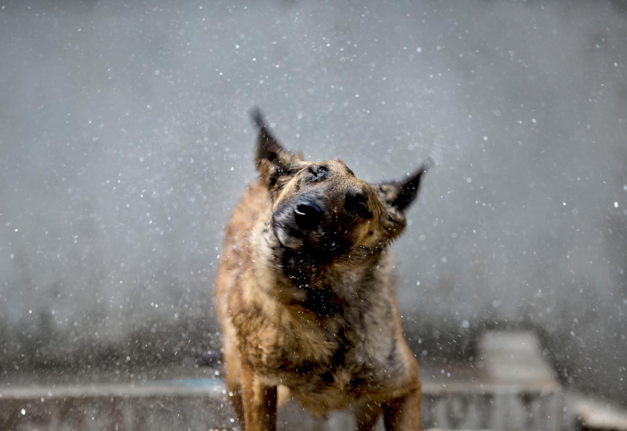
worldwildlife.org/initiatives/fresh-water
Notes:
Visit the World Wildlife website to learn more about how we’re working to conserve water for people and nature.

Slide 19
Photo Credits
Page 2: © Frank PARHIZGAR / WWF-Canada
Page 3: © Jaime Rojo / WWF-US
Page 4: © Hartmut Jungius / WWF
Page 6: © Martin Harvey / WWF
Page 7: © Frank PARHIZGAR / WWF-Canada
Page 8: © Scott Dalton / WWF-US
Page 9: © Karine Aigner/WWF-US
Page 10: © Global Warming Images / WWF
Page 11: © Shutterstock / Hedrus / WWF-Sweden
Page 12: © Jaime Rojo / WWF-US
Page 13: © Xiaodong Sun / WWF-UK
Page 14: © Meridith Kohut/WWF-US
Page 15: © James Suter / Black Bean Productions / WWF-US
Page 16: © Scott Dalton / WWF-US
Page 17: © R.Isotti, A.Cambone / Homo Ambiens / WWF
© Meridith Kohut/WWF-US
© WWF / Simon Rawles
Page 18: © WWF-US / Narendra Shresth

