Slide 2
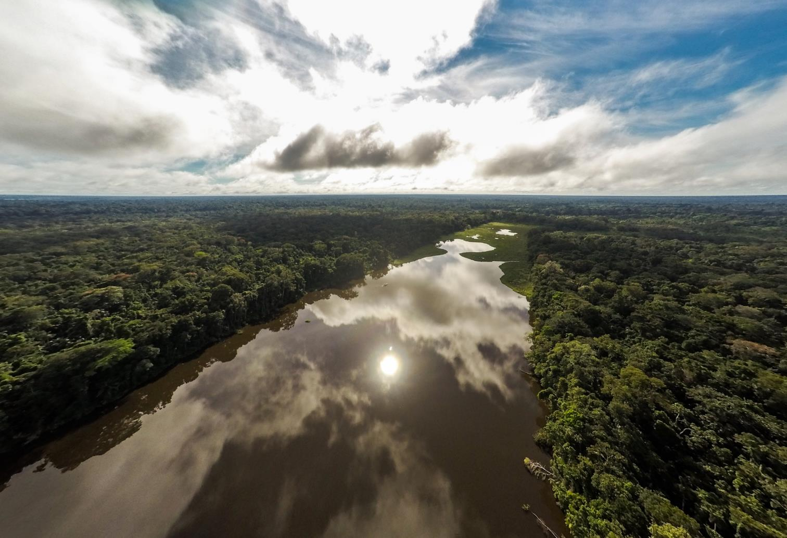
Forests
Notes:
Forests are one of WWF’s 6 main focus areas

Slide 3
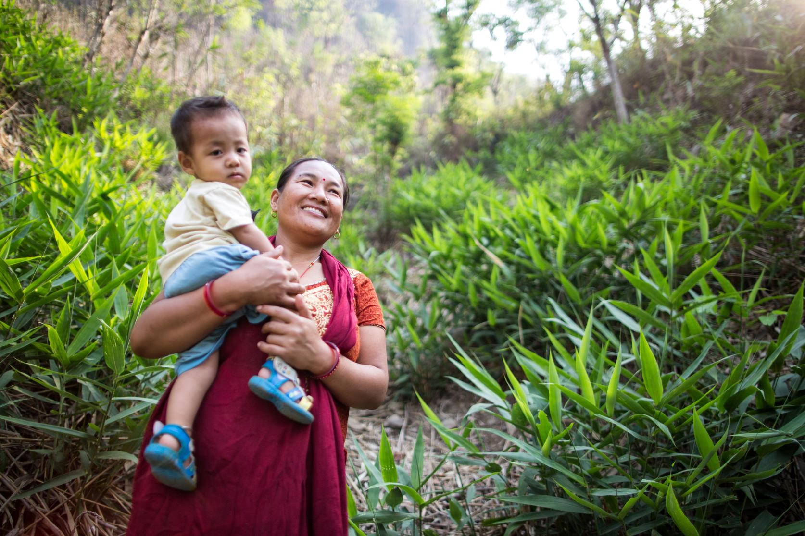
People depend on forests.
Notes:
Almost 300 million people, particularly in developing countries, live in forests. Forests also provide a vast array of resources to all of us, including food, wood, medicine, fresh water, and the air we breathe. Without the trees, the ecosystem that supports the human population can fall apart.

Slide 4
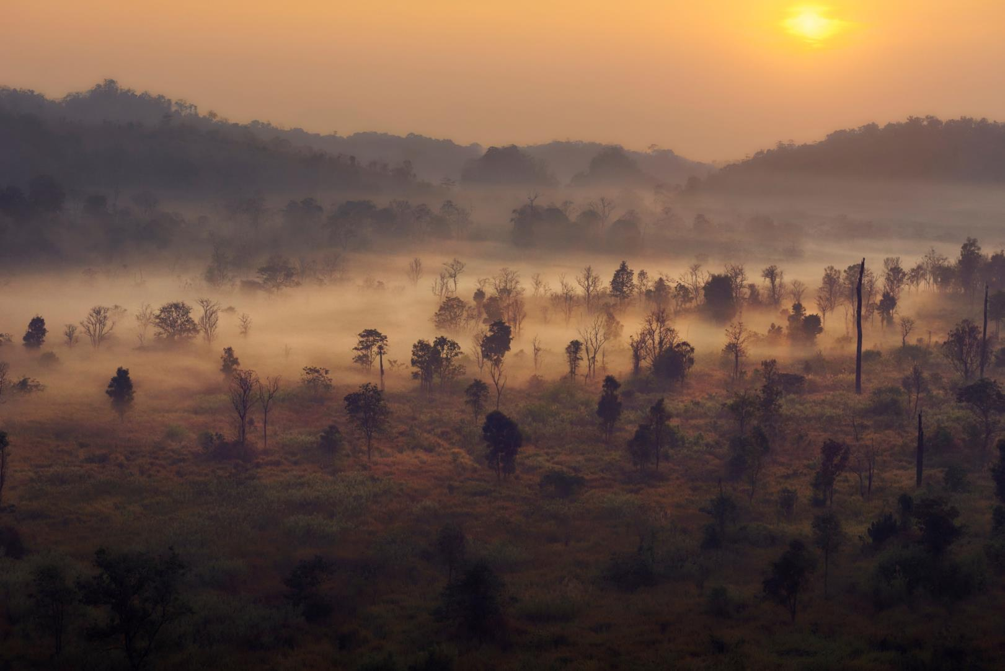
Forests remove carbon dioxide from the atmosphere.
Notes:
Forest trees and other plants soak up carbon dioxide from the atmosphere and store it away as they grow and thrive. Tropical forests alone hold more than 210 gigatons of carbon, seven times the amount emitted each year by human activities.

Slide 5
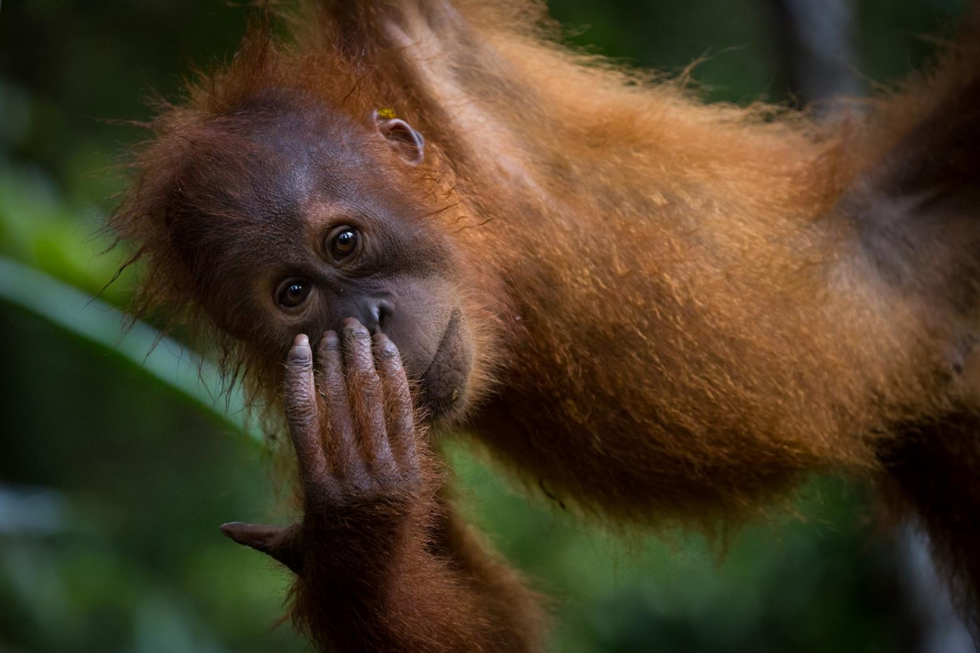
Forests are the most biodiverse places on Earth.
Notes:
Eighty percent of the world’s known terrestrial plant and animal species can be found in forests, and tropical rainforests are home to more species than any other terrestrial habitat. A square kilometer of forest may be home to more than 1,000 species.

Slide 6
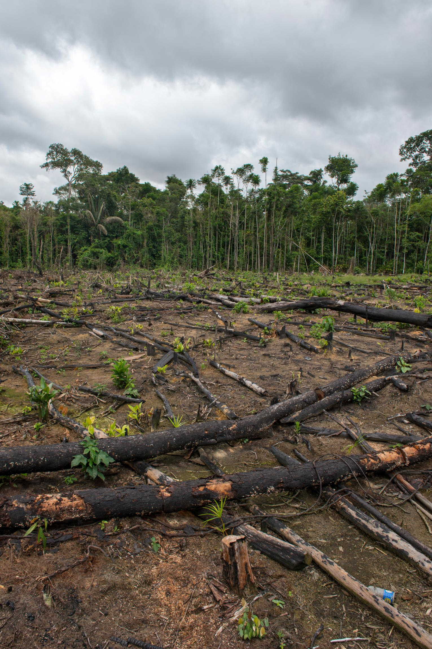
Threats to forests – expanding agriculture and illegal logging – are growing.
Notes:
But threats to the world’s forests are growing. Expanding agriculture, due to an increased population and shifts in diet, is responsible for most of the world’s deforestation. Illegal and unsustainable logging, usually resulting from the demand for cheap wood and paper, is responsible for most of the degradation of the world’s forests—the largest threat to the world’s forests. In degraded forests, small trees, bushes and plants often are severely damaged or dead; rivers are polluted; slopes are eroded; and more.

Slide 7
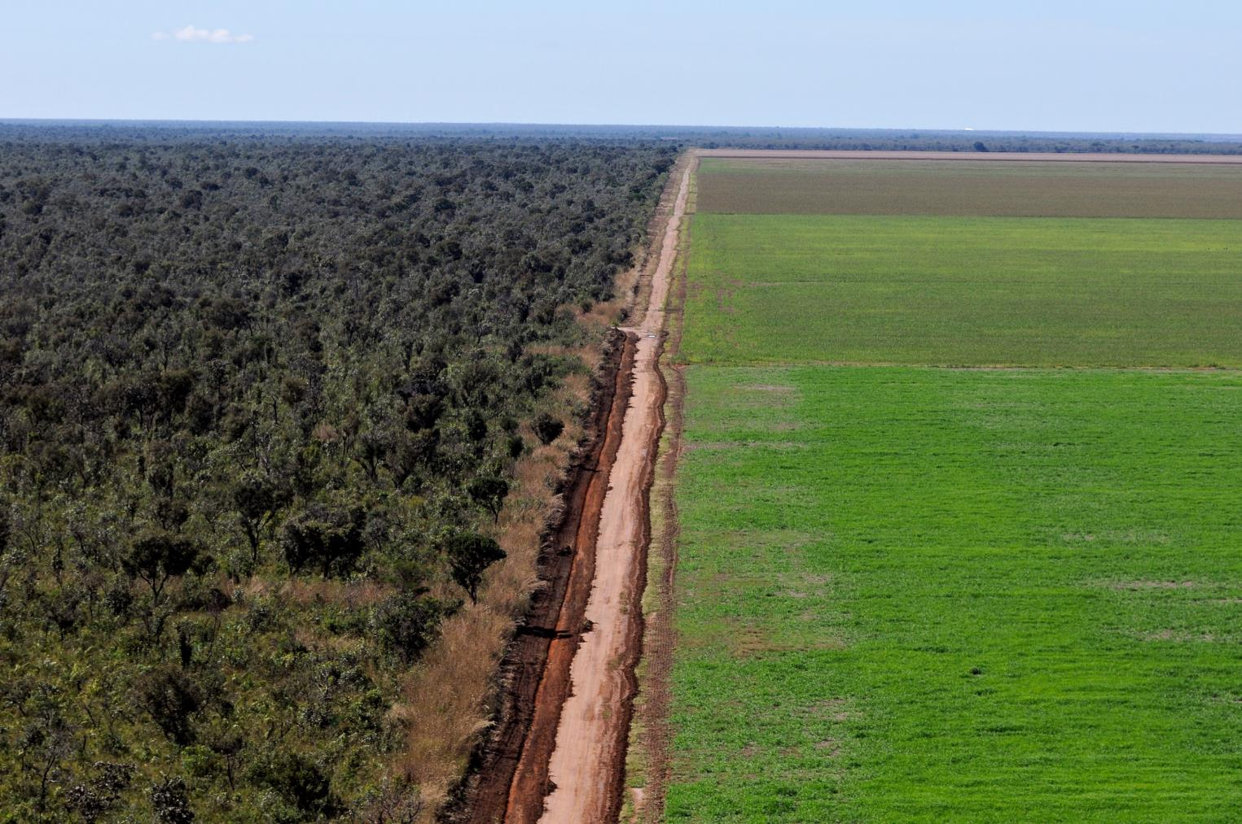
We’re losing forests at an alarming rate.
Notes:
The threats are so severe that we are losing huge swathes of forests at an alarming rate. The Amazon, the planet’s largest rain forest, lost at least 17% of its forest cover in the last half century due to human activity—mainly clearing trees to create new or larger farms and ranches.

Slide 8
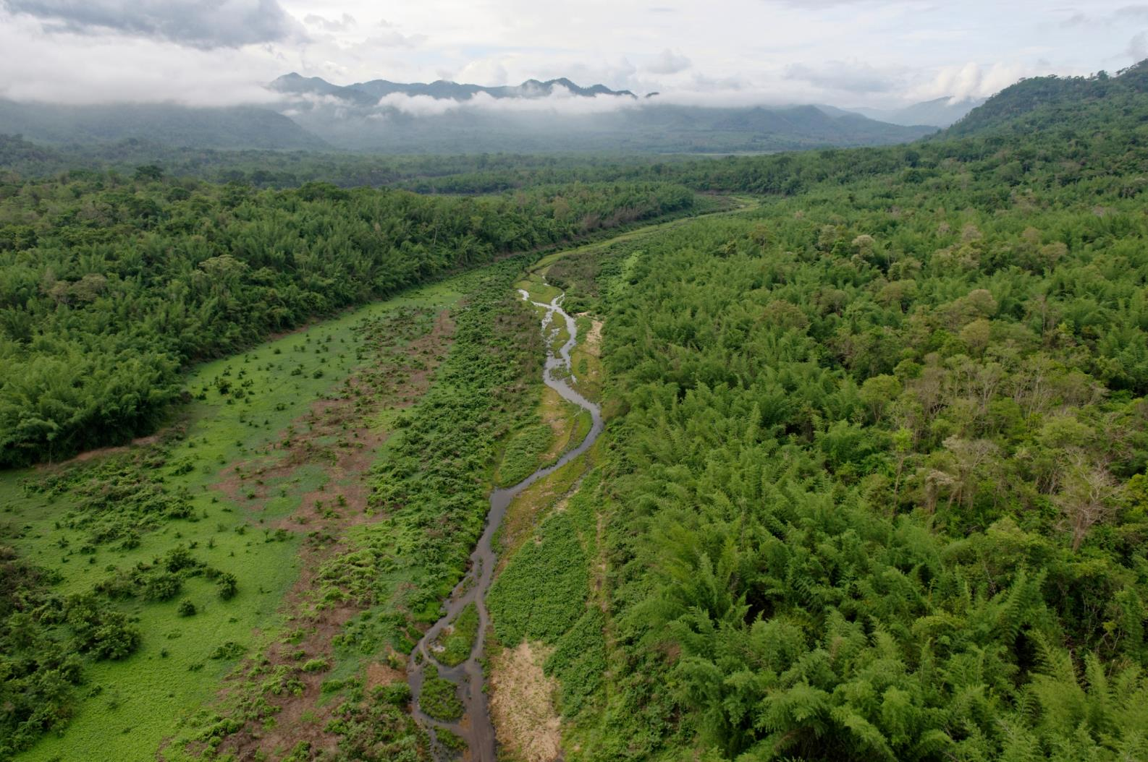
WWF is working to protect forests
Notes:
WWF is working to address the threats to forests: By 2020, we must conserve the world’s forests to sustain nature’s diversity, benefit our climate and support human well-being.
WWF works primarily in tropical rain forests, which are the most biologically diverse and complex forests on Earth—forests in the Amazon, the Congo Basin, the Greater Mekong and other regions near the equator. But we also operate projects in temperate regions, such as the Russian Far East and the United States.

Slide 9
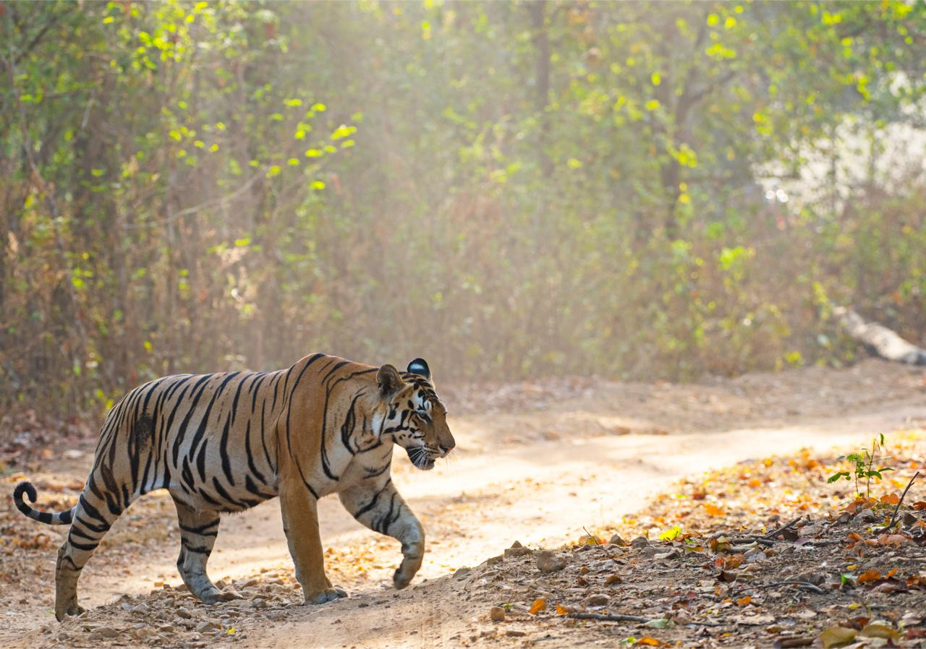
Earth for Life
Securing funding to protect forests and their inhabitants
Notes:
One of the ways WWF works to save forests is by closing the gap between how much is available for forest conservation and how much is needed. We help create multi-million dollar funds to properly manage forests that are designated as protected.
The funding is to train park officials about responsible forest management, buy satellite GPS collars to monitor and track endangered wildlife, and more.

Slide 10
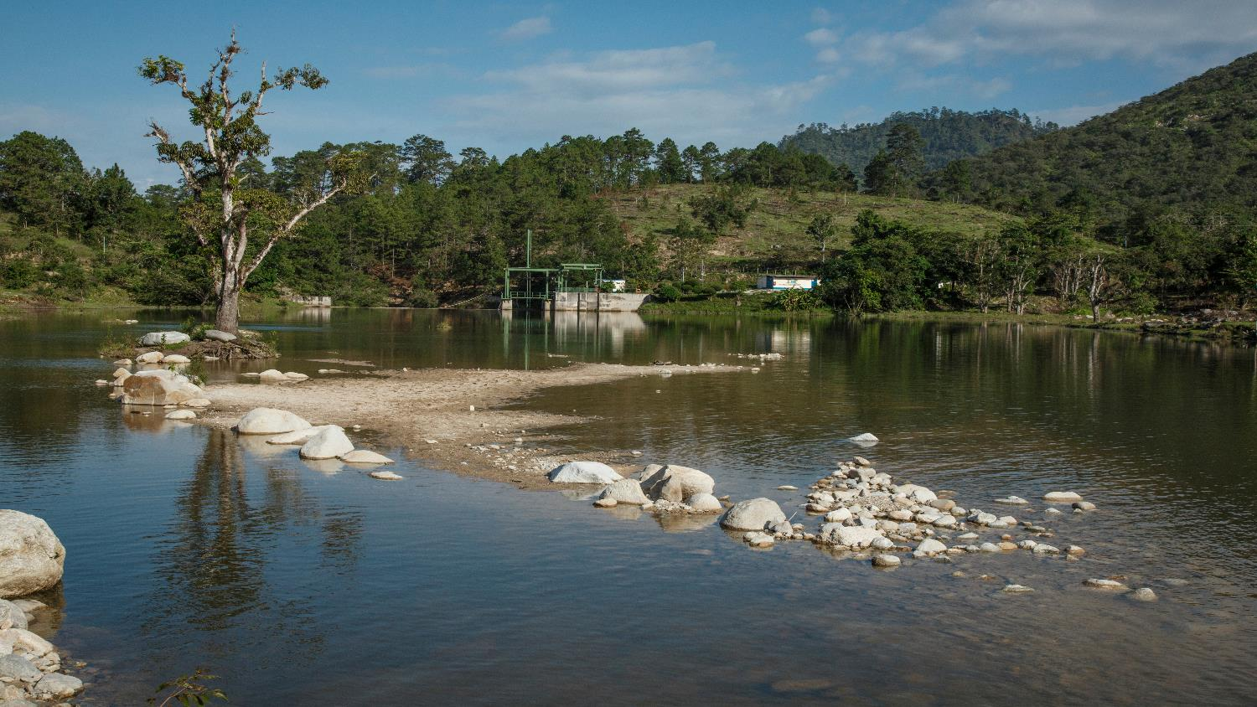
Infrastructure
Building a public and political will for forest-friendly infrastructure solutions
Notes:
One of the main drivers of deforestation and forest ecosystem destruction is infrastructure. Current infrastructure plans do not account for ecosystem and climate influences and can, thus, be of great harm. For the next wave of investments in infrastructure, we have a unique opportunity to use our strong business and government ties to build a will for change and include the interest of our forests into future infrastructure implementations by creating the tools and incentives for it.

Slide 11
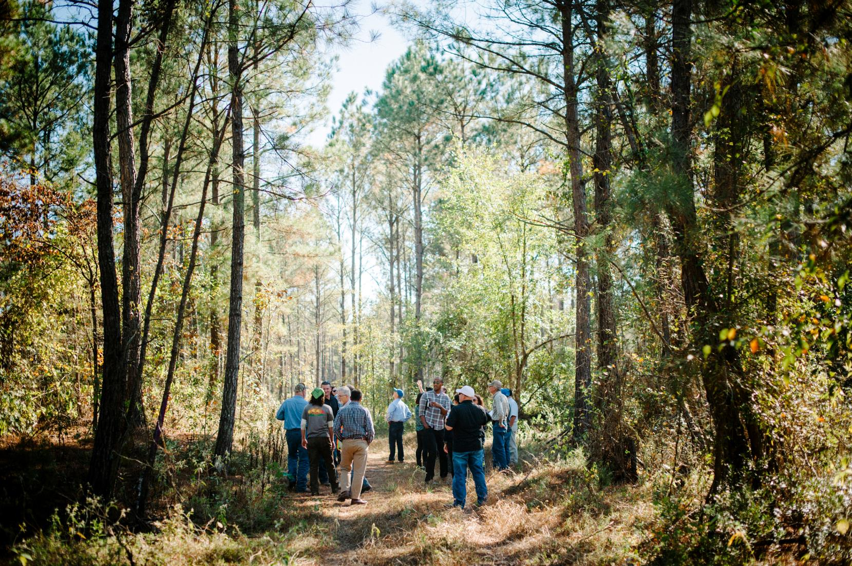
Forest and Climate
Stopping illegal and unsustainable logging
Notes:
Forests will not survive unless the responsible management of them becomes the norm. That requires eliminating illegal and unsustainable logging. To do so, WWF works to
strengthen the US government’s ability to prosecute illegal timber cases;
stop illegal logging in countries that export high volumes of timber;
ensure full implementation of the Lacey Act, a US law that prohibits illegal timber and timber products from entering the US market;
and design rural energy programs that rely on fuels other than firewood.

Slide 12
Forest Positive
Partnering with businesses from many sectors to support forest conservation
Notes:
We capitalize on our strong relationships with businesses on local levels to support science-based forest conservation and protect our forests, from local to global level.
Additionally, we harness the power of US companies that buy and sell forest products to move the entire industry toward responsible practices. For example, through our Global Forest & Trade Network, we help US companies source products from responsibly managed forests, particularly those certified by the Forest Stewardship Council (FSC). We also encourage consumers to look for and purchase FSC-certified products.

Slide 13
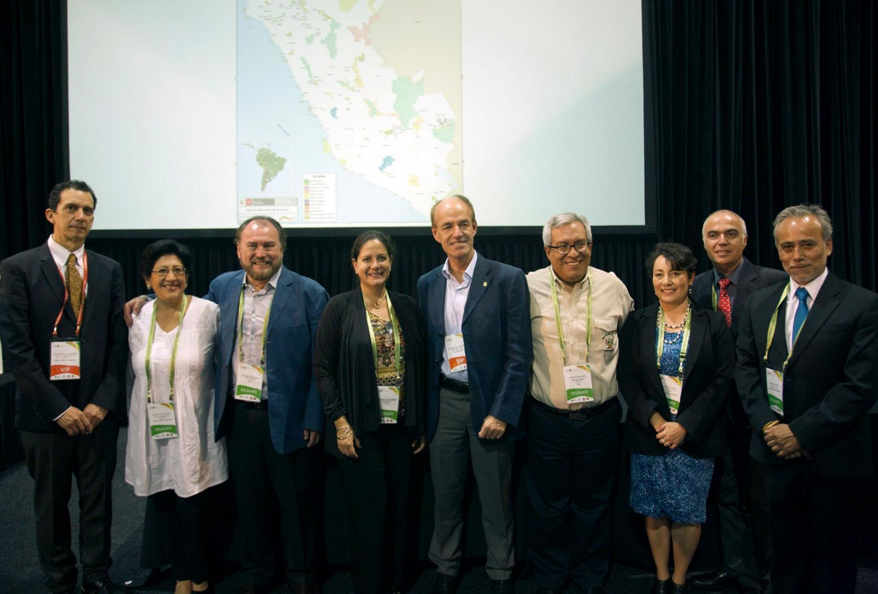
Permanently protecting forests
Notes:
WWF and partners use an innovative funding approach—called Project Finance for Permanence (PFP)—that ensures the long-term financial stability of protected areas. It is a means for permanent and full funding for protected areas.
WWF first used the PFP approach in Brazil. Public and private entities—including WWF, the Linden Trust for Conservation and the Gordon and Betty Moore Foundation—announced in 2014 a new $215 million fund to create, consolidate and maintain Brazil’s 150 million acre network of protected areas -- 15 percent of the Brazilian Amazon. This area, now protected indefinitely, is almost three times larger than all US national parks combined.

Slide 14
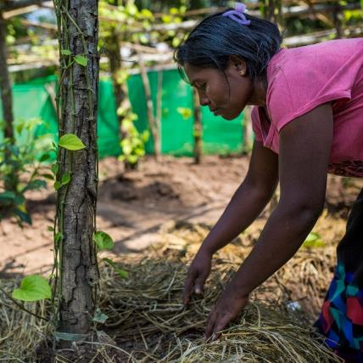
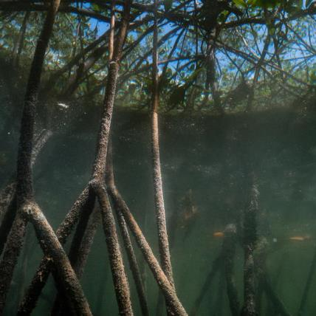
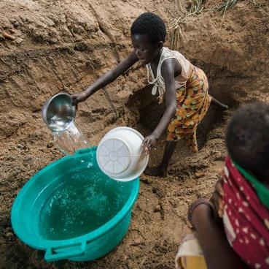
Major Projects
Changing the global rubber market
Protecting Colombia’s land resources
Preserving natural capital in Mozambique
Notes:
WWF’s forests team is working on a variety of projects around the world. These include:
Changing the global rubber market - Forests in Asia, home to elephants, tigers and other endangered species—are often cleared to make room for growing rubber trees. They are among the most threatened forests in the world. That’s why WWF has set an ambitious goal of transforming the global rubber market.
Colombia PFP – After the Colombian government reached peace with guerilla factions after a decades-long conflict, many areas previously thought as too dangerous to enter are becoming available for exploration – and exploitation. WWF supports a program known as PFP which aims to protect many of these areas and ensure that any use of theirs is regulated and sustainable.
Preserving natural capital in Mozambique – As one of the fastest growing nations in the world – but also the 7th poorest – Mozambique is experiencing a huge need for resources. To ensure that the country’s natural capital, providing its people with essential benefits, is harvested sustainably, as well as to counter the dire effects of climate change in the region, WWF partners with local governments, businesses and organizations and makes protection of the country’s resources a priority.

Slide 15
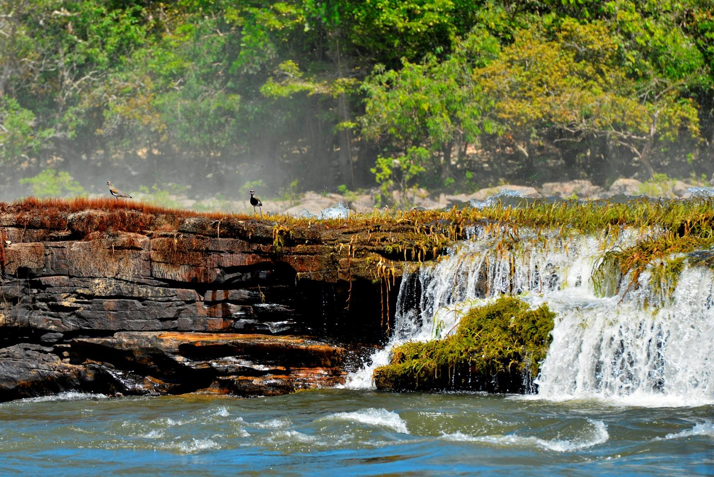
worldwildlife.org/initiatives/forests
Notes:
Visit the World Wildlife website to learn more.

Slide 16
Photo Credits
Page 2: © Day's Edge Productions / WWF-US
Page 3: © Karine Aigner/WWF-US
Page 4: © Adam Oswell / WWF-Thailand
Page 5: © Christy Frank
Page 6: © Nicolas Villaume / WWF-US
Page 7: © Adriano Gambarini / WWF-Brazil
Page 8: © Adam Oswell / WWF-Thailand
Page 9: © Dipankar Ghose / WWF-India
Page 10: © Audra Melton / WWF-US
Page 11: © Brandon Thibodeaux / WWF-US
Page 12: © Jürgen Freund / WWF
Page 13: © Phil Freeman / WWF-Aus
Page 14: © Hkun Lat / WWF-US
© Day’s Edge Productions
© Green Renaissance / WWF-US
Page 15: © WWF-Brazil / Adriano Gambarini

