Slide 2
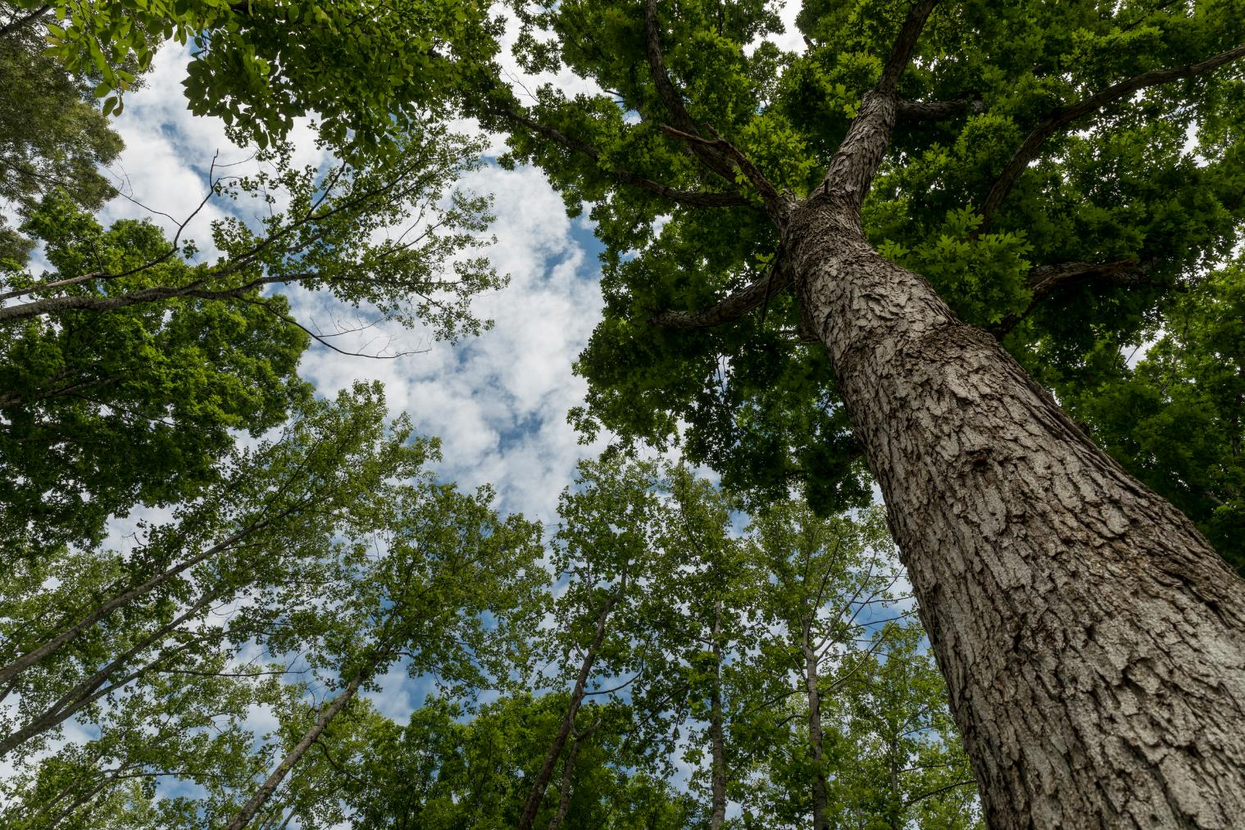
Forest Stewardship Council
Notes:
The Forest Stewardship Council, or FSC, is an independent, non-profit organization that sets standards under which forests and companies are certified. The goal is to protect the future of forests for generations.

Slide 3
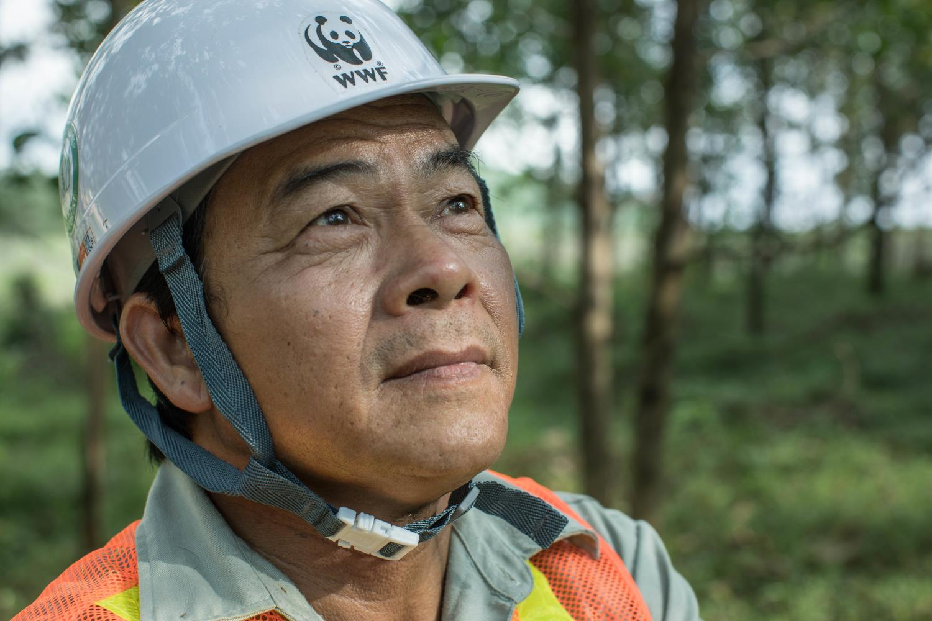
WWF helped found the FSC in 1993 to combat illegal and unsustainable logging.
Notes:
WWF and other partners founded the Forest Stewardship Council in 1993 to address the lack of consistent, strict, and enforced governance on forest management throughout the world.

Slide 4
FSC is the gold standard in forest certification.
Notes:
FSC is the gold standard in forest certification. Because of it’s rigorous environmental and social requirements, it’s the only forest certification that WWF supports.

Slide 5
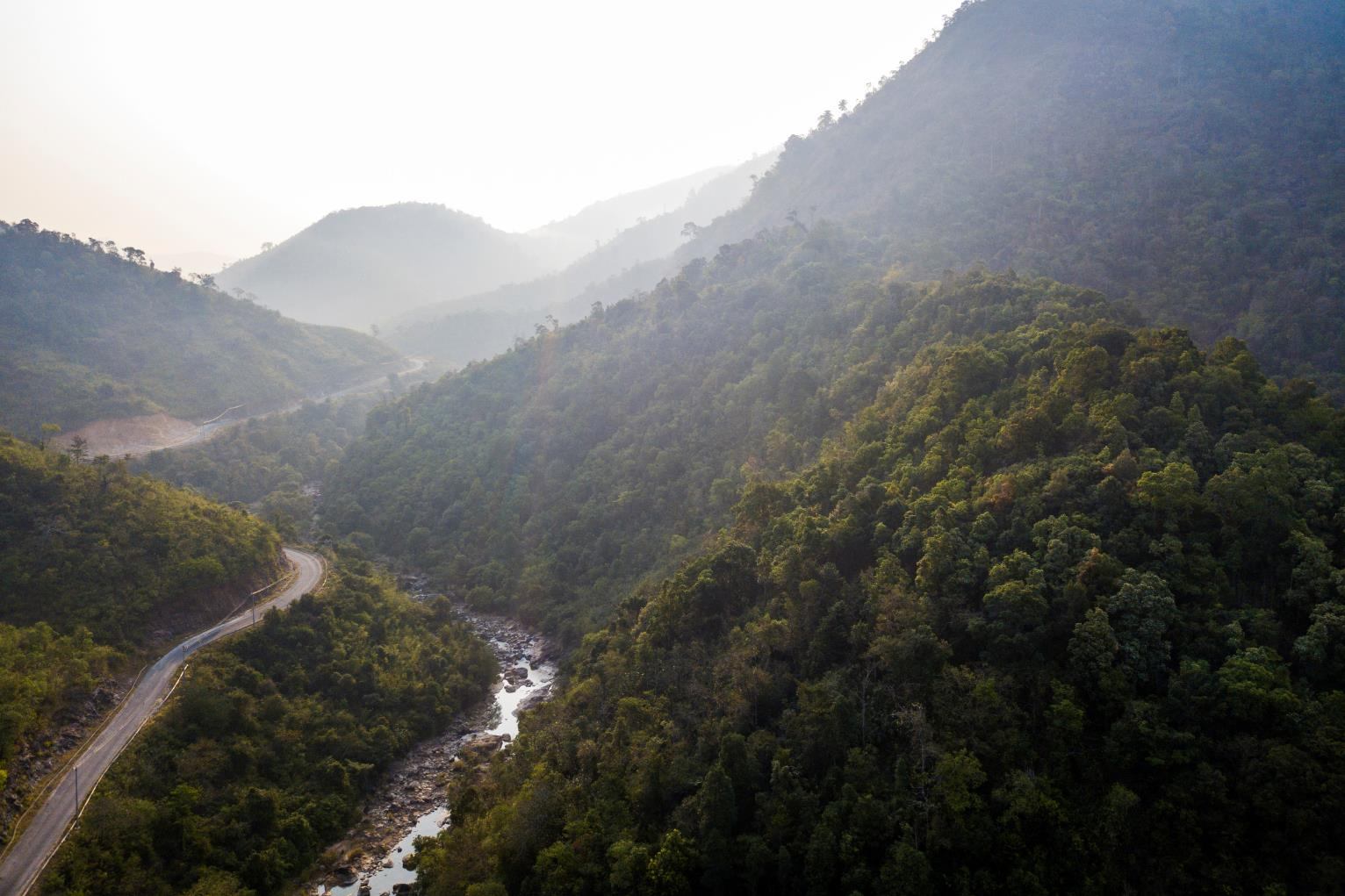
Why we need FSC
Notes:
We need the Forest Stewardship Council to safeguard the world’s forests—making sure they can meet human needs in a sustainable way.

Slide 6
Almost 300 million people live in forests, but we all depend on them.
Notes:
Forests are critical to life on earth – especially humans. Almost 300 million people live in forests. Forests provide a vast array of resources to all of us, including food, wood, medicine, fresh water, and the air we breathe. Without the trees, the ecosystem that supports the human population can fall apart.

Slide 7
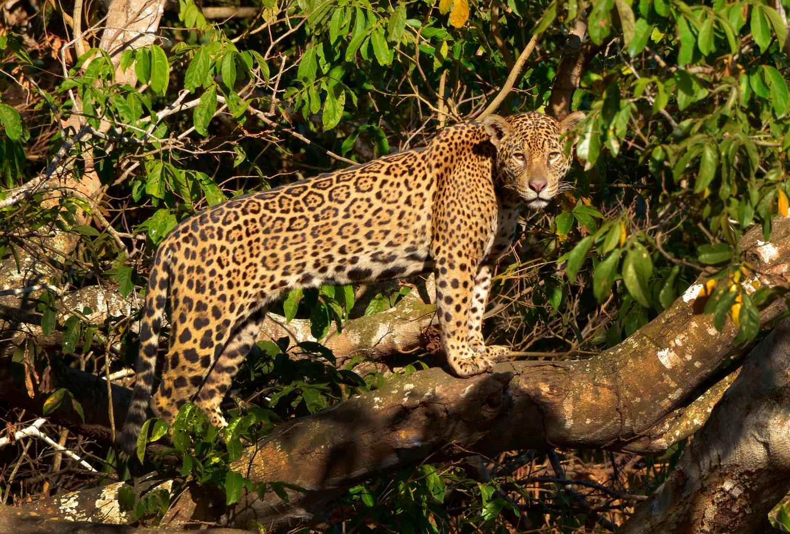
8 out of 10 terrestrial species live in forests.
Notes:
Forests are the most biodiverse places on Earth. 80% of species that live on land make their homes in forest.

Slide 8
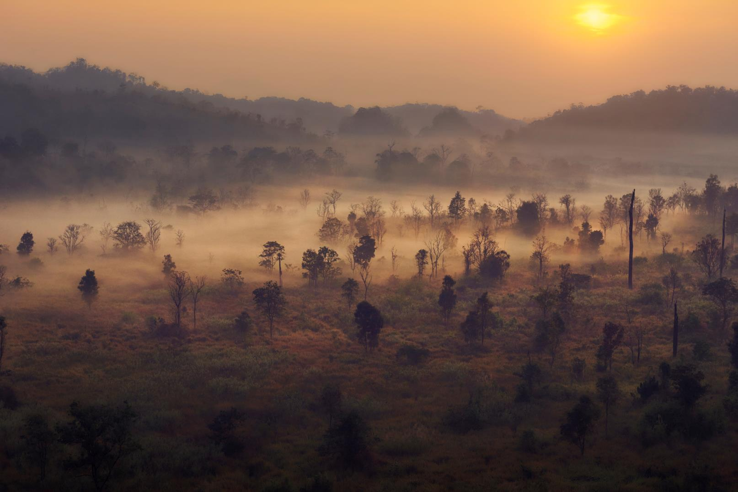
Forests also remove harmful carbon dioxide from the atmosphere.
Notes:
Forest trees and other plants soak up carbon dioxide from the atmosphere and store it away as they grow and thrive. Tropical forests alone hold more than 210 gigatons of carbon, seven times the amount emitted each year by human activities.

Slide 9
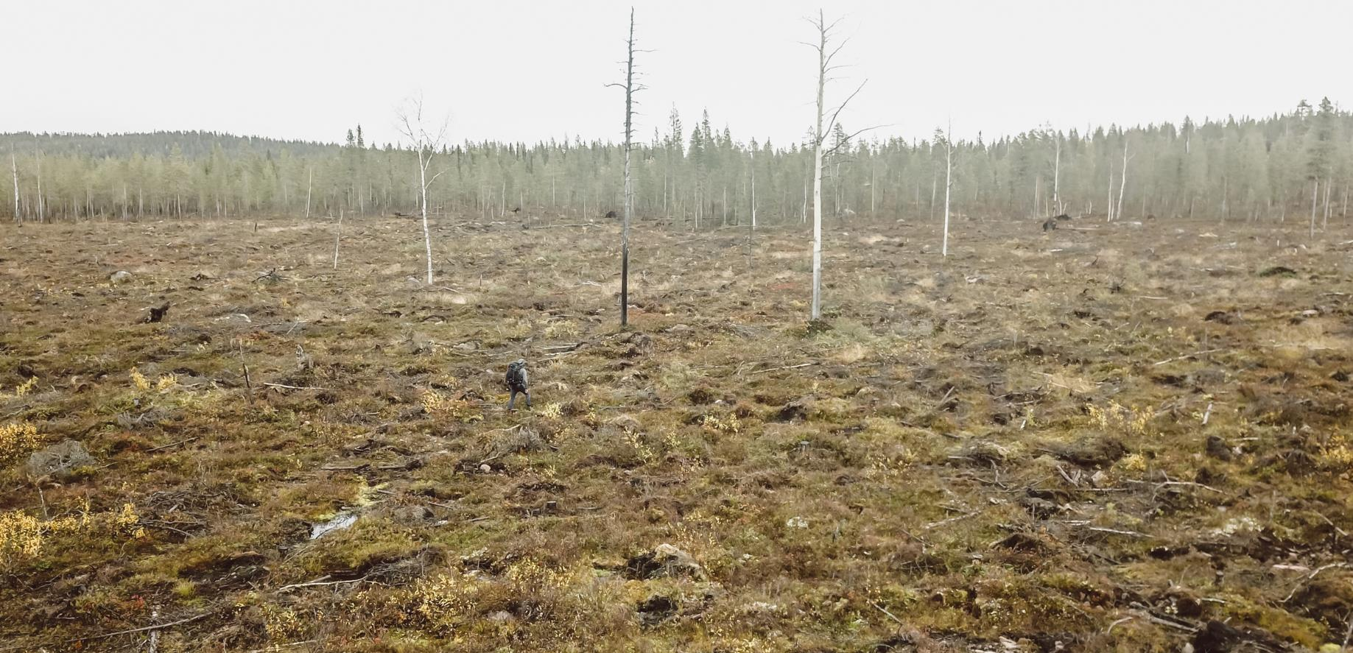
Our forests are under threat from agricultural expansion and illegal logging.
Notes:
But threats to the world’s forests are growing. Expanding agriculture is responsible for most of the world’s deforestation. Illegal and unsustainable logging is responsible for most of the degradation of the world’s forests. In degraded forests, large trees are removed, small trees, bushes and plants often are severely damaged or dead; rivers are polluted; slopes are eroded; they can no longer support wildlife species.

Slide 10
Some everyday products like paper, napkins, and furniture can come from illegal and unsustainable logging.
Notes:
The wood harvested from unsustainable and illegal logging creates some of the products we use every day—things like toilet paper, napkins, brooms and bed frames, though not all of these products on the market come from unsustainable logging. Trees are being cut down at a rapid rate—the equivalent of 27 soccer fields per minute—to meet the demand for such products.

Slide 11
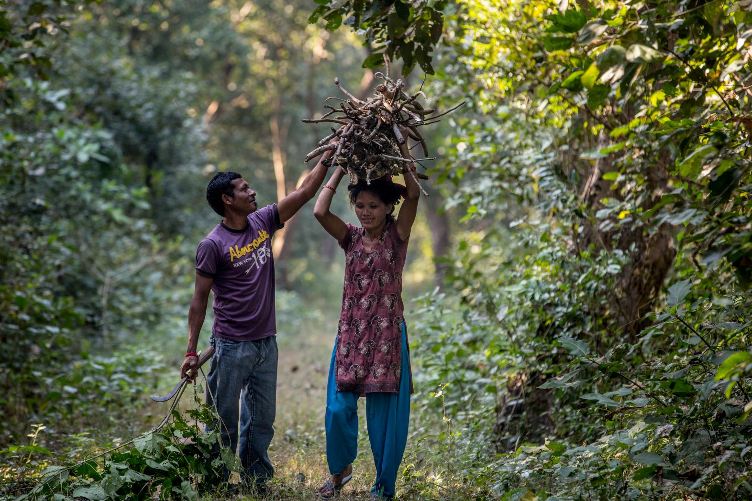
How FSC protects forests
Notes:
The Forest Stewardship Council helps to stop illegal logging by giving consumers, companies, suppliers, and producers a better option.

Slide 12
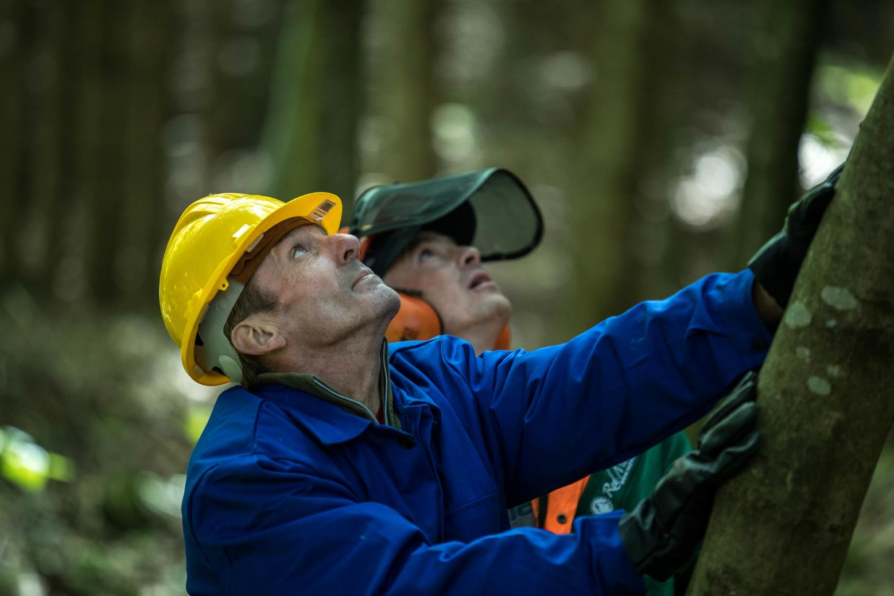
FSC-certified forests meet rigorous environmental standards to protect wildlife, water resources, and the forest itself.
Notes:
Forests certified by FSC must meet a rigorous set of environmental requirements, including:
No deforestation or conversion of natural forests to plantations.
FSC forests protect rare old growth
They also protect rare, threatened and endangered species.
FSC limits clearcut sizes in order to protect forest ecosystems and
restricts the use of highly hazardous pesticides.
FSC also ensures water quality.

Slide 13
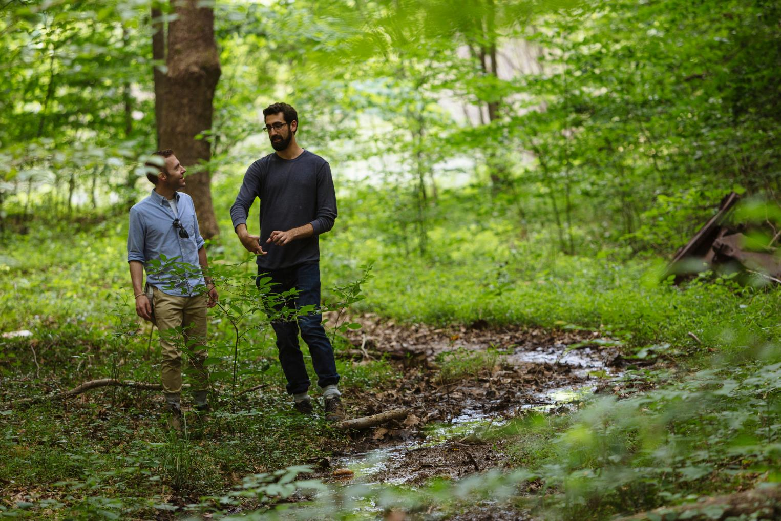
They must also meet social standards – engaging local communities and protecting indigenous peoples.
Notes:
FSC forests must also meet social standards:
FSC requires forest managers - on both public and private lands - to engage local community members and to protect customary rights of indigenous people, ensuring their voices are part of the certification process and impacts of forest operations are addressed. In addition, FSC requires the results of certification audits to be released to the public, even on private lands.

Slide 14
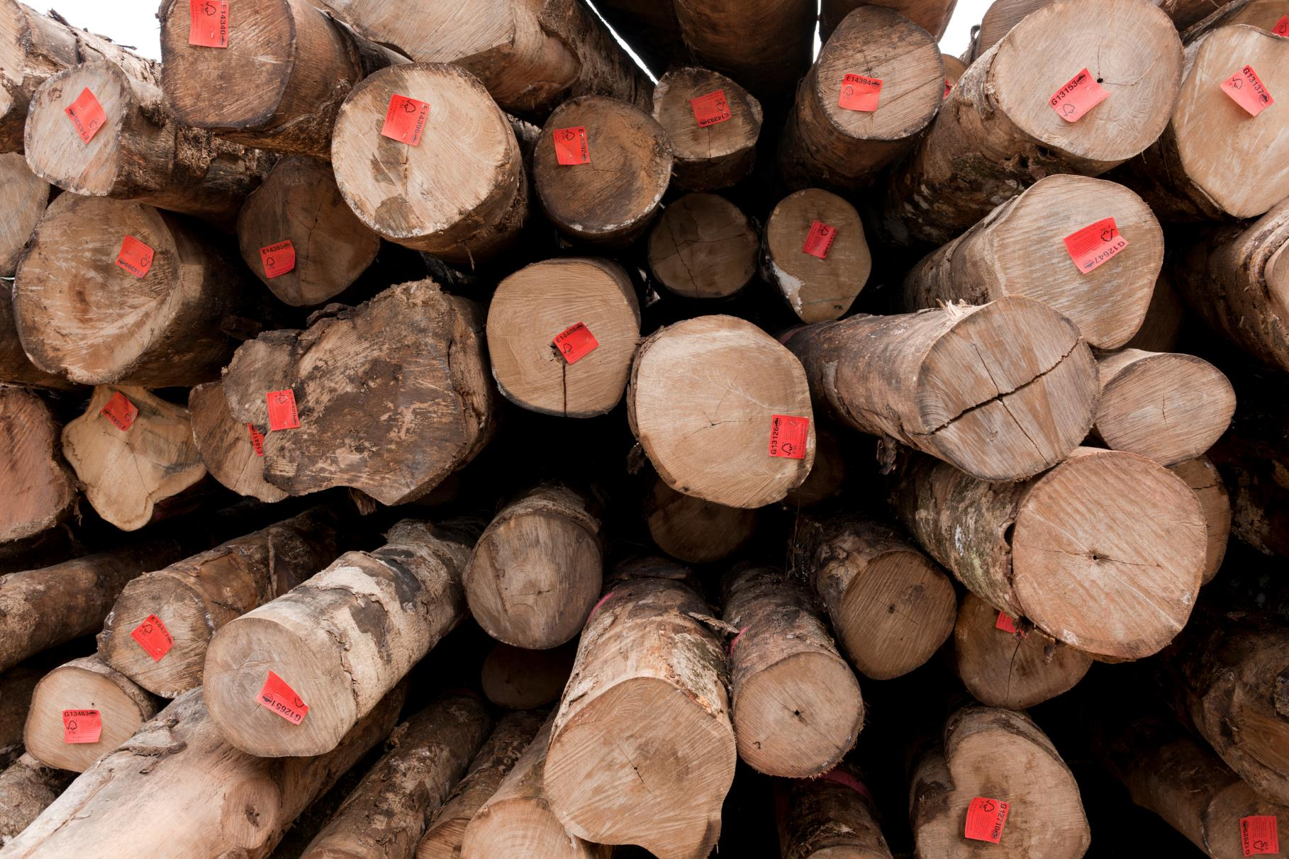
Around 16% of the world’s timber is FSC-certified.
Notes:
FSC has certified forests in 85 countries, covering almost 780,000 square miles globally and more than 55,000 square miles in the US alone. FSC-certified forests – including natural forests and plantations – produce some 16 per cent of global timber by volume.

Slide 15
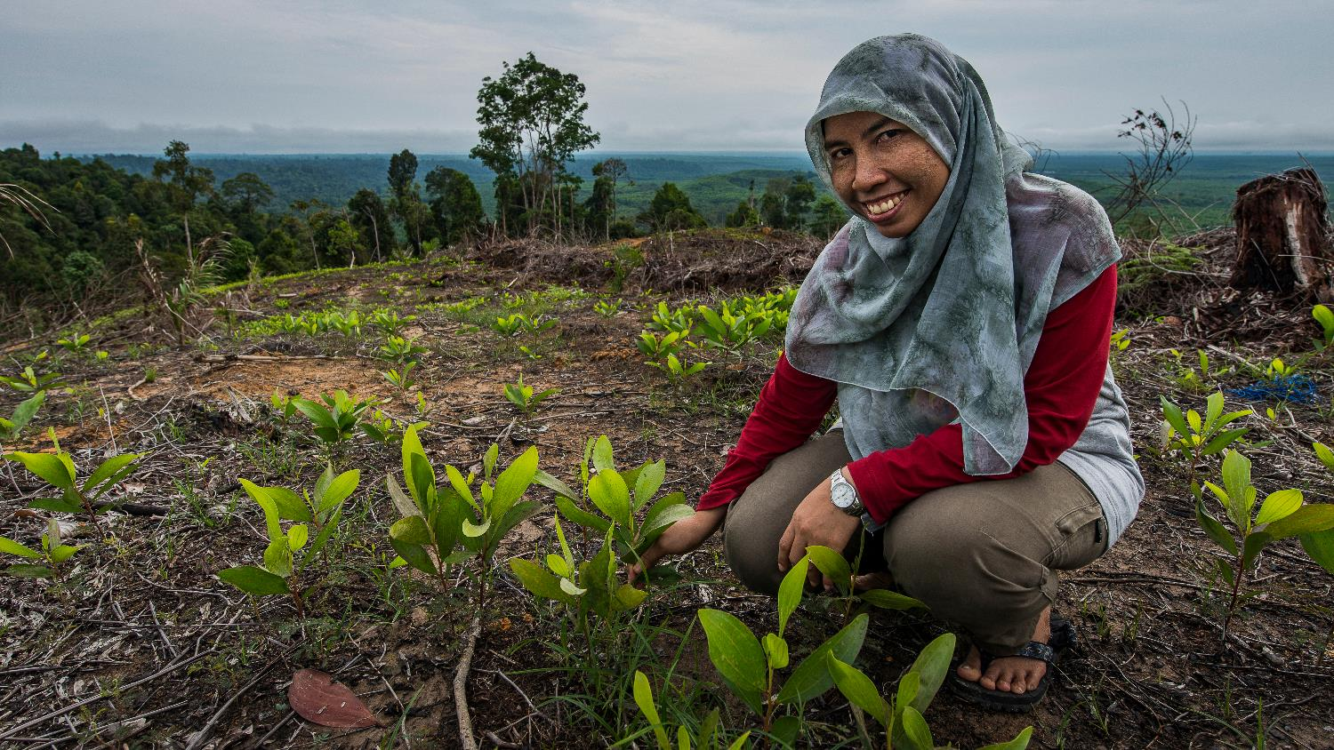
FSC is the one of the best ways to save our forests. We create a self-perpetuating system for encouraging sustainable growth.
Notes:
FSC convinces landowners to get their land FSC certified. We then get companies to source their wood from those landowners, then encourage consumers to buy FSC products.

Slide 16
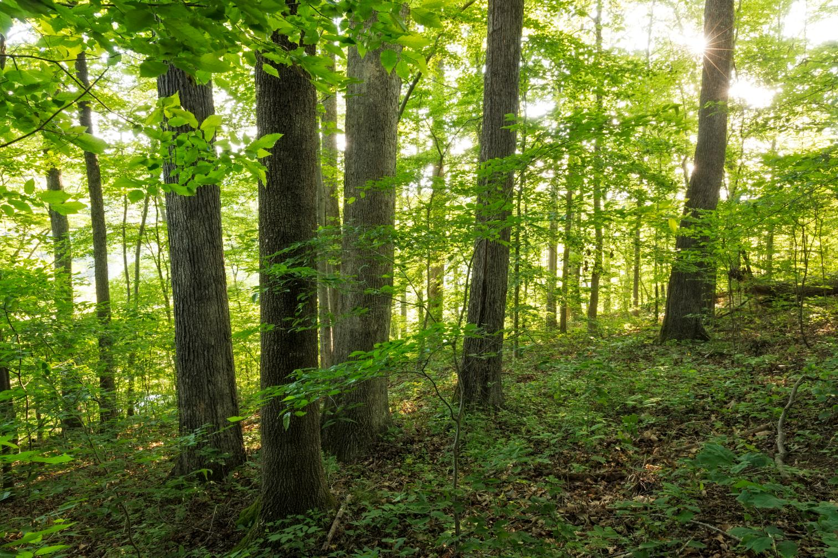
How you can help
Notes:
FSC works by harnessing market demand for a better product. As a consumer, you can help drive that demand.

Slide 17
Consider your own consumption habits.
Notes:
First, consider your own consumption habits. Every product has an environmental footprint - from the materials used to create it, to the pollution emitted during manufacturing, to the packaging that ends up in landfills. Before you buy, ask yourself if you really need it. Where possible, buy gently used instead of new, and look for minimal packaging and shipping.

Slide 18
Look for the label when buying wood and paper products.
Notes:
When you do need to buy new wood or paper products, look for the FSC checkmark label. It’s easy--FSC-certified products are carried in most major retail stores across the country. And if you don’t see it, ask about it. Request that your local retailers carry only FSC-certified products, and tell others about the importance of shopping FSC.

Slide 19
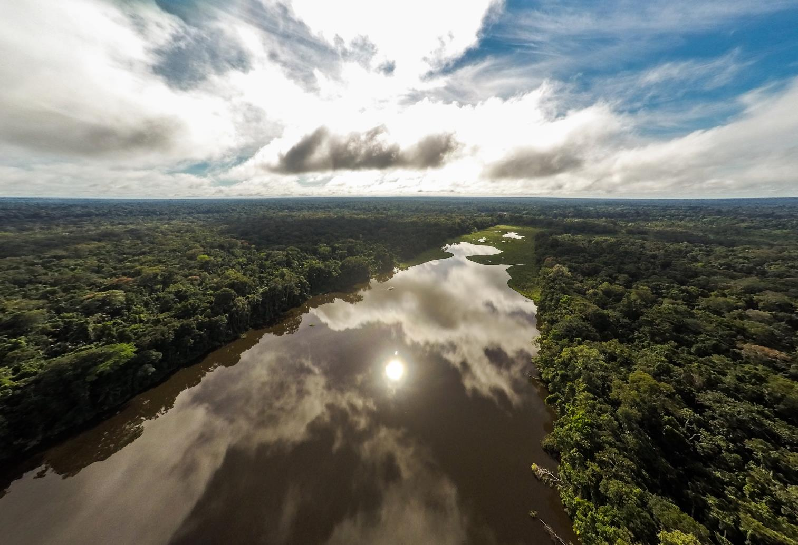
worldwildlife.org/initiatives/forests
Notes:
Visit the World Wildlife website to learn more about forest conservation and the Forest Stewardship Council.

Slide 20
Photo Credits
Page 2: © Mac Stone / WWF-US
Page 3-4: © James Morgan / WWF
Page 5: © Hkun Lat / WWF-US
Page 6: © Karine Aigner/WWF-US
Page 7: © Tom Fiske
Page 8: © Adam Oswell / WWF-Thailand
Page 9: © Victor Daggberg
Page 10: © Theodore Kaye / WWF China
Page 11-12: © James Morgan / WWF-US
Page 13: © Mac Stone / WWF-US
Page 14: © Jürgen Freund / WWF
Page 15: © Ola Jennersten / WWF-Sweden
Page 16: © Mac Stone / WWF-US
Page 17: © James Morgan / WWF
Page 18: © Edward Parker / WWF
Page 19: © Day's Edge Productions / WWF-US

