Slide 2
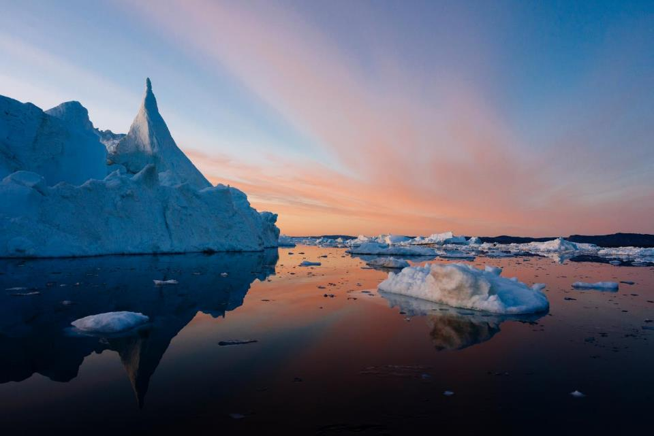
The Arctic
Notes:
The Arctic is a priority region for WWF. And it’s like no other place in the world.

Slide 3
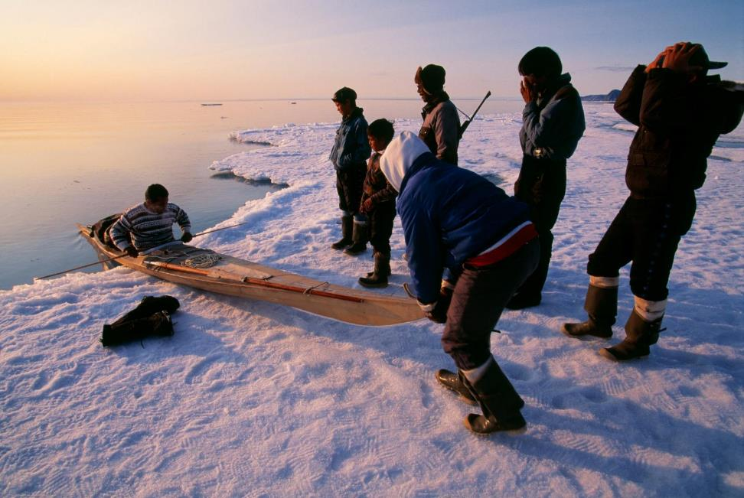
The Arctic is home to 4 million people—400,000 are indigenous.
Notes:
About 4 million people live in the Arctic, spread out over eight countries, including the United States. Roughly 400,000 indigenous people live throughout the Arctic, speaking more than 40 languages, some of which have few remaining speakers.

Slide 4
Arctic landscapes include sea ice, coastal wetlands, upland tundra, mountains, rivers, and the ocean.
Notes:
It also features diverse landscapes—from the sea ice to coastal wetlands, upland tundra, mountains, wide rivers, and the sea itself—support abundant wildlife and many cultures.

Slide 5
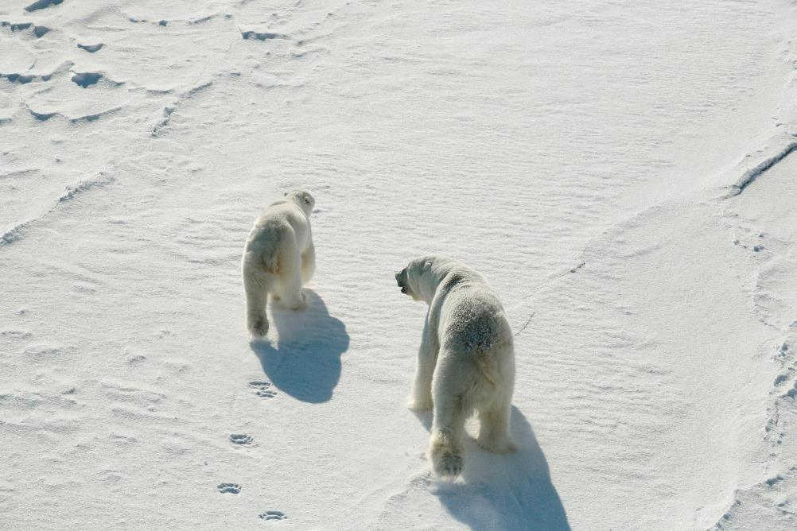
The Arctic hosts some of the world’s most iconic wildlife.
Notes:
The Arctic also has some of the world’s most iconic wildlife—including polar bears. You’ll also find arctic wolves, seals, and brown bears, among others.

Slide 6
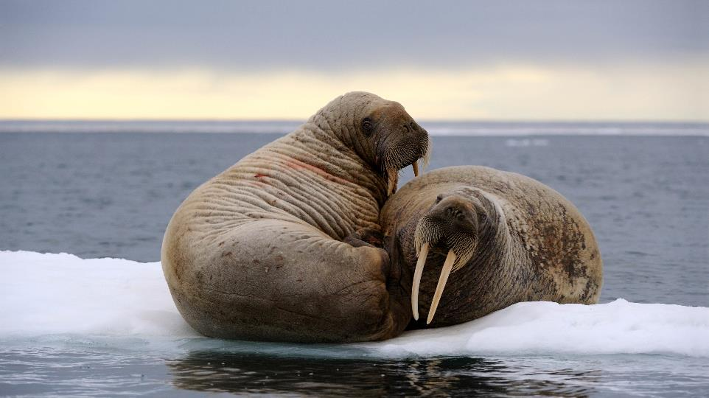
Marine wildlife is also abundant in the Arctic.
Notes:
The remarkably productive waters of the Arctic are home to a variety of marine mammals, like narwhals, dolphins and porpoises, and several kinds of whales. Almost half of the fish caught in the United States comes from the Bering Sea making fisheries vital to local livelihoods. Across the Bering Sea in Russia, the Kamchatka Peninsula’s river systems produce up to one-quarter of all wild Pacific salmon.

Slide 7
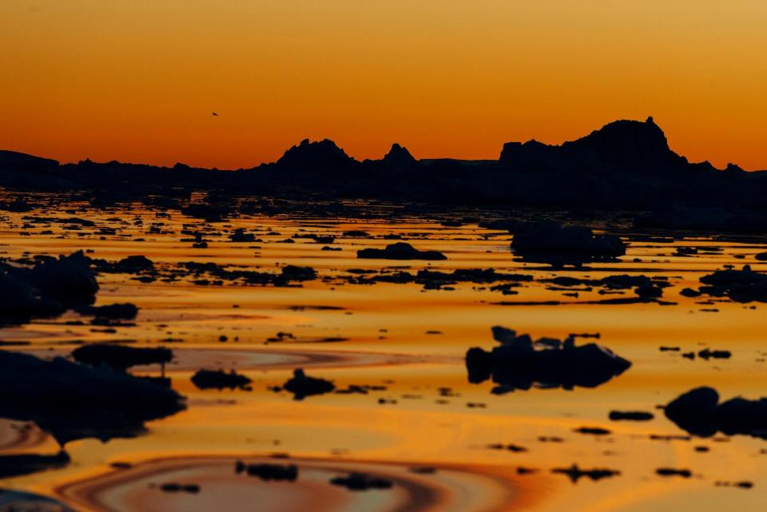
The biggest threat to the Arctic is climate change which challenges wildlife and creates access to minerals, energy resources, and shipping routes.
Notes:
The Arctic is warming at twice the global rate, opening a new ocean at the top of the world. This change challenges wildlife and creates access to minerals, energy resources, and shipping routes. The Arctic, including the Bering, Beaufort and Chukchi seas, now faces an uncertain future due to climate change, mining, shipping, oil and gas development, and overfishing.

Slide 8
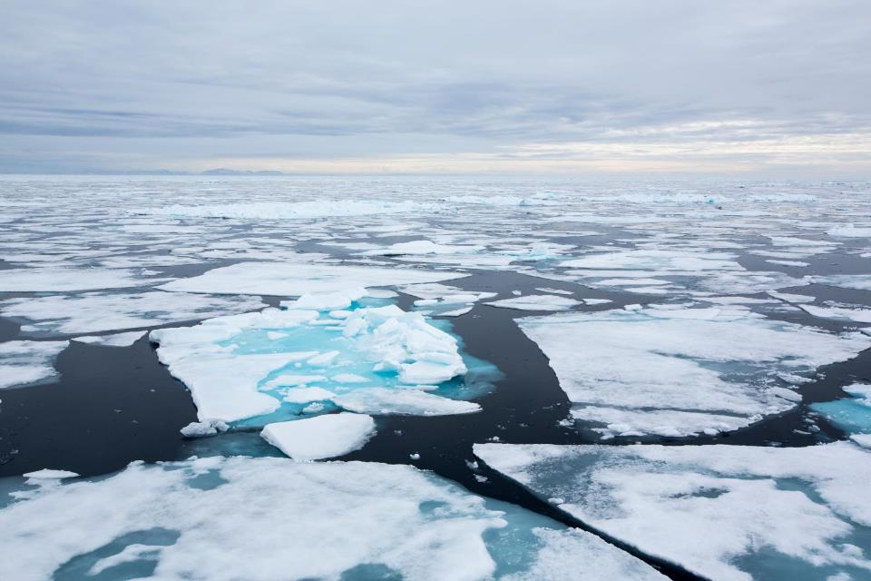
The Arctic is warming at twice the rate of the rest of the world. This opens a new ocean at the top of the world.
Notes:
The release of greenhouse gasses from the burning of fossil fuels and other sources is causing temperatures in the Arctic to warm at twice the rate of the rest of the world, resulting in lower levels of sea ice, melting permafrost and rising sea levels all over the world.
The decrease in volume and extent of Arctic sea ice has serious implications for marine mammals that depend on the ice for their survival, such as ringed seals and polar bears.

Slide 9
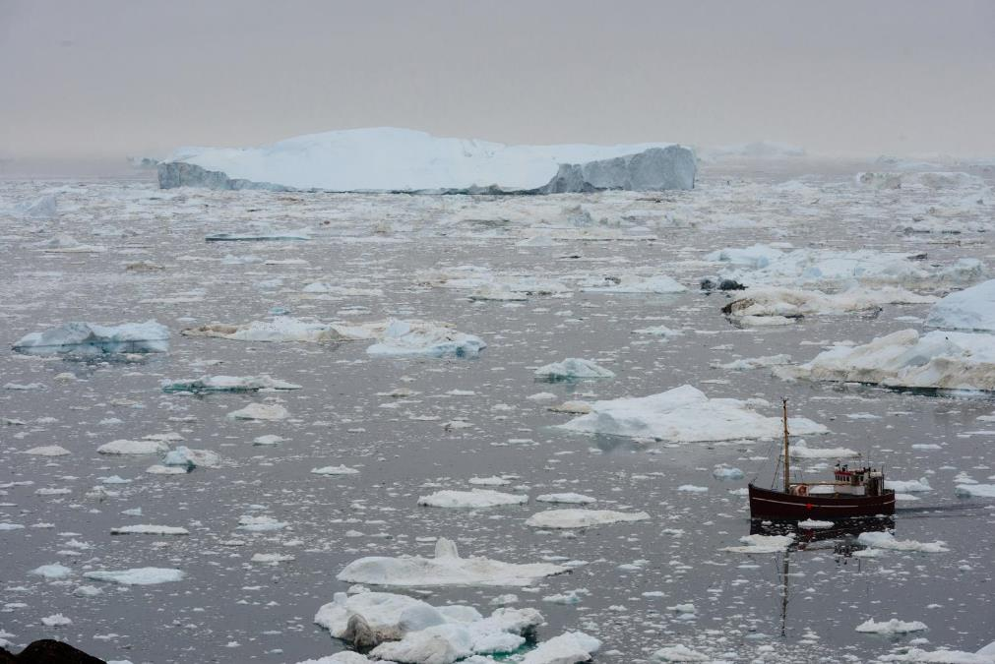
Arctic waters are also becoming more acidic—harming life at the base of the food chain.
Notes:
The burning of fossil fuels is also making Arctic waters more acidic, harming zooplankton species like pterapods—the very base of the Arctic’s rich food chain—as well as corals and shellfish.

Slide 10
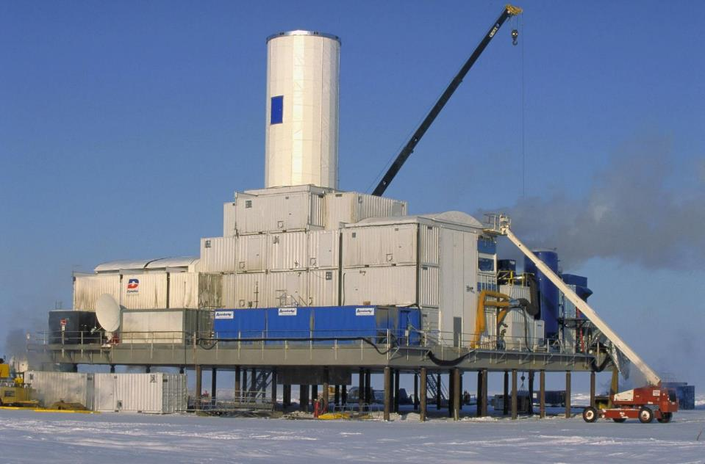
Oil and gas drilling in the Arctic is extremely risky and potentially disastrous.
Notes:
Oil and gas drilling always poses challenges—and these challenges are even greater in the extreme conditions of the Arctic, where storms are frequent, ice is still present for much of the year, daylight nonexistent during the winter, and response infrastructure is more than 1,000 miles away.
Much of the world’s untapped oil reserves are offshore, beneath the Arctic's waters. Oil spills can kill birds, fish and marine mammals, and the smaller organisms that feed larger species. There is no proven technology that allows for the complete containment of oil spilled in the marine environment.

Slide 11
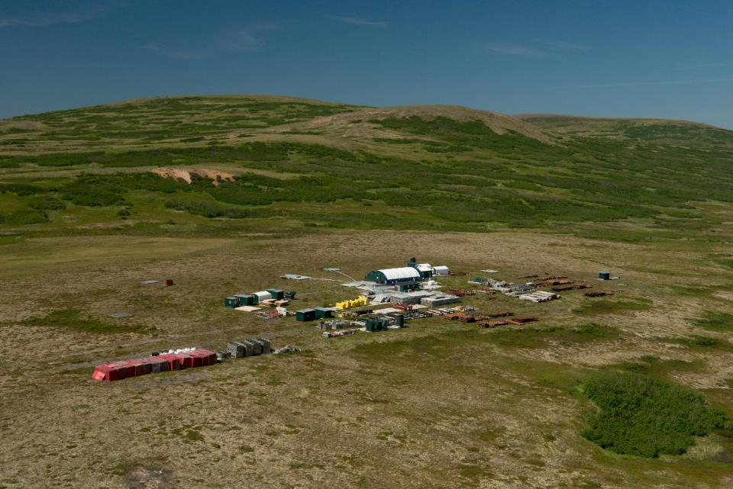
The proposed Pebble Mine could devastate Arctic freshwater ecosystems.
Notes:
If permitted and constructed, the proposed Pebble Mine would be the largest open-pit copper and gold mine in North America. Based on current projections, the mine would permanently destroy miles of important salmon habitat and generate up to 10 billion tons of toxic waste. Release of this toxic waste would devastate freshwater ecosystems and impact the region’s unmatched salmon runs as well as the communities, commercial fishing industry, and wildlife which depend on them.

Slide 12
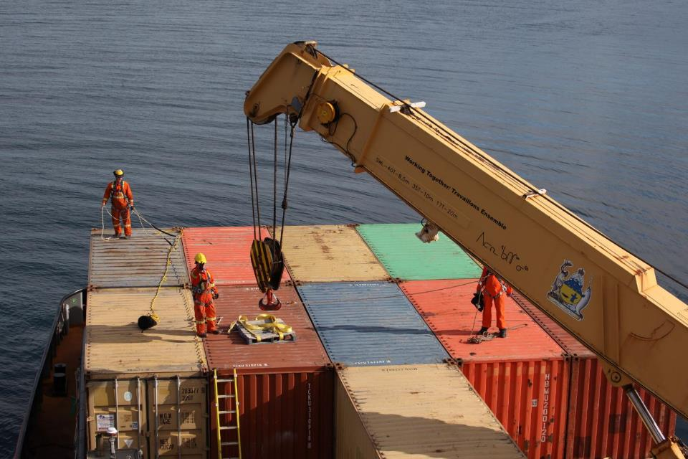
Melting sea ice has opened up new passages for travel and commercial transportation, inviting new risk.
Notes:
Climate change has brought on longer open water seasons, which coupled with the growing pressures of globalization, means more of the Arctic’s waterways are opening for travel and commercial transportation. Ship traffic in the Bering Strait alone, the narrow waterway between Alaska and Russia, is likely to increase in the coming years. More ships means a greater risk of wrecks, spills, noise, pollution, and the introduction of non-native species. Still, much of the Arctic Ocean has not been adequately surveyed and there a lot of work to be done to establish new routing and regulations.

Slide 13
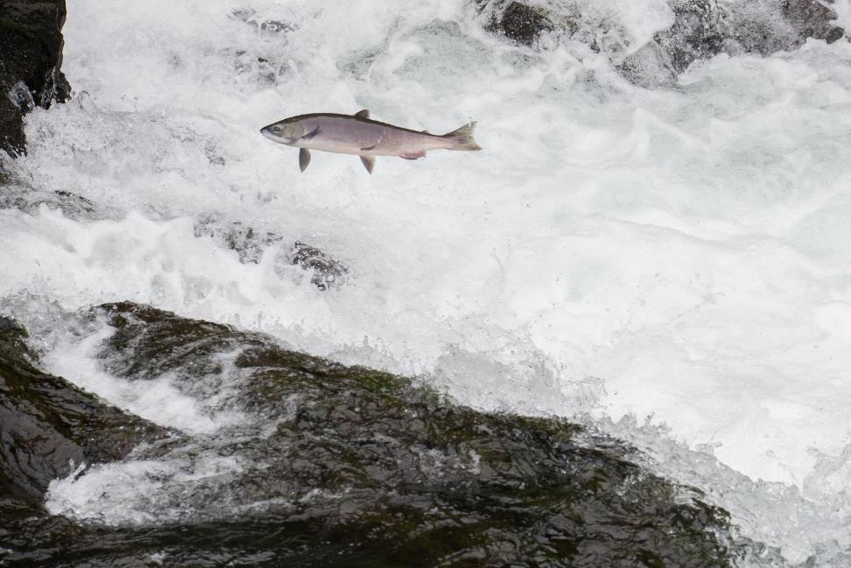
The Arctic is a major source for the world’s fish—and supplies are running thin.
Notes:
The Arctic has four of the world’s 10 major fisheries, including salmon and pollock, along with a substantial amount of community-based and subsistence fishing. But climate change, the world’s growing appetite for fish, and a lucrative black market creates new stresses on supply. Overfished waters have a negative impact up and down the food chain– including for people.

Slide 14
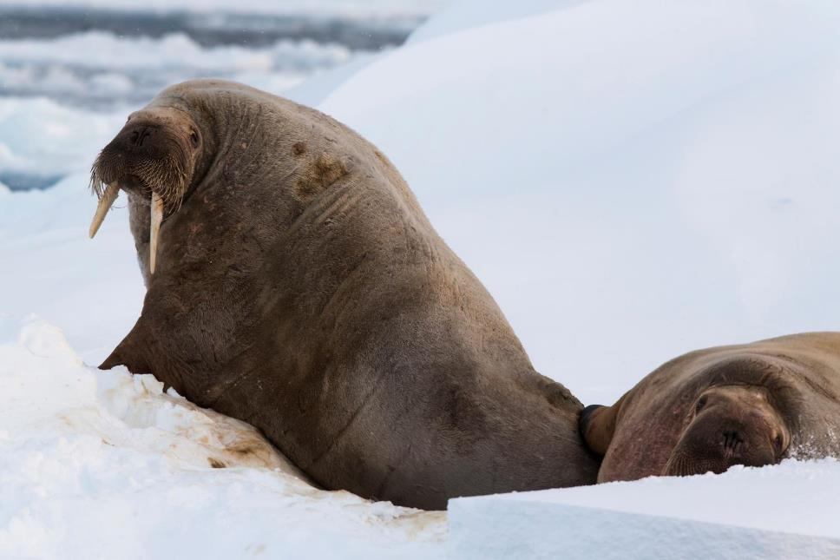
WWF is working to protect the Arctic
Notes:
WWF is working to protect this critical region by addressing both direct and indirect threats.

Slide 15
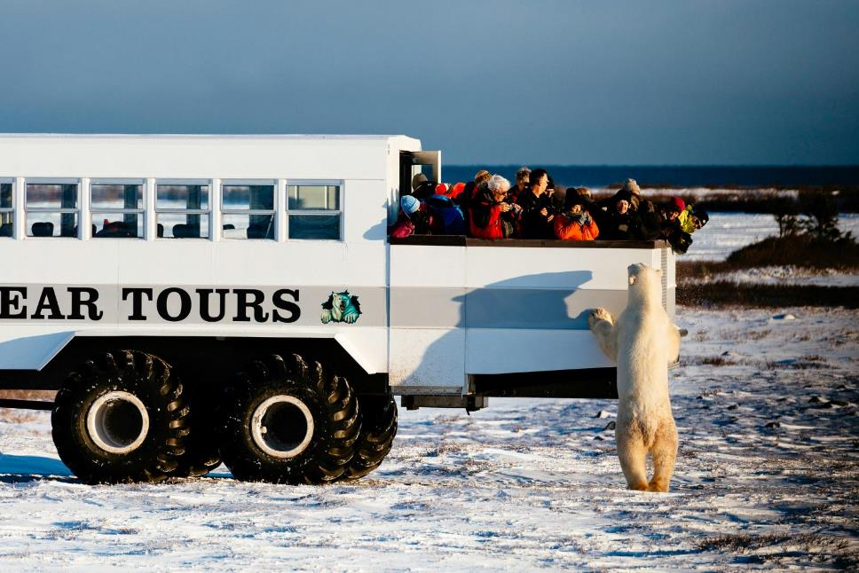
Making sure development—including tourism, oil, mining, and shipping—is sustainable
Notes:
As the climate changes, Arctic ecosystems are under growing pressure from industry seeking to expand. Activities including oil development, mining, shipping and cruise tourism are often presented as potential pathways to economic development opportunities. While WWF works to ensure that this development is sustainable, we also work to make certain that economic growth is sustainable and conserves the Arctic’s unique places and species.

Slide 16
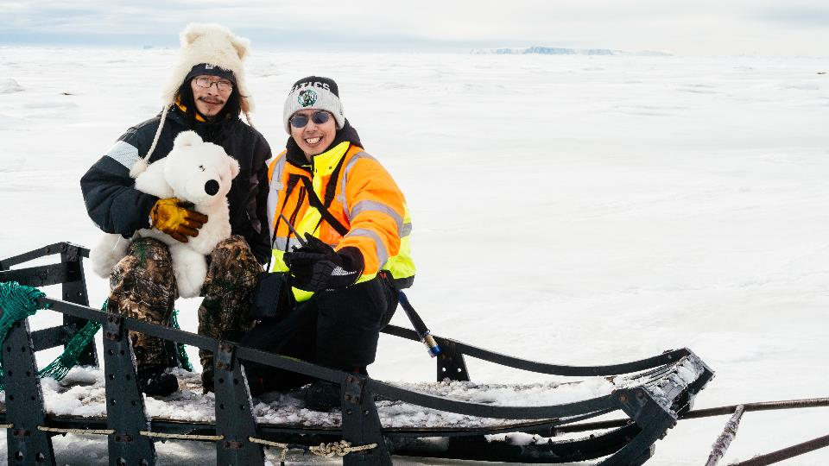
Working on behalf of local communities—preventing new oil and gas drilling and ensuring fishing is sustainable
Notes:
WWF continues to engage in efforts to prevent new oil and gas drilling in America’s Arctic as well as ensure that local communities have access to renewable energy options. Our work is also focused on fishing that is sustainable, certified and returning the maximum benefit to local communities.

Slide 17
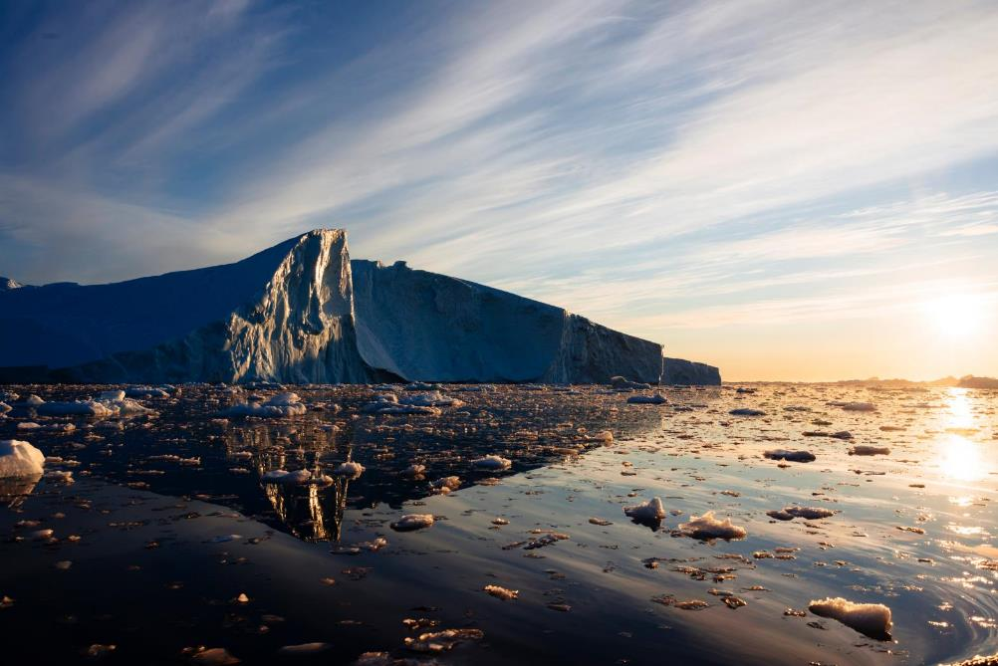
Engaging with—and evaluating—Arctic governments
Notes:
WWF actively engages with numerous local, national and regional institutions responsible for governing various activities in the Arctic. This work includes the Arctic Council, the high-level intergovernmental forum on Arctic conservation and sustainable development. WWF has been an Observer since 1998.
In 2017, WWF completed the first-ever Arctic Council Conservation Scorecard. This project will continue to assess the implementation of Council direction together with national governments, encouraging them to provide reporting and advocating for a more effective and transparent Council.

Slide 18
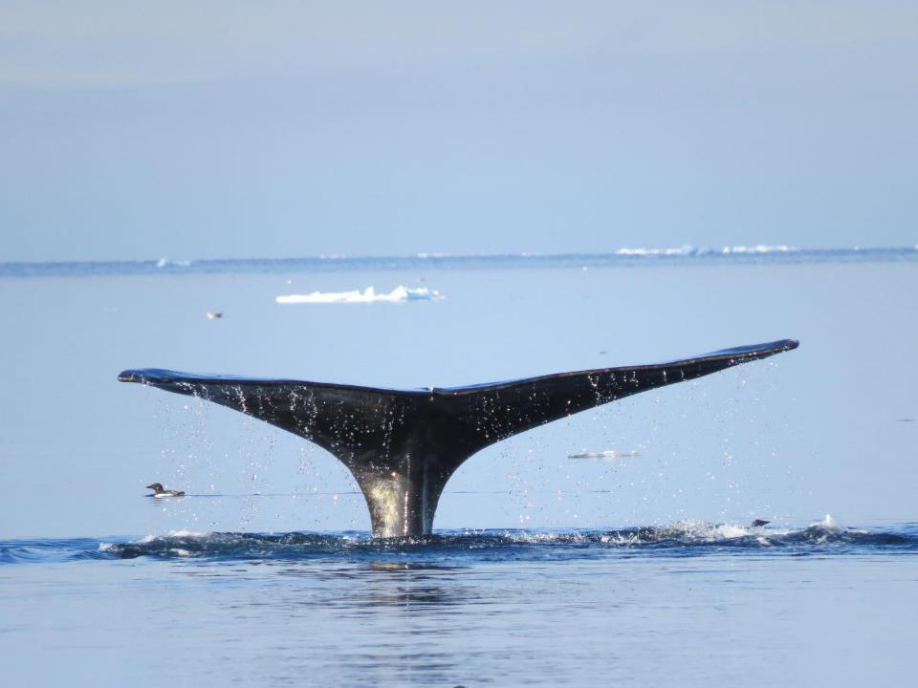
Protecting ecologically critical areas and priority species
Notes:
Our vision of a well-managed, biodiverse Arctic is one where key habitats, ecosystems and populations of priority species are shielded from the direct pressures of human activity. This means establishing a network of specially managed marine areas across the Arctic to protect marine life and help it adapt to changing conditions. WWF is also working for the implementation of effective management measures to complement these areas.

Slide 19
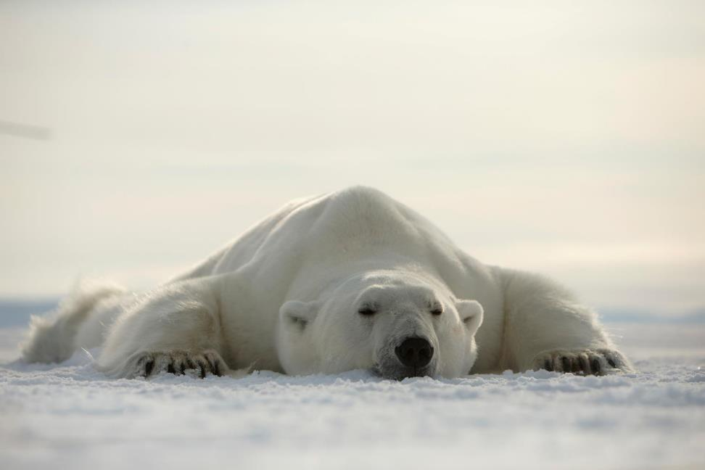
Addressing climate change—the major threat to biodiversity in the Arctic
Notes:
In addition, WWF is dedicated to reducing the major threat to biodiversity in the Arctic—climate change.

Slide 20
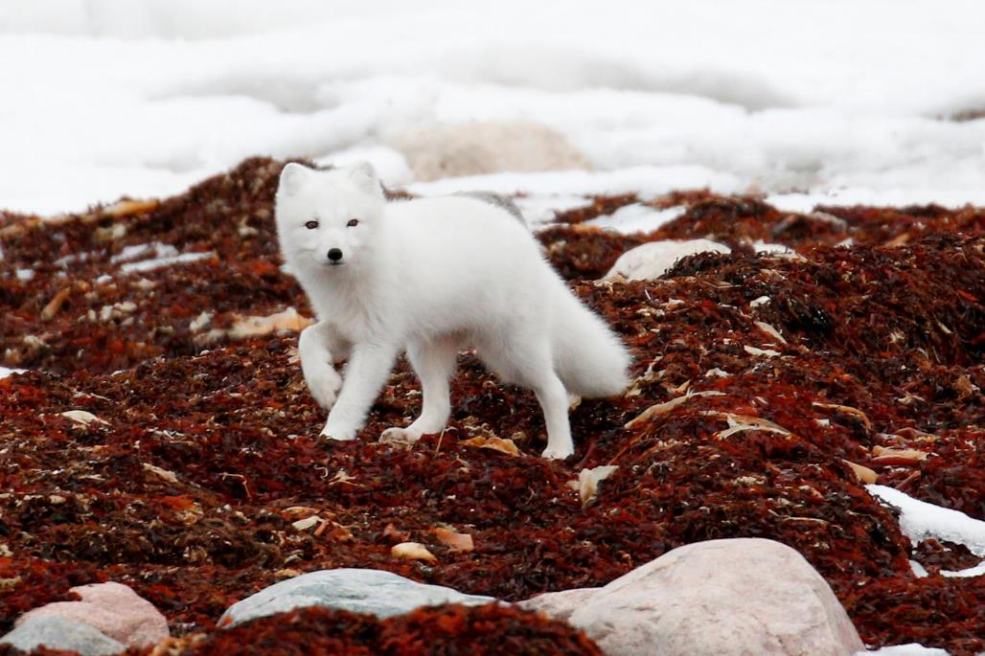
worldwildlife.org/places/arctic
Notes:
Visit the World Wildlife website for more information.

Slide 21
Photo Credits
Page 2: © Elisabeth Kruger / WWF-US
Page 3: © Staffan Widstrand / WWF
Page 4: © Elisabeth Kruger / WWF US
Page 5: © Magnus Andersen / Norwegian Polar Institute / WWF-Canon
Page 6: © naturepl.com / Eric Baccega / WWF
Page 7: © Elisabeth Kruger / WWF-US
Page 8: © Global Warming Images / WWF
Page 9: © Elisabeth Kruger / WWF-US
Page 10: © US Department of Energy
Page 11: © Paul Colangelo / WWF-US
Page 12: © Vicki Sahanatien / WWF
Page 13: © McDonald Mirabile / WWF-US
Page 14: © Canon / Brutus Östling / WWF-Sweden
Page 15-17: © WWF-US / Elisabeth Kruger
Page 18: © WWF / Clive Tesar
Page 19: © Canon / Brutus Östling / WWF-Sweden
Page 20: © Donna Pomeroy

